Slide 1
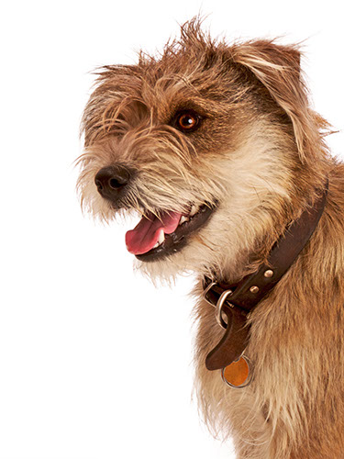
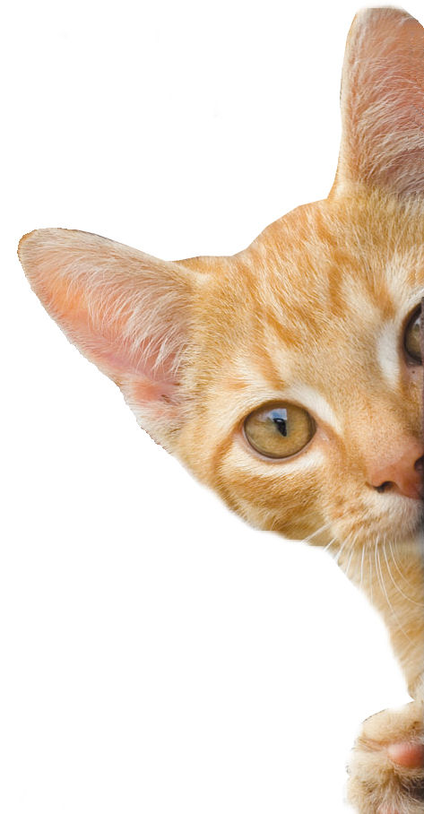
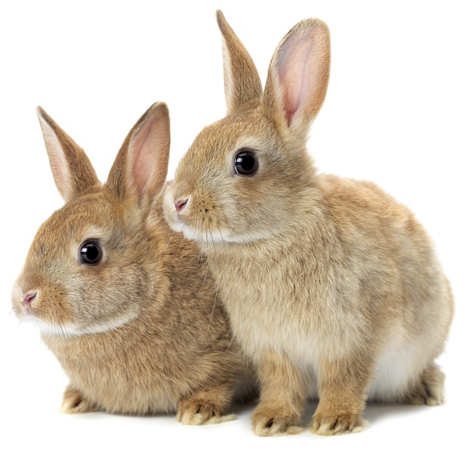
Healthy Pets
Notes:
Introduce yourself and PDSA
Ask children to guess what your job is
Ask what they think vet nurses do.
Ask if they think this is an important job and if it’s important to help sick and injured animals to get better.
Explain that PDSA is a special kind of vets, because we’re a charity.
Ask them what a charity does and explain that we look after pets when owners can’t afford to take their pets to the vet.
Ask them what would happen to all the sick and injured pets we treat if PDSA weren’t around.
.
Explain that today, you’re going to learn about what pets need to be healthy and happy and also about one of the pets that PDSA has helped in our Pet Hospitals.

Slide 2
My Pets
Notes:
Replace this with image of your pets and share funny stories about them

Slide 3
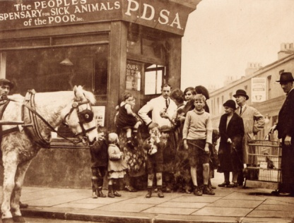
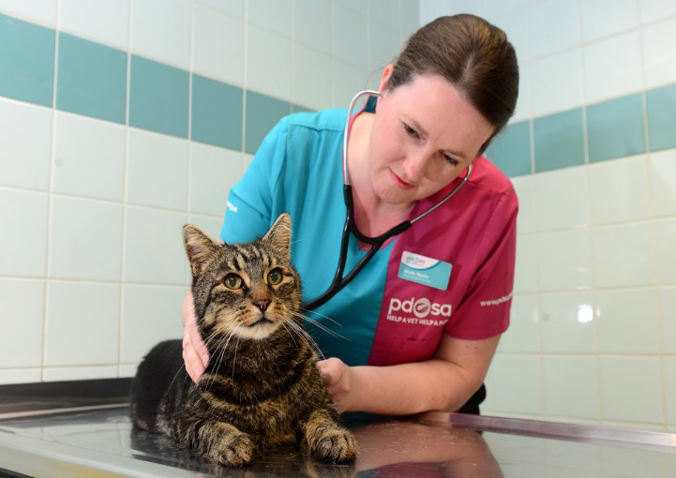
The UK’s leading vet charity …
PDSA is a 100 year old charity who have been treating sick and injured pets since 1917
They have Pet Hospitals all over the UK
They help one sick or injured pet every 5 seconds!
It costs the charity more than
£1 million every week to do their work
Notes:
Share the details on the slide and:
Tell children that PDSA treat the sick and injured pets of people in need..
Ask them if they think it’s important to help sick and injured animals to get better.
Explain that PDSA is a special kind of vets, because they’re a charity. Ask them what a charity does and explain that PDSA looks after pets when owners can’t afford vet treatment.
Ask them what would happen to all the sick and injured pets PDSA treat if they weren’t around.

Slide 4
Learning Objectives
I will recognise that all animals have needs and address what those needs are.
I will be aware of the Five Welfare Needs and will be able to recall them.
I will understand that they are responsible for the wellbeing of pets.
Learning Outcomes
P
I understand that humans are responsible for the wellbeing of their pets.
I can explain what dogs, cats and rabbits need.
I can explain how we can address the needs of pets.

Slide 5
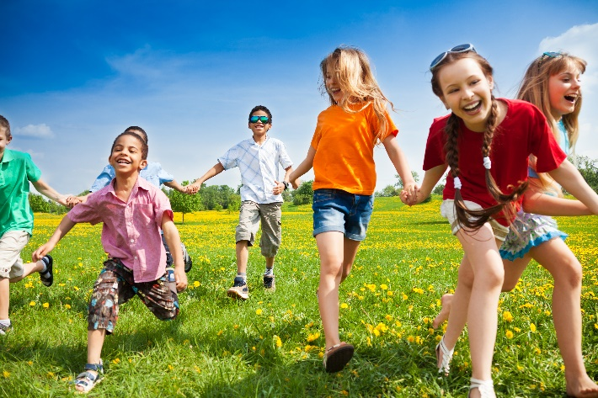
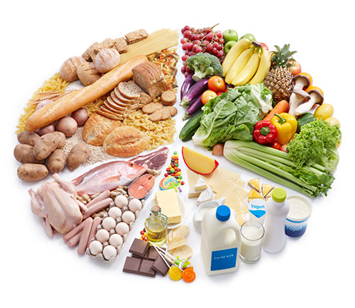
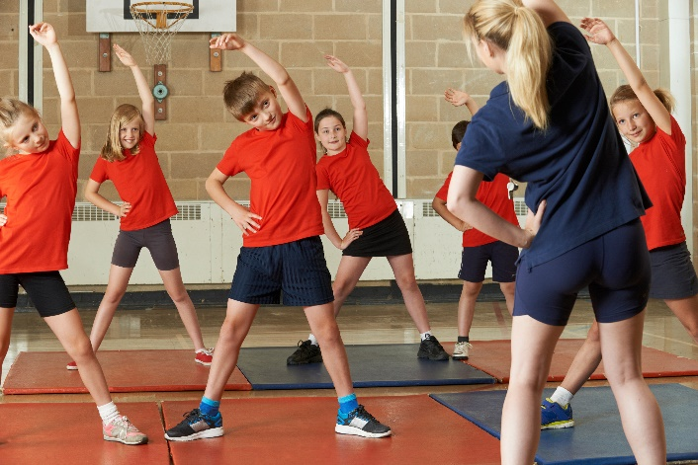
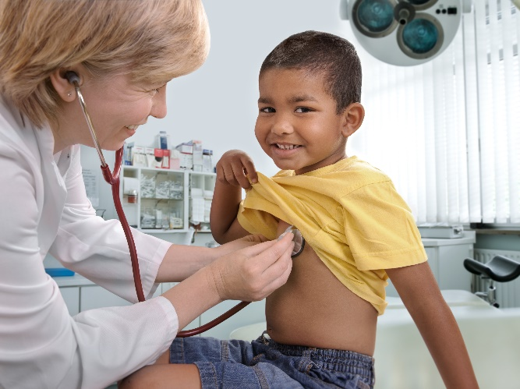
WHAT DO YOU NEED?
A HOME
FRIENDS
FOOD
&
WATER
EXERCISE & FUN
GOOD HEALTH
Notes:
This slide sets up for the welfare needs – encourage the children to think about what they need to stay happy and healthy.
If they get stuck for answers show each picture individually and see if they can come up with the answers.
When you get to the health slide, talk about the things they do to keep themselves healthy: Brush their teeth, bathe, wash and brush their hair, trim their nails, have vaccinations etc. Also talk about where they go when they’re poorly – compare vets with doctors.

Slide 6
A HOME
FRIENDS
HEALTH
FOOD & WATER
EXERCISE & FUN
What do pets need?…
Notes:
All pets, whether they’re large or small, need the same five things to keep them healthy and happy:
The right kind of safe, warm home with lots of space
The right kind of food and 24 hour access to fresh water
Exercise and fun (the chance to show normal behaviour)
Friends (This can be other animals, people, or both)
Health ( We all need to make sure our pets are kept healthy and take them to the vet when they’re not well)
Ask whose responsibility it is to keep pets healthy and happy and confirm that owners are responsible for looking after their pet properly.
You can introduce actions for each symbol to help the pupils remember the icons.
E.g. running on the spot for exercise and fun

Slide 7
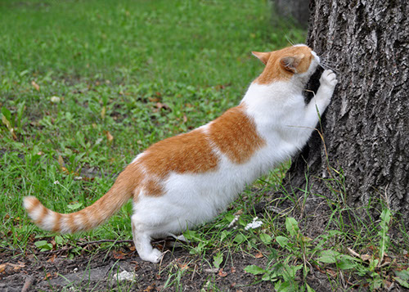
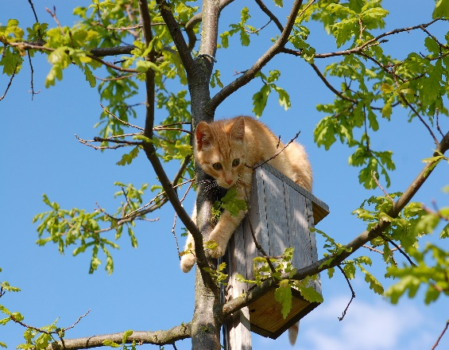
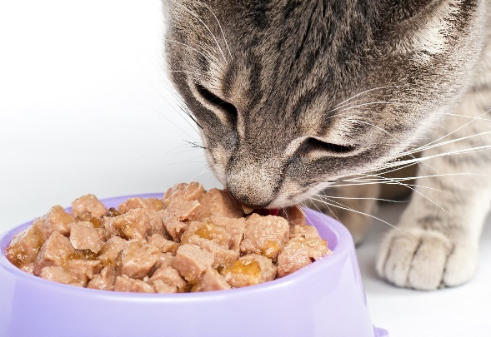
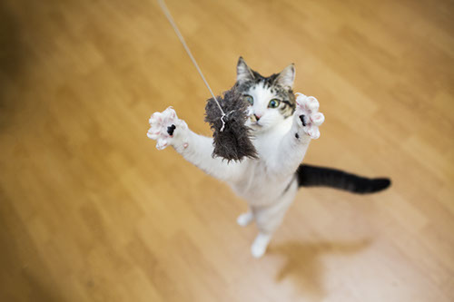
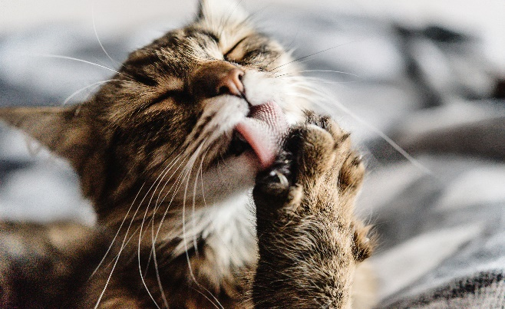
Cats – What do they do?
Scratch/Scent Mark
Climb/Hide
Eat/Drink
Sleep
Hunt/Play
Groom
Notes:
So let’s start with cats – you can see from the headings that cats naturally do lots of different things.
Explain each picture
Scent mark/scratch – Cats leave their individual scent behind from the pads of their feet and their faces, to let other cats know that this is their territory – cats naturally like to live alone, although some will put up with other cats if they have enough space around them or if they’ve grown up together. Explain that cats rub their faces on furniture and on people to leave their scent – explain that by rubbing their faces on you, they’re telling other cats that you belong to them!
Climb/Hide – cats are great at climbing. They’re very agile creatures with great balancing skills. Explain that cats climb so they can stay safe and see what’s going on from above and that if they’re scared they’ll hide.
Eat/Drink – All living things need water to survive and must have fresh water at all times. Explain that cats often prefer to drink from running water or from pools. This means they prefer to drink from wide and flat bowls or fountains. Explain that cats have to eat meat to survive and can’t be vegetarian. Also explain that some cats still have wild behaviour and hunt. Explain that this is natural behaviour for a cat.
Sleep – Explain that cats sleep a lot – for almost two thirds of their lives! They can spend up to 16 hours every day asleep. In the mammal world, only sloths and bats sleep for longer than cats. Cats actually do have ‘catnaps’ and sleep for short periods of time very frequently. They tend to be awake early morning and when it’s going dark – the best time for hunting.
Hunt/Play – Cats like to hunt and play at hunting. They’ll try to stay hidden for as long as possible and sneak up on their prey or their toys – they’ll move very slowly so that they won’t be seen and when they get close enough they’ll sprint as fast as they can to catch their prey.
Groom– Cats love to be clean and spend a lot of time grooming themselves – their tongues have lots of hairs on them that act like little combs. Ask if anyone has been licked by a cat and talk about how their tongues are rough like sandpaper.
Ask if they’d like to see some cats in action and introduce the video.
Here is a video of some cats showing some cat behaviours

Slide 8
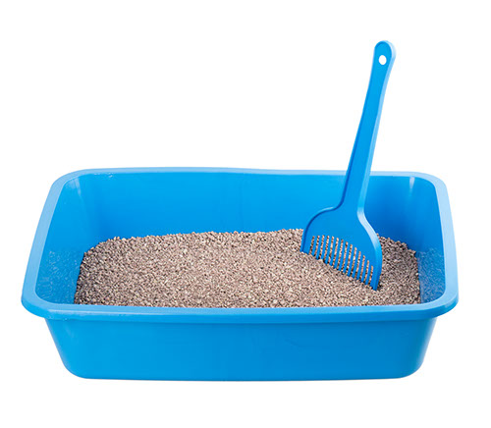
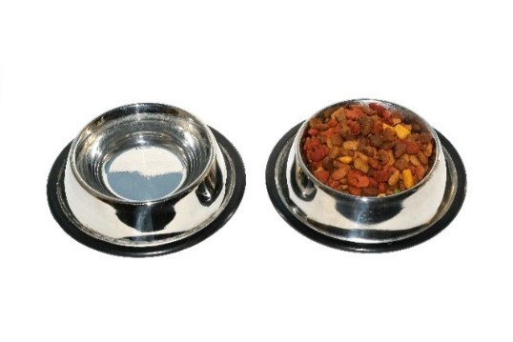
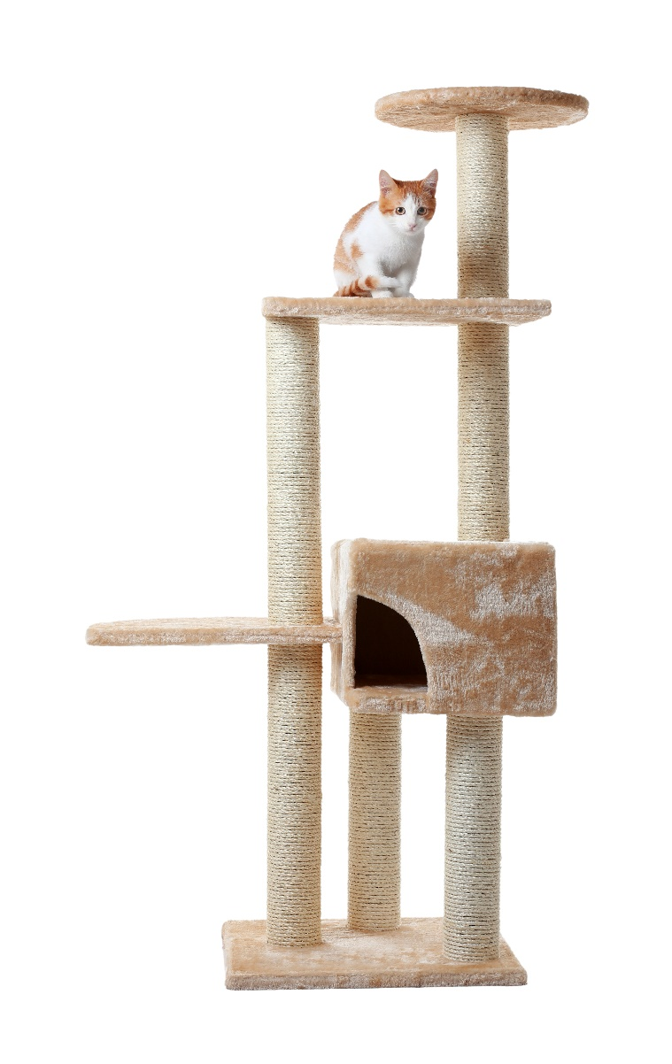
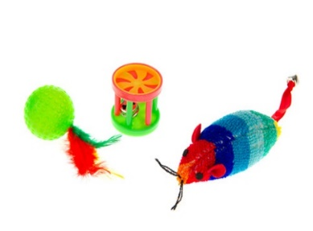
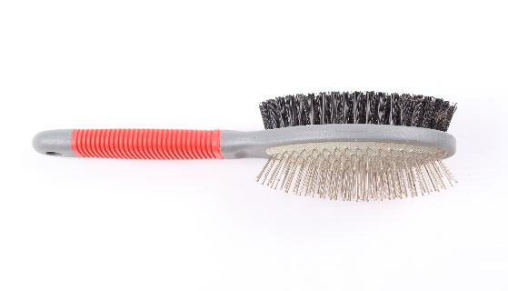
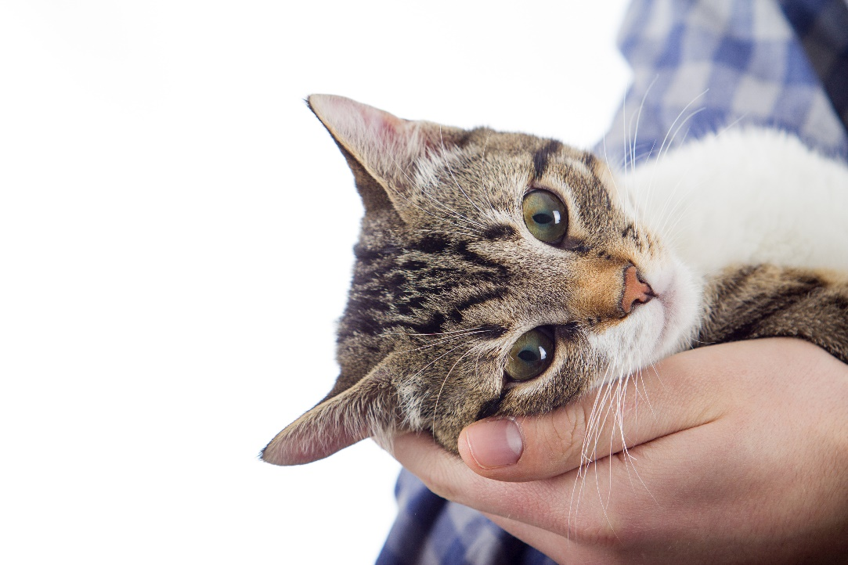
WHAT DO THEY NEED?
CATS …
Notes:
Ask children if they can guess what things they’d need to provide a cat with to keep it happy.
Show each picture and ask group to discuss why they need it:
Scratch post – display natural scratching/scent marking/climbing behaviours – up high away from dangers
Water fountain for fresh water or wide brimmed bowl – away from food and litter tray
Food – complete balanced diet, either wet/dry or both.
Litter tray – at least one per cat in household in different areas of house and away from food and water bowls.
Toys – practice stalking/hunting behaviours
Companionship – people rather than lots of cats
Discuss the dangers of feeding cats milk

Slide 9
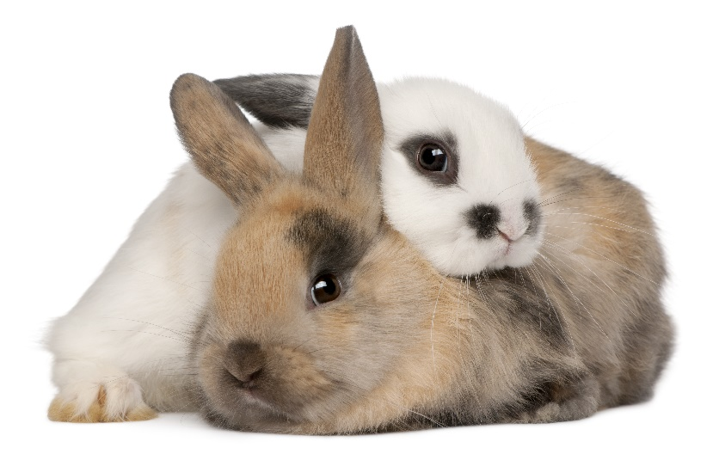
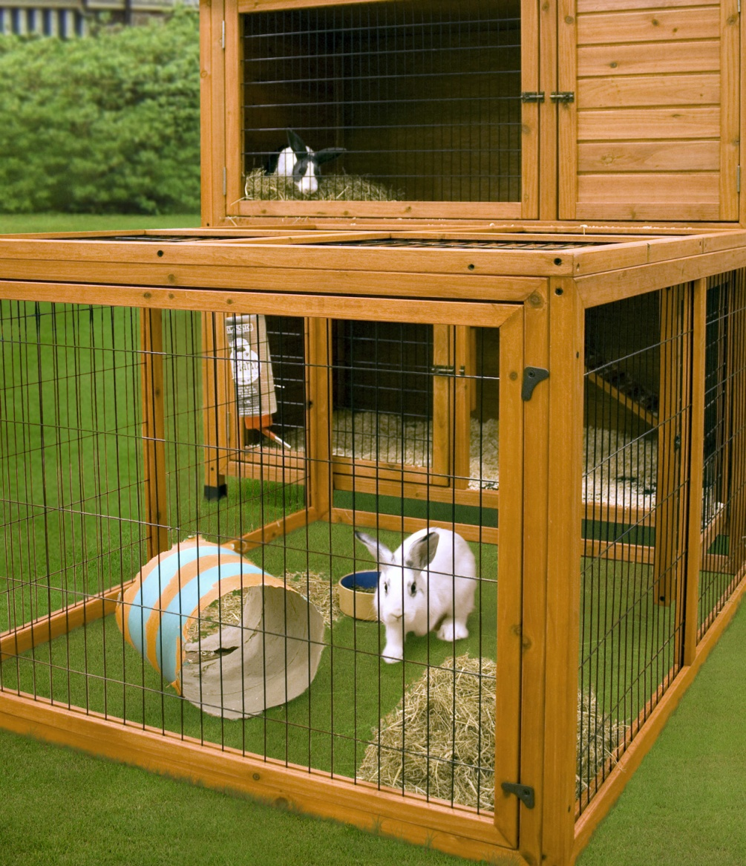
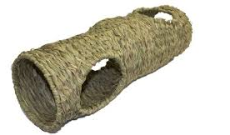
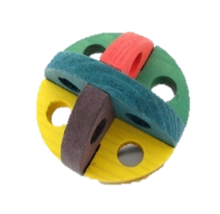
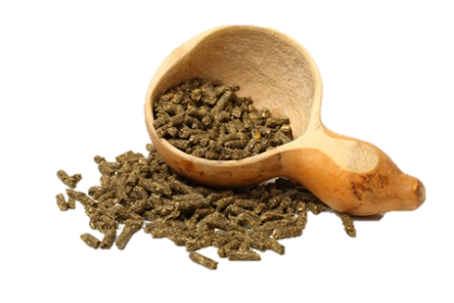
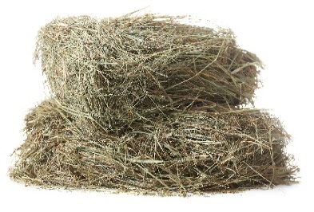
RABBITS
Notes:
Ask the group what they think pet rabbits need
Big hutch with plenty of room to run around – reflect on the video at just how much space a rabbit needs – a hutch alone is not enough – they are not ‘easy’ pets to care for as people think. You could get one of them to do 3 big hops and stand as tall as possible to show how much space they need.
Food – pellets are better than muesli as they contain all nutrients, lots of hay & grass, small amount of greens, & unlimited water.
Hay – explain importance of right amount of hay in their diet for their tummies and their teeth.
Toys to play with and tunnel etc. to run through and hide in.
Friends – rabbits hate being alone – remember how they live in the wild – in groups – they look out for each other – a lone bunny will be a very worried and lonely bunny!
Discuss carrots and how calorific they are for rabbits

Slide 10
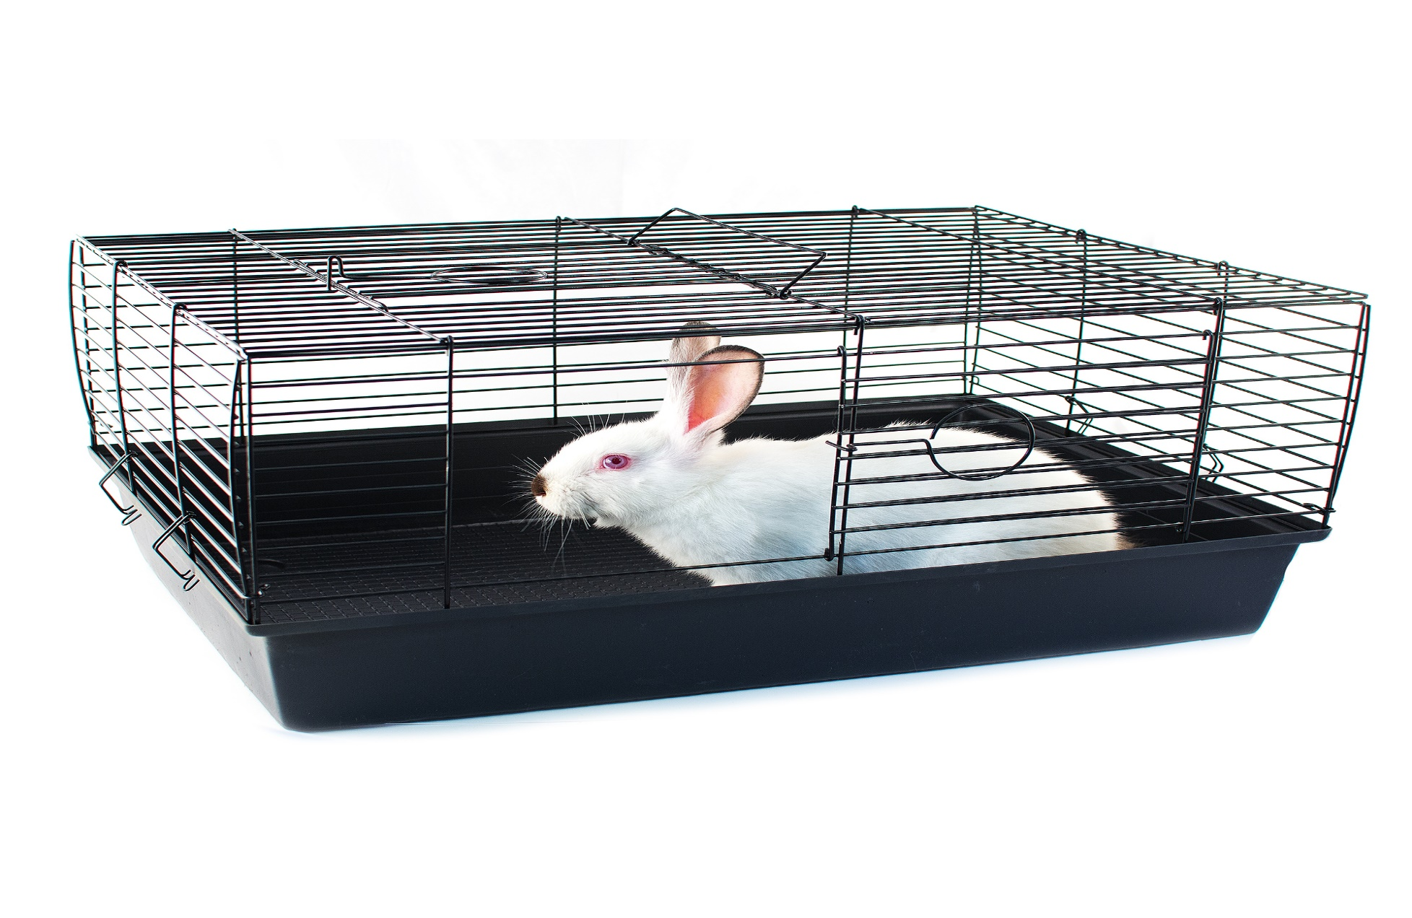
Notes:
Ask:
Based on what we’ve just learnt about rabbits, what is this rabbit missing in terms
of his five welfare needs being met?

Slide 11
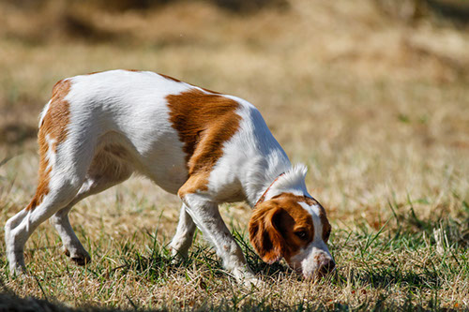
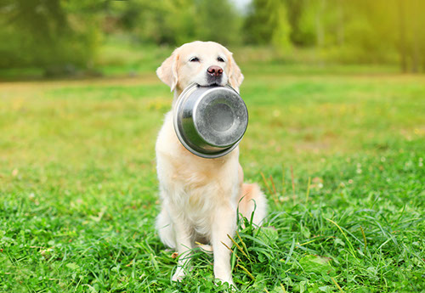
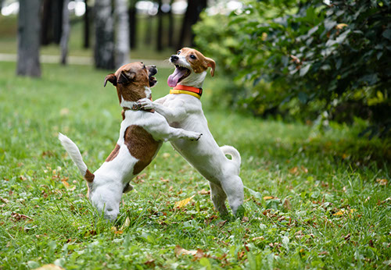
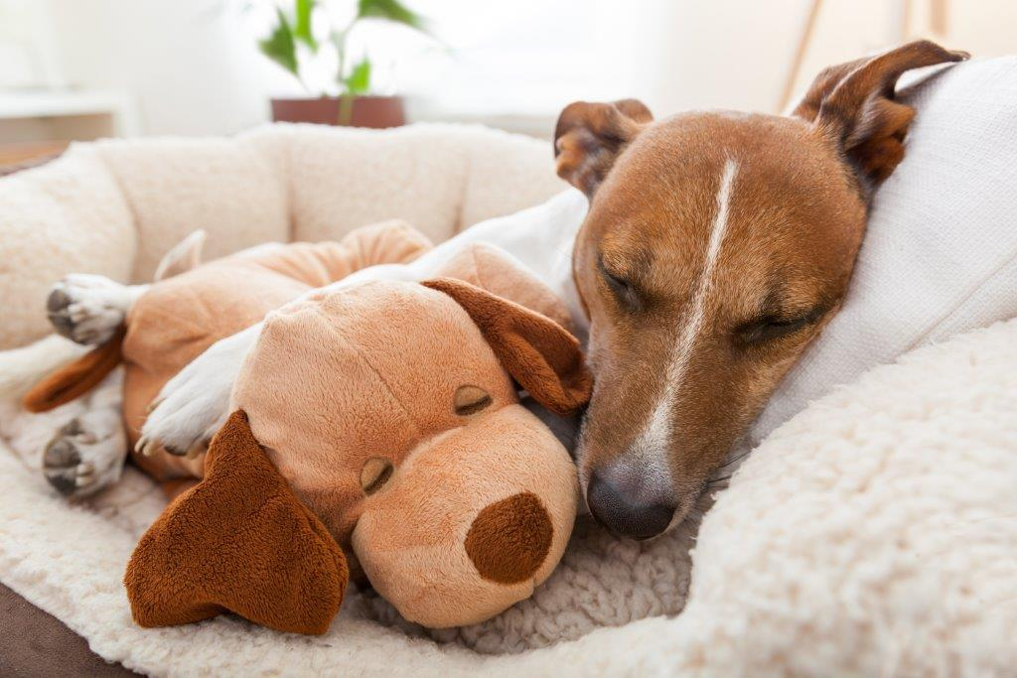
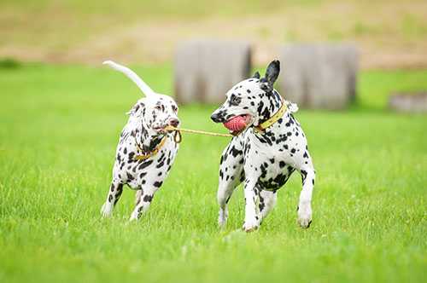
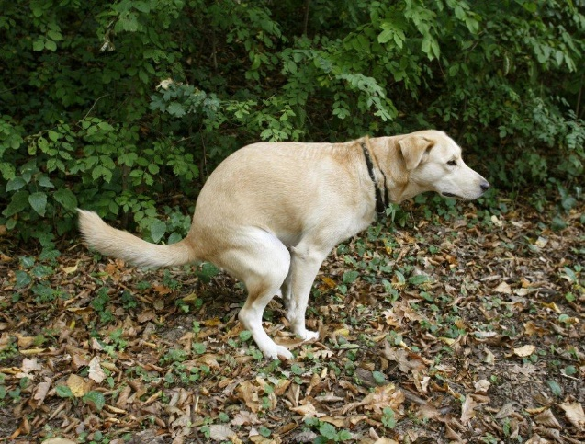
Dogs – What do they do?
Sniff/Smell
Eat/Drink
Exercise/Socialise
Sleep
Hunt/Play
Toilet
Notes:
Sniffing/smelling –Explain that dogs use their great sense of smell to sniff people, other dogs and the environment. Explain that some dogs use their great sense of smell to help people, by sniffing out drugs, weapons, people buried by earthquakes etc. Tell them amazing facts of dogs sniffing out cancer and being able to tell a person’s mood by how they smell.
Eat/Drink – Explain that dogs are omnivores. Check if anyone knows what this means. Confirm that omnivores can survive on eating either meat or plant material (or a mixture of both) We provide them with their food which must be a complete balanced diet that gives them everything they need – not our food! Explain that some human foods can be dangerous to dogs. Explain that they need unlimited fresh water.
Exercise/Socialise - Explain that dogs are very social and don’t like to be left alone. People have developed such a strong bond with dogs that we’ve replaced their ‘wolf pack’ – which is why we should make sure that our dogs are only left alone for up to four hours at a time. Wolves will exercise naturally by hunting and covering large distances. Our pet dogs need lots of exercise too – at least two walks a day, with time off the lead to run.
Sleep – Explain that it’s important to make sure that dogs have their own bed and that they’re not approached when they’re on it – give explanation and safety advice.
Hunt/Play – Explain that play is a huge part of a dog’s life. Dogs love to play but it’s no fun playing on their own, so make sure your dog gets plenty of chance to play with other dogs and also has lots of toys that you can help him play with at home. Remember, dogs use their mouths to play – they don’t mean to hurt, but sometimes their teeth can hurt our delicate skin – other dogs with fur coats make a much better play mate. Unlike cats, our domestic dogs don’t hunt but they still have some natural desires – they love to chase and catch with toys – just like in the picture
Toileting/Scent marking Explain that this is something that dogs do. They’ll often seek out spots that another dog, or many dogs, have used to pee on, to make their mark on the world and mask the scent markers left by other dogs. Female dogs in heat will pee at every chance they get, to try to attract a mate. Explain that scent marking and sniffing are like doggy Facebook. Explain the importance of poop scooping from a public health angle.
Here are some dogs doing some great doggy things and a few tricks too

Slide 12
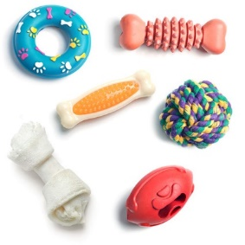
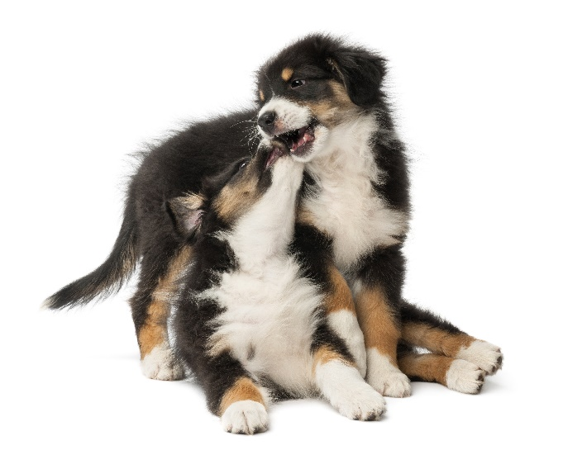
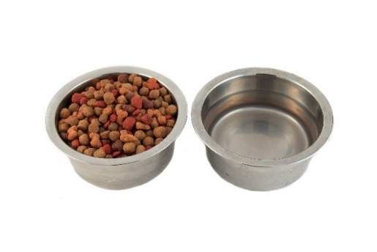
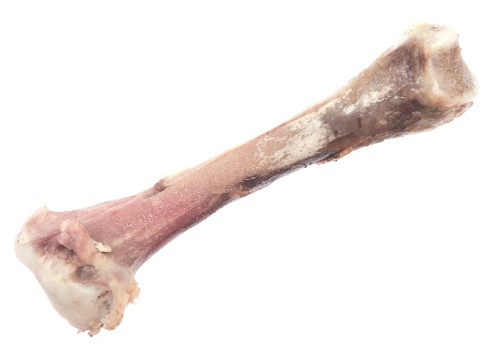
WHAT DO THEY NEED?
DOGS …
Notes:
What do they need based on what we’ve just spoken about?
Explain the needs of dogs.
Explain the dangers of feeding chocolate and bones

Slide 13
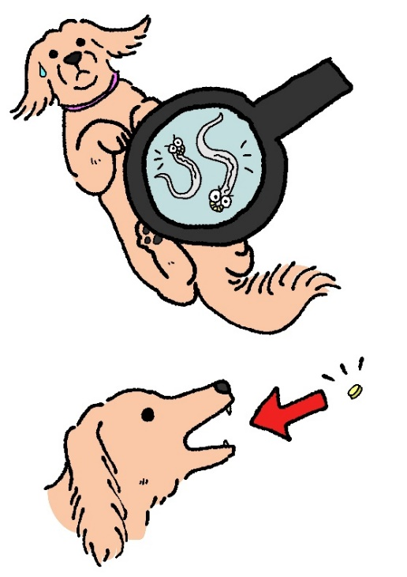
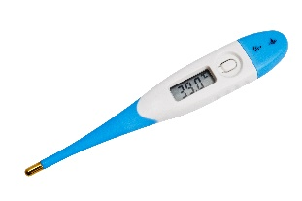
KEEPING PETS HEALTHY
Notes:
Explain each aspect of preventive healthcare
Vaccinations – explain need to given every year to dogs, cats and rabbits to prevent disease
Scan for chip – explain dog microchip law but also good to have other pets chipped too
Grooming – explain that pets need to be groomed to keep their skin and coat healthy. Explain that it’s also a chance to check all is ok – look for parasites
Parasites – explain internal and external and treatment – Use toy flea and worm.
Neutering – explain the importance of neutering
Ask children if they’d like to meet one of the pets we’ve helped to get better at PDSA.

Slide 14
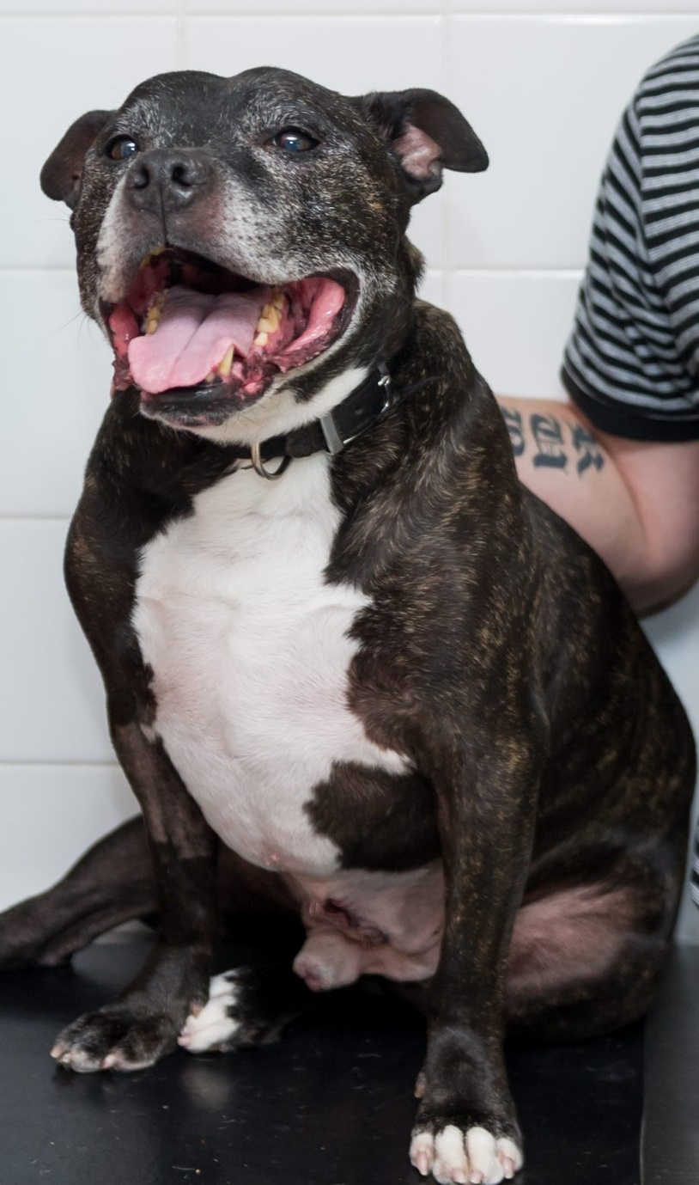
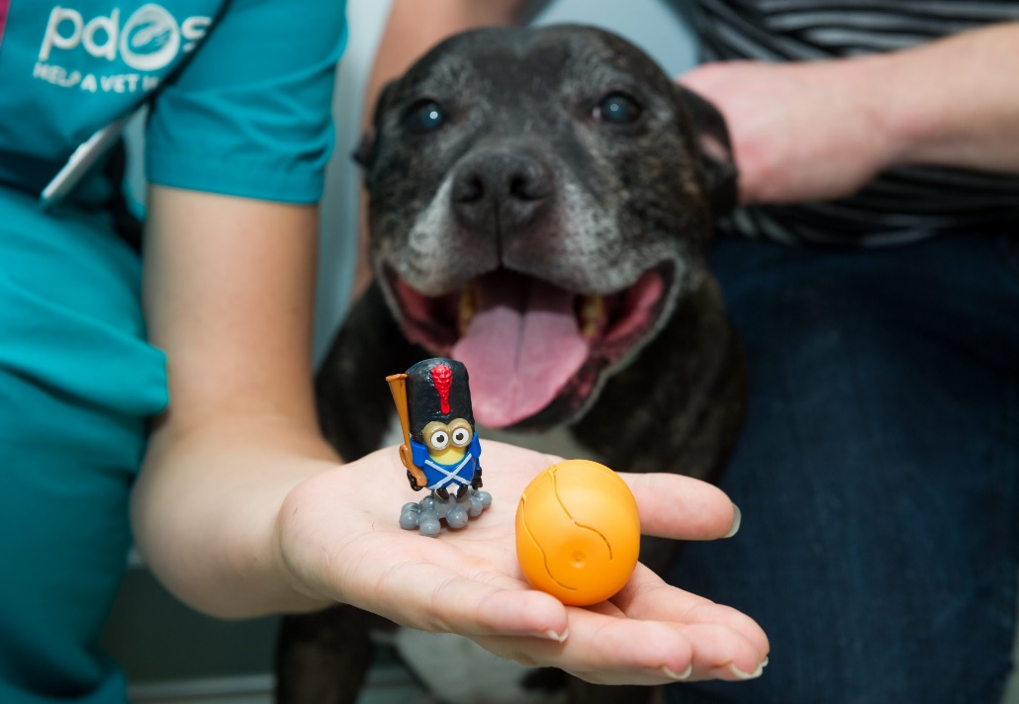
CHASE THE DOG
Notes:
When hungry pooch Chase gobbled down a chocolate egg with a plastic toy in it, there were no prizes for guessing which toy was lurking inside his stomach, when an x-ray showed very clearly the shape of a Minion toy.
Although chocolate is poisonous to dogs, Chase didn’t show any signs of illness, as his owners saw him eat the chocolate egg and rushed him straight into our Pet Hospital in Romford.
Action taken:
The team at Romford PDSA Pet Hospital x-rayed Chase to find out where the egg was in his body before operating to remove it. Luckily, the toy was still in his stomach. If it had moved further down into his intestines it could have caused a blockage, which would have been much more dangerous for Chase, or could’ve even killed him.
Vet’s/nurse’s comment:
PDSA’s Head Nurse, Sarah Burt, said: ‘When Chase came to us you wouldn’t have known he was in danger because he was very alert and lively, but thankfully his owners had seen him swallow the egg and brought him to us straight away. We took an x-ray which showed up the plastic toy really well and then operated on him to remove it. We were all pleased that Chase went on to make a full recovery.’
Owner’s comment:
‘I’m so grateful to the amazing vets and nurses at PDSA, there’s no way we could ‘ve afforded private veterinary fees for the treatment he needed, so I don’t know what we would‘ve done without PDSA. My children were really worried about Chase and it’s reassuring to know PDSA is always there in an emergency.’

Slide 15
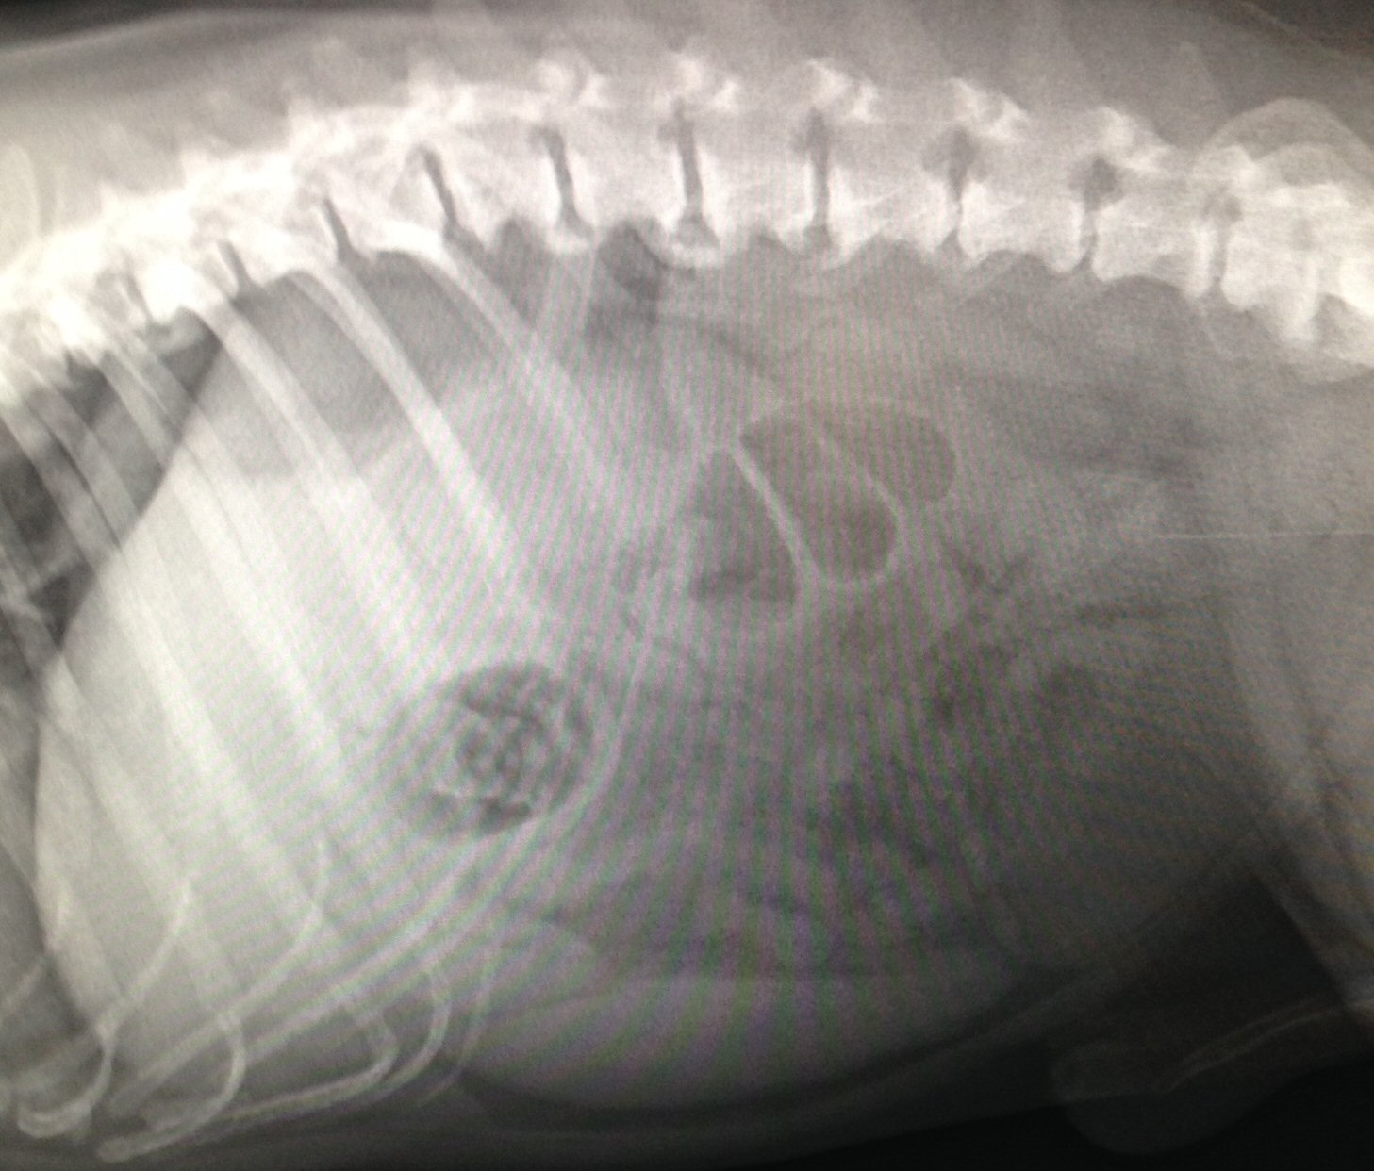
CHASE’S X-RAY

Slide 16
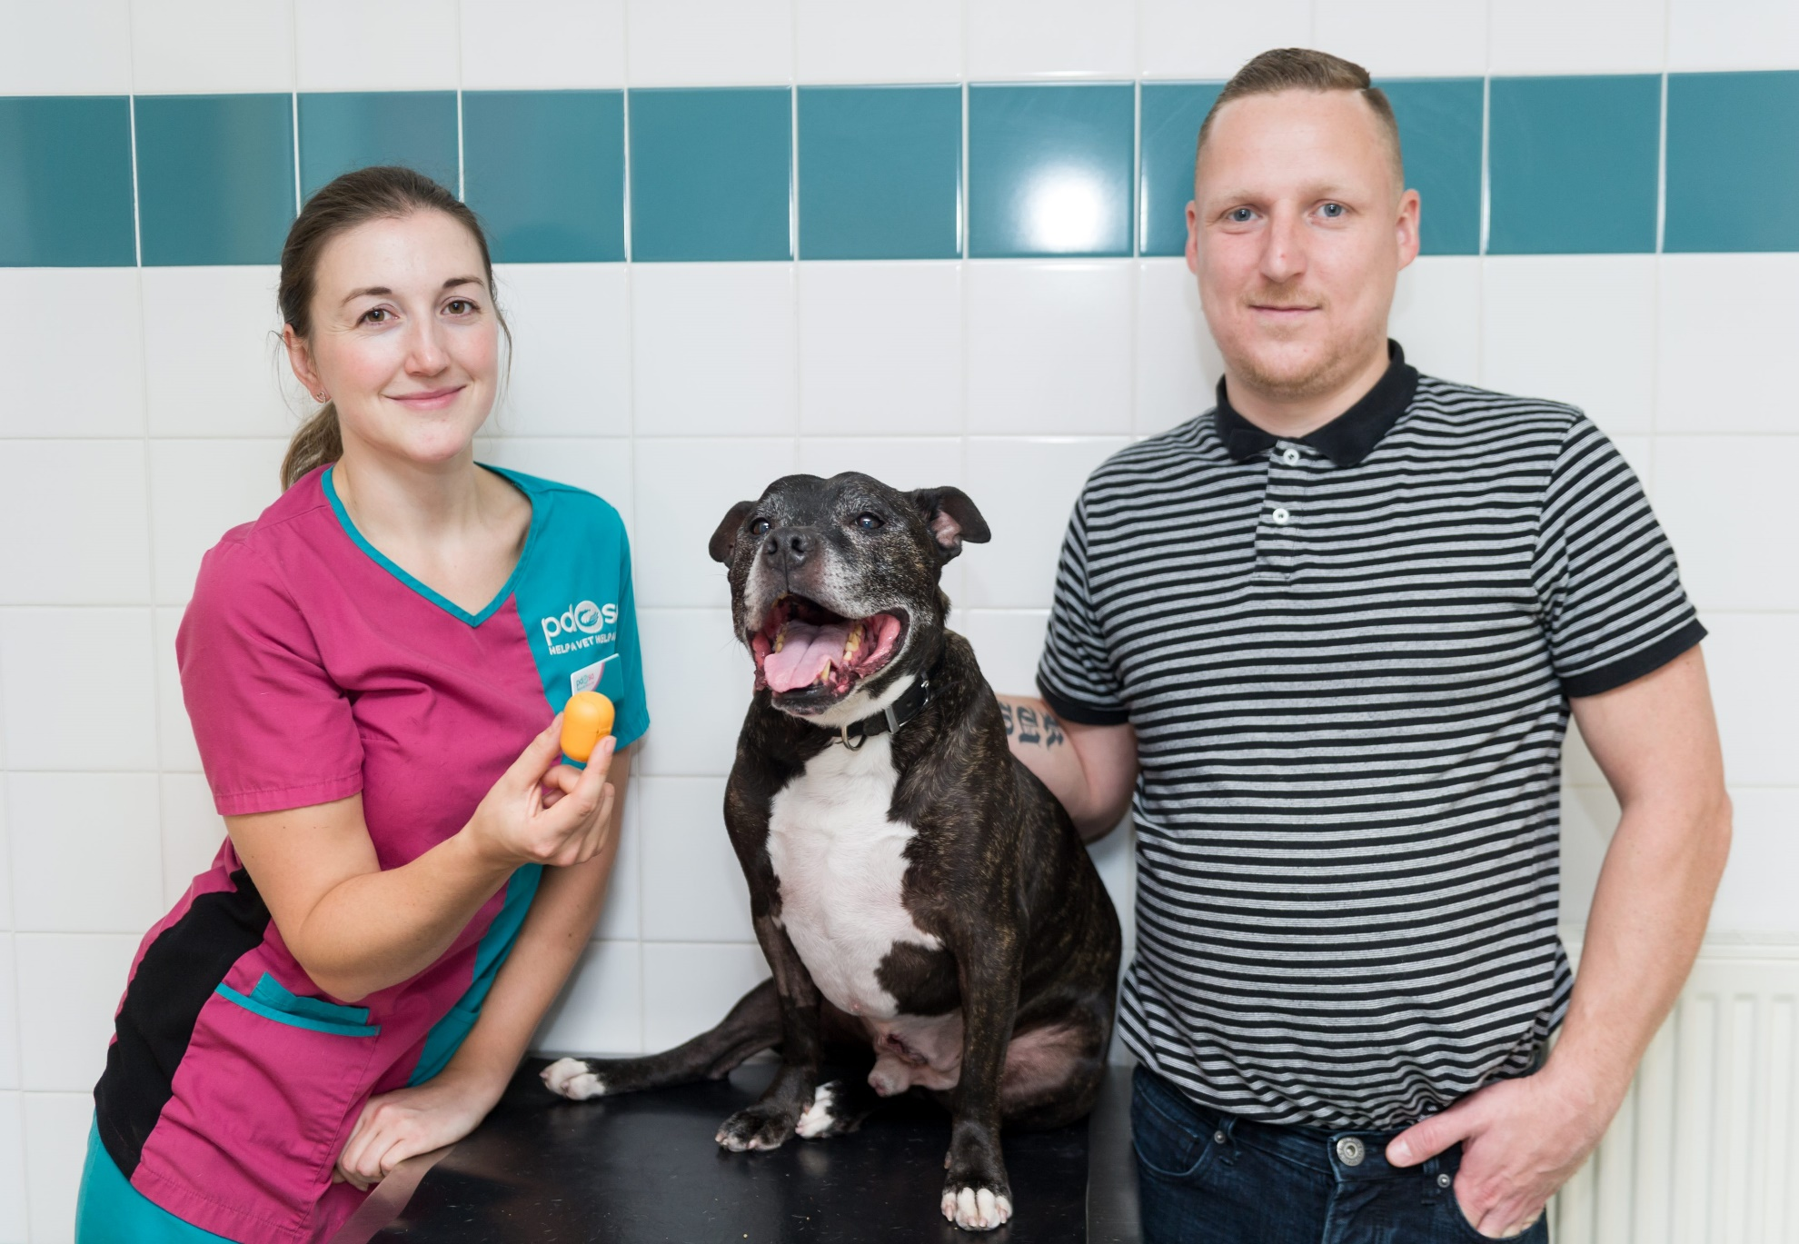
SAVED thanks to PDSA

Slide 17
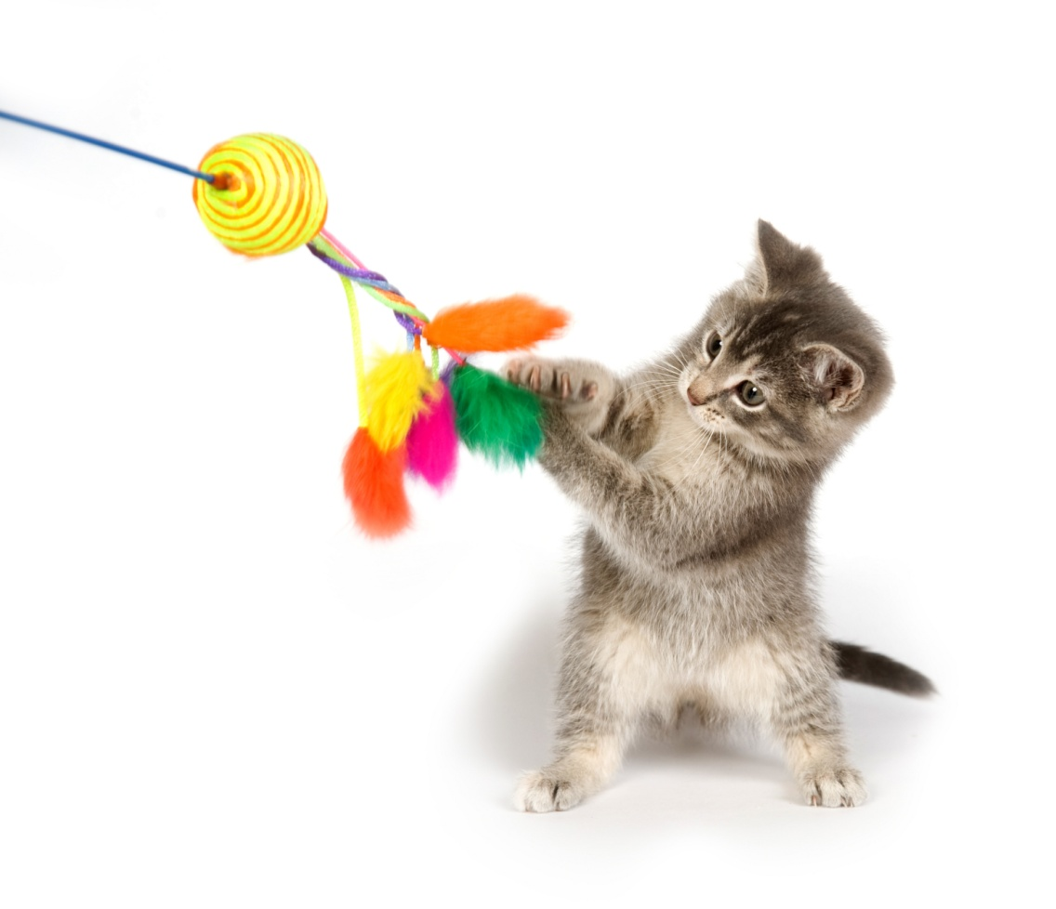
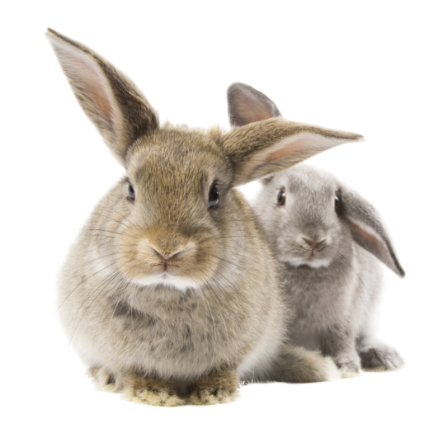
Thanks!
Notes:
Thank them all for being fab, joining in and answering questions.
Remember:
to ask the teachers for their completed feedback forms back before they leave the room.
To leave each teacher with a Pet day flyer.
To give each child a take home puzzled pets flyer

