Slide 1
Animal-based Careers and Qualifications
Notes:
Introduce yourself
Explain that today they’re all going to:
Learn about some of the careers available that involve working with animals (both inside and outside the hospital)
Learn what knowledge, skills and qualifications they will need in order to do these jobs.

Slide 2
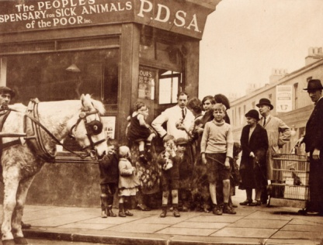
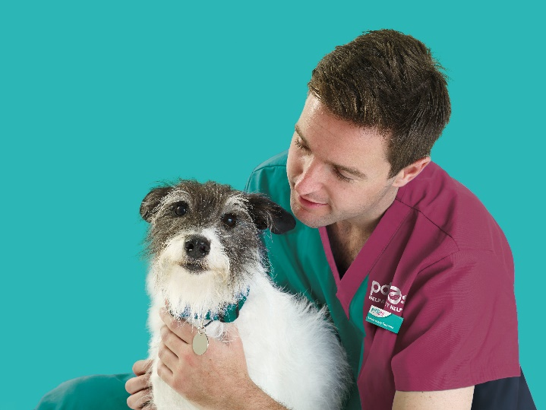
The UK’s leading vet charity …
Our charity is 100 years old and we’ve been treating sick and injured pets
since 1917
We have Pet Hospitals all over the UK
We help a sick or injured pet every 5 seconds!
It costs more than £1 million every week to do our work
Notes:
Introduce PDSA
Share the details on the slide and:
Explain that PDSA is a special kind of vets, because we’re a charity. Ask them what a charity does and explain that PDSA looks after pets when owners can’t afford vet treatment.
Ask them if they think what PDSA does is important
Ask them what would happen to all the sick and injured pets PDSA treat, if we weren’t around.
Ask the group where they think the money comes from for PDSA to treat all these sick and injured pets - Explain that it comes from people doing fundraising and donating money

Slide 3
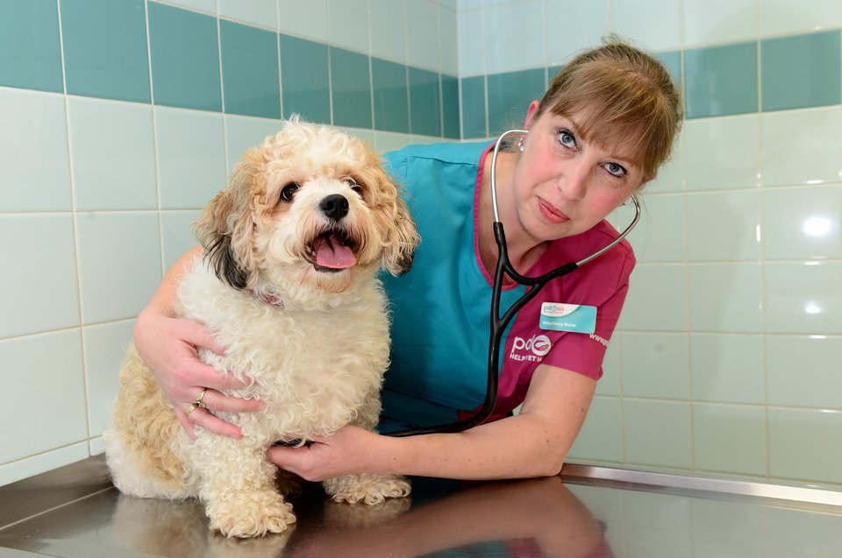
Vet
Notes:
Working closely with vet nurses, the vet will be required to diagnose, treat and discuss rehabilitation with animal owners. Experience with MRI scanning machines, ultrasound and x-rays, as well as other equipment is required. The candidate needs to possess a caring, attentive and easy-going nature and have the ability to describe ailments and treatments to the animals' owners in layman's terms.

Slide 4
To train as a Vet you’ll need:
A veterinary degree from a recognised university
A levels or equivalent in Biology, Chemistry and either Maths or Physics
Experience of working in a veterinary practice and working with and handling animals including livestock.
Notes:
The Royal College of Veterinary Surgeons (RCVS) is the governing body of the profession in the United Kingdom.
To train to be a veterinary surgeon you will need to go to university and take a veterinary degree.
The universities in the UK offering veterinary degrees approved by the RCVS are Bristol, Cambridge, Edinburgh, Glasgow, Liverpool, London (the Royal Veterinary College) and Nottingham.
The degree courses are five years in length (six years at some schools).
Some universities may accept a third A level in a non-science subject, but it must be an academically sound subject. The minimum grades generally expected are two A's and a B, though some schools will require three grade A's.

Slide 5
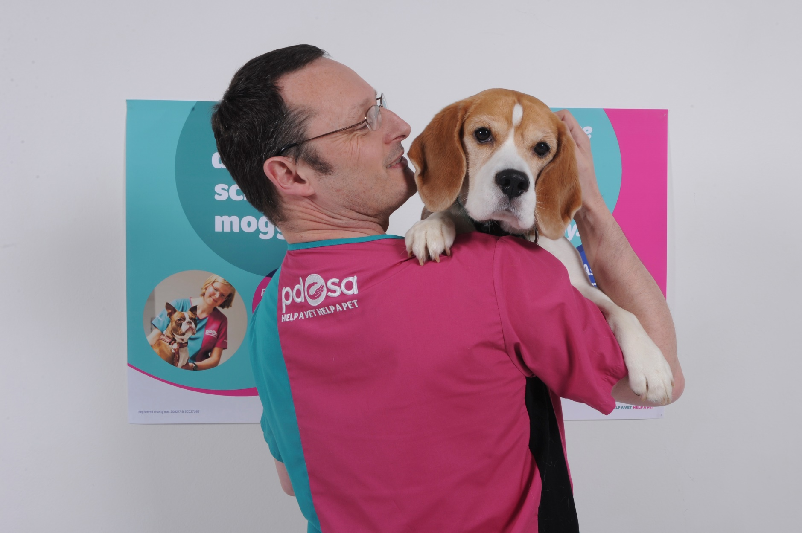
Vet Nurse
Notes:
Veterinary nurses assist vets in the diagnosis, treatment and care of sick or injured domestic, farm and zoo animals. Responsibilities of the job include:
administering drugs, anaesthetics and injections, preparing animals for surgery, holding and monitoring animals during operations, maintaining, sterilising and laying out surgical equipment, cleaning up after surgery, undertaking diagnostic tests, preparing and sending off laboratory samples and taking x-rays.

Slide 6
To train as a Vet Nurse you’ll need:
Level 3 Diploma or Degree (FdSc) in Veterinary Nursing
5 x GCSEs or equivalent at grade C or above, which must include English
You may find it useful to have some relevant work experience. This could be as a volunteer with a vet, local kennels, animal welfare centre or animal charity.
Notes:
The current veterinary nursing qualification is the Royal College of Veterinary Surgeon’s (RCVS) level three diploma in veterinary nursing or a Degree (FdSc) in Veterinary Nursing.
The diploma can be done on either a full time basis or apprenticeship-style alongside a job in a veterinary practice. It takes between two and three years to qualify.
The degree takes three years to complete. The middle year is practice-based.
Some universities offer a foundation or BSc honours degree in veterinary nursing too.
To start training as a veterinary nurse you must have the following minimum educational qualifications:
Five GCSEs at grade C and above (or five Scottish Standard Grades one to three), which must include English Language, Maths and a Science subject.
OR
An animal nursing assistant (ANA) or veterinary care assistant (VCA) qualification, along with functional skills level two in application of number and communication.
The British Veterinary Nursing Association can provide details about these qualifications and how to get them.

Slide 7
Activity
You will be given a job to discuss within your groups.
Your task is to:
Write a job description for the role.
Write down what qualifications you think you need to apply for this role.
Write down what qualities you think you’d need to possess in order to complete this role.
Notes:
Divide the class into small groups or pairs and give each group a job to discuss (you will need to print each of the job slides prior to the session).
Each group will be required to feed back to the rest of the group (on their job slide) following this activity.

Slide 8
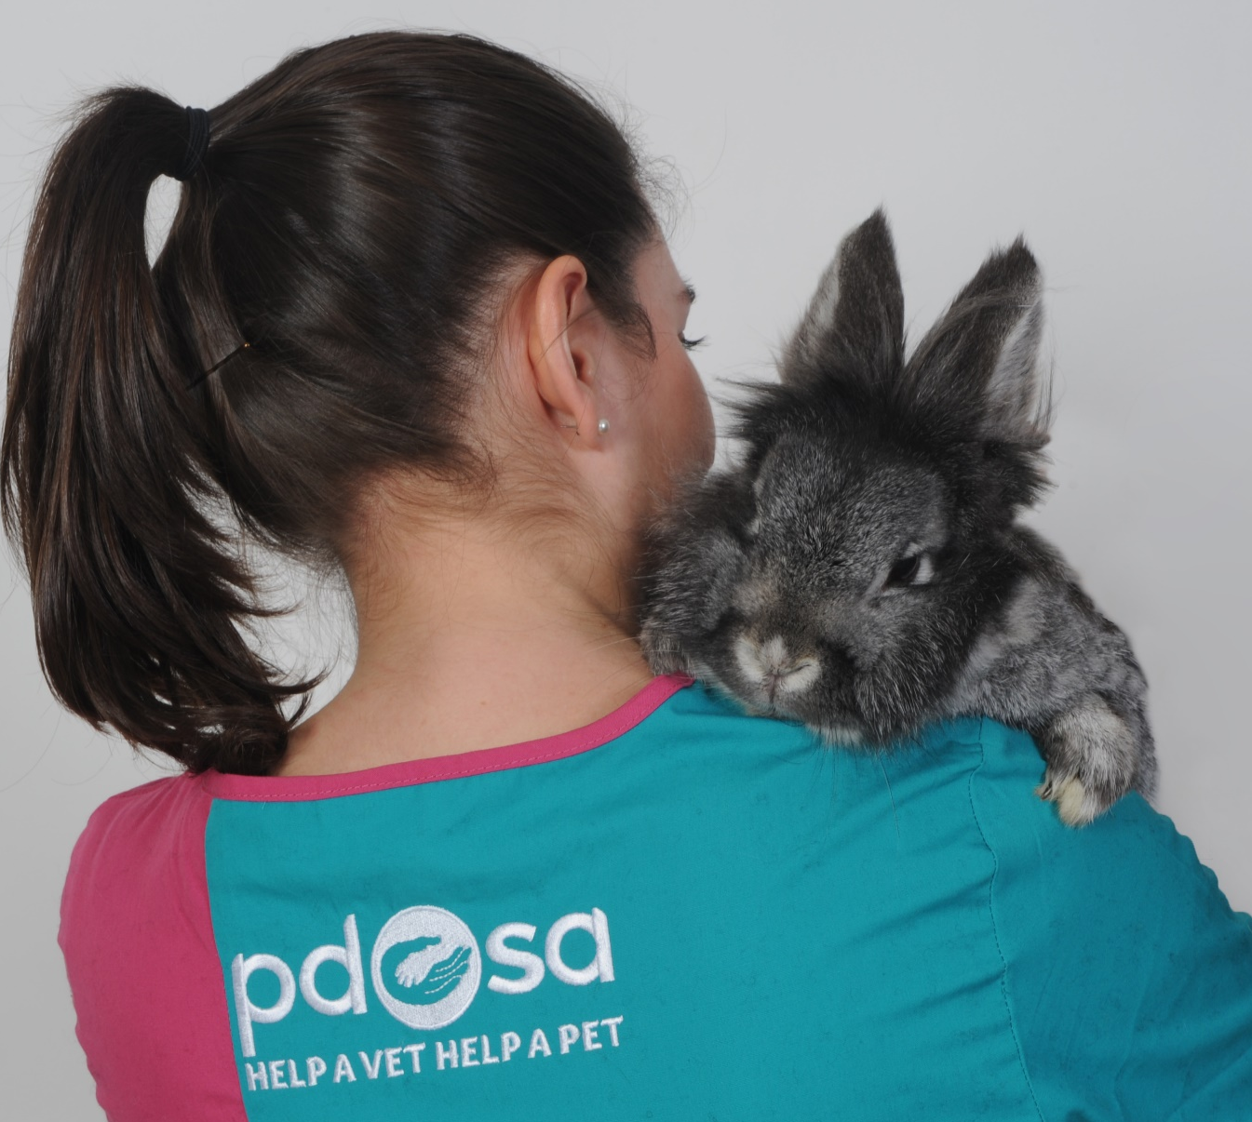
Animal Care Assistant
Notes:
Animal care workers look after animals in places like kennels, rescue centres or sanctuaries. You’ll need the ability to handle animals patiently, gently and confidently, the ability to cope with upsetting situations like working with injured or badly treated animals, a willingness to do dirty or unpleasant tasks and the ability to take responsibility for the duty of care of animals.
Organisations such as PDSA can offer information on volunteering opportunities. There are a number of relevant courses including: BTEC National Award, Certificate and Diploma in animal management. Levels 1, 2 and 3 Award, Certificate and Diploma in work-based animal care.

Slide 9
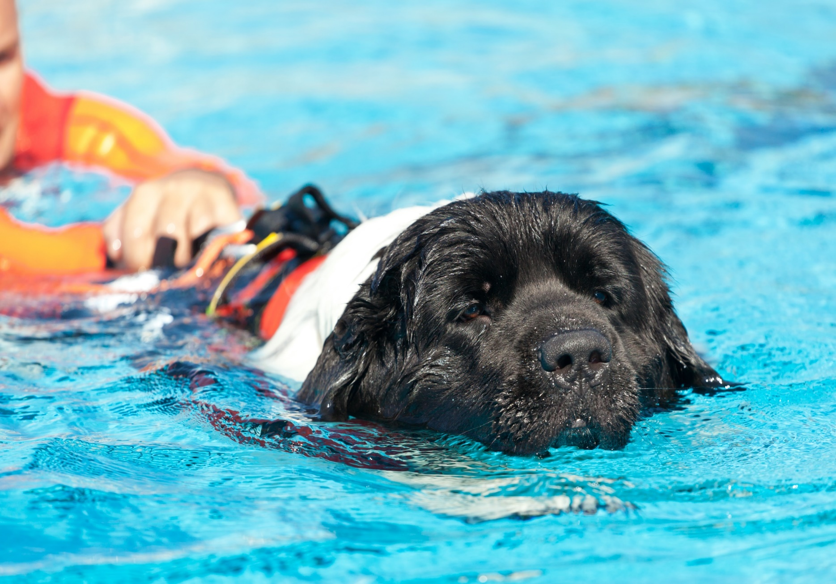
Canine Rehabilitation Therapist
Notes:
Canine rehabilitation therapists are responsible for creating and implementing therapy plans to increase an animal’s mobility and minimize any pain they may be experiencing as a result of an injury or a chronic condition. The therapist works through the treatment plan with the dog, making adjustments as necessary to ensure that progress is being made in each session.
Short-term courses and internships can be taken to train and become certified to do this role as well as University courses in Animal Physiotherapy.

Slide 10
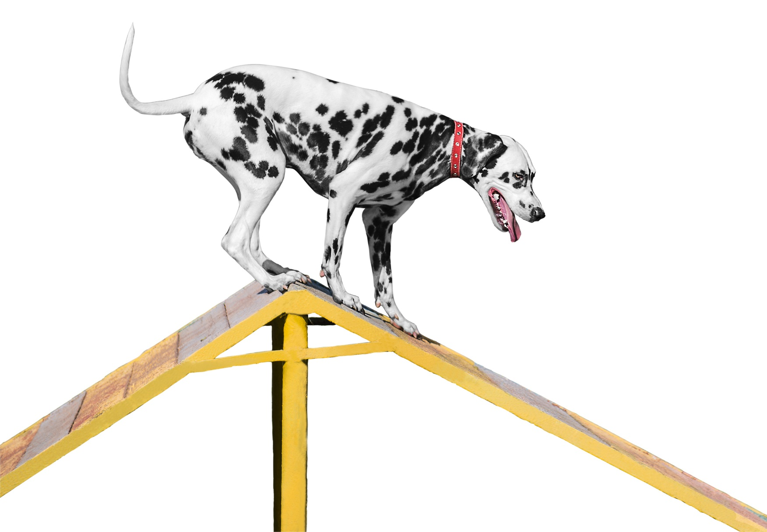
Dog Agility Trainer
Notes:
A dog trainer is responsible for using a variety of learning techniques to effect behavioural changes. Such learning techniques may include a combination of desensitization, operant conditioning, positive reinforcement, clicker training, hand signals, verbal cues, and reward systems.
Dog trainers must also communicate with owners who take classes with their pets and are responsible for reinforcing teaching methods at home. A good trainer can clearly convey training methods and plans with the owner to increase their effectiveness.
There are organisations that run courses for people who want to become dog training instructors, and a few specialising in agility. These are usually intensive and have an exam at the end. It is recommended that you try and gain as much training and teaching experience as possible. It is essential that you possess good presentation skills.

Slide 11
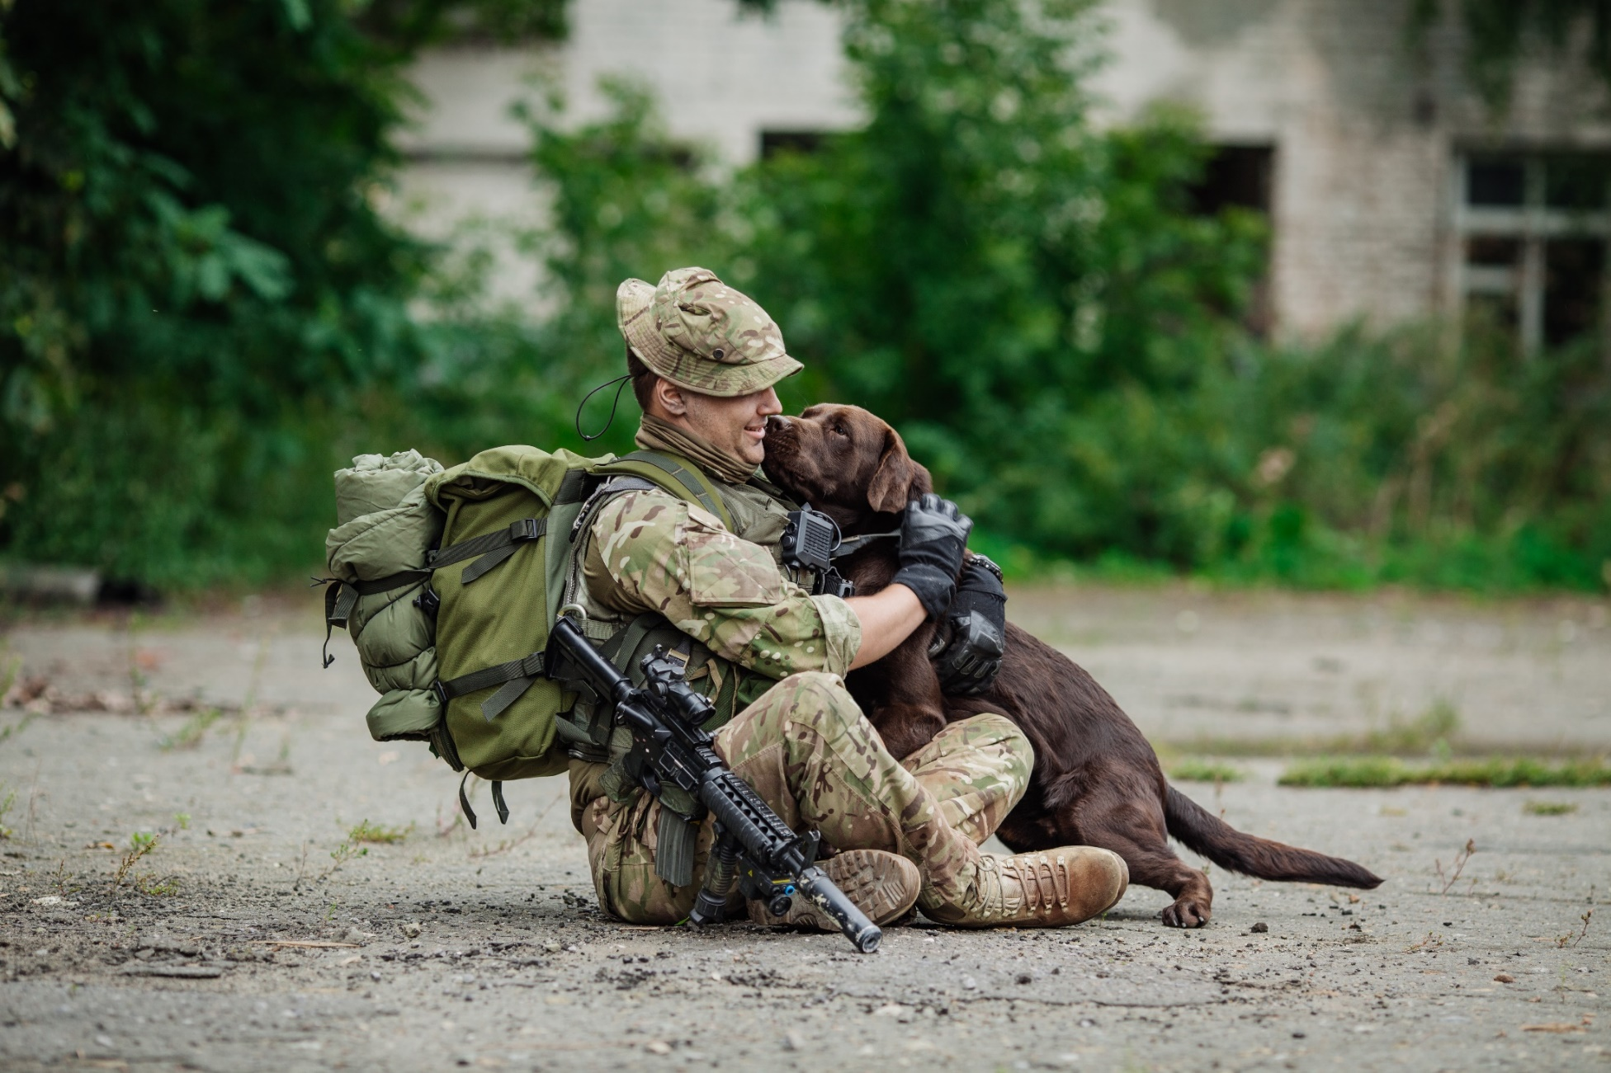
Military Dog Handler
Notes:
Military Working Dog (MWD) handlers are responsible for the care and training of his or her service dog, which contributes to combat operations abroad and installation security at home by providing target odour detection (explosive/drug). Service dogs, generally seen as a non-lethal option for neutralizing a threat, also serve as a psychological deterrent during law enforcement operations.
There are no set requirements, but you’ll need experience of caring for dogs. You’ll usually need some training and experience in the organisation you wish to work for before moving into dog handling.
You could gain voluntary experience with the National Search and Rescue Dog Association before applying for dog handling training.
Skills needed:
- The ability to work a dog efficiently and look after its welfare needs
- Self-confidence and the ability to work with minimum supervision
- Patience with inexperienced dogs
- Good observation skills
- The ability to judge a situation accurately and react instantly

Slide 12
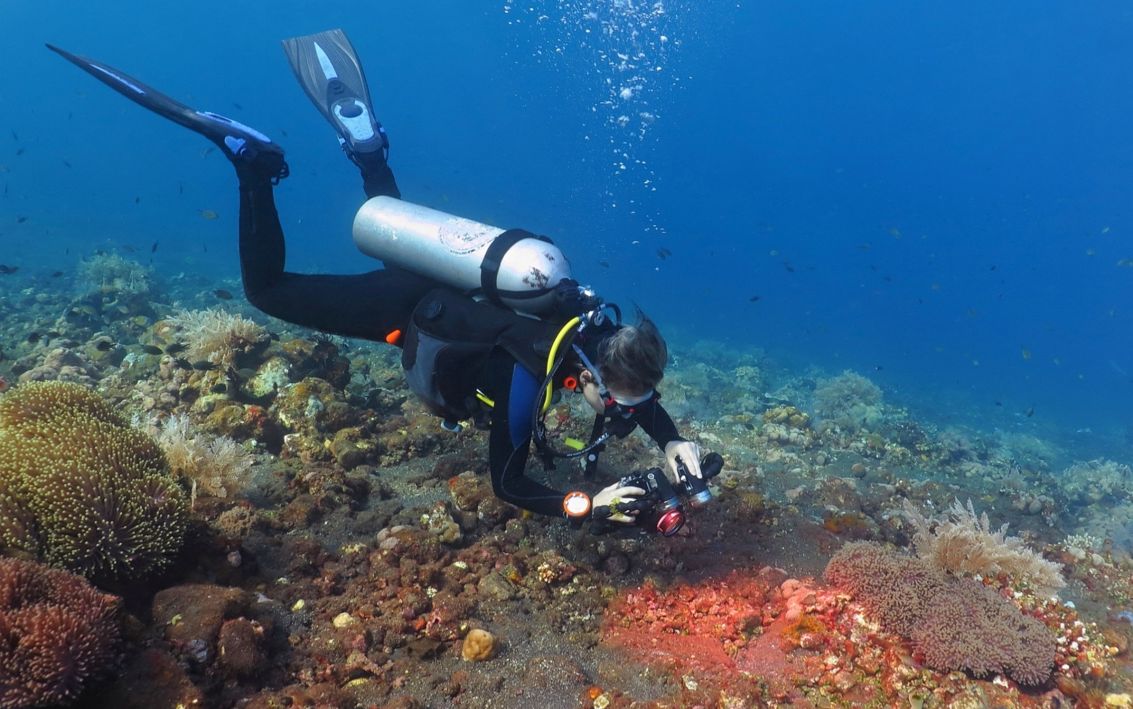
Marine Biologist
Notes:
A marine biologist is the biological professional who is responsible for carrying out study and research on sea, study the forms of life under water, atmosphere and environment under water, its interaction with land and most importantly study pertaining to ocean and sea floor. Hence these professionals study about plants and animals in the sea, the behaviour of ocean currents and its effect on the life under water, and about the life forms on the verge of extinction, so that measures can be taken to preserve them.
You’ll need a degree in oceanography or a related subject, and a postgraduate master's degree (MSc). You may also need a PhD in a subject like oceanography, maths, geology or environmental science.
Skills required
You’ll need:
- strong mathematical skills
- excellent observational and practical skills
- accuracy and attention to detail
- excellent spoken and written communication skills to present your findings

Slide 13
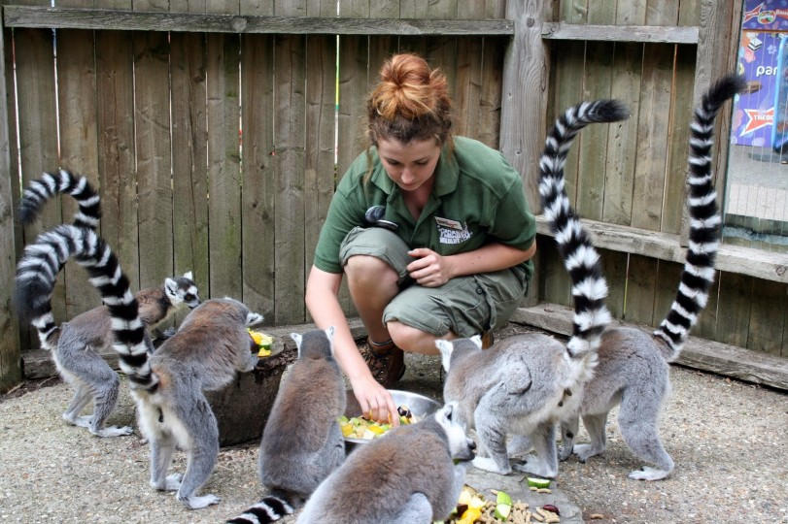
Zoo Keeper
Notes:
Whether working at zoos, aquariums or animal parks, Zookeepers are responsible for overseeing the well-being of animals and maintaining their facilities, often forming a close bond with the creatures they care for. In addition to interacting with animals, Zookeepers educate the public about animals and conservation.
A Zookeeper typically works as part of a team of keepers, focussing on one or more groups of animals. Most Zookeepers can expect to work both indoors and outdoors and perform a broad range of tasks, from cleaning up animal waste to contributing to academic animal research.
You'll usually need a minimum of 5 GCSEs (or equivalent) at grades 9 to 4 (A* to C) including English, maths and science.
Some zoos may ask for A levels or an equivalent qualification in animal care or animal science. Others may ask for a higher level qualification like a foundation degree or degree.
You'll need experience of working with animals. You could volunteer in a zoo or safari park.
Some zoos run unpaid work placements or internships. You could also get experience with animals at a farm, kennels or riding stables.
You may be able to work your way up through an apprenticeship.
Skills required
You'll need:
- the ability to handle animals with confidence and compassion
- observation skills
- excellent communication and IT skills

Slide 14
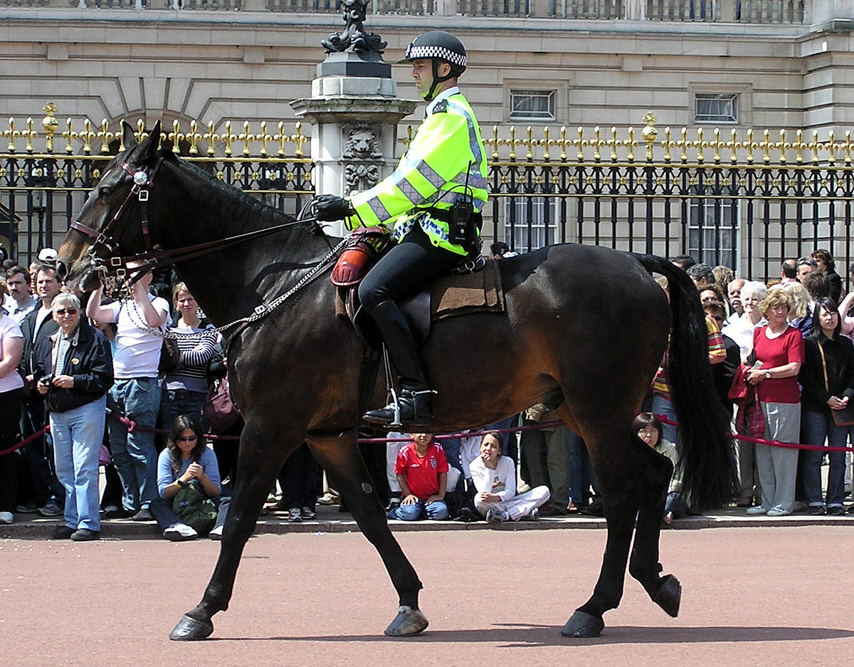
Mounted Police
Notes:
The most visible duties of a mounted police officer are conducting patrols on horseback and assisting with crowd control at events. Mounted officers are very effective in crowd control roles; it is commonly said in the industry that a mounted officer is comparable to ten or more officers on foot in such situations.
In order to be a mounted policeman/woman, you’ll need to have worked as a police officer first.
Each police force has its own recruitment rules, but the basic guidelines are the same.
You'll need to:
- be aged 18 or over
- be a British or Commonwealth citizen, a European Union (EU) or European Economic Area (EEA) citizen, or a foreign national with the right to stay and work in the UK for an indefinite period
pass background and security checks, and give details of any previous convictions
If your application is successful, you’ll be invited to an assessment centre where you’ll:
- have an interview
- take written tests
- take a physical fitness test
take a medical and eyesight test
Skills required
You'll need:
- the ability to communicate well
- confidence, courage and initiative
- the ability to learn facts and procedures quickly
- to be calm and decisive in challenging situations
- the ability to work in a team

Slide 15
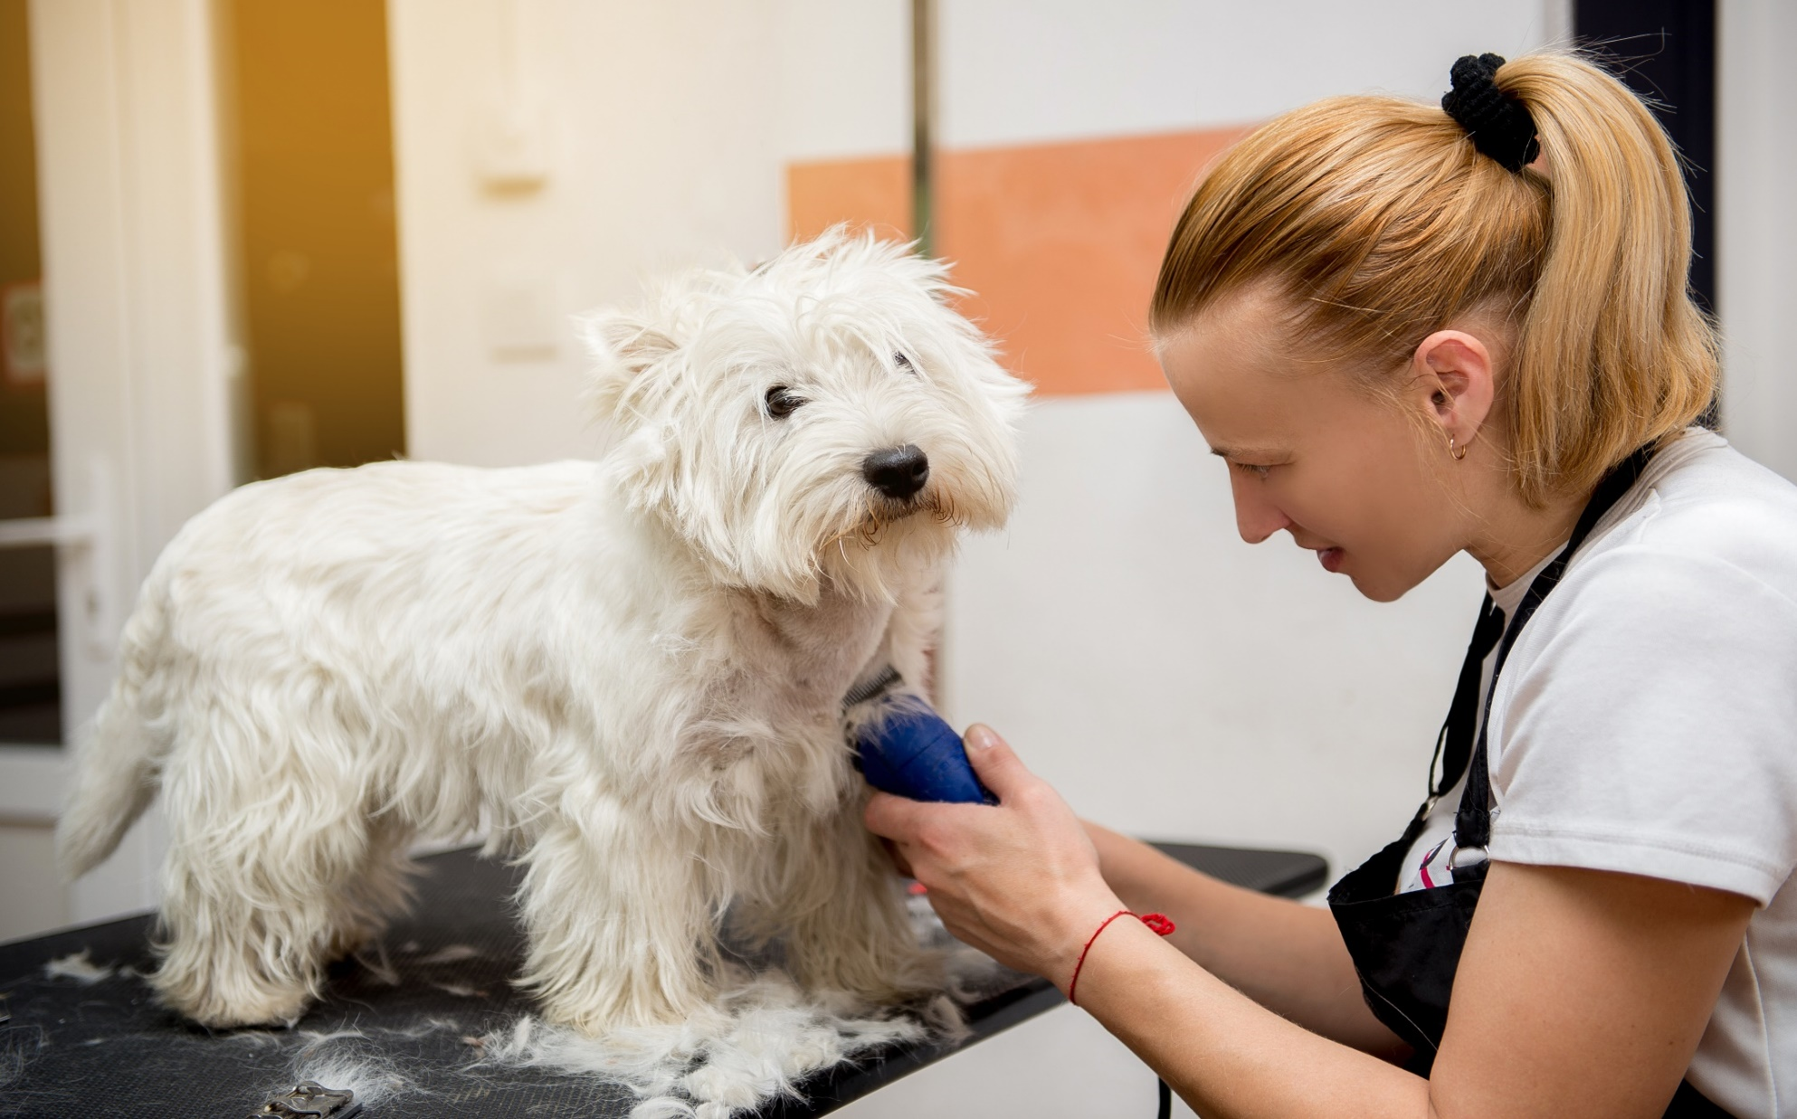
Groomer
Notes:
Pet groomers bathe and style the fur on dogs and cats, and they may also clip the pet’s fur and nails. Groomers may provide their services to a family pet, or they may specialize in preparing show animals for events. Some groomers are self-employed, but others use their trade at kennels, pet shops, veterinary offices or pet supply retailers.
There are no set entry requirements, but you’ll need experience with dogs. You could start by:
doing voluntary work with dogs, like in kennels
working under a qualified and experienced dog groomer
doing a basic course in animal care at a private training centre or college
Skills required
You’ll need:
- the ability to handle dogs firmly but gently
- the ability to calm and control nervous dogs
- patience and attention to detail
- good communication and customer care skills

Slide 16
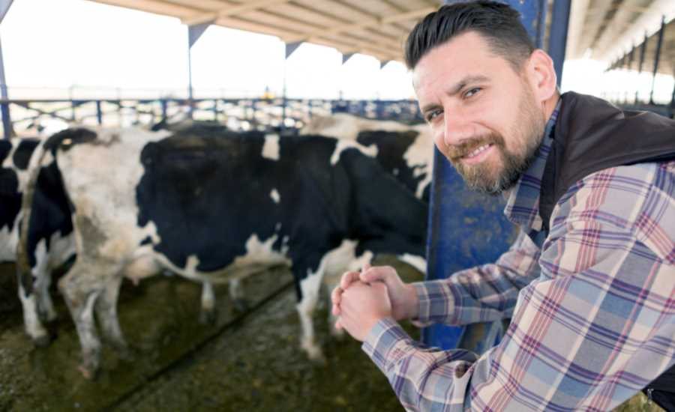
Dairy Farmer
Notes:
Dairy farmers breed and raise cows and supply milk to the milk and milk products industries. Dairy farmers usually own their herds and the farmland. Although most dairy farms are owned and operated by families, some milk comes from very large farms owned by corporations and operated by farm managers and dairy production technicians. Skills required
You'll need:
- practical skills
- a willingness to work flexibly

Slide 17
Medical Researcher
Notes:
Medical researchers study diseases and other physical conditions that affect animals in order to improve treatment options or lessen the affect of some diseases. Through medical research, new vaccines, treatment protocols and medicines are developed, and links between certain behaviours and diseases are identified. Medical researchers work for research labs at hospitals and universities, pharmaceutical companies and government agencies.
Skills required
You’ll need:
- problem solving skills
- accuracy and attention to detail
- the ability to analyse and interpret data
- excellent communication skills
- a creative and innovative approach
- the ability to organise, lead and motivate a team

Slide 18
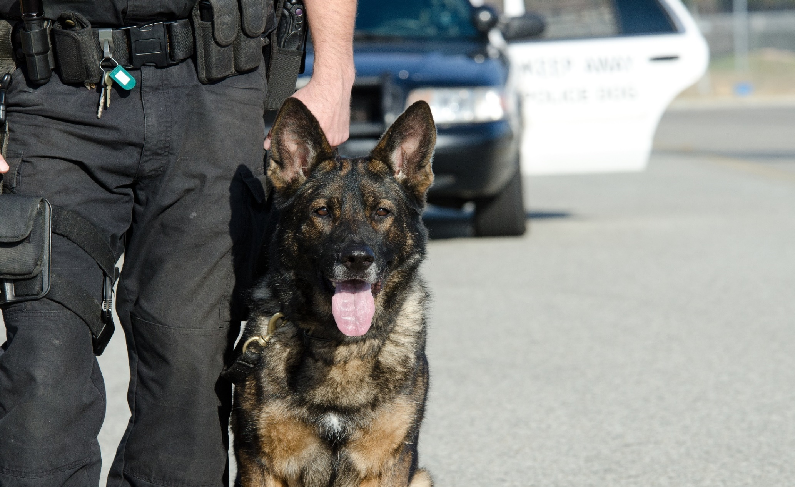
Police Dog Handler
Notes:
Police dog handlers use trained police dogs to help contain suspects, sniff out illegal substances and find dangerous weaponry. These professionals complete specialized dog handling courses so that they can recognize and interpret canine behaviour, sounds and stances. Having received the proper training, the dog and its handler can be dispatched to search for narcotics, uncover explosives and track fugitives.
See military dog handler notes.

Slide 19
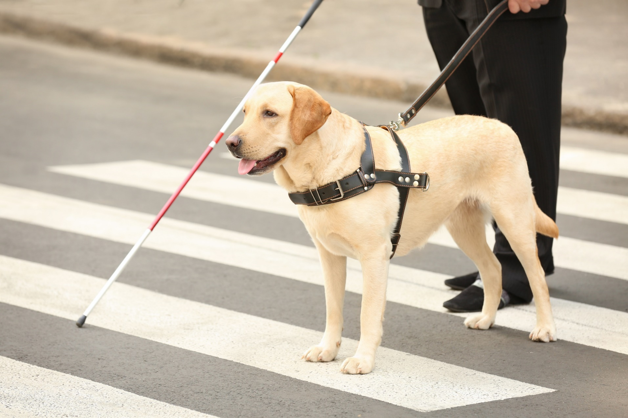
Guide Dog Trainer
Notes:
Service dog trainers teach guide dogs, hearing dogs and therapy dogs to assist people with disabilities. Apprentice trainers typically work at service dog training schools under the supervision of experienced instructors and, with experience, may go on to instruct other trainers. This is a physically demanding position, which requires trainers to walk and control dogs of various sizes and breeds. Trainers are matched with puppies and work with their partner dogs through the entire training process.
Each organisation sets its own entry requirements for job vacancies, like:
Guide dogs – you’ll need 3 GCSEs at grades 9 to 4 (A* to C), or equivalent, including English
Hearing dogs – you’ll need sign language skills (although training is given in British Sign Language) and experience of working with deaf people
- You must be at least 18 years old.
- You’ll usually need a full, clean driving licence.
- It would be useful to have experience of working with dogs, like volunteering at a kennels, dog rescue centre or other animal welfare organisation.
- Knowledge of basic dog handling and behaviour management methods would be helpful.
- You’ll also need some understanding of the issues faced by people with disabilities.
- It may help if you have a qualification in animal care work, although this isn’t essential.
- You could get into this job through an advanced apprenticeship in animal care.
Skills required
You’ll need:
- Patience with dogs and their owners
- A commitment to helping people
- Excellent communication skills
- The ability to inspire confidence in dogs and their owners

Slide 20
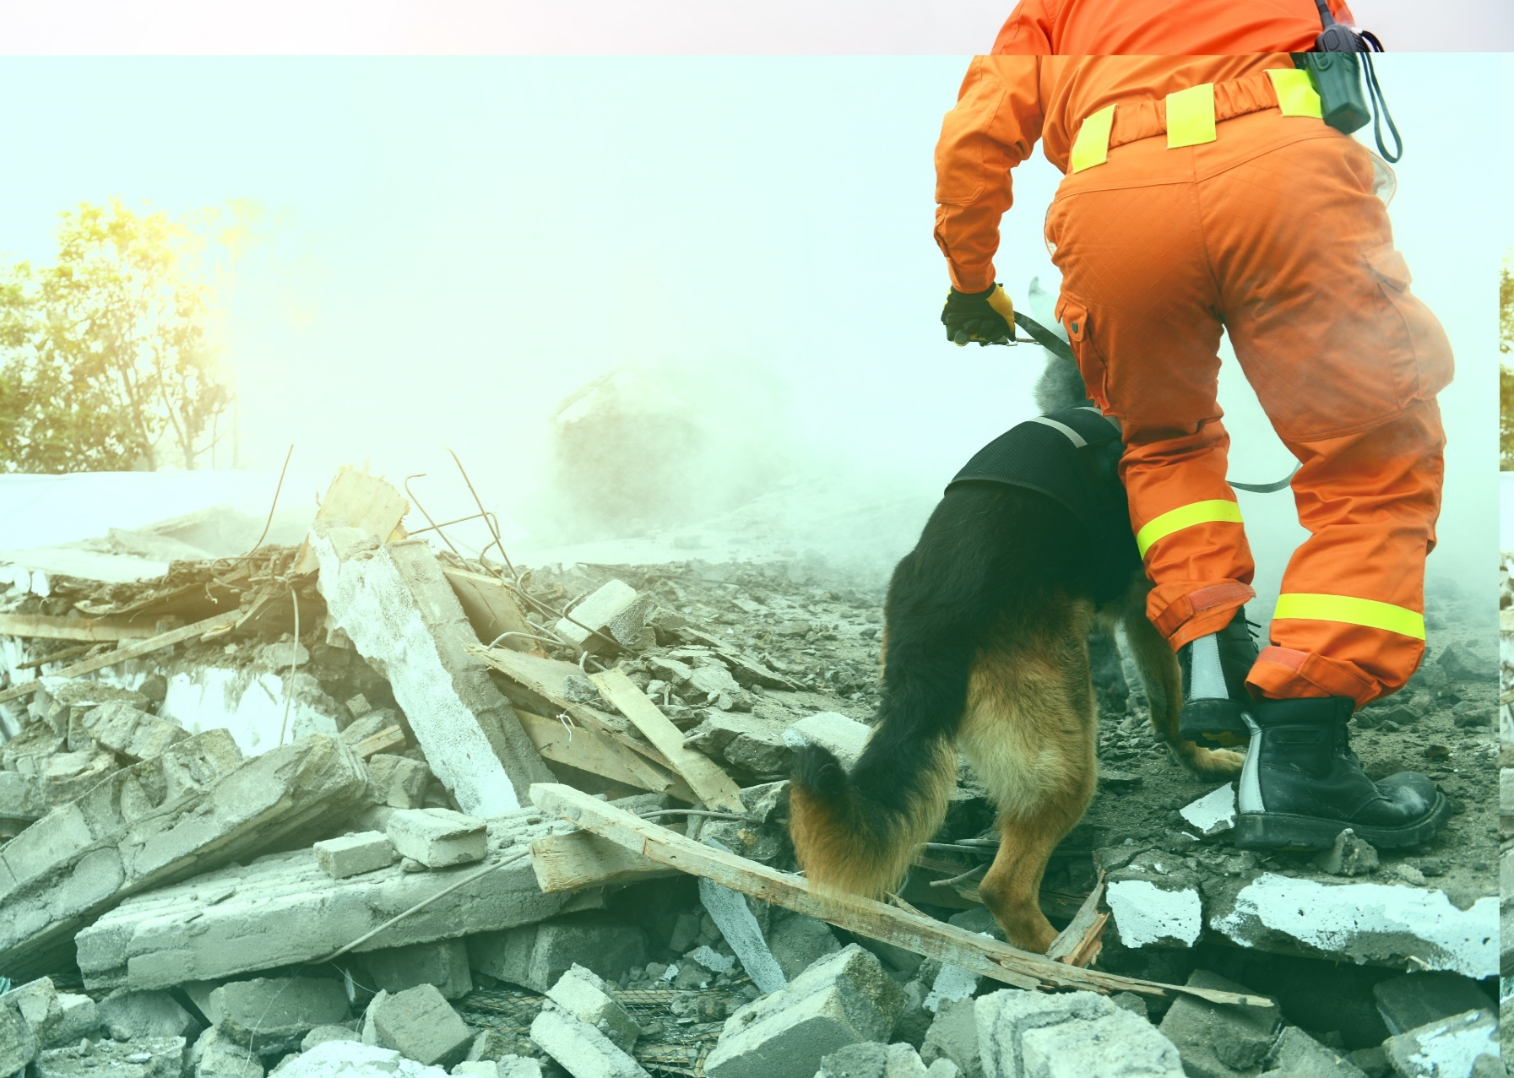
Search and Rescue
Notes:
Search-and-rescue dog handlers use canines to find missing persons. While some local work may be performed by volunteers and their dogs, most professional search-and-rescue work requires significant training. These professionals are trained to interpret dog reactions, such as barking, that may signify a find.

Slide 21
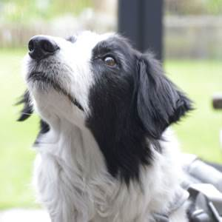
Play Bryn’s story
Bryn
Notes:
Share video

Slide 22
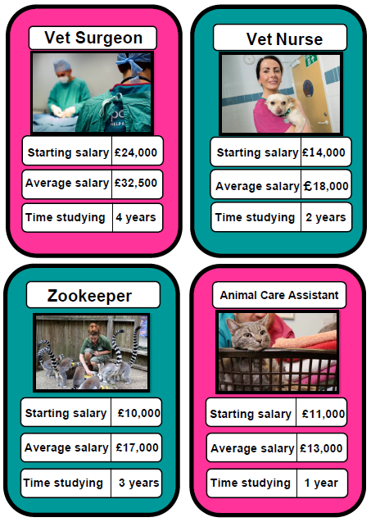
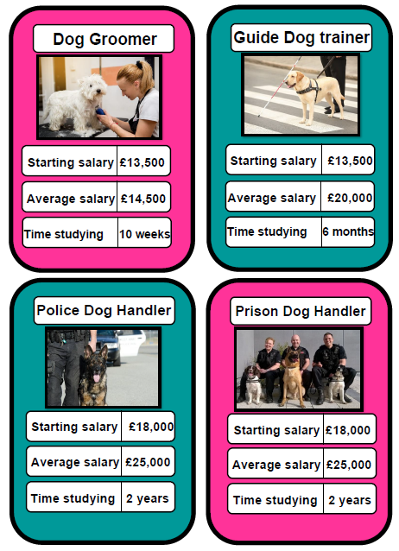
Activity
Notes:
If there’s time hand out the Top Trump cards and play in pairs/small groups

Slide 23
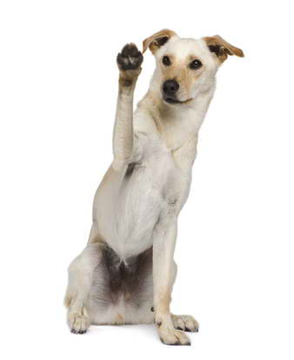
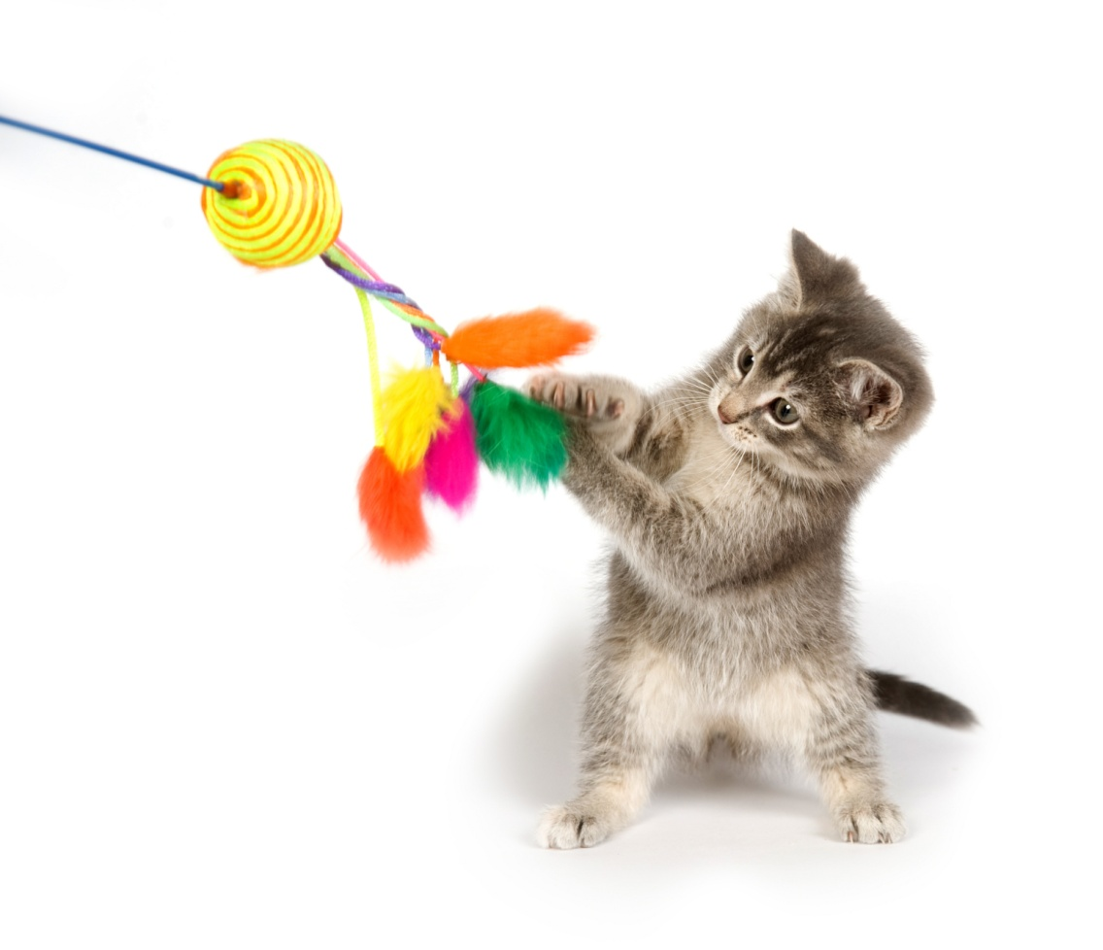
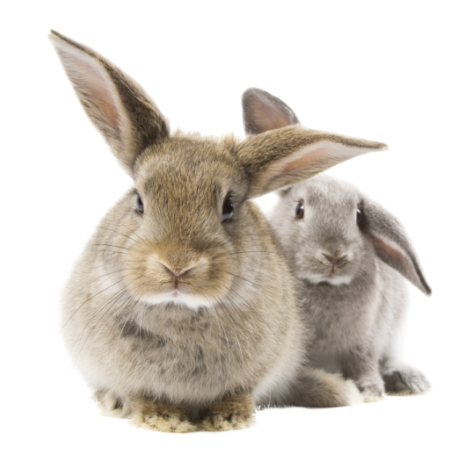
Thanks!

