Slide 1




Notes:
Share:
Introduce the session and PDSA.
Tell children that PDSA treat the sick and injured pets of people in need...
Explain that PDSA is a special kind of vets, because they’re a charity. Discuss what a charity is and explain that PDSA looks after pets when owners can’t afford vet treatment.
Ask:
If they think it’s important to help sick and injured animals to get better?
What would happen to all the sick and injured pets PDSA treat if they weren’t around?
Share:
.
Tell them that today, you’re all going to learn about what pets need to be healthy and happy and also about some of the pets that PDSA has helped in their Pet Hospitals.

Slide 2

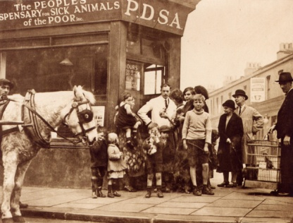
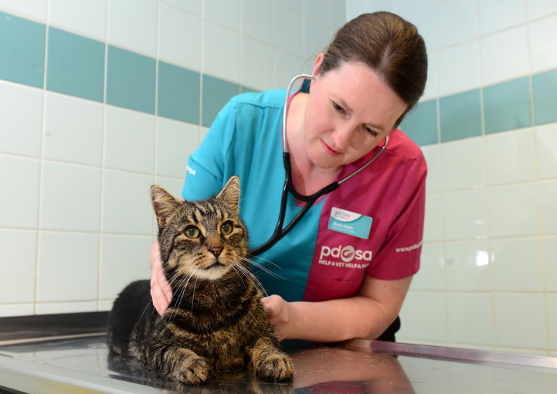

The UK’s leading vet charity …
Our charity is almost 100 years old and we’ve been treating sick and injured pets since 1917
We have 51 Pet Hospitals and 380 Pet Practices across the UK
Half a million sick and injured pets are treated in our Pet Hospitals every year
It costs more than £1 million every week to do our work
Notes:
Share the details on the slide and:
Ask:
Where they think the money comes from for PDSA to treat all these sick and injured pets?
Share:
That is comes from people doing fundraising and donating money
Ask:
Would everyone like to see behind the scenes in one of our Pet Hospitals?

Slide 3
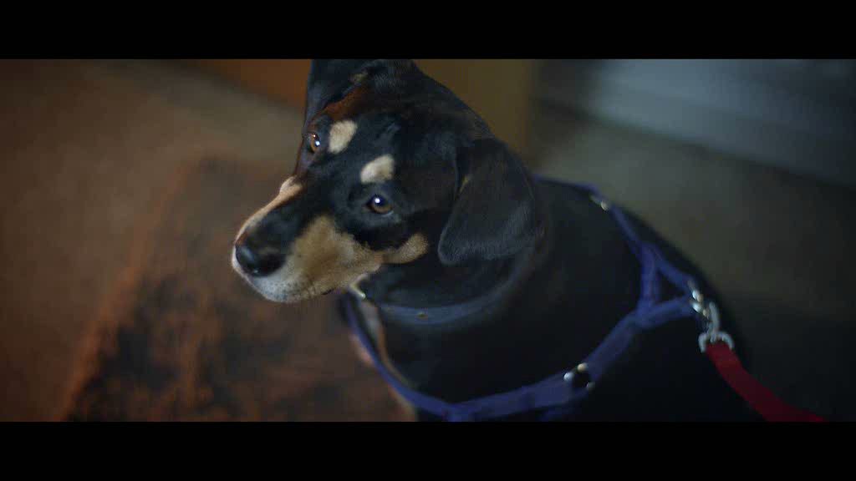
TV advert here
Notes:
Play:
PDSA video
Discuss:
Discuss afterwards what kind of things they noticed in the video.

Slide 4




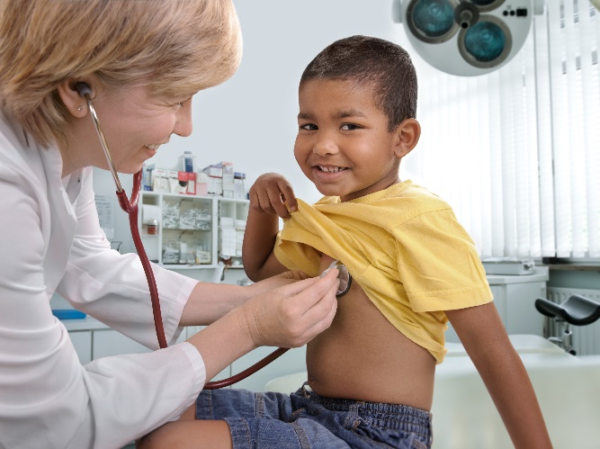
People - What do we need?
Home
Friends
Healthy diet
Exercise & Fun
Good Health
Notes:
Ask:
Encourage the children to think about what THEY need to stay happy and healthy.
Share:
Show each picture individually and see if they can come up with the answers.
Discuss:
When you get to the health slide, talk about the things they do to keep themselves healthy: Brush their teeth, bathe, wash and brush their hair, trim their nails, have vaccinations etc. Also talk about where they go when they’re poorly – compare vets with doctors.

Slide 5
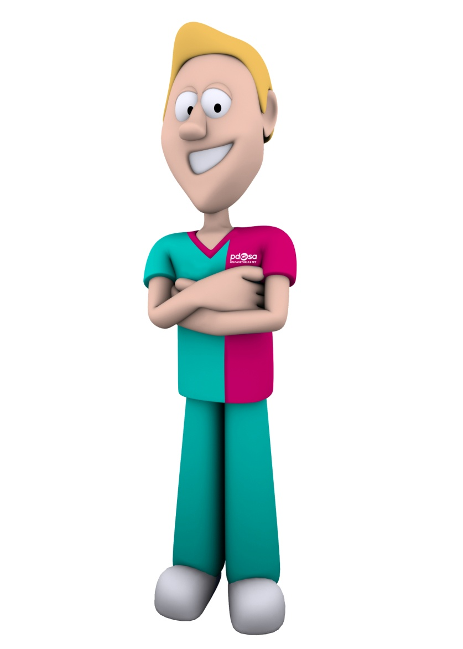





What do pets need?…
The right
ENVIRONMENT
To show natural
BEHAVIOUR
Good
HEALTH
A healthy
DIET
COMPANIONSHIP
The five welfare needs
Notes:
Share:
Explain that pets are just like us and need a variety of things to keep them happy and healthy even though they are very different from us and from each other (different species)
For instance; you wouldn’t keep a dog in a rabbit hutch or a cat in a fish tank!
Environment – Pets need a clean, safe environment with enough space
Diet – Pets need the right kind of food in the right amount and 24 hour access to fresh clean water
Behaviour – Pets need to be able to express their normal behaviour; they need to exercise, to play and do specific things, depending on the species
Health – Pets need to be kept in good health. This means taking them to the vet when they’re ill, but also making sure we keep them healthy.
Companionship – Pets need the company of people and sometimes other animals, depending on their species.
Responsibility: Stress to the children that if they have a pet, that it’s their responsibility to make sure that all these welfare needs are met. People who don’t provide these needs are now breaking the law.

Slide 6
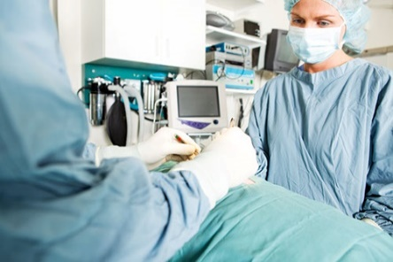
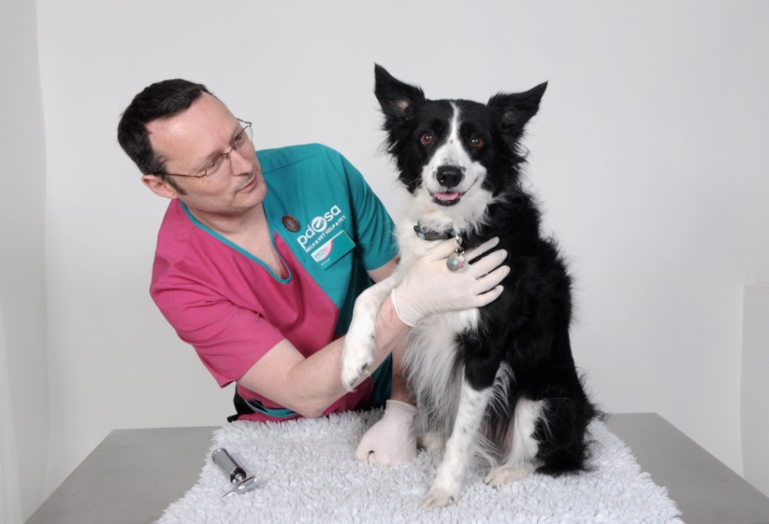
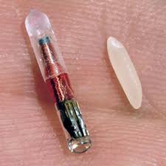
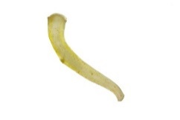
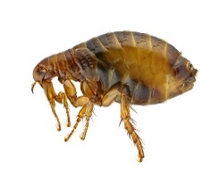
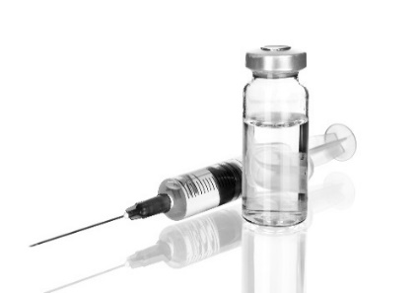
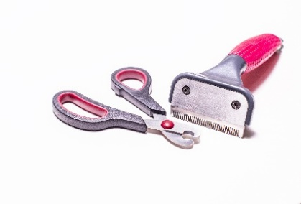

Keeping Pets Healthy …
Neutering
Microchipping
Health checks
Getting rid of Parasites
Grooming/Dental care
Vaccinations
Notes:
Ask/Share/discuss:
Health checks – Explain that pets should go to the vet at least once every year to have a health check. This gives vets a chance to make sure they’re healthy.
Neutering – It’s best to get pets neutered, as it stops lots of unwanted animals being born and also protects our pets against dangerous diseases.
Microchipping –A chip that’s inserted under the skin with the pet’s name, address etc. This can be scanned by vets and rescue centres if they get lost. Explain that dogs now have to have a microchip by law.
Vaccinations - Explain that this needs to be done every year in dogs, cats and rabbits to prevent dangerous diseases.
Parasites – Pets need to be treated for fleas, which suck their blood and make them very itchy. They also need to be treated for worms, which can live inside their digestive system and cause illness.
Grooming – Explain that grooming keeps skin and hair healthy and helps you to spot parasites and lumps and bumps etc. Explain that all dogs need to be brushed/combed, but long – haired dogs need more grooming. Long – haired dogs need to be brushed every day and short – haired, once a week.
Dental care – Explain that vets are also pet dentists. Dog’s teeth should be brushed every day like ours, but this must be done by an adult and you must use special meat flavoured toothpaste, as our toothpaste is poisonous to them.

Slide 7
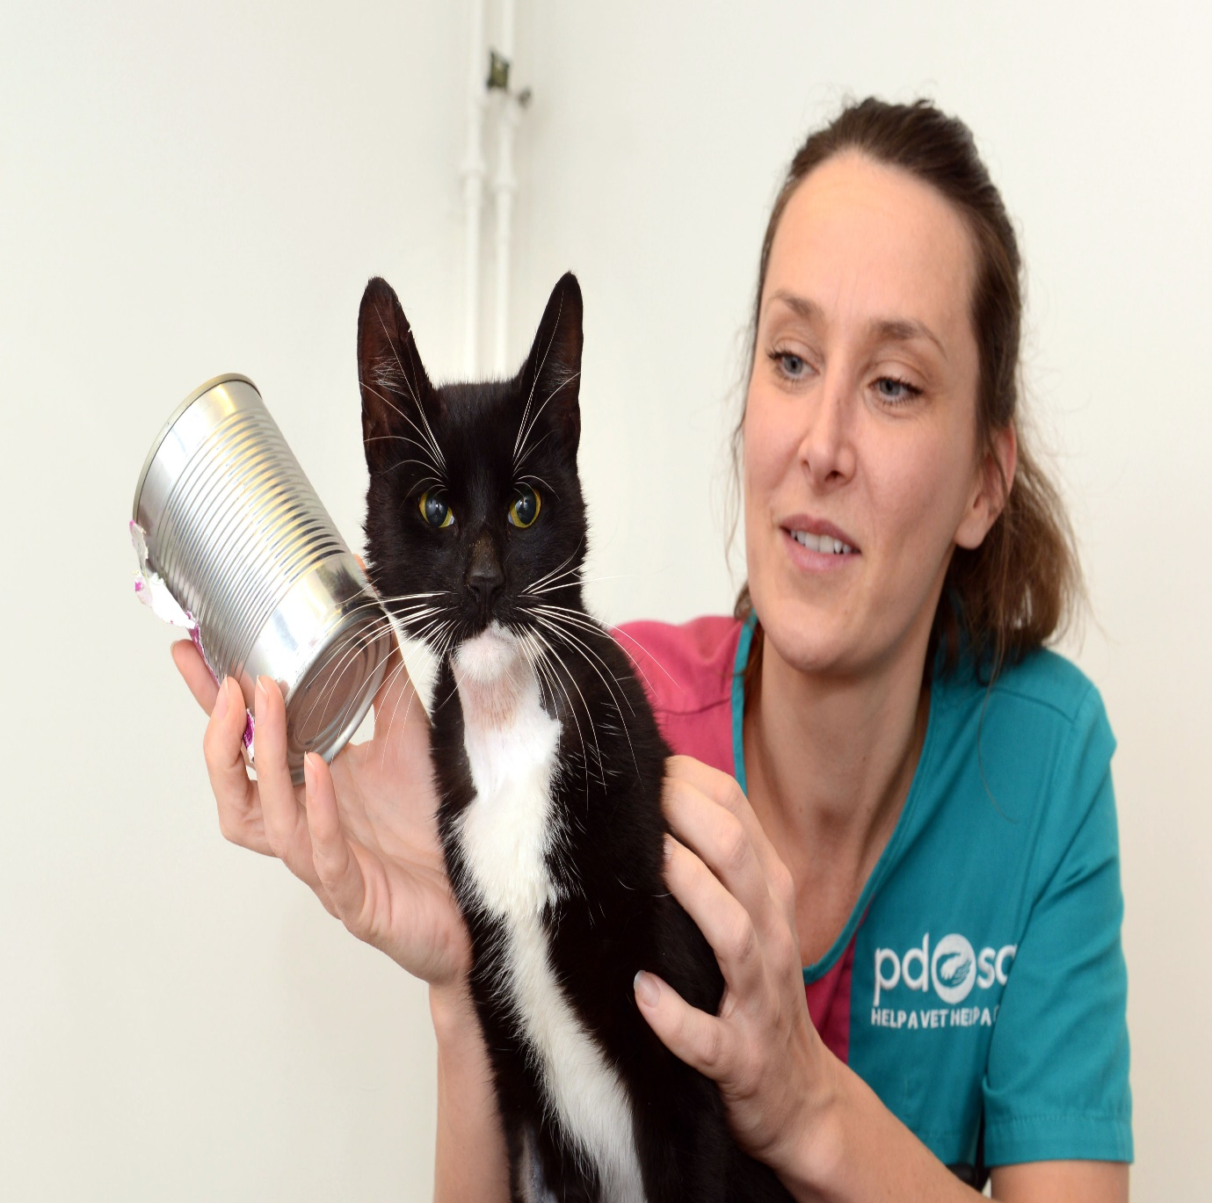
Poor Felix got his head stuck in a tin
Notes:
Share:
Playful Felix got himself into a tight spot when going through the recycling bins in a neighbour’s garden. His owner heard a clatter as Felix jumped over the fence into the garden and when she looked outside, he was sitting on the grass with a food can stuck on his head.

Slide 8
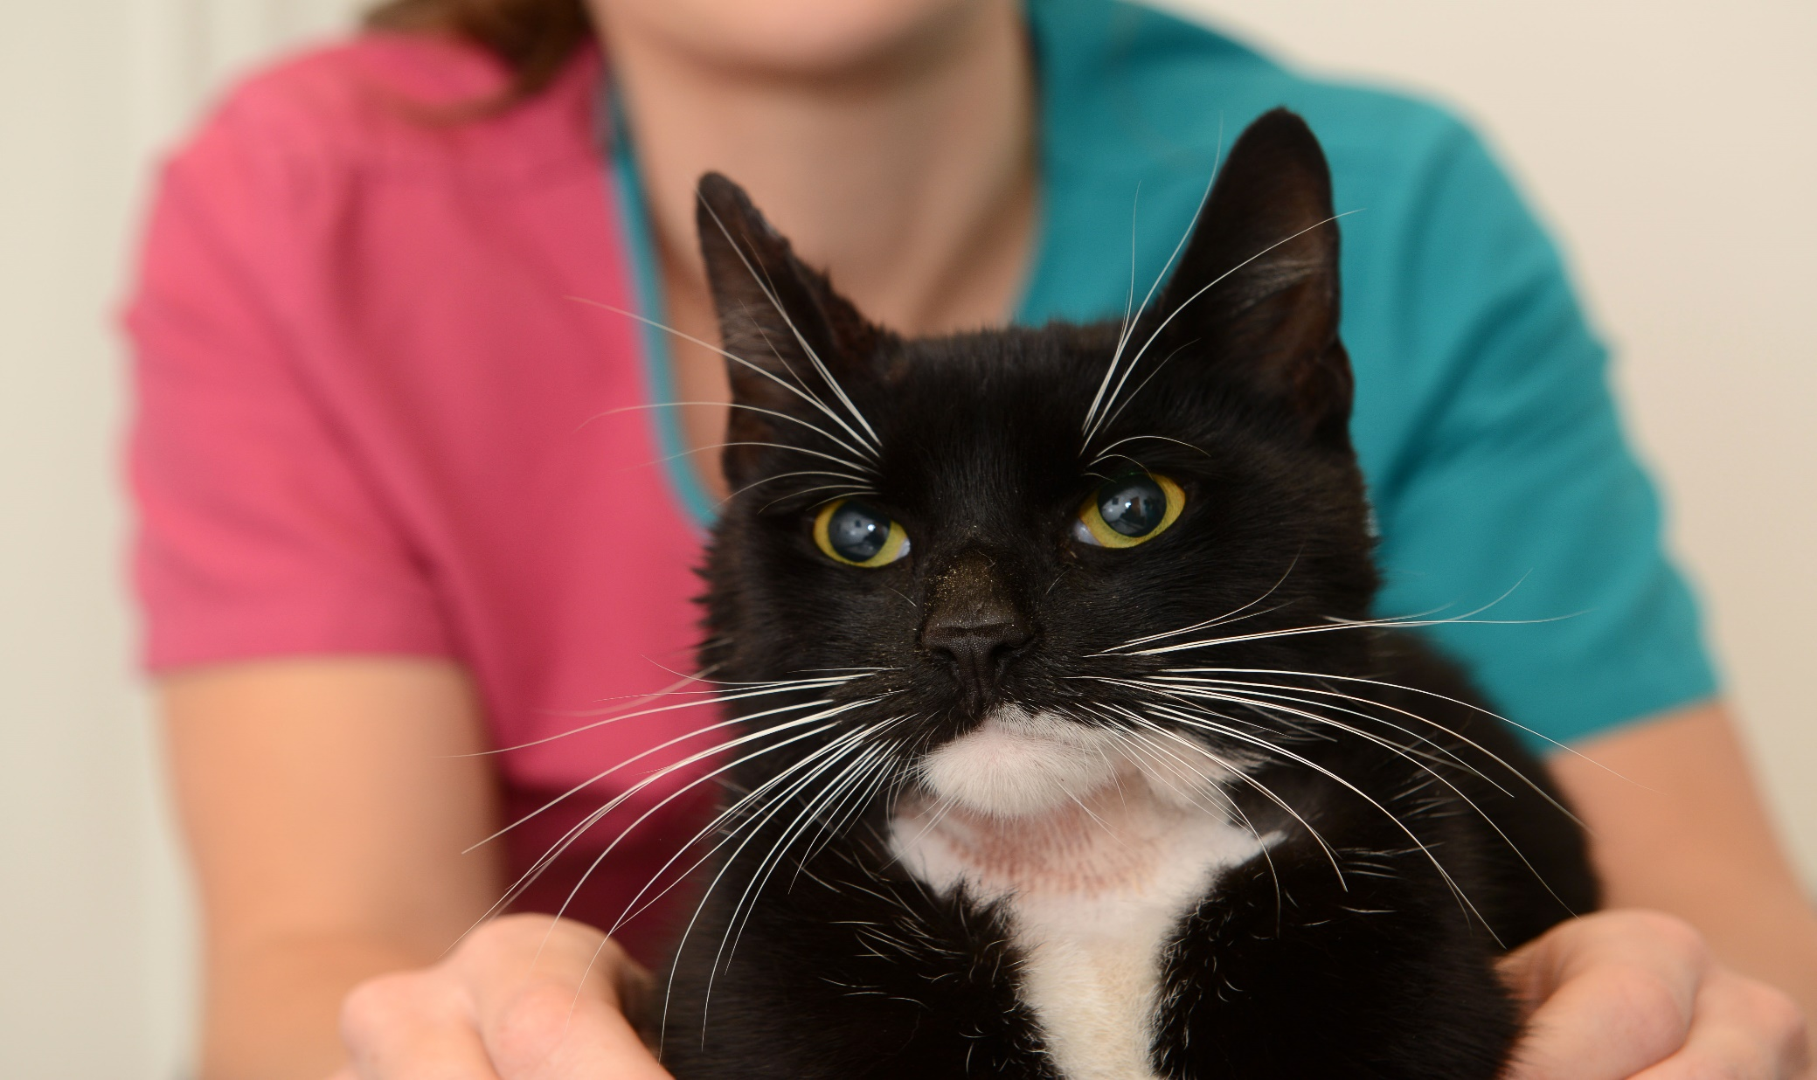
Saved thanks to PDSA
Notes:
Share:
Action taken
The team at PDSAs Pet Hospital in Coventry rushed Felix straight in to remove the can. Felix had been trying to pull the can off his head himself and had cut his ear on a sharp edge, which was bleeding quite a lot. Once his wound had been cleaned, Felix was kept in for a few hours so vets and nurses could keep an eye on him.
Mention that the sharp edges on tins and glass are really dangerous to pets and wild animals too, so it’s best to keep recycling boxes covered. If you have to keep your recycling boxes outside, make sure that all food containers are rinsed out with water to remove any tempting smells. Also, squashing or flattening tin cans makes sure that animals won’t get stuck, like Felix did.
Explain that Felix made a full recovery

Slide 9
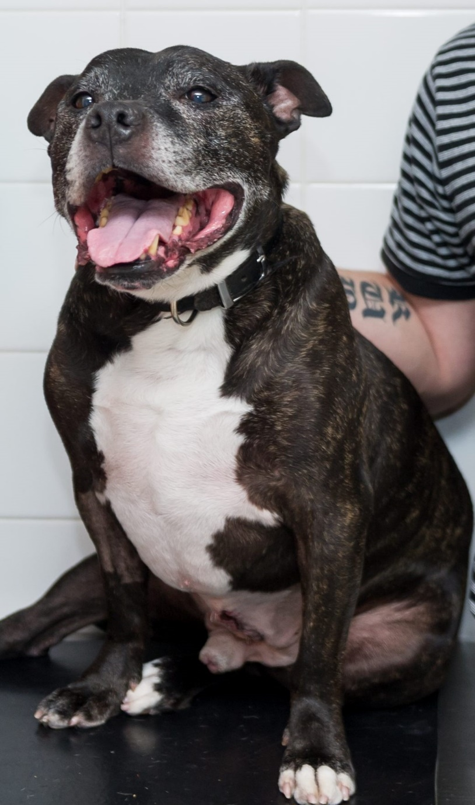
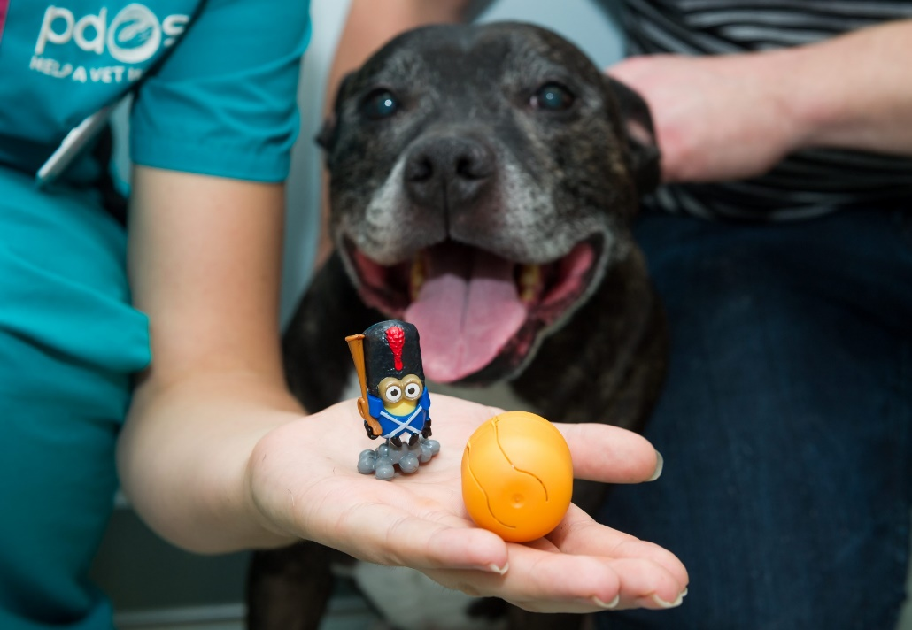
Chase swallowed a toy!
Notes:
Share:
When hungry pooch Chase gobbled down a chocolate egg with a plastic toy in it, there were no prizes for guessing which toy was lurking inside his stomach, when an x-ray showed very clearly the shape of a Minion toy.
Although chocolate is poisonous to dogs, Chase didn’t have time to show any signs of illness, as his owners saw him eat the chocolate egg and rushed him straight into PDSA’s Pet Hospital in Romford.

Slide 10
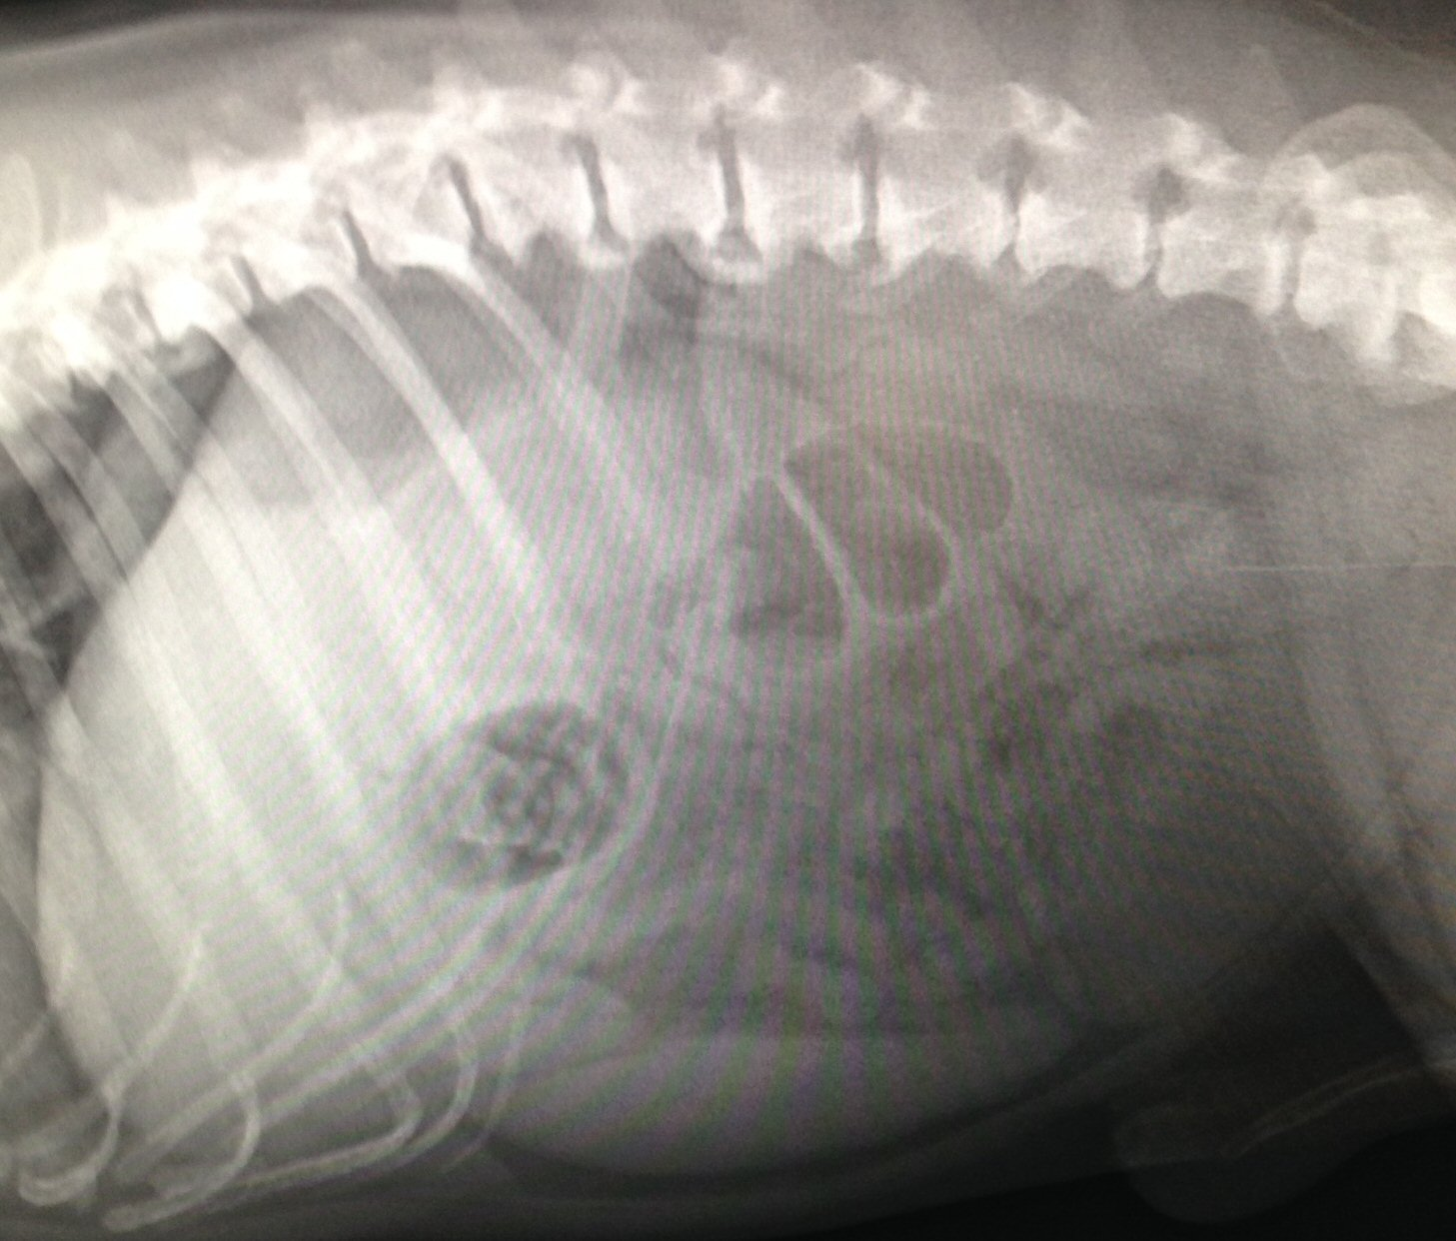
Notes:
Share:
Take a look at Chase’s X-Ray and see if you can spot the toy in his stomach.

Slide 11
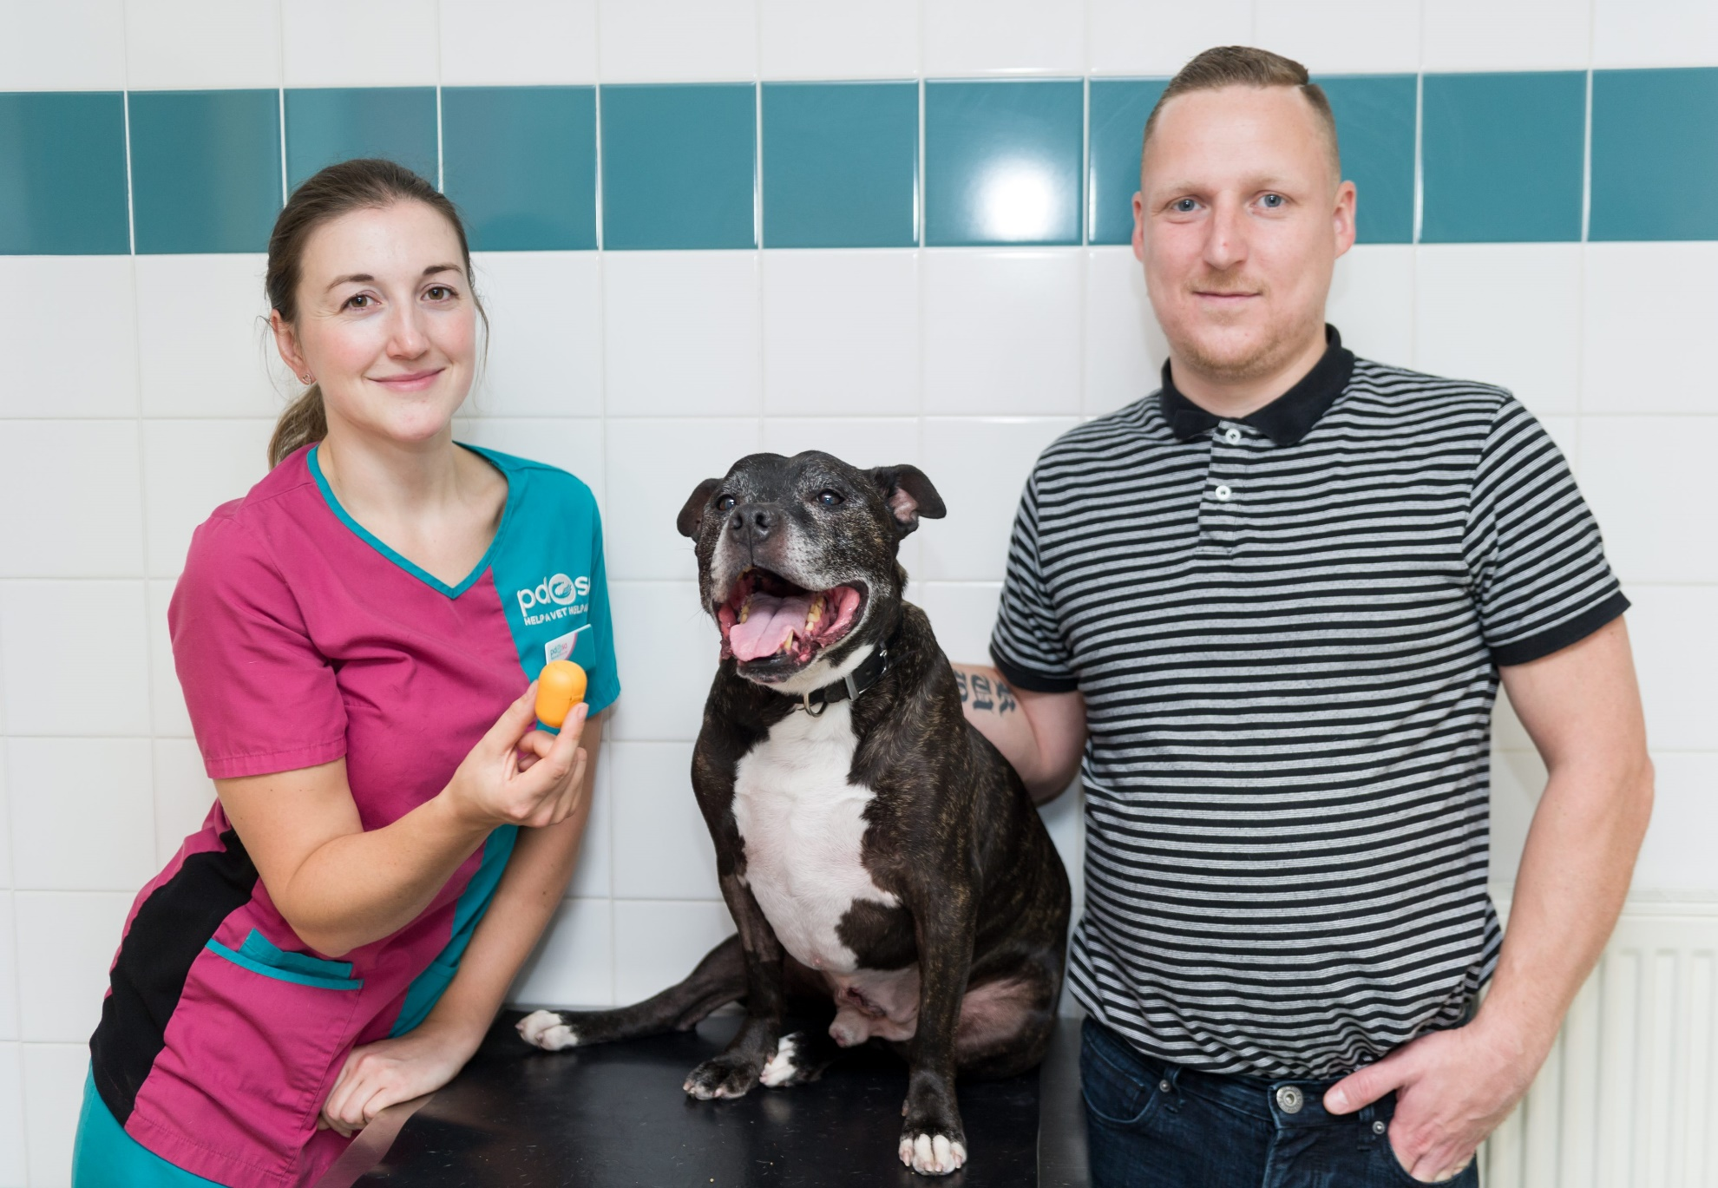
Saved thanks to PDSA
Notes:
Share:
Chase made a full recovery thanks to PDSA.

Slide 12
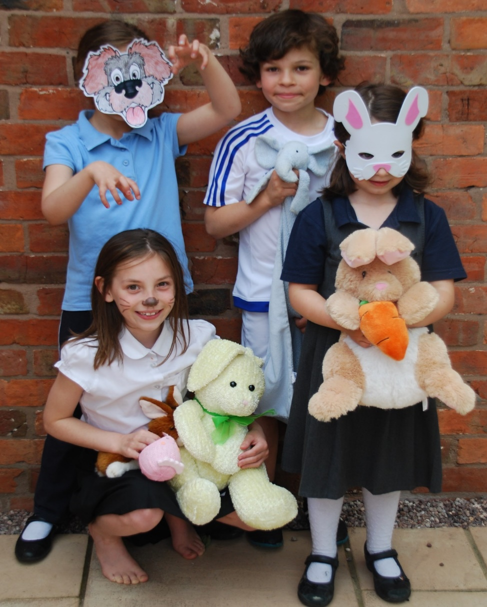
Want to help pets like Felix and Chase?
Hold your own
Pet Day
Fundraising slide – Pet day
Notes:
Share:
Explain that to celebrate PDSAs centenary in 2017, schools can hold their own Pet Day to raise money for sick and injured pets like Felix and Chase. Explain that schools can register to get their own Pet Day pack to help with their fundraising.
find out more at pdsa.org.uk/education-centre/pet-day

Slide 13




Thank you

