Slide 1
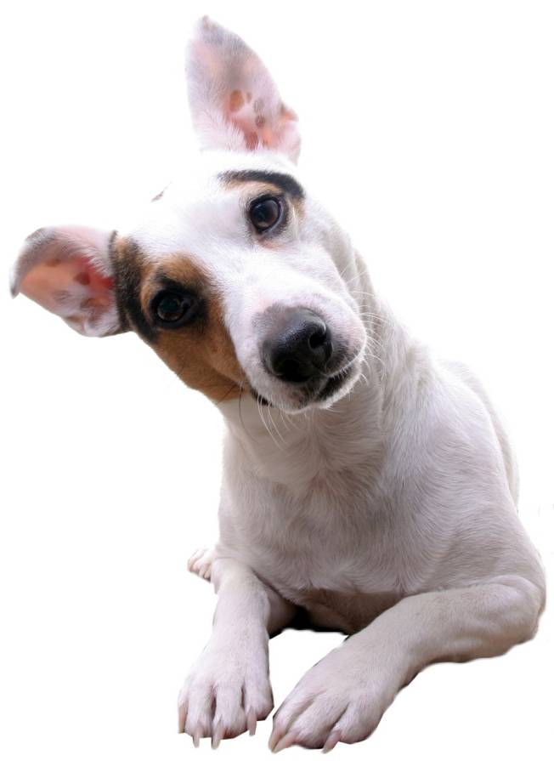
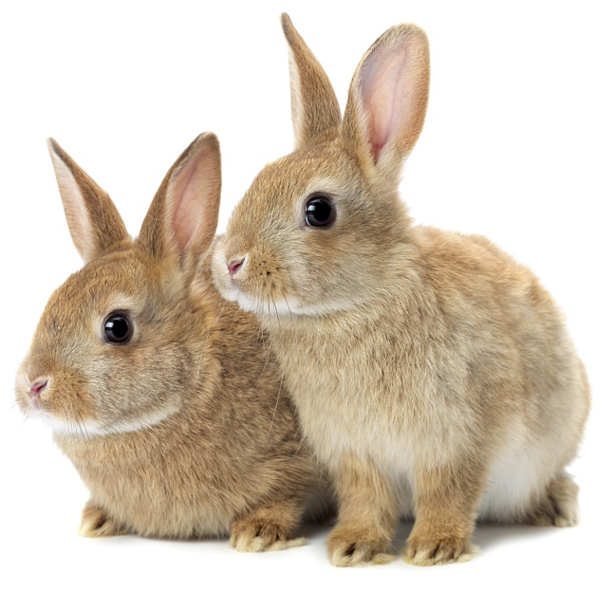
Notes:
Ask if children have heard of PDSA,.
Ask what is a vet and what do they do.

Slide 2
TV advert here
Notes:
Behind the scenes at the vets

Slide 3
Hi
I’m Super Vet!
Hi
I’m Pickles!
Hi
I’m Amber!
Hi
I’m Dodger!
Hi
I’m Sparky!
Meet the Pet Protectors Gang!
Notes:
Introduce the PP gang and ask the children to guess what the creatures are.
Sparky – Dog
Amber – Cat
Pickles – Rabbit
Dodger – Guinea Pig
SuperVet – Vet
Children could then pretend to be all those animals – making the noises they make and behaving like each animal.

Slide 4
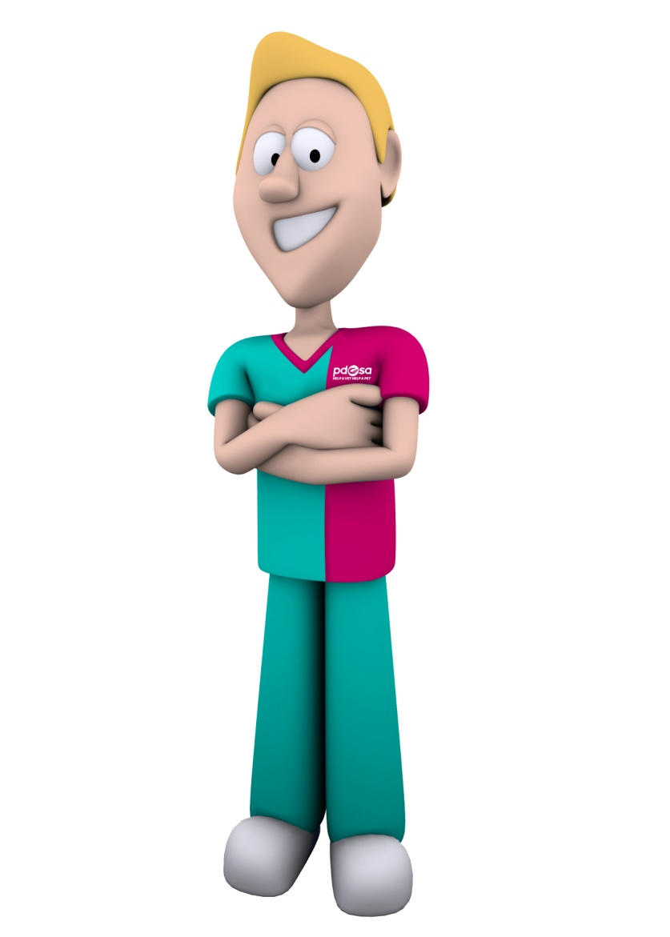
All pets need …
The right
HOME
To play & have fun
Good
HEALTH
Food and Water
FRIENDS
The five welfare needs
Notes:
Explain that pets are just like us and need a variety of things to keep them happy and healthy even though they are very different from us and from each other (different species)
For instance; you wouldn’t keep a dog in a rabbit hutch or a cat in a fish tank!
Environment – Pets need a clean, safe environment with enough space
Diet – Pets need the right kind of food in the right amount and 24 hour access to fresh clean water
Behaviour – Pets need to be able to express their normal behaviour; they need to exercise, to play and do specific things, depending on what species they are.
Health – Pets need to be kept in good health. This means taking them to the vet when they’re ill, but also making sure we keep them healthy.
Companionship – Pets need the company of people and sometimes other animals, depending on the species.
Responsibility: Ask children to tell you who is responsible for keeping pets happy and healthy. Stress to the children that if they have a pet, that it’s their responsibility to make sure that all these welfare needs are met. Tell them that people who don’t provide these needs are now breaking the law.

Slide 5
Sparky’s
Day
Out…
Notes:
As you go through the story, you may want the children to clap or do bunny ears etc, whenever they spot a welfare symbol or shout out the matching colour!

Slide 6
Once upon a time...
There was a dog called Sparky.
Notes:
Starts out like a typical fairytale...
Once upon a time there was a dog called Sparky...

Slide 7
Super Vet told Sparky he had fleas!
He was feeling very itchy, so he went to visit Super
Vet …
He gave Sparky some medicine to make them go away.
Notes:
About ‘HEALTH’
One day he woke up feeling very itchy, so he went to visit his friend Super Vet...
Super Vet checked Sparky’s ears, eyes, nose, teeth and fur (fun to point to the different areas/add your own).
After checking him over Super Vet told Sparky he had fleas!
It may be worth pausing after fleas for the possible ‘eewwww’
He gave Sparky some medicine to make them go away.

Slide 8
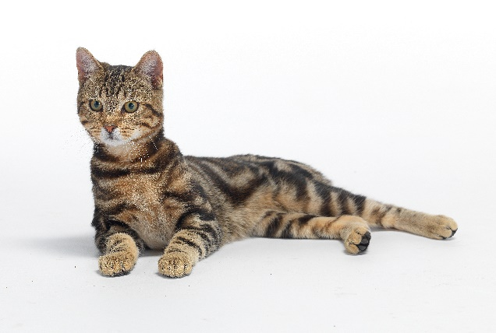
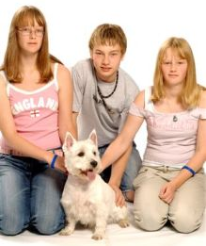
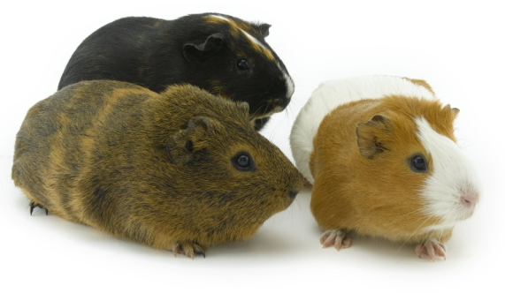
A very happy Sparky ran out the door to look for his friends.
That’s not my friend
They’re not friends either!
He
found..
My friends!
Notes:
About ‘FRIENDS’
A very happy Sparky ran out the door to look for his family.
He looked around and spied an angry cat, “that’s not my family” he thought,
Sparky looked around again and saw a family of guinea pigs “they’re not my family either”
So he turned right around and saw “My family” he barked and he bounded over to say hello.

Slide 9
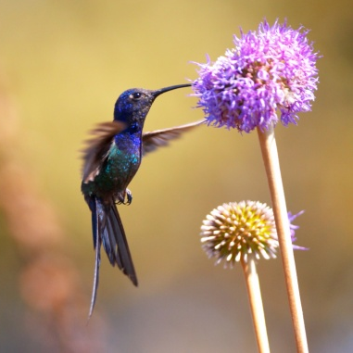
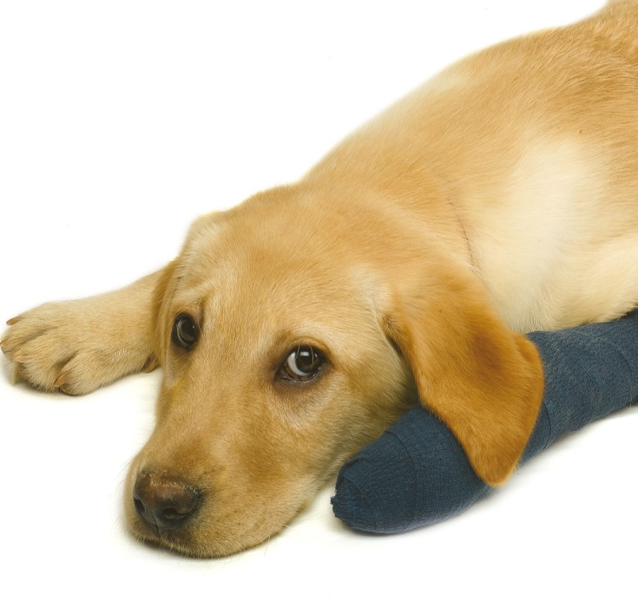
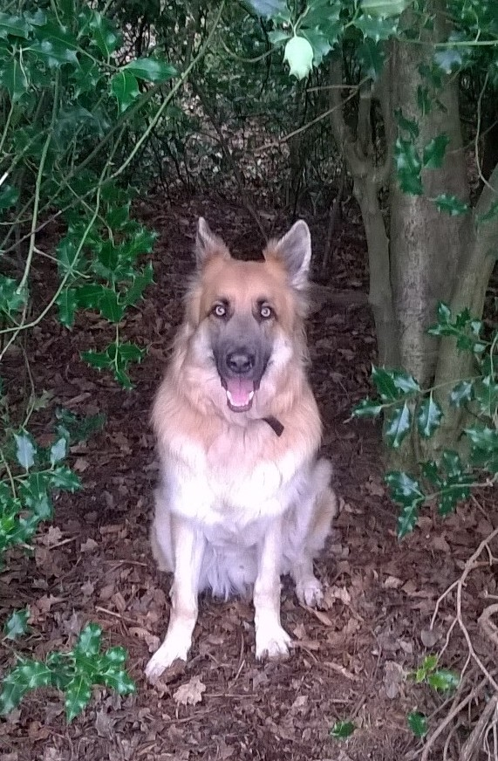
Dogs can’t fly!
That doesn’t look like much fun
Now that my family are here, what shall I do?
Yes PLEASE!
Notes:
About ‘BEHAVIOUR’
Now that I’ve found my family, what shall I do?
There were birds flying about outside and they looked they were having fun but “Dogs can’t fly” Sparky thought to himself.
Then he saw another dog that had to rest indoors as he’d been to the vet with a poorly leg. “That really doesn’t look any fun to me” Sparky thought.
Then he saw his doggy friend playing in the woods “Yes please” he said, I’d love to use my nose to follow all of those different smells.

Slide 10
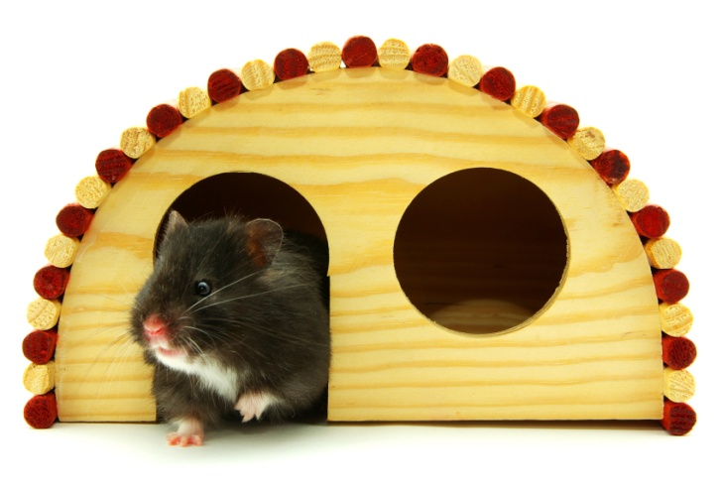
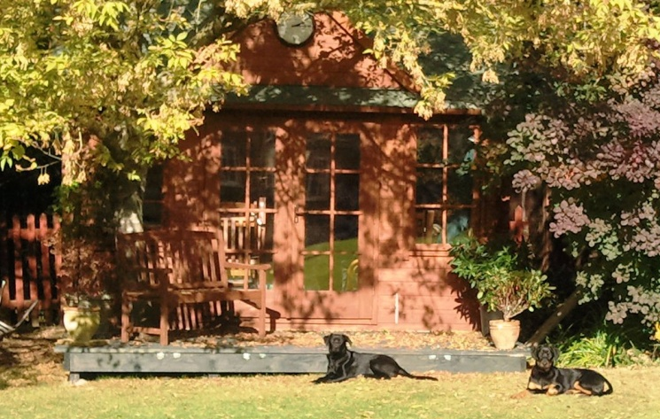
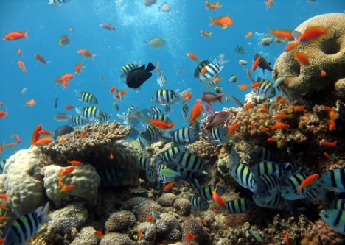
That’s too small. It’s for hamsters!
All that walking and playing has tired me out. I need a rest. Now where is my home?
Just right for me...
I can’t live there, that’s for fish!
Notes:
About “HOME”
After a while, all that walking and playing tired Sparky out and he needed a rest but he couldn’t stay in the park.
Where’s my home he wondered?
He quickly spotted a very nice house but shook his head sadly “That’s not my house, it’s too small. It’s for hamsters”
Then he saw another place where animals live but it was too wet “I can’t live there, it’s for fish!”
As he came round the corner he started wagging his tail, “That’s my house, it is just right for me”

Slide 11
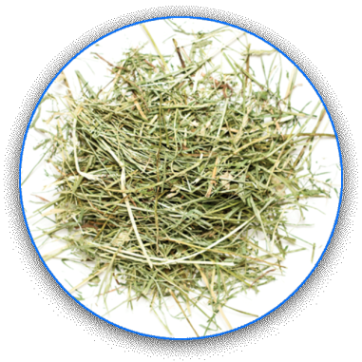
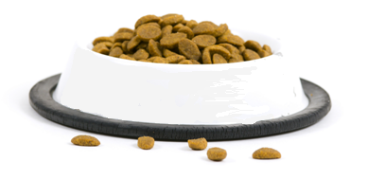
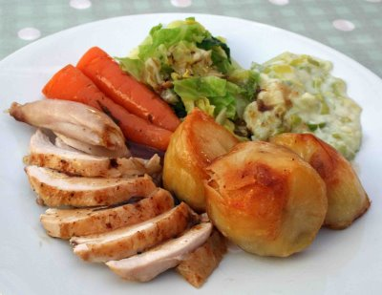
That’s rabbit food!!!
There were lots of lovely smells from the kitchen...
mmm...
Yummy!
After Sparky woke up from his sleep, he stretched and realised it was time for dinner...
That’s not my food. It’s for my owners!
Notes:
About “DIET”
After Sparky woke up from his sleep, his tummy starting rumbling and he realised it was time for dinner. He took a big sniff and followed his nose into the kitchen where lots of lovely smells were coming from.
The first food Sparky saw didn’t look very tasty “Blurgh, that’s rabbit food, I’m not eating that”
Then he saw some yummy looking food on the table “but that’s not my food, it’s for people, so it must be my owner’s dinner”.
Next , he saw something in the corner of the room, “mmm, mmm, mmm, there’s my yummy dinner”

Slide 12
With good food in his tummy and some cuddles from his owners, it was finally time for bed and lots of lovely dreams...
Good night Sparky
Notes:
What an exciting day Sparky has had! With good food in his tummy and some cuddles from his owner it was finally time for bed and lots of lovely dreams (speaking quieter at this point)
Goodnight Sparky (in a whisper)
Before goodnight Sparky you may want to see what Sparky is dreaming about and remind them of the names of the welfare needs.

Slide 13
The End

