Slide 1
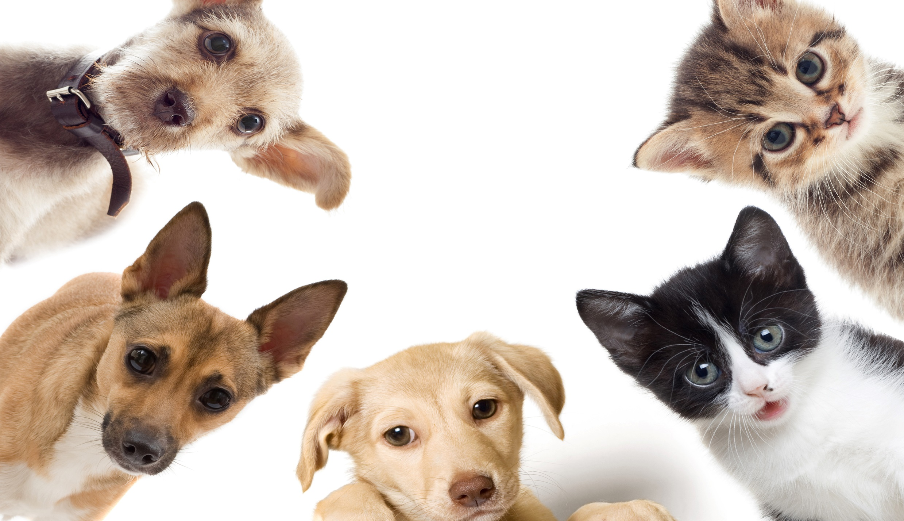
Pet Teams
Notes:
Share:
Introduce the session and PDSA.
Tell children that PDSA treat the sick and injured pets of people in need...
Explain that PDSA is a special kind of vets, because they’re a charity. Discuss what a charity is and explain that PDSA looks after pets when owners can’t afford vet treatment.
Ask:
If they think it’s important to help sick and injured animals to get better?
What would happen to all the sick and injured pets PDSA treat if they weren’t around?
Share:
Tell them that today, you’re all going to learn about what pets need to be healthy and happy and also about some of the pets that PDSA has helped in their Pet Hospitals.

Slide 2
Learning Objectives
I will learn about people who work in teams as part of their job.
I will learn why it is important to work as a team.
Learning Outcomes
P
I can justify why it’s important to work as a team.
I can describe how people work as a team at work.
I can work with my peers as a team to complete a challenge.

Slide 3
Why is it important to work as a team?
Notes:
Why is it important to work as a team?
Pupils work in groups to discuss the answer. They could do this by creating a spider diagram with 'teamwork' in the centre.

Slide 4
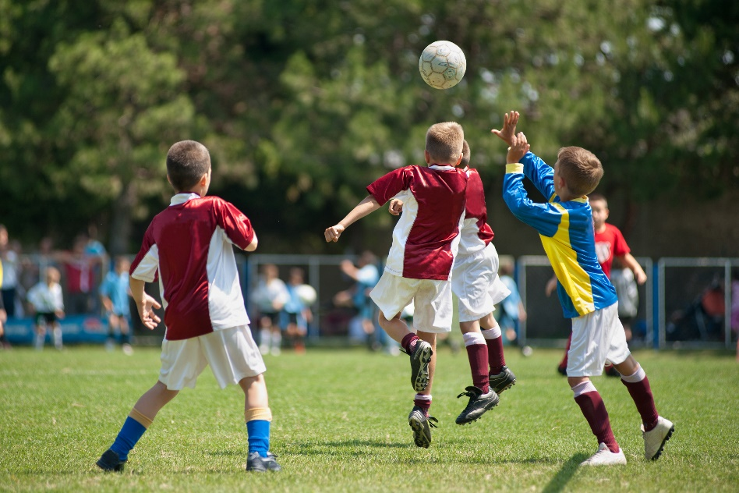
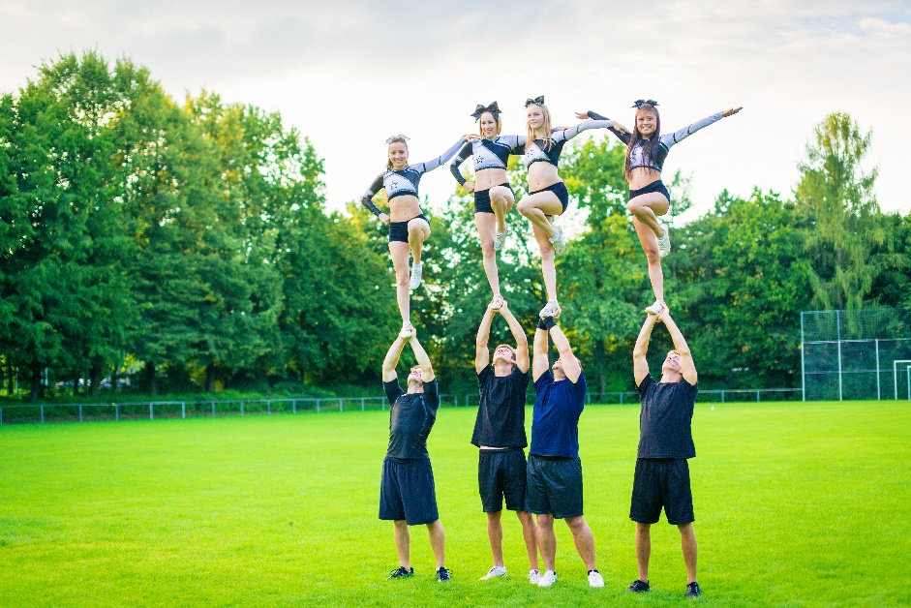
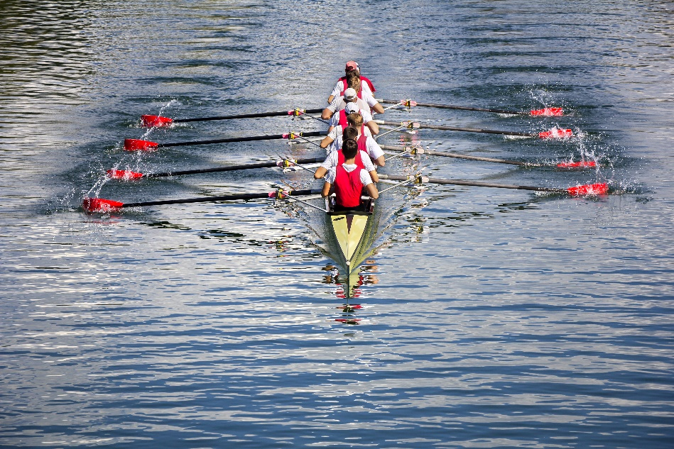
Notes:
Why do these sports people need to work as a team?
What would happen if they didn't work as a team?

Slide 5
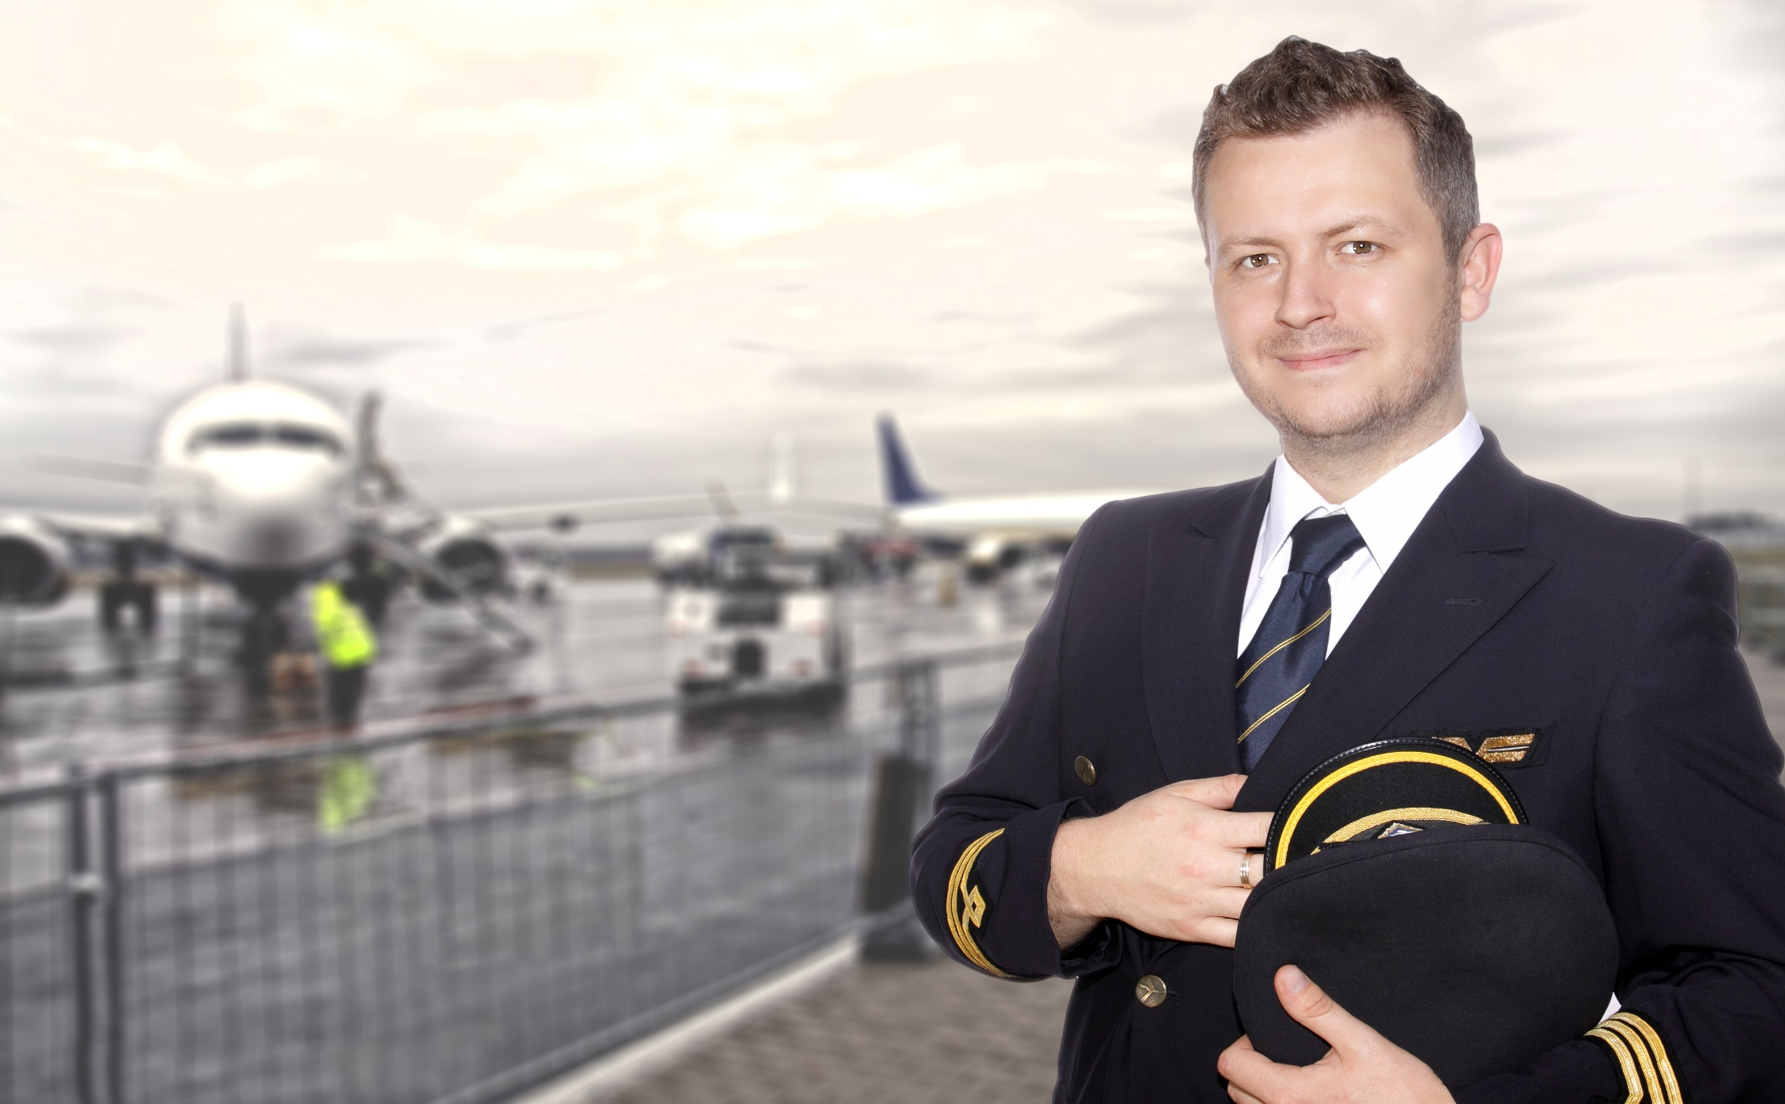
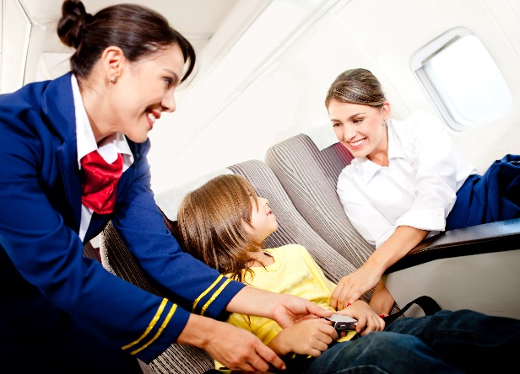
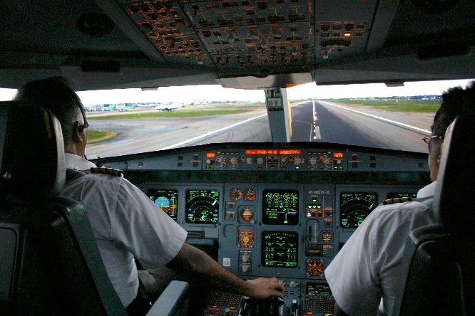
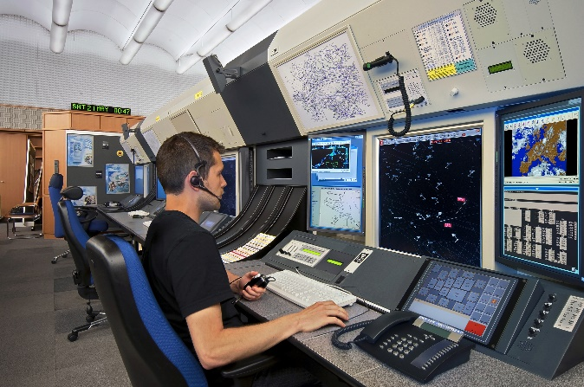
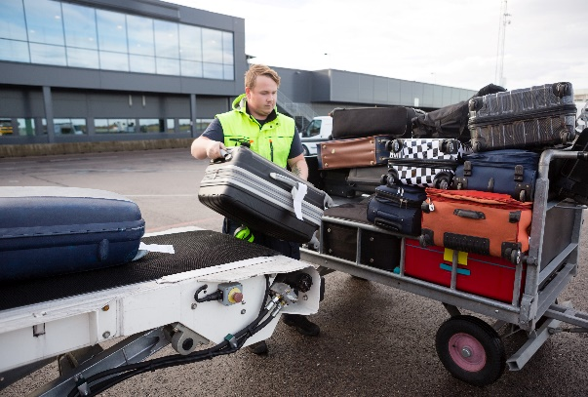
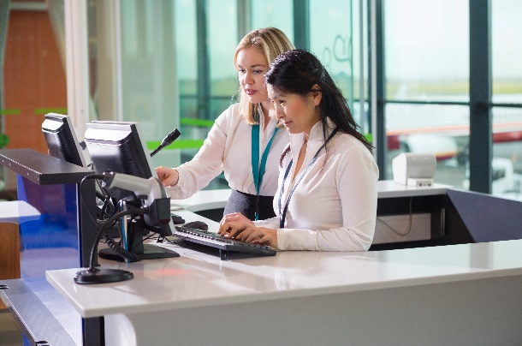
Notes:
Only show the first image when the pupils are listing team members and then run through each image after hearing some responses.
Pupils list everyone who works as a team with a pilot.

Slide 6
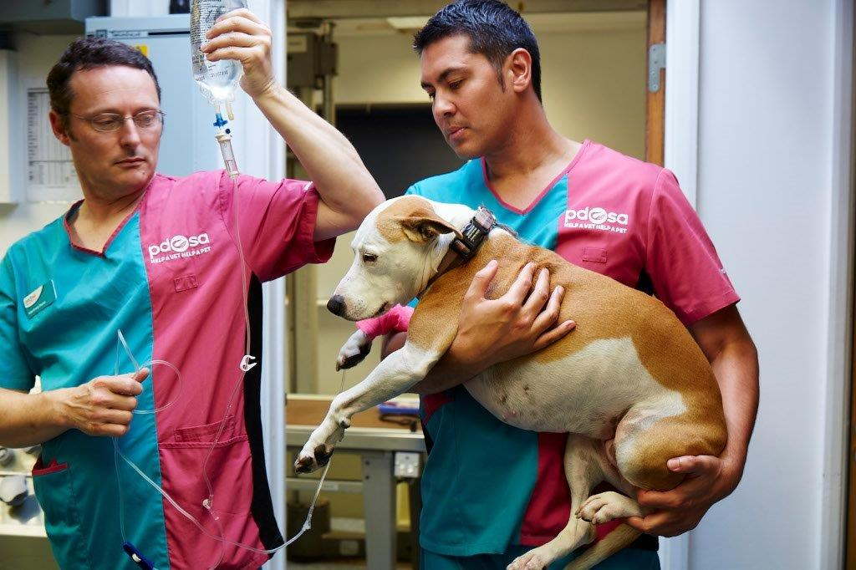
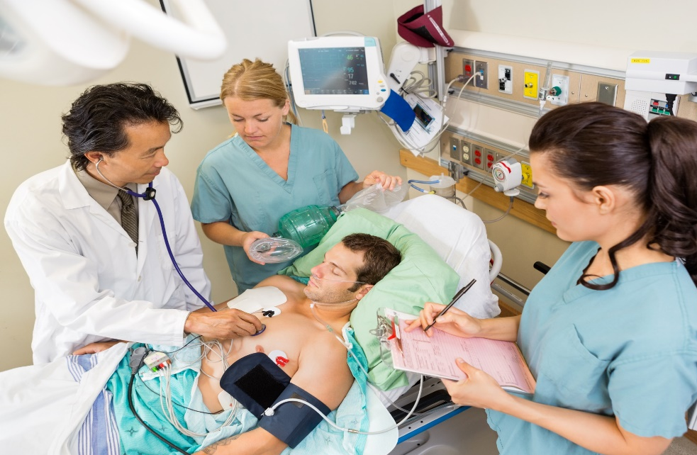
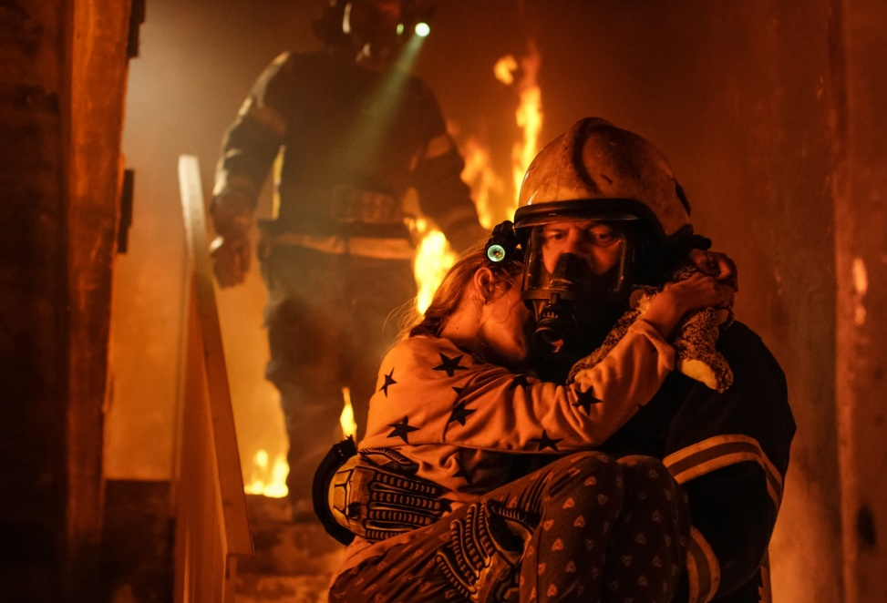
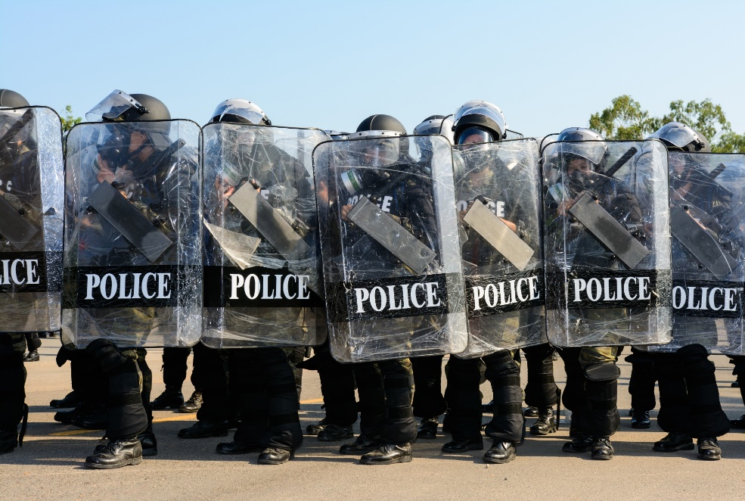
Notes:
Pupils pick a picture to discuss.

Slide 7
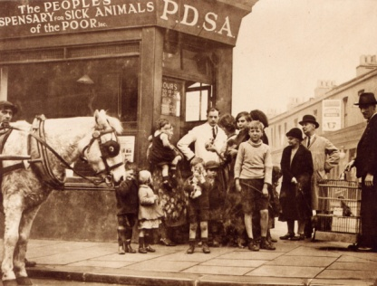
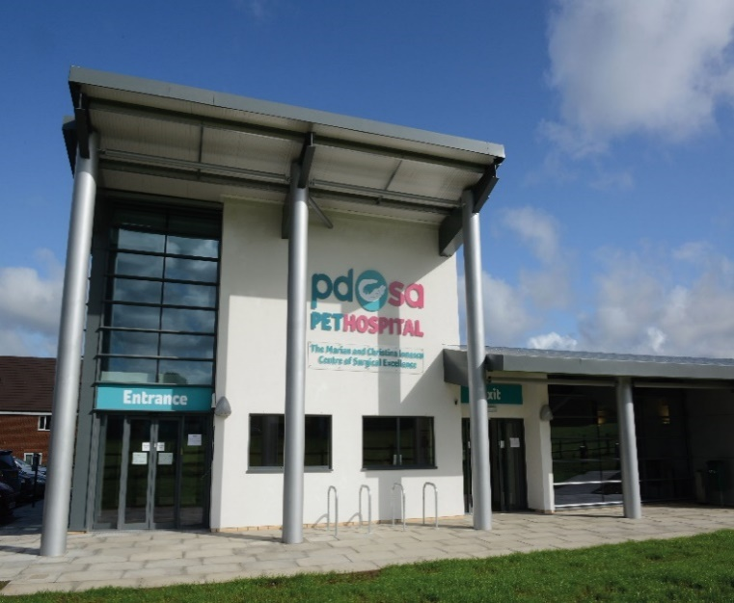
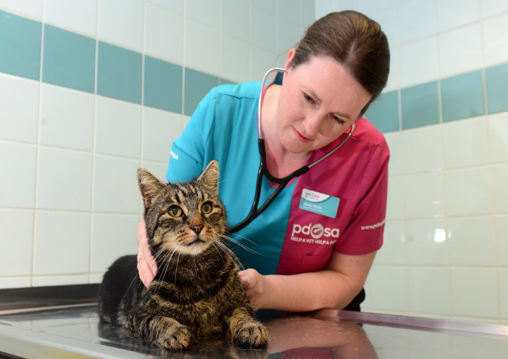
The UK’s leading vet charity …
PDSA is a 100 year old charity who have been treating sick and injured pets since 1917
They have Pet Hospitals all over the UK
They help one sick or injured pet every 5 seconds!
It costs the charity more than
£1 million every week to do their work
Notes:
Share the details on the slide and:
Tell children that PDSA treat the sick and injured pets of people in need..
Ask them if they think it’s important to help sick and injured animals to get better.
Explain that PDSA is a special kind of vets, because they’re a charity. Ask them what a charity does and explain that PDSA looks after pets when owners can’t afford vet treatment.
Ask them what would happen to all the sick and injured pets PDSA treat if they weren’t around.

Slide 8
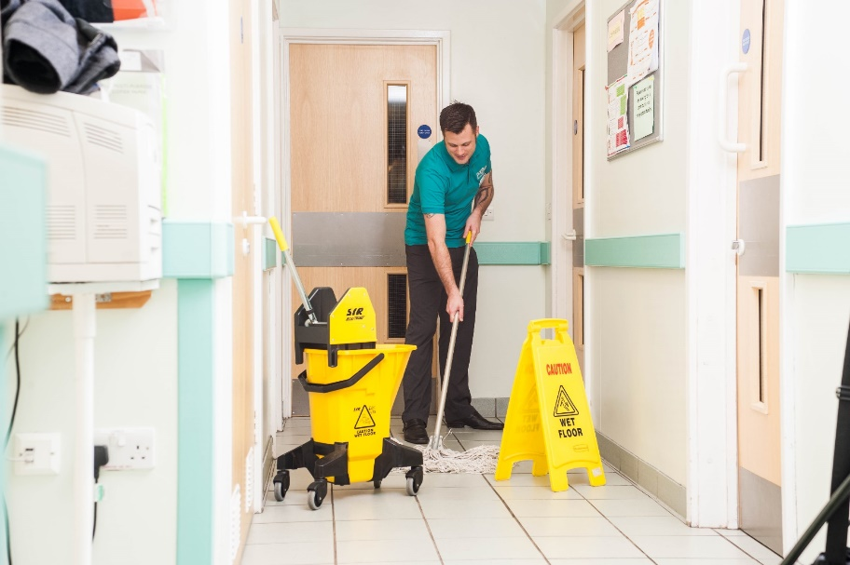
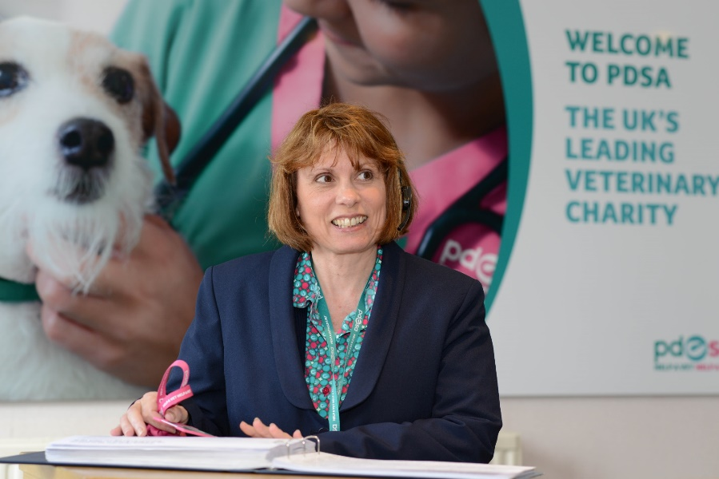
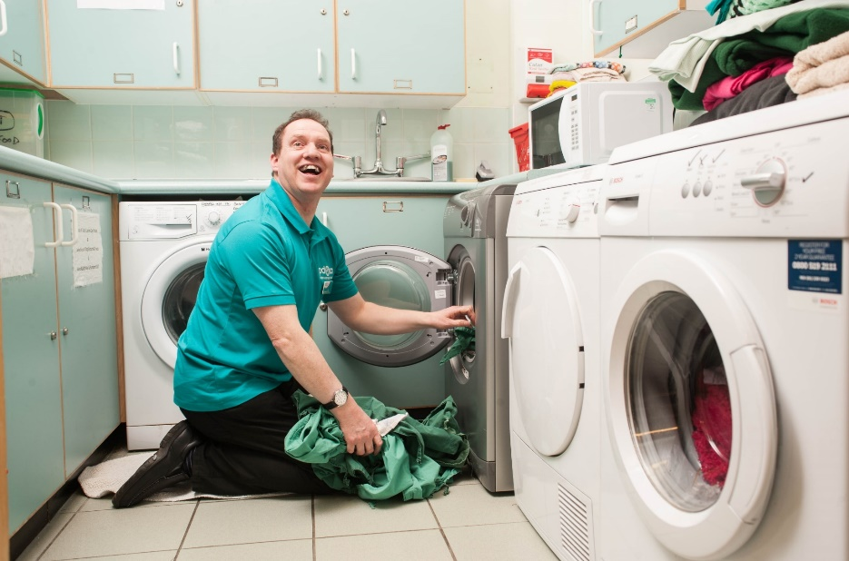
Notes:
Explain that PDSA couldn't carry out it's work without the help of volunteers. They’re just as important as the paid staff.
Volunteering can be very rewarding and can help you get your dream job in the future.

Slide 9
Your Team Challenge
In teams, make a vehicle that can transport a pet patient to the PDSA Pet Hospital.
You can only use the recycled materials provided.
It doesn’t matter if your vehicle drives or flies – as long as your patient arrives quickly and safely!
Activity
Notes:
Children will need to be supplied with a range of materials such as:
Bottles
Plastic/paper cups or plates
Straws
Elastic bands
Paper
String
Cotton reels
Sticky tape
Glue
Pens

Slide 10
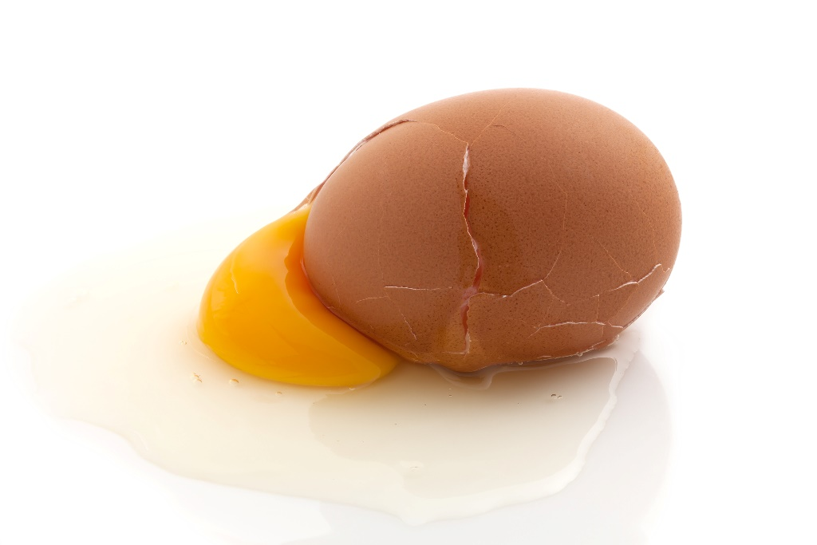
Your patient is an egg.
You can decorate your egg however you want.
The team who gets their patient to the finish line in the fastest time (and still in one piece) wins.

Slide 11
Feedback
Did you work well as a team?
Did your egg break?
What went well?
What didn’t go well?
If you could repeat the task, what would you do differently?

Slide 12
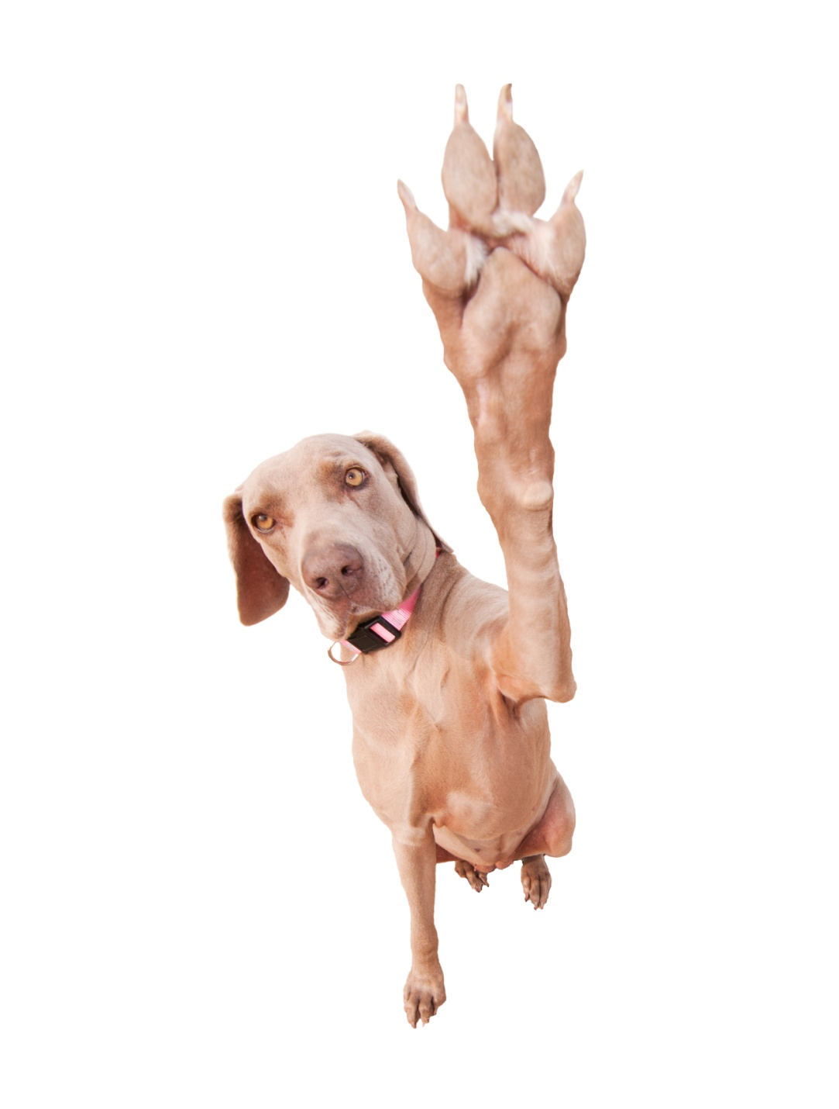
Thanks!

