Slide 1
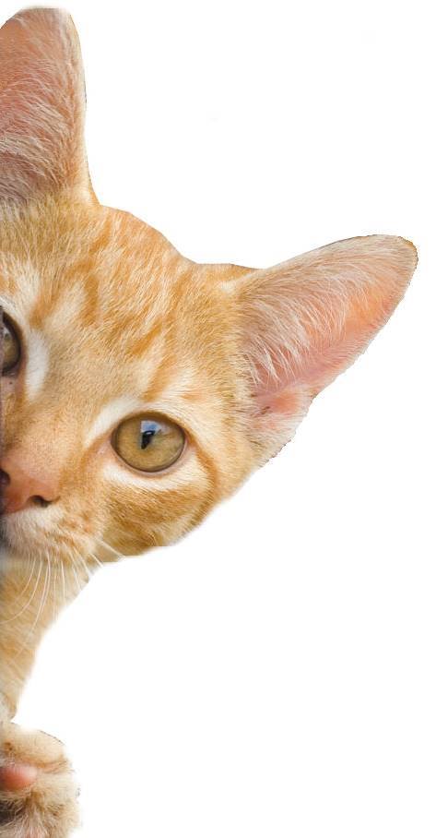
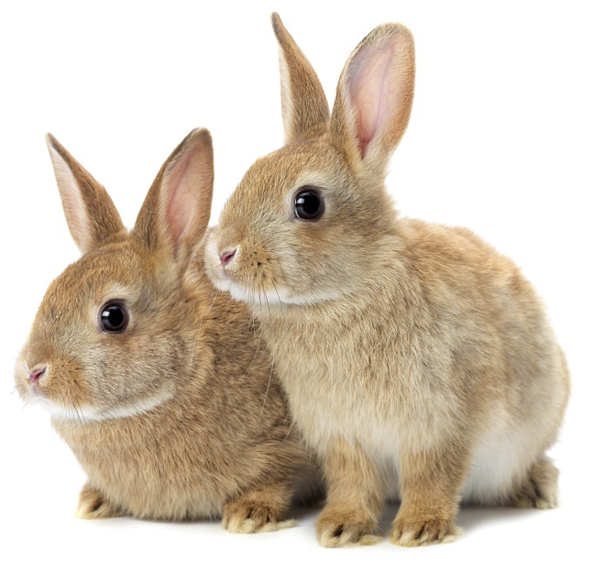
Body Parts
Notes:
Share:
Introduce the session and PDSA.
Tell children that PDSA treat the sick and injured pets of people in need...
Explain that PDSA is a special kind of vets, because they’re a charity. Discuss what a charity is and explain that PDSA looks after pets when owners can’t afford vet treatment.
Ask:
If they think it’s important to help sick and injured animals to get better?
What would happen to all the sick and injured pets PDSA treat if they weren’t around?
Share:
.
Tell them that today, you’re all going to learn about what pets need to be healthy and happy and also about some of the pets that PDSA has helped in their Pet Hospitals.

Slide 2
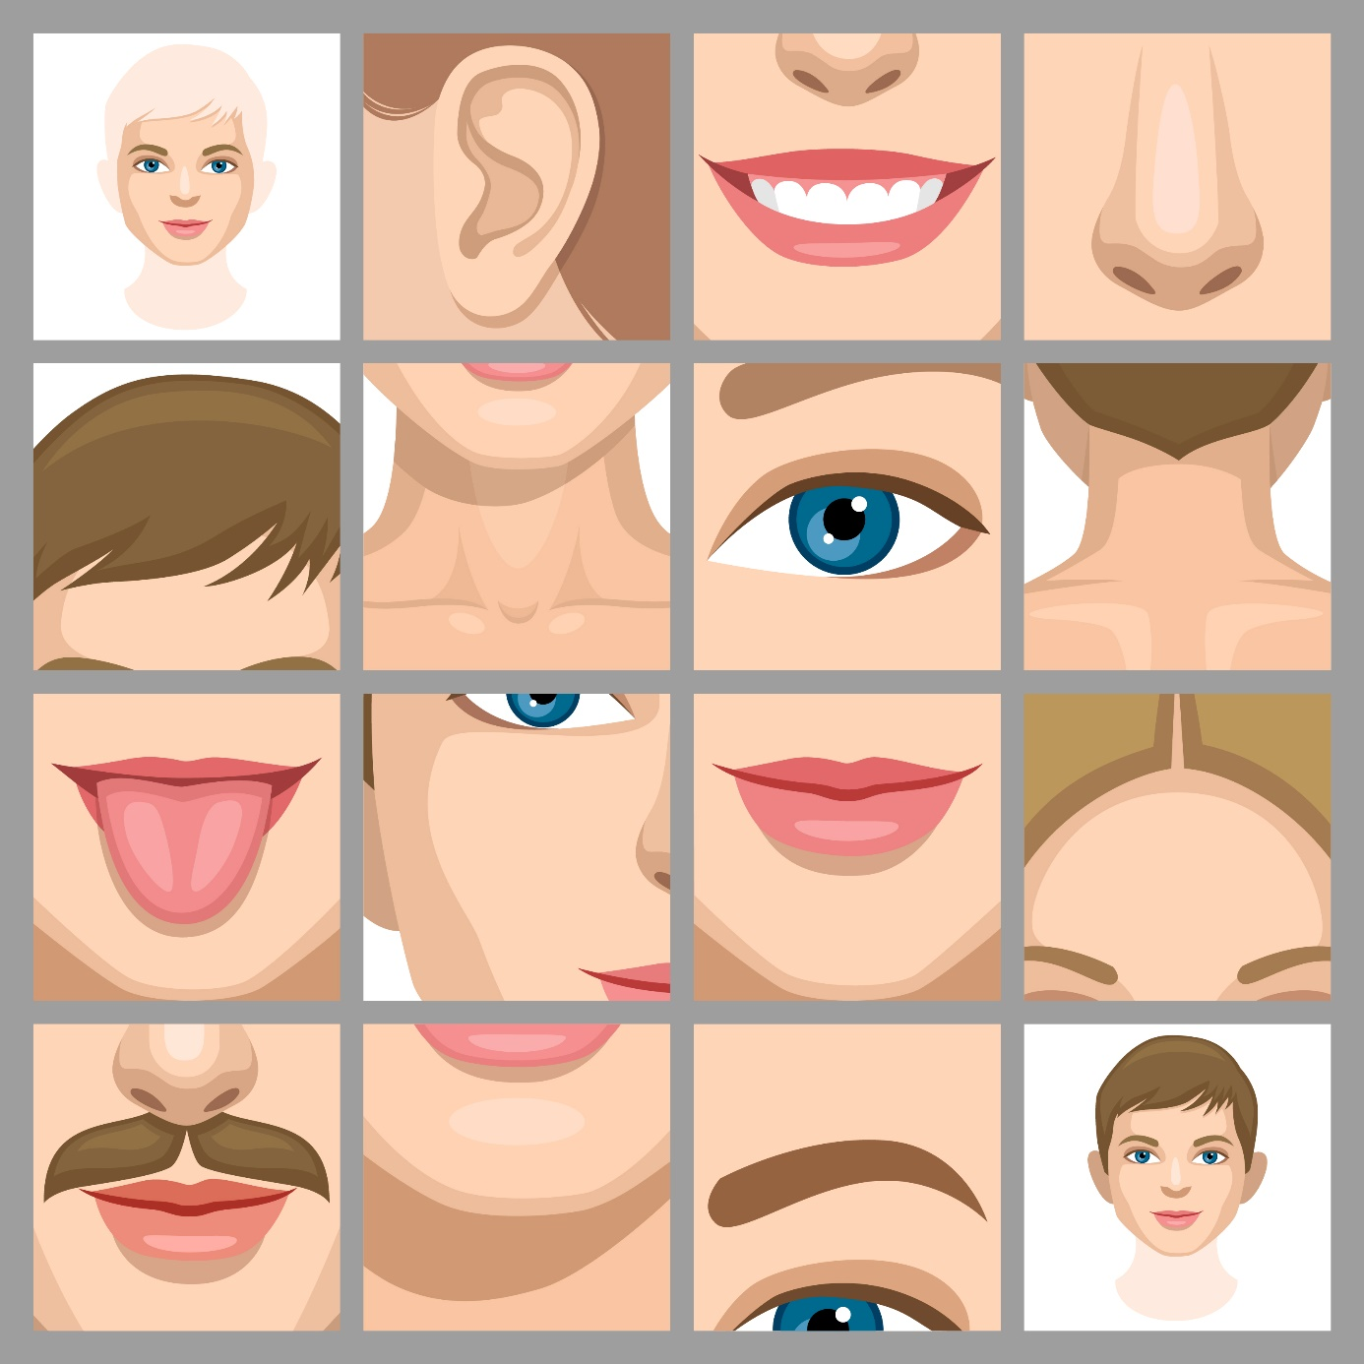
Choose one of the images shown on the left.
Ask your partner to guess which image you’ve picked. They can ask you questions but you can only answer yes or no.
What am I?

Slide 3
Learning Objectives
I will learn about different organs in the body and what their functions are.
I will learn about the digestive and circulatory systems.
Learning Outcomes
P
I can label the main organs in the body.
I can describe what certain organs do in the body.
I can describe the digestive and circulatory systems.

Slide 4
Organs
Notes:
Vital organs and their functions
The brain is the body's control centre, receiving and sending signals to other organs through the nervous system and through secreted hormones. It is responsible for thoughts, feelings, memory storage and general perception of the world.
The heart is a responsible for pumping blood throughout the body to get oxygen to the cells.
The job of the two kidneys, is to remove waste and extra fluid from the blood. The kidneys take urea out of the blood and combine it with water and other substances to make urine.
The liver has many functions, including detoxifying of harmful chemicals, breakdown of drugs, filtering of blood, bile secretion and production of blood-clotting proteins.
The lungs are responsible for removing oxygen from the air we breathe and transferring it to our blood where it can be sent to our cells. The lungs also remove carbon dioxide, which we exhale.
The windpipe, responsible for moving air from the mouth and nose to the lungs to support breathing. It has rings of cartilage all the way down, so it can’t collapse and prevent air getting to the lungs.
The oesophagus is the food pipe, which carries food and water from the mouth to the stomach, so it can be digested.
The stomach is a muscular organ. As food reaches the end of the oesophagus, it enters the stomach, which secretes acid and enzymes that digest food.
The bladder stores urine, which allows urination (weeing) to be under voluntary control
The intestine’s job is to absorb most of the nutrients from food and water, so the energy goes into the bloodstream, where it can be carried to the cells of the body
The spleen plays multiple supporting roles in the body. It acts as a filter for blood as part of the immune system. Old red blood cells are recycled there and white blood cells are stored there. It also helps to fight certain kinds of bacteria
The colon is part of the large intestine, the final part of the digestive system. Its function is to reabsorb fluids and process waste products from the body and prepare for it to be eliminated from the body in the form of faeces (poo)
The spinal column’s major function is the protection of the spinal cord; it also provides stiffening for the body and supports movement.
The rectum is the last stop before waste is eliminated from the body in the form of faeces (poo)

Slide 5
Body Systems
Notes:
Explain that the human body is made up of different systems and that every one of them has a different function.
This slide shows just a few of these and we will go into two of these in more detail.
The nervous system is the body’s main control system. It consists of the brain, the spinal cord, and a network of nerves that extend out to the rest of the body.
This circulatory system consists of the heart and a network of vessels that carry blood. It supplies oxygen and nutrients to the body’s cells and removes waste products.
The respiratory system is centred on the lungs, which work to get life-giving oxygen into the blood. They also rid the body of a waste product, carbon dioxide.
The digestive system takes in the food the body needs to fuel its activities. It breaks the food down into units called nutrients and absorbs the nutrients into the blood.
The muscular system consists of layers of muscles that cover the bones of the skeleton, extend across joints, and can contract and relax to produce movement.
The skeleton is a strong yet flexible framework of bones and connective tissue. It provides support for the body and protection for many of its internal parts.

Slide 6
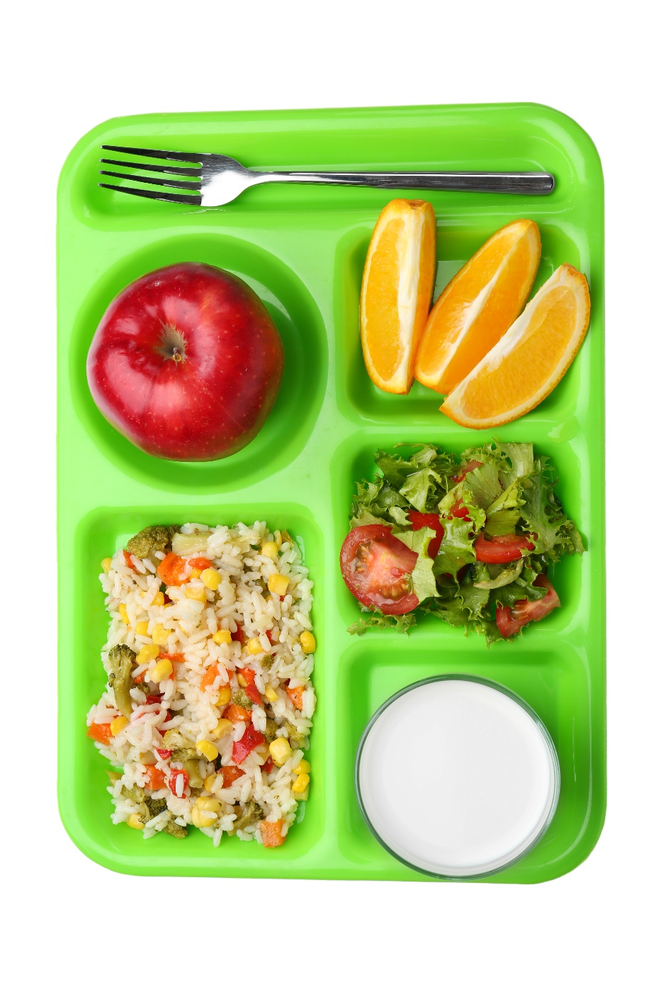
So you’ve just eaten your school dinner but do you know what happens next?
An empty stomach makes you feel hungry – you might even hear your tummy rumble in silent reading. This reminds you that you’re feeling hungry.
When you bite, chew and swallow your food have you noticed it’s soft and gooey? Well that’s because of your saliva (spit).
The Digestive System

Slide 7
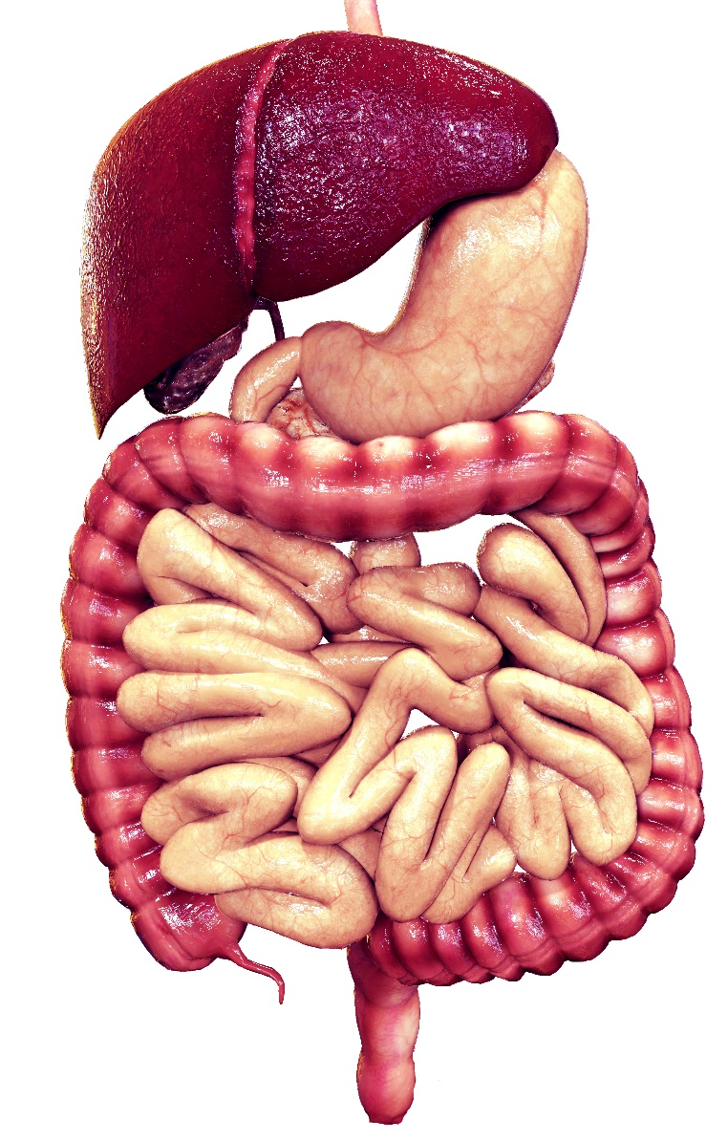
Digestion starts when you swallow your food. That yummy sandwich travels a whole 30ft through your body.
The journey starts with the oesophagus, a tube that pushes food down to your stomach.
Your liver collects nutrients from food that help your body and the gall bladder and pancreas send juices to the intestines to help the digestion process.
In the stomach, the food mixes with juices called acids. Theses acids help break down the food.
The journey continues through the small and large intestines.
It takes around a day for what’s left to come out as poo and pee.
The Digestive System

Slide 8
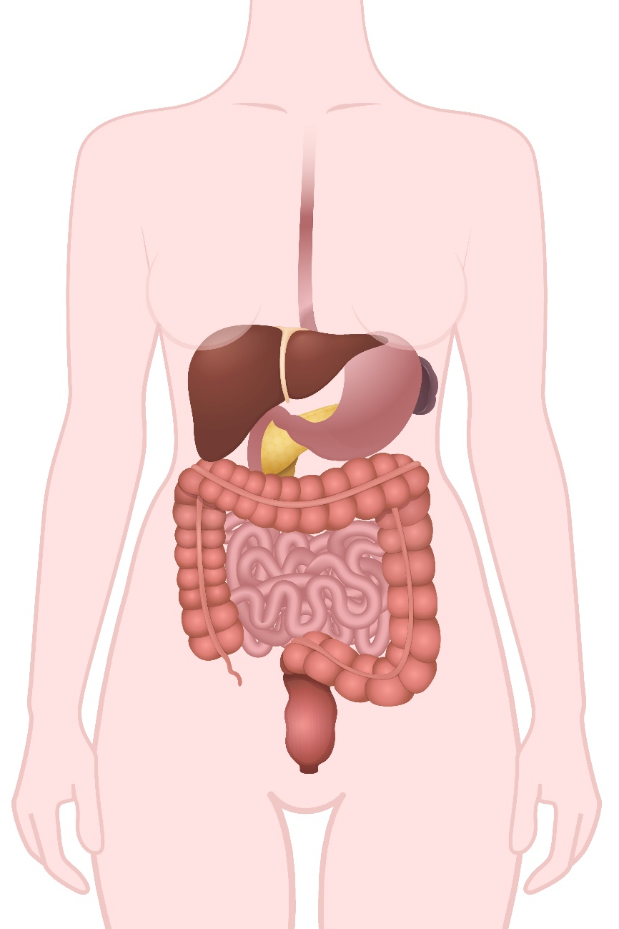
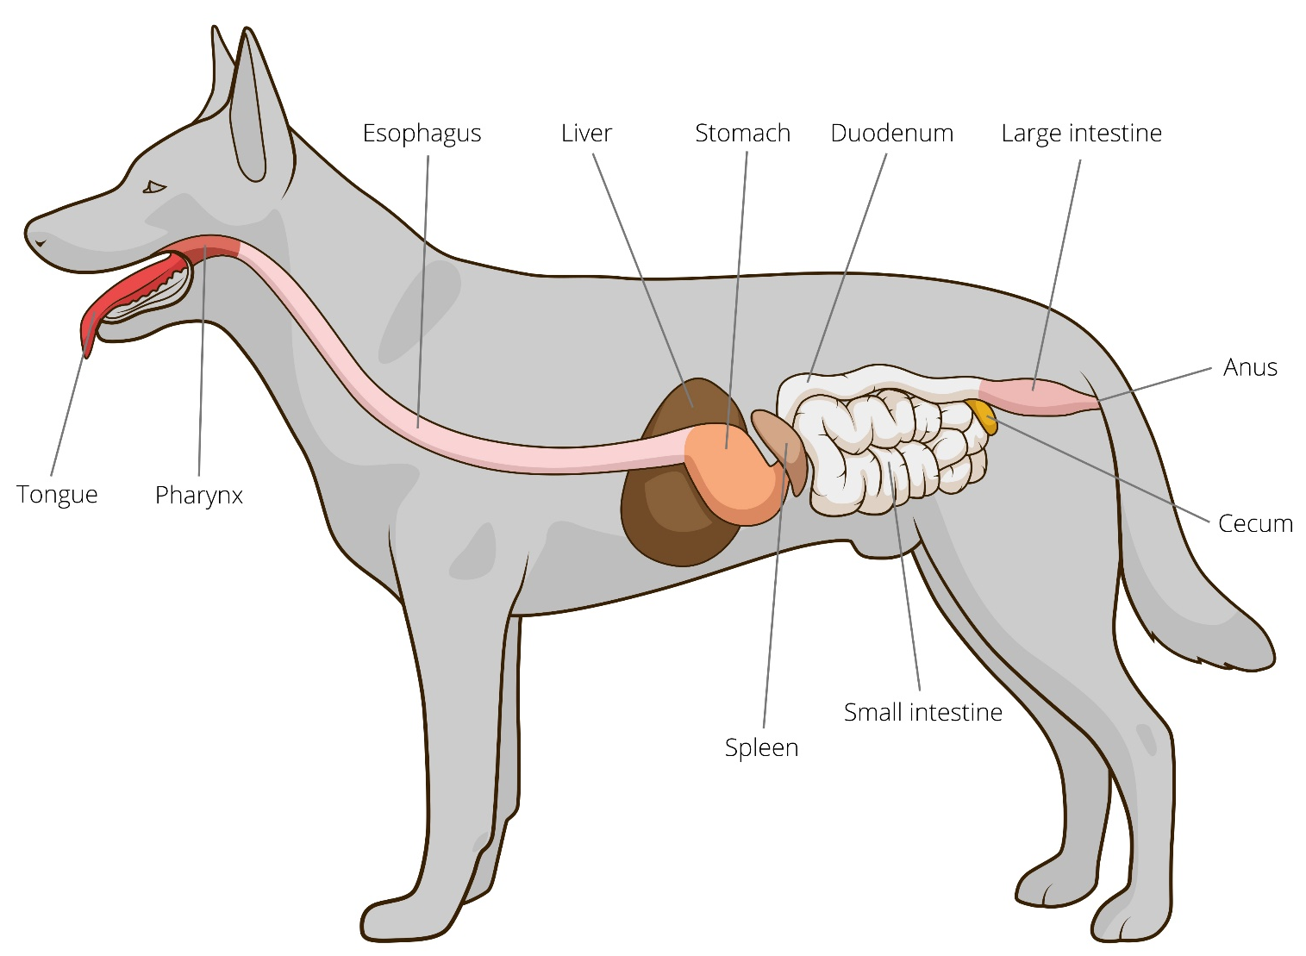
The Digestive System
Notes:
Ask the pupils if they notice any similarities between the human digestive system and the canine digestive system.
Explain that they’re very similar, however there are a few differences:
Dogs have saliva but it lack the enzymes that break down food. Instead their saliva kills off bacteria so they don’t get sick when eating something gross.
Dogs don’t chew their food so if it doesn’t fit down the oesophagus they vomit.
Their stomach contains a lot more acid than ours and holds on to the food longer to make sure it is broken down.
Their intestines are much smaller than ours.

Slide 9
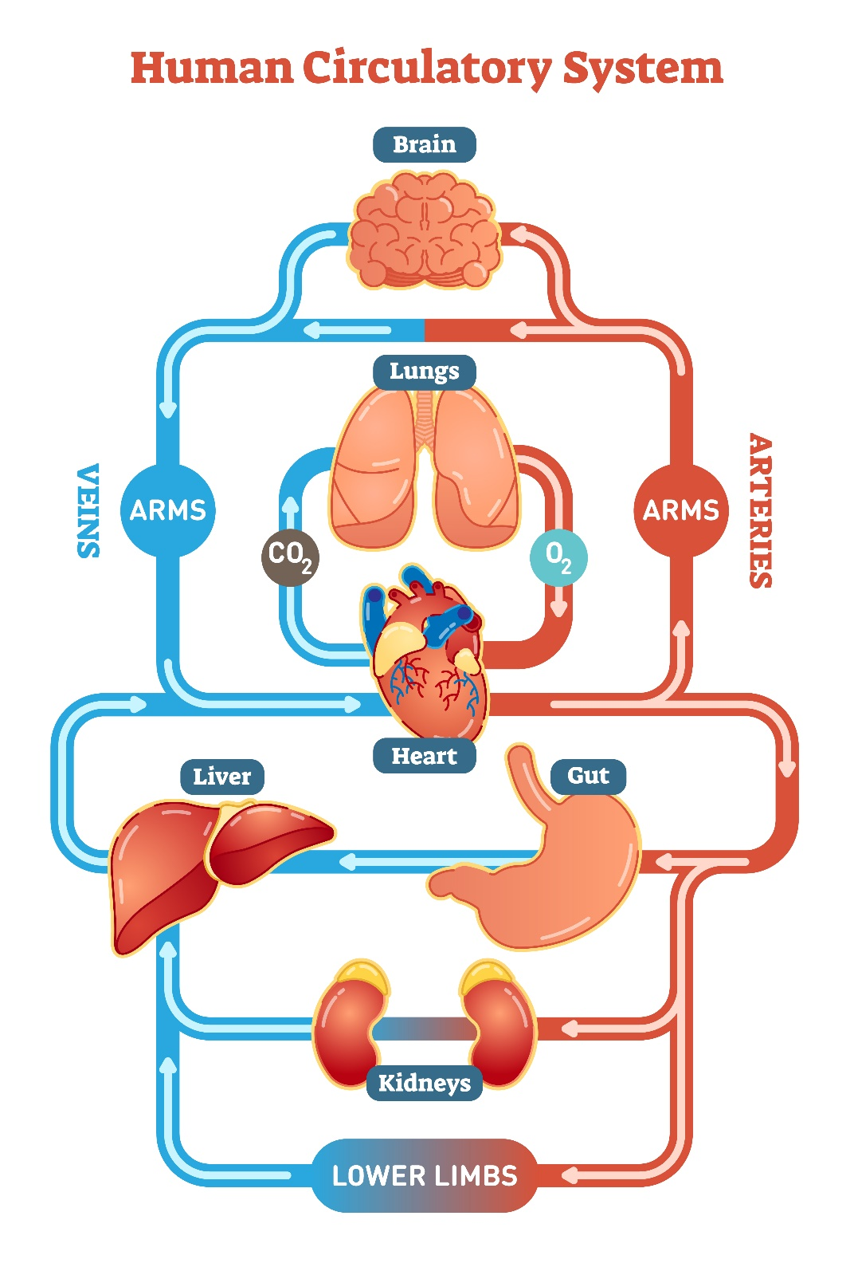
This is perhaps the most important system as it transports blood and important nutrients around the body.
This system involves the heart, blood and blood vessels.
The heart is a muscle that pumps blood around the body. Blood only takes around 20 seconds to travel around your entire body and 60 seconds to reach every cell.
Blood carries oxygen and nutrients so your cells can survive, as well as removing waste.
Blood vessels that take blood away from the heart are called arteries and the ones that carry blood to the heart are called veins.
The Circulatory System
Notes:
Even though your heart is inside your body, you can still tell it’s working on the outside by feeling your pulse. You can find your pulse by pressing on your skin wherever there is a large vein below the surface. Two good places to find it are on the side of your neck and the inside of your wrist.
Ask the pupils to fee their pulse.
Address that is important to keep your heart healthy by eating healthy food and exercising – and that this is the same for pets.

Slide 10
A HOME
FRIENDS
HEALTH
FOOD & WATER
EXERCISE & FUN
What do pets need?…
Notes:
All pets, whether they’re large or small, need the same five things to keep them healthy and happy:
The right kind of safe, warm home with lots of space
The right kind of food and 24 hour access to fresh water
Exercise and fun (the chance to show normal behaviour)
Friends (This can be other animals, people, or both)
Health ( We all need to make sure our pets are kept healthy and take them to the vet when they’re not well)
Ask whose responsibility it is to keep pets healthy and happy and confirm that owners are responsible for looking after their pet properly.

Slide 11
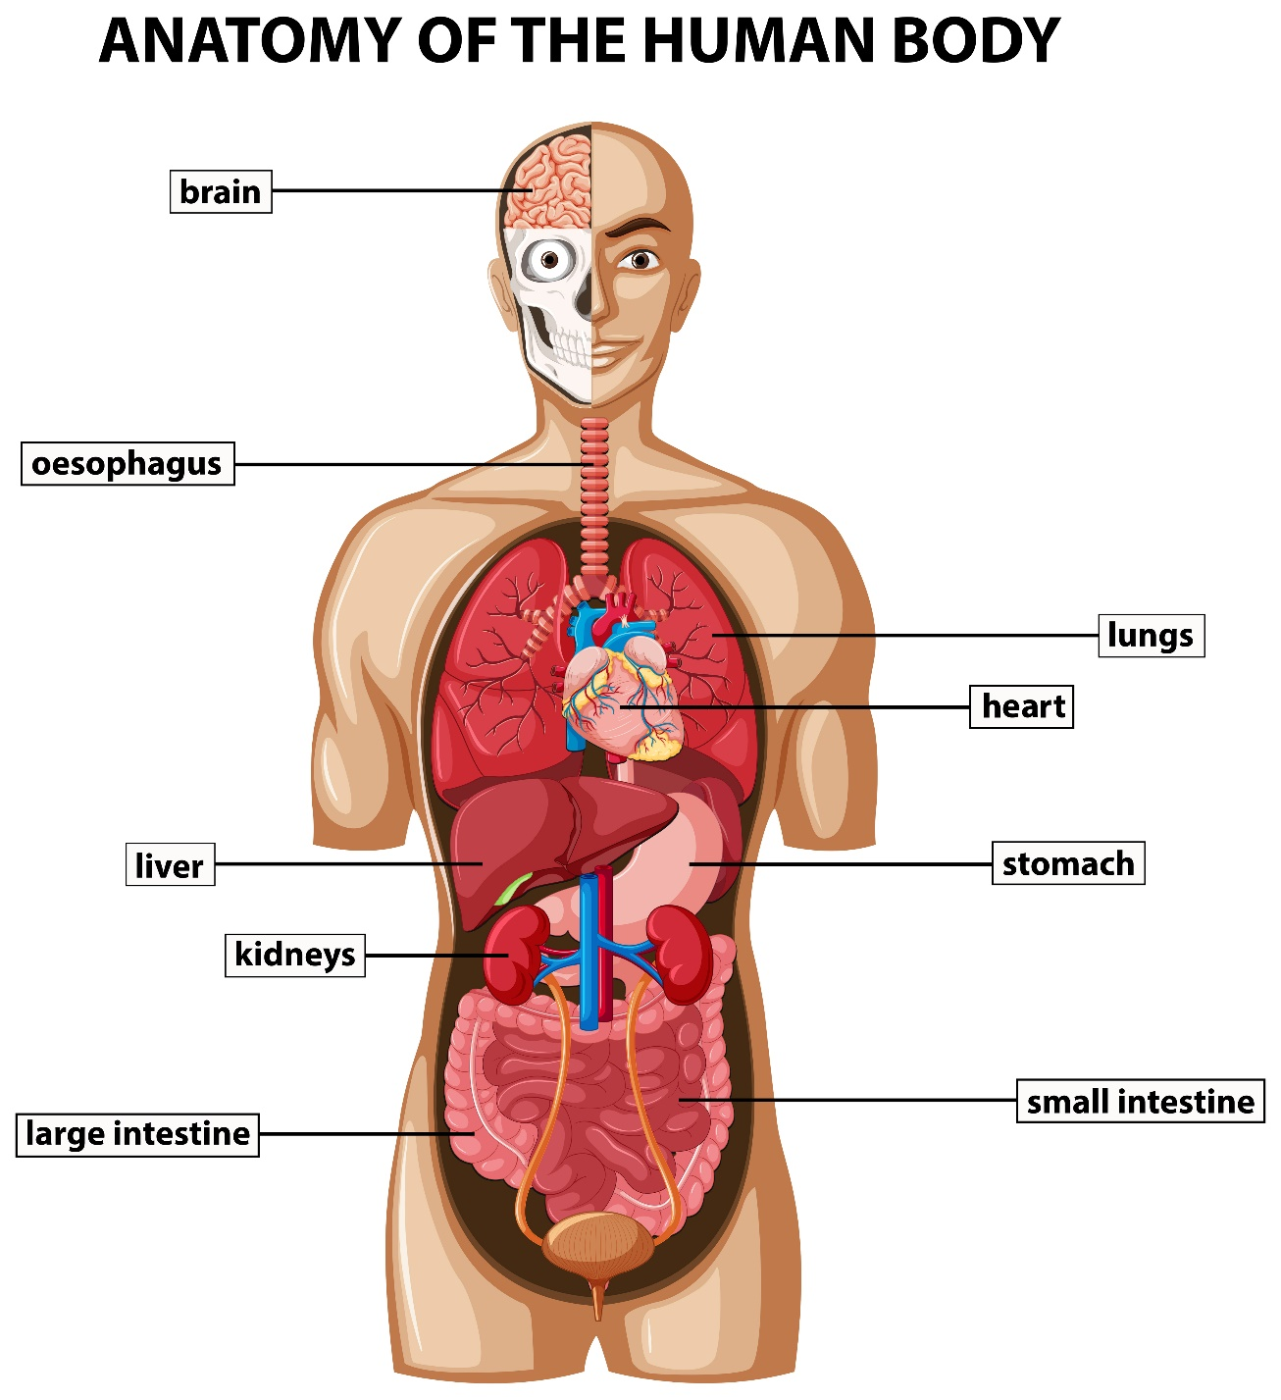
Human Anatomy
Notes:
Either print and allow pupils to fill in the gaps or do as a class.

Slide 12
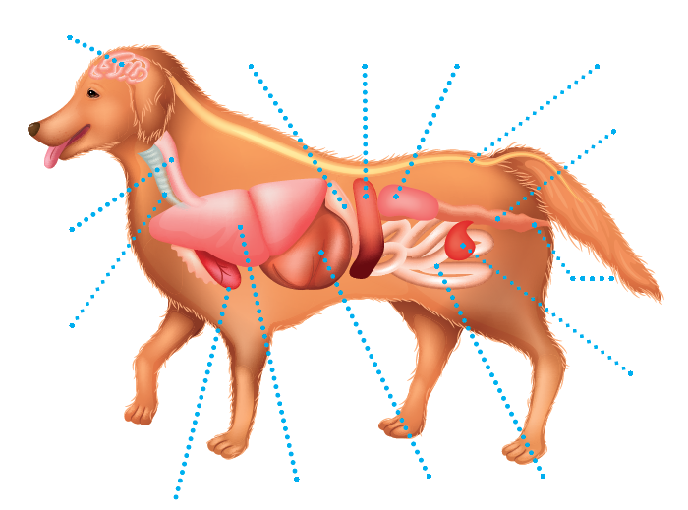
spleen
brain
stomach
kidneys
spine
colon
oesophagus
anus
windpipe
bladder
lungs
intestine
heart
liver
Canine Anatomy
Notes:
Either print and allow pupils to fill in the gaps or do as a class.
Low ability children will need the words as a list.
High ability children could write down the function of each organ as an extension task.

Slide 13
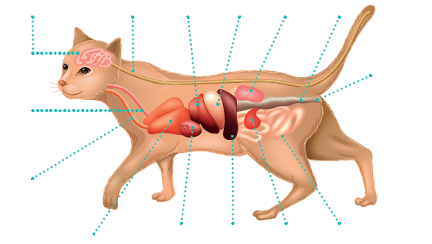
spine
stomach
colon
brain
kidneys
liver
anus
oesophagus
windpipe
heart
intestine
lungs
spleen
bladder
Feline Anatomy
Notes:
Either print and allow pupils to fill in the gaps or do as a class.
Low ability children will need the words as a list.
High ability children could write down the function of each organ as an extension task.

Slide 14
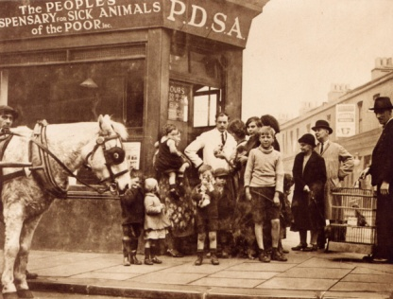
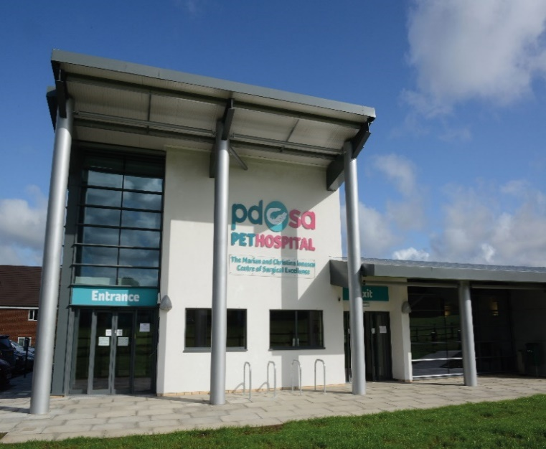
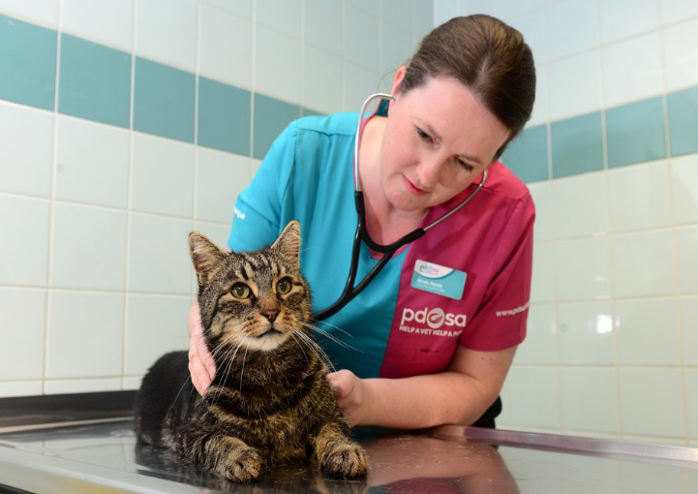
The UK’s leading vet charity …
PDSA is a 100 year old charity who have been treating sick and injured pets since 1917
They have Pet Hospitals all over the UK
They help one sick or injured pet every 5 seconds!
It costs the charity more than
£1 million every week to do their work
Notes:
Share the details on the slide and:
Tell children that PDSA treat the sick and injured pets of people in need..
Ask them if they think it’s important to help sick and injured animals to get better.
Explain that PDSA is a special kind of vets, because they’re a charity. Ask them what a charity does and explain that PDSA looks after pets when owners can’t afford vet treatment.
Ask them what would happen to all the sick and injured pets PDSA treat if they weren’t around.

Slide 15
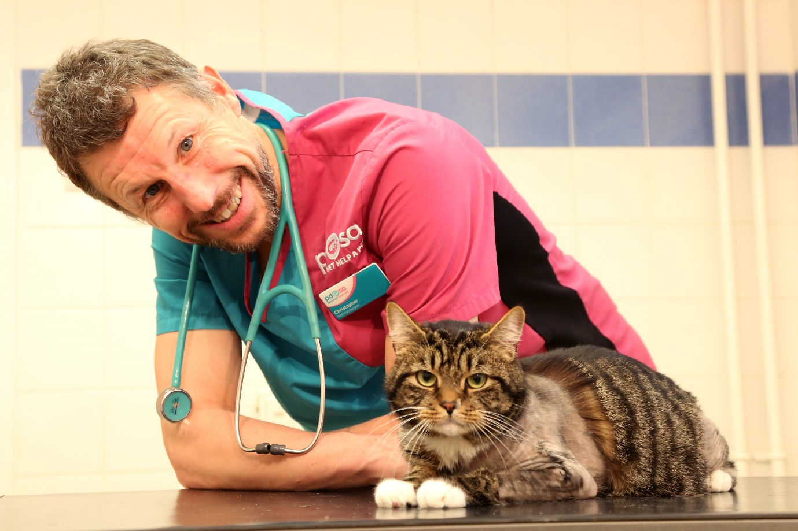
Perci
Notes:
Name:
Perci
Species:
Feline
Breed:
Domestic Short-haired
Colour
Tabby
PDSA Vet :
Chris Sherwood
What happened?
Perci, the two year old tabby cat was rushed to PDSA’s Leicester Pet Hospital for emergency treatment, when he suffered life-threatening injuries after being hit by a car outside his house.
Action taken:
Perci’s injuries were so severe that his owners were warned he may not survive the night. He was given medicine and was treated for shock and made comfortable, before he could be x-rayed. His x-ray showed that he had broken three of his four legs!
Vet’s comment:
‘Perci suffered terrible injuries in the road accident - it’s rare for a cat to break as many as three legs. Although his injury means he might never be able to use his right back leg fully again, he’s a real fighter and has lots more life in him yet. We’re so pleased he’s making such a brilliant recovery.”
Owner’s comment:
“I’m so grateful to the vets and nurses at the Pet Hospital in Leicester who did everything they could to save Perci. I wanted to give something back, so I set up a fundraising page to help raise money for Perci’s life-saving treatment. With the support of friends and family, we collected an amazing £1,300 for PDSA. I feel really happy that this will help other sick and injured pets, like Perci, who are in need of vet treatment.

Slide 16
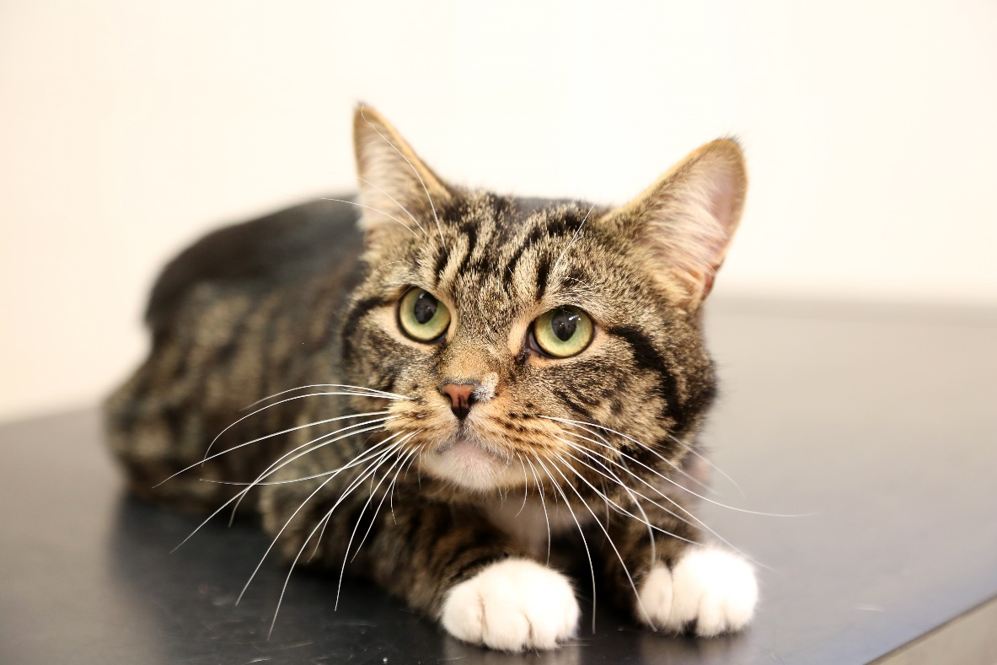
Saved thanks to PDSA!
Perci

Slide 17
Thanks!

