Slide 1

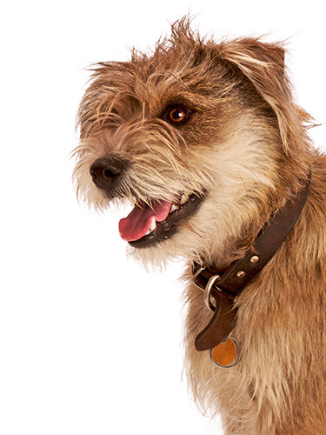
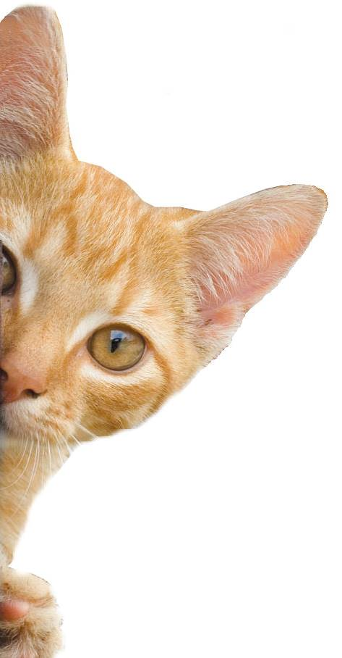
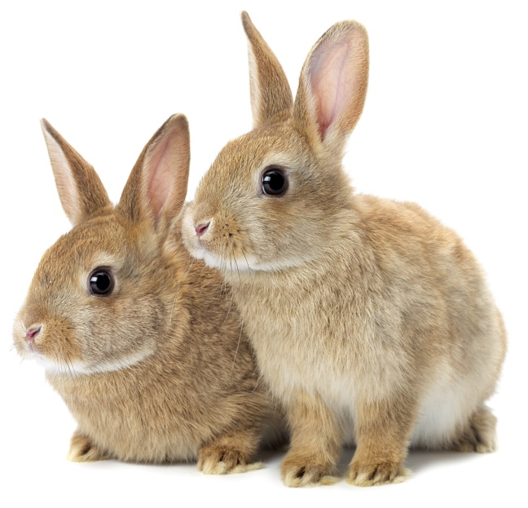
Feelings
Notes:
Share:
Introduce the session and PDSA.
Tell children that PDSA treat the sick and injured pets of people in need...
Explain that PDSA is a special kind of vets, because they’re a charity. Discuss what a charity is and explain that PDSA looks after pets when owners can’t afford vet treatment.
Ask:
If they think it’s important to help sick and injured animals to get better?
What would happen to all the sick and injured pets PDSA treat if they weren’t around?
Share:
Tell them that today, you’re all going to learn about what pets need to be healthy and happy and also about some of the pets that PDSA has helped in their Pet Hospitals.

Slide 2
Synonyms and Antonyms
A synonym is a word that has a similar meaning
An antonym is a word that means the opposite
Eg.
Angry > calm & annoyed
Loved > hated & adored
Safe > unsafe & secure

Slide 3
Now your turn…
Happy >
Strict >
Evil >
Cautious >
Caring >
Crowded >

Slide 4


Learning Objectives
I will learn to consider the feelings of others, including animals.
I will learn how to recognise when a dog or cat is feeling happy or sad.
Learning Outcomes
P
I can recognise human feelings and guess why they may be feeling that way.
I understand that people act differently because of the way they feel.
I can list different feelings.

Slide 5

How is the girl on the left feeling?
How do we know this?
What do you think the other children did to make her feel this way?

Slide 6

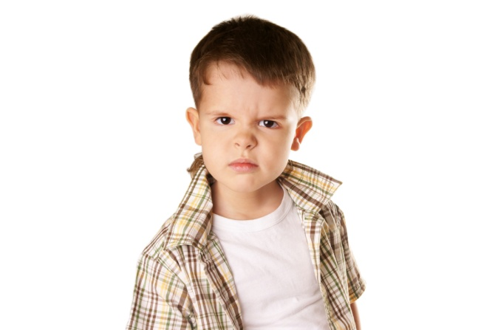


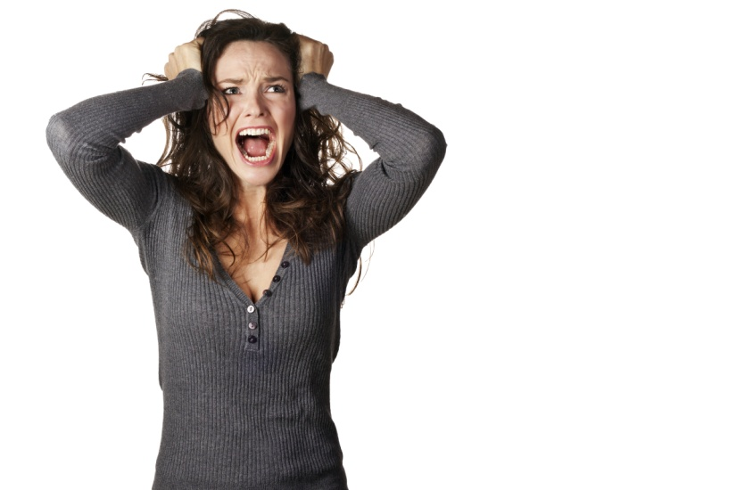
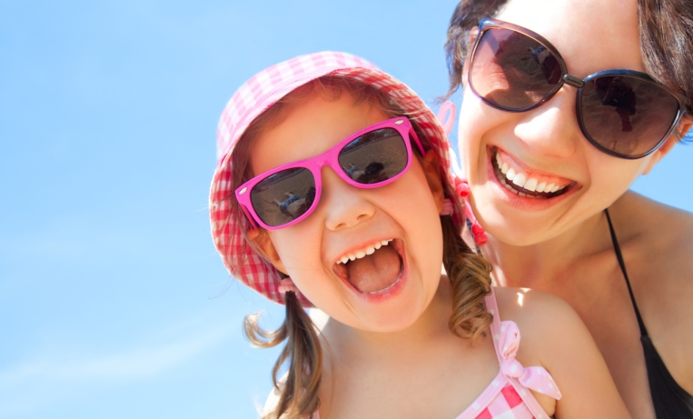
How do these people feel?
Notes:
Ask:
What do you think these people are feeling?
Without talking to each other, how can people understand what someone is trying to say?
Discuss:
Go through each image and use questioning to discuss with group
We can normally work out how people are feeling through their body language – this means you can tell what a person is feeling or trying to tell you just by looking at them.

Slide 7
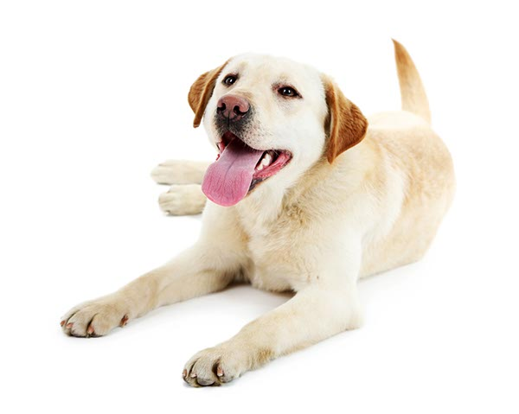
‘I’m happy and relaxed’
Notes:
Ask:
How do you think this dog is feeling based on his body language?
Share/Discuss:
These dogs are trying to tell us that they’re happy and relaxed. How do we know this? They’re showing us some very simple signs:
The whole body looks relaxed and when they move it’s very free and wiggly – remember – a wiggly dog is a happy dog!
Their mouth is open and relaxed
Their tail is held at a normal level – not too high or tucked between their legs (but remember that some dog breeds always hold their tail in a certain way – Husky’s hold theirs high, greyhounds and whippets often hold theirs tucked low)
Sometimes they might play bow, like the Dalmatian on the slide – that means they’re really happy and they’re inviting you to play with them
Rolling on their back and exposing their tummy is often a sign that a dog’s happy and relaxed – and feels safe with you

Slide 8
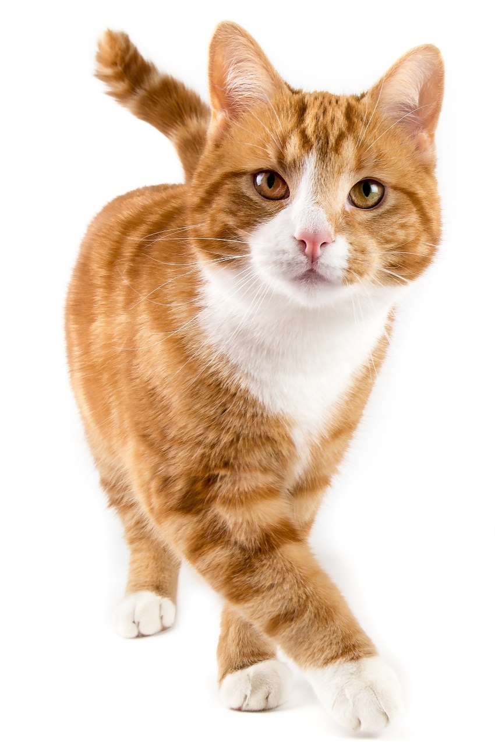
‘I’m happy and relaxed’
Notes:
How do you think this cat is feeling? Ask audience and discuss
A happy cat is easy to recognise – you should be able to pick up their cat body language easily. This is the state you’ll want you cat to be in as much as possible, as it’s the perfect state for quality time between you and your cat.
Signs of happy cat behaviour
When sitting, your cat will be relaxed and upright, with ears pointed up and forward, but relaxed, sometimes swivelling gently towards familiar sounds like your family’s voices.
When lying down, they may have their paws tucked neatly underneath them, or be lying stretched out on their side or even on their back, with legs spread outwards, which shows they are very happy!
They may snooze with their eyes closed or half open, or look heavy-lidded – almost like they are daydreaming at times! If they blink very slowly, try blinking slowly back to show you’re relaxed too – this mimicking behaviour is a great way to bond with your cat.
Whiskers will be relaxed and their tail still – or held high with a slight curl if they’re standing to say hello to you.
If you stroke your cat, their eyes may close in contentment and they will gently purr.

Slide 9
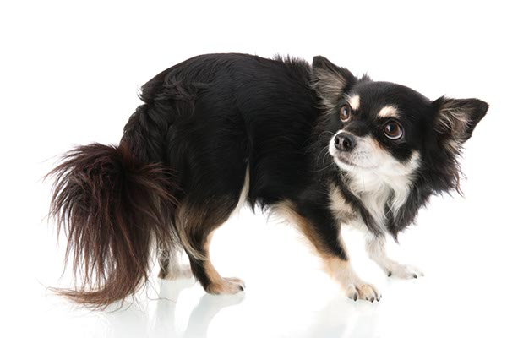
“I’m stressed and worried”
Notes:
Ask:
The group how people look when they’re uncomfortable or anxious. Ask them to show you.
What do you think these dogs are trying to tell us?
(Invite children to put their hands up and answer. Ask them why they think these things)
Share/Discuss:
These dogs are trying to tell us that they’re uncomfortable and anxious. How do we know this? They’re showing us some very simple signs:
Stiff body – remember – stiff dogs are worried or anxious, wiggly dogs are happy!
Ears back or flat against head
Sideways rolling of their eyes so that you can see the whites (“whale eyes” or “half moon eyes”)
Yawning when they’re not tired
Licking their lips when they’re not hungry

Slide 10
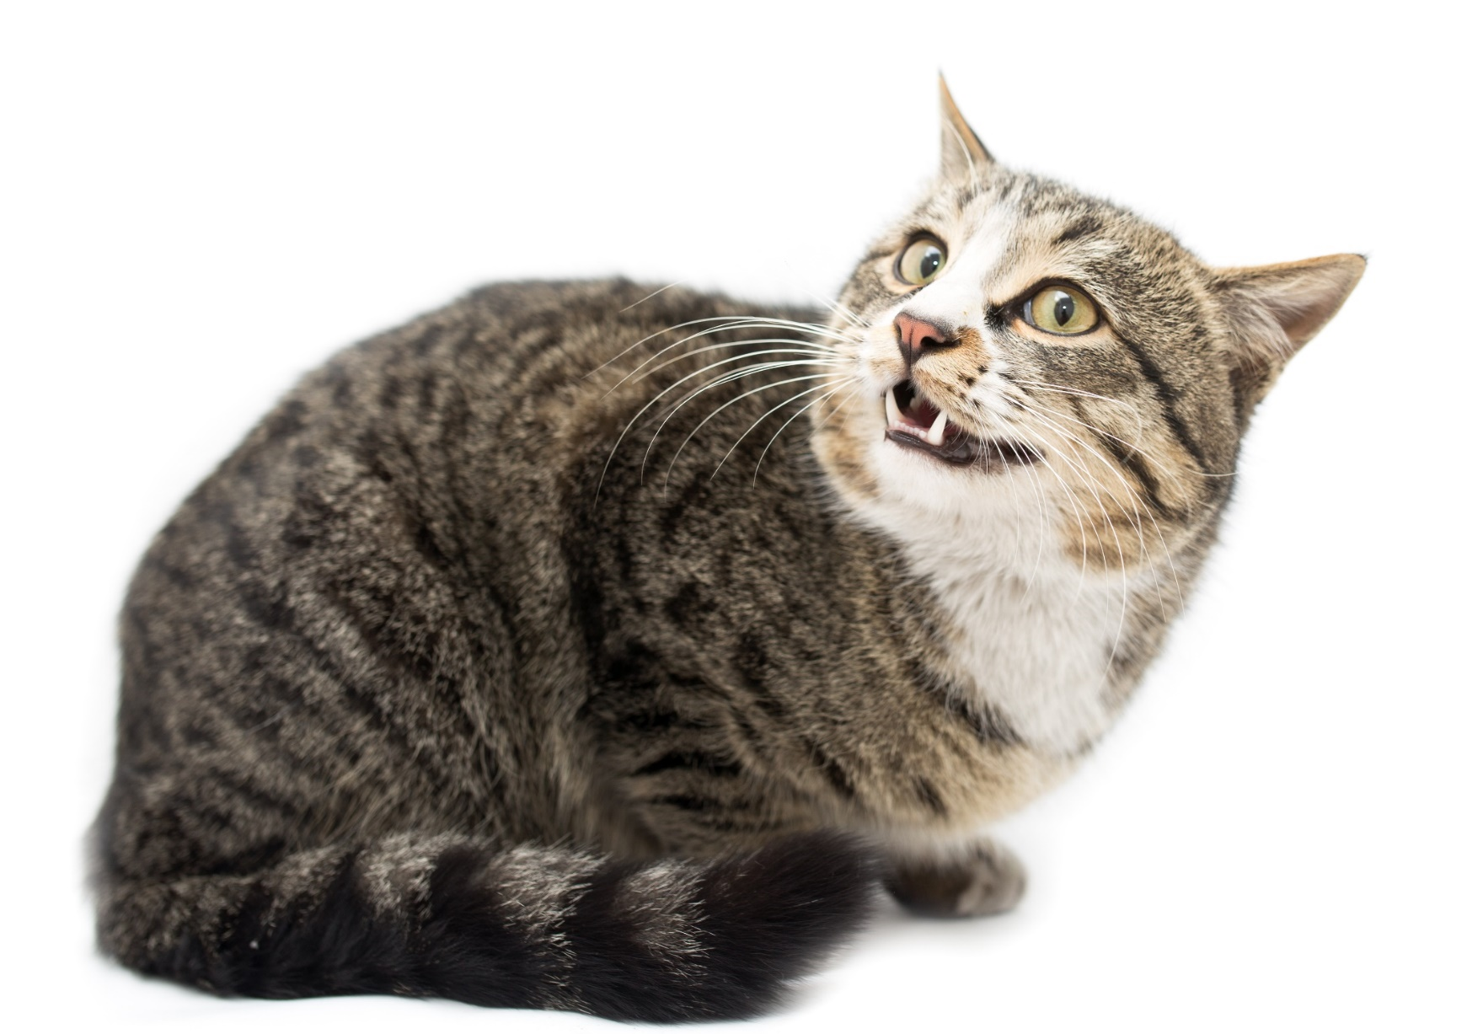

“I’m feeling anxious”
Notes:
How is this cat feeling? Ask the pupils
Cats can be very sensitive, especially to change. It can take some time for them to settle after unexpected changes, so learning to read the symptoms of anxious cat behaviour can help you to help your cat get back to a relaxed state. The sooner you recognise the cat body language signs, the sooner you can offer a stroke when they approach you for reassurance and some attention Cats can take anywhere from a few days to a few weeks to get used to big changes, become accustomed to them and to return to normal.
Some cats cope much better with change than others, but all cats will become anxious with changes such as:
A house move
The introduction of another pet into the household
A new baby or strangers in the household
Noise and disruption
Signs of anxious cat behaviour
Your cat's eyes will be open and not blinking, with pupils dilated into an oval or circle.
Their ears might move from their relaxed forward position to scan for more information, swivelling around independently from each other. If they are very anxious, their ears may even flatten back to their head.
Their head will begin to lower, with whiskers pulled back to the side to appear small and non-threatening – or even be swept forward on alert.
As anxiety increases, your cat might start to cower, or their back might arch to prepare to run.
Cat tail language is very important – it might be still or moving slowly side to side at the tip, which is a sign of anxiety.

Slide 11
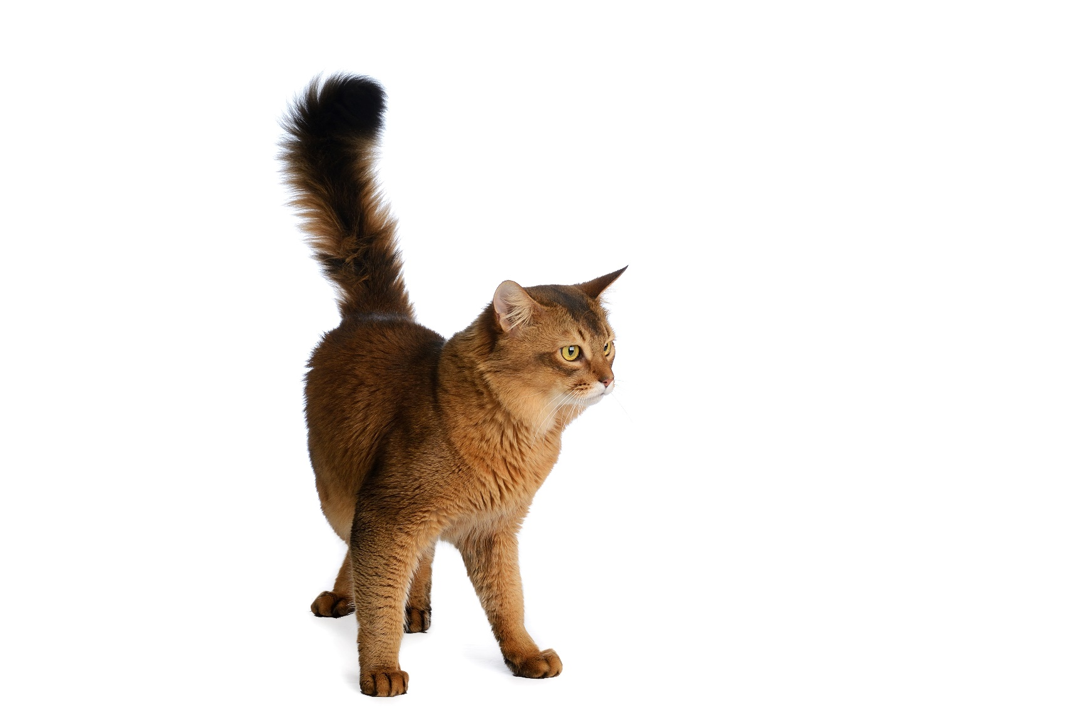
“I’m getting angry”
Notes:
How is this cat feeling? Ask the pupils
If your cat displays angry behaviour, you’ll need to tread very carefully. Always avoid provoking an angry cat - don't stare or shout at them, or make sudden movements, and avoid trying to touch or comfort them as they may interpret this as an added threat and lash out. Instead, retreat slowly, remove any threats if it's safe to do so and give your cat time and space to calm down.
If your cat is displaying signs that they are angry on a regular basis, you may wish to seek the help of your vet or an animal behaviourist who can help you fully understand the cause of such negative cat body language.
Signs of angry cat behaviour
An angry cat will be rigid, with tail held out stiff and straight or curled around and under their body.
They will act very differently from usual – they could be silent, hissing, spitting or growling.
They will try to look large and threatening, with fur erect, stiff front legs, or crouching in a threatening manner.
Their ears will be tense, and flat back against their head, and whiskers will be stiff away from their face.
Their eyes will be hard and focused. Their pupils may be narrowed, although some cats might have round, unblinking eyes.

Slide 12
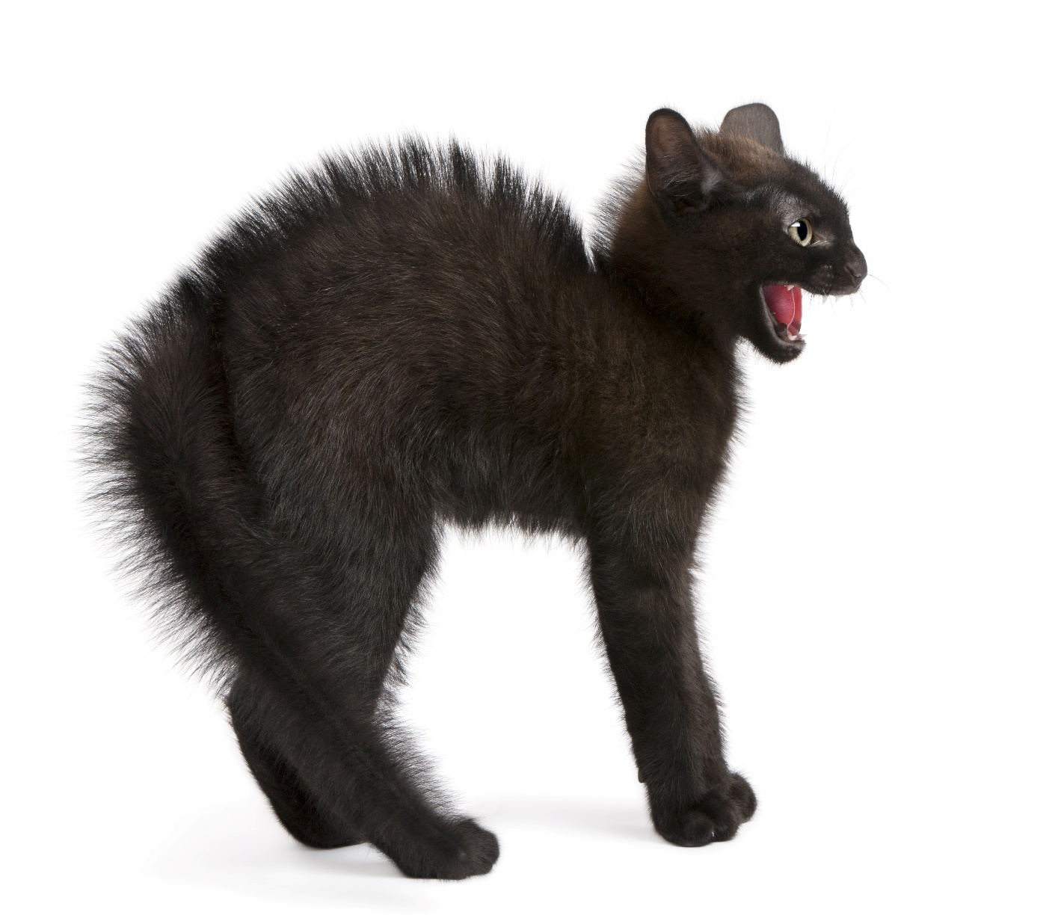
“I’m scared”
Notes:
How is this cat feeling? Ask the pupils
Anxious cat behaviour might be subtle, but when your cat is afraid, it should be easier to spot – if they’re scared by something such as loud noises, your cat won’t be reassured by a stroke and it’s likely that even their favourite treat might not do the trick. Their body language is telling you that they’re frightened, and it will only return to normal when they feel safe. Try not to move quickly to try and comfort them, as you could be seen as another threat. Instead, remove anything that could be causing their fear if you can, and wait for them to calm down. Giving them access to safe places to hide, especially high up, is really important in reducing their fear – allow them as much hiding time as they need and don’t try to rush them. They will come round in their own time.
Signs of fearful cat behaviour
Your cat’s ears will be flattened back against their head, which might be lowered with their gaze angled upwards.
They may run away, or stand or crouch very still if this isn’t possible.
Their eyes will be open very wide, with pupils fully dilated and whiskers flattened or bristling.
They may hiss or spit at close threats, growl or strike with claws out.
Some cats will straighten their front legs to make themselves look taller, or arch their backs and fluff themselves up to look bigger.
Their tail may be held under their body, or be slashing vigorously from side to side.

Slide 13

What would make you feel happy?

Slide 14
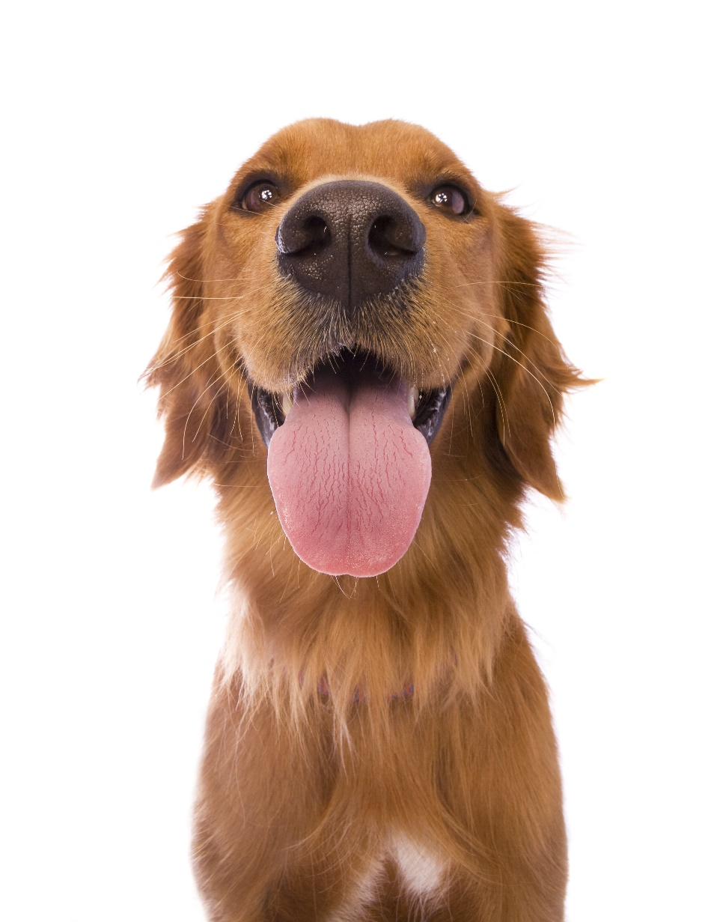
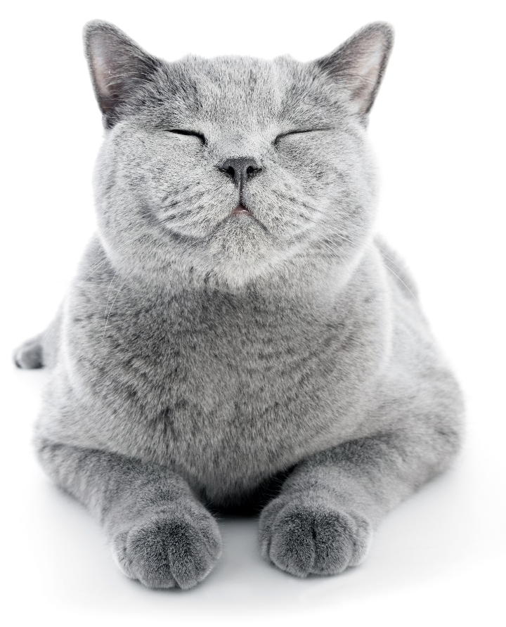
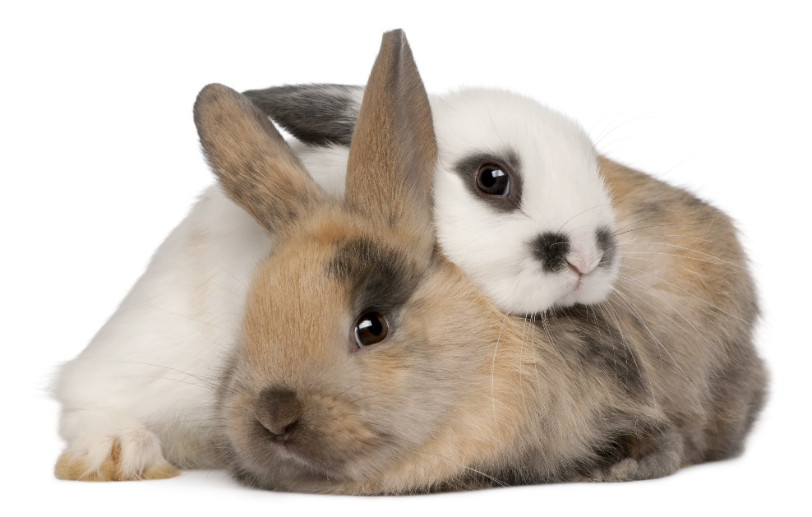
What do you think would make a pet feel happy?

Slide 15





A HOME
FRIENDS
HEALTH
FOOD & WATER
EXERCISE & FUN
What do pets need?…
Notes:
All pets, whether they’re large or small, need the same five things to keep them healthy and happy:
The right kind of safe, warm home with lots of space
The right kind of food and 24 hour access to fresh water
Exercise and fun (the chance to show normal behaviour)
Friends (This can be other animals, people, or both)
Health ( We all need to make sure our pets are kept healthy and take them to the vet when they’re not well)
Ask whose responsibility it is to keep pets healthy and happy and confirm that owners are responsible for looking after their pet properly.

Slide 16
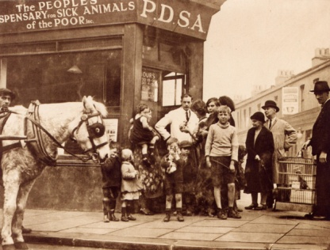

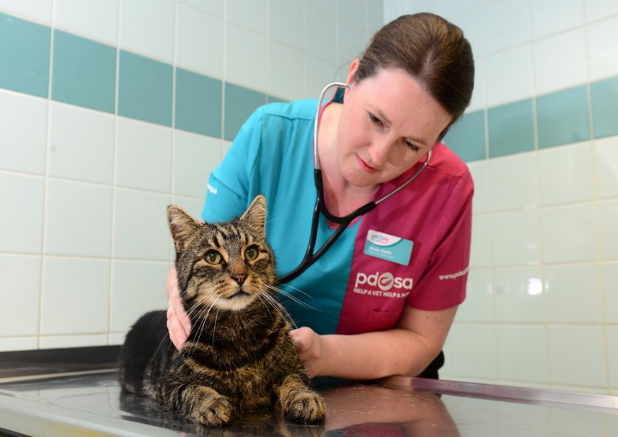
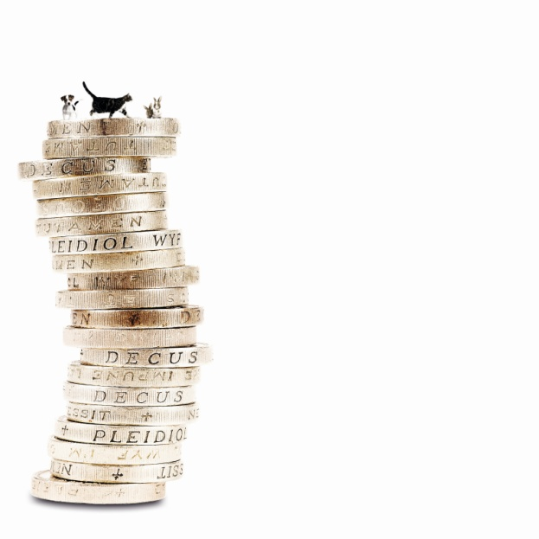
The UK’s leading vet charity …
PDSA is a 100 year old charity who have been treating sick and injured pets since 1917
They have Pet Hospitals all over the UK
They help one sick or injured pet every 5 seconds!
It costs the charity more than
£1 million every week to do their work
Notes:
Share the details on the slide and:
Tell children that PDSA treat the sick and injured pets of people in need..
Ask them if they think it’s important to help sick and injured animals to get better.
Explain that PDSA is a special kind of vets, because they’re a charity. Ask them what a charity does and explain that PDSA looks after pets when owners can’t afford vet treatment.
Ask them what would happen to all the sick and injured pets PDSA treat if they weren’t around.

Slide 17
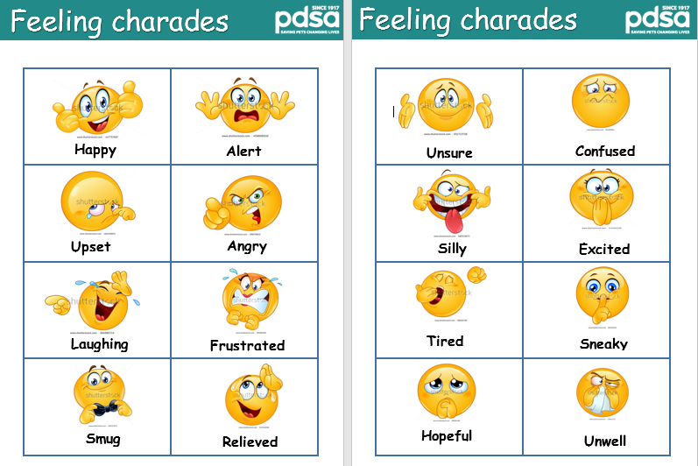
Activity 1: Charades

Slide 18
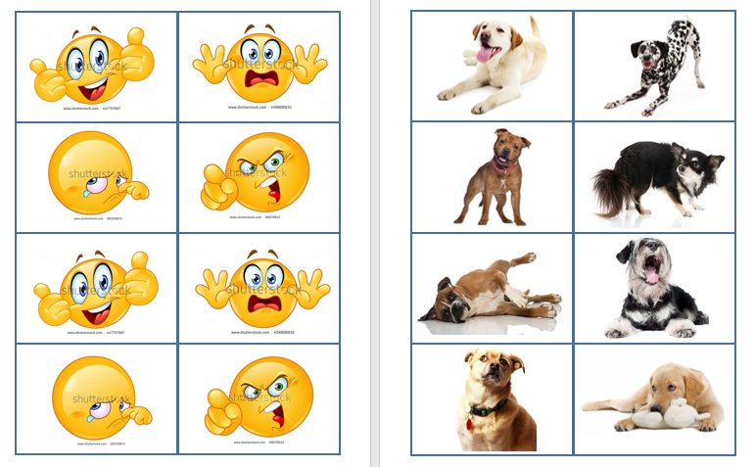
Activity 2: Snap

Slide 19
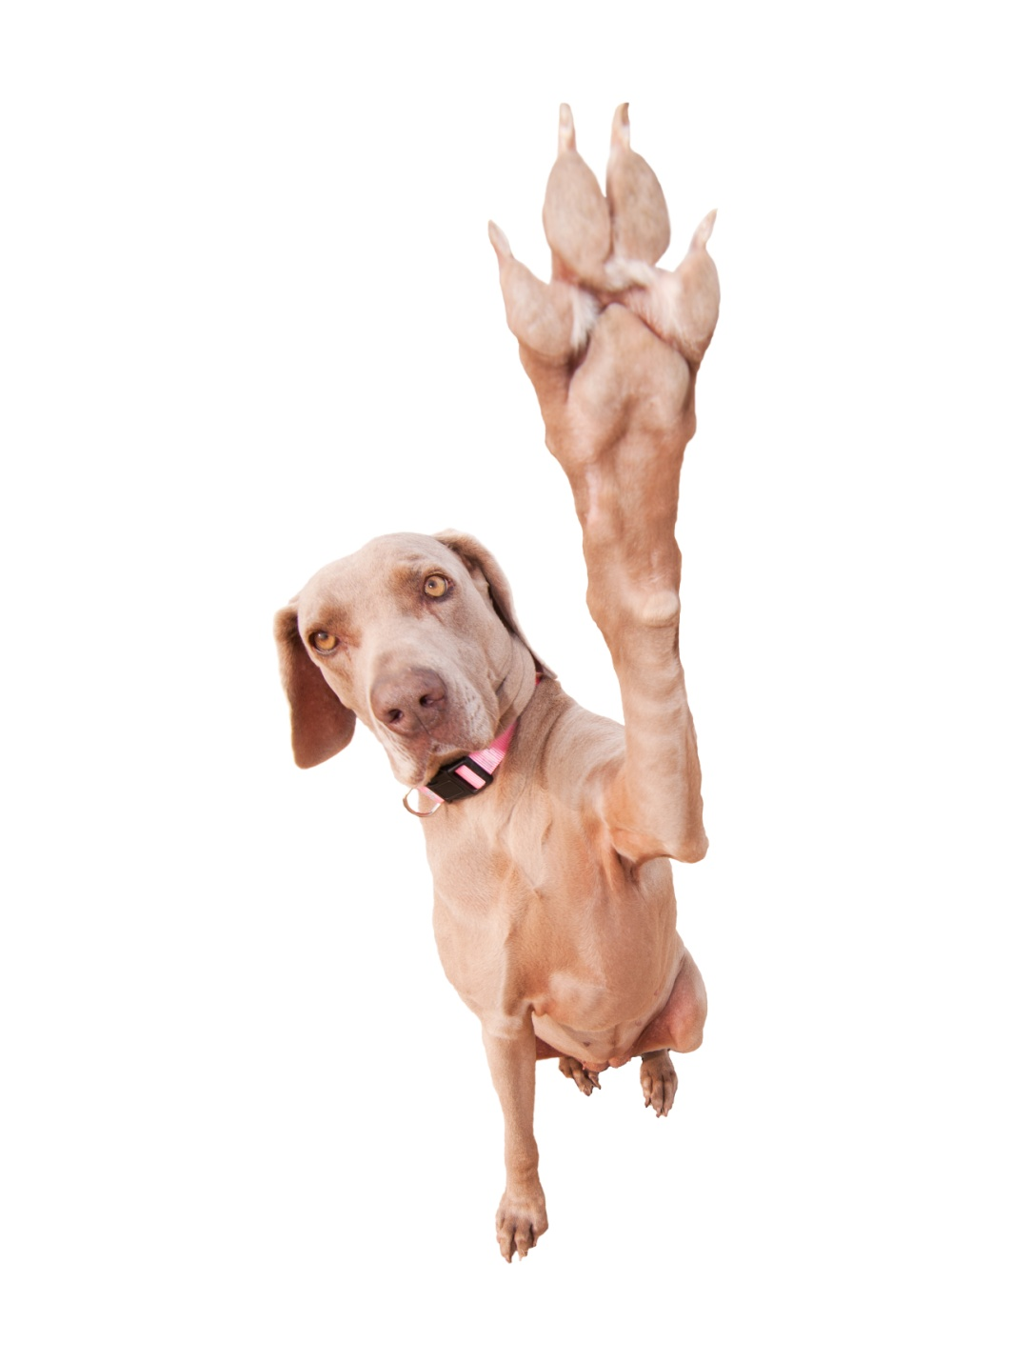
Thanks!

