Slide 1

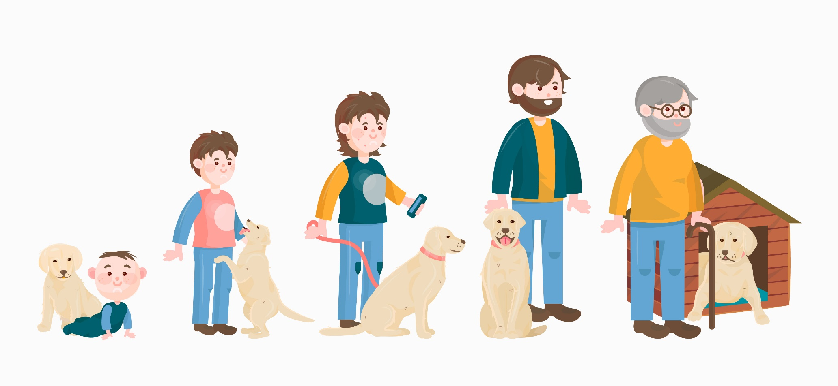
Growing and Changing
Notes:
Share:
Introduce the session and PDSA.
Tell children that PDSA treat the sick and injured pets of people in need...
Explain that PDSA is a special kind of vets, because they’re a charity. Discuss what a charity is and explain that PDSA looks after pets when owners can’t afford vet treatment.
Ask:
If they think it’s important to help sick and injured animals to get better?
What would happen to all the sick and injured pets PDSA treat if they weren’t around?
Share:
.
Tell them that today, you’re all going to learn about what pets need to be healthy and happy and also about some of the pets that PDSA has helped in their Pet Hospitals.

Slide 2
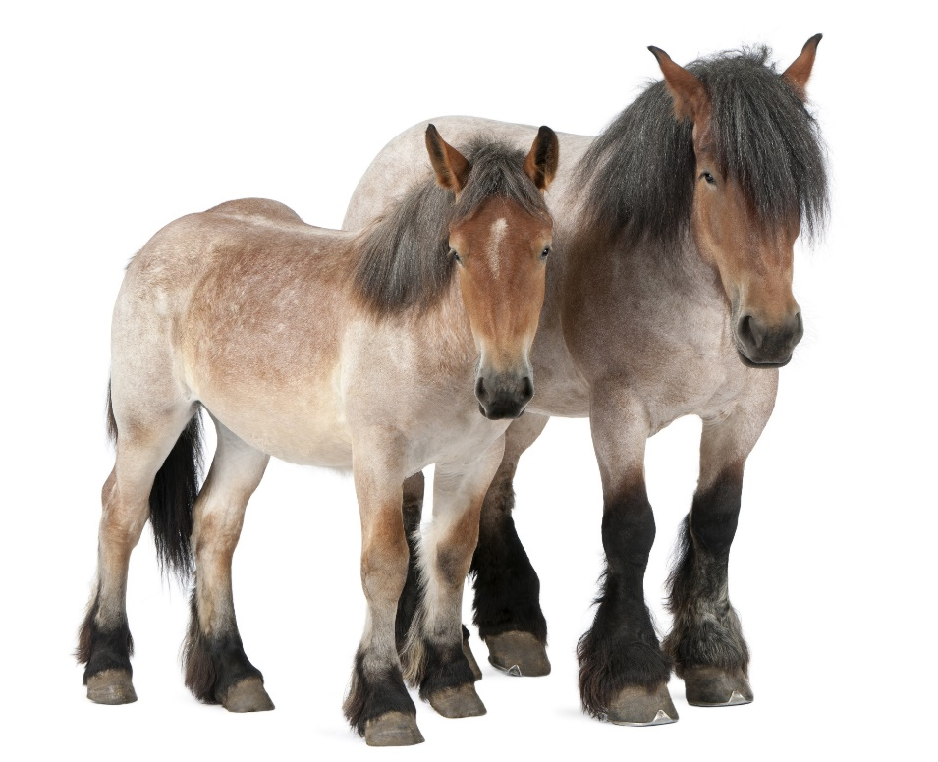
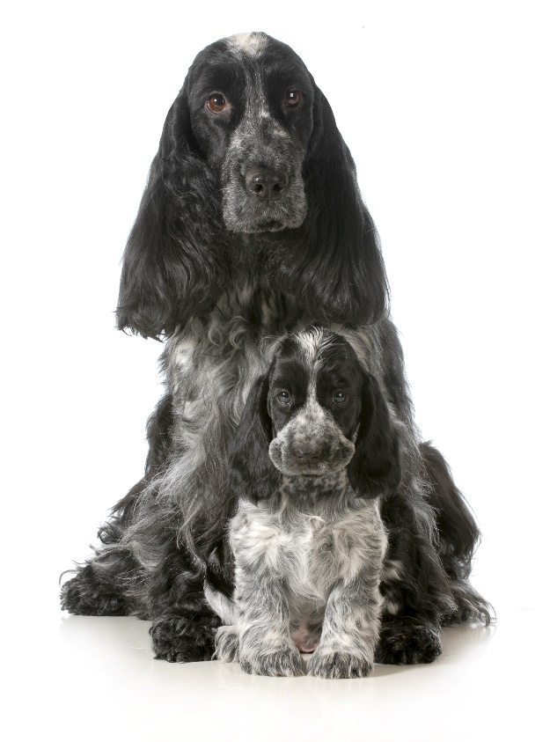
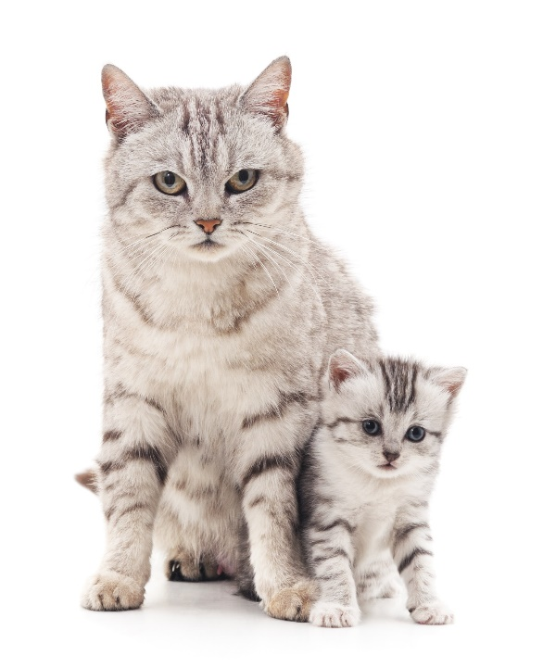
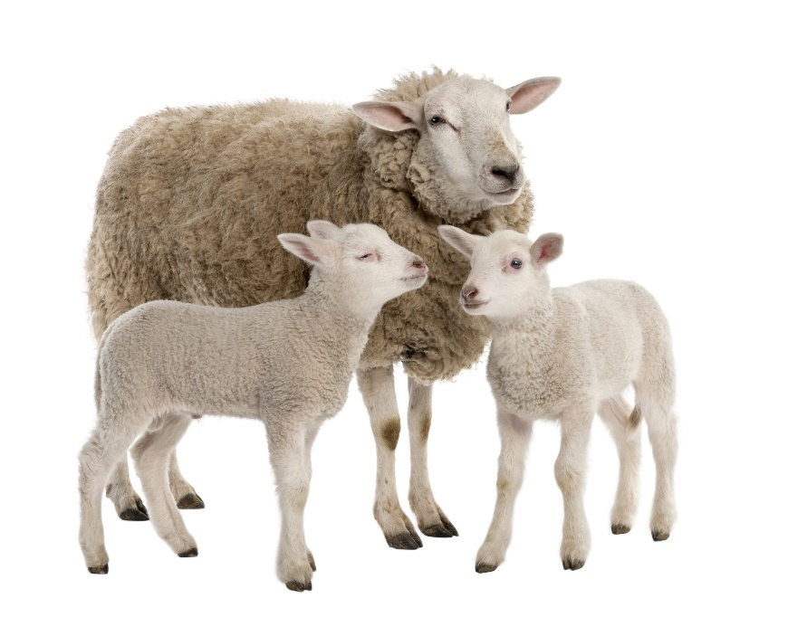
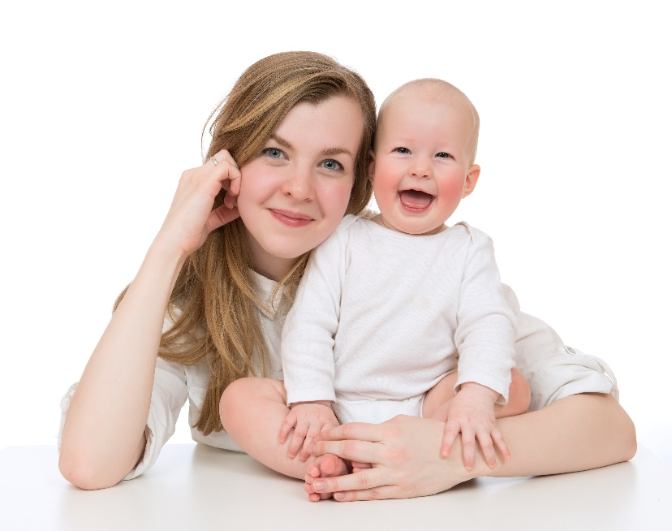
Offspring
Notes:
When a mammal has babies, their babies are called their offspring.
We’re going to do an activity to test your knowledge of what different baby animals are called.

Slide 3

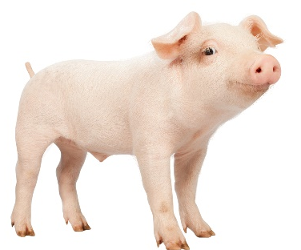
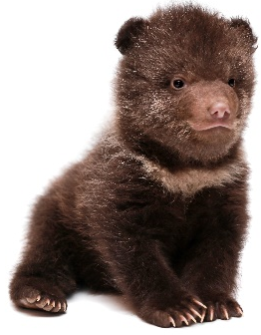
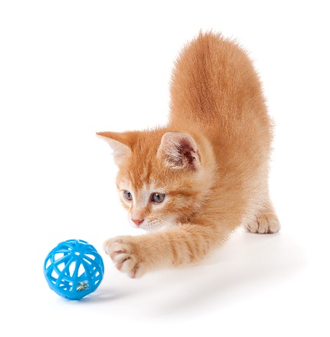
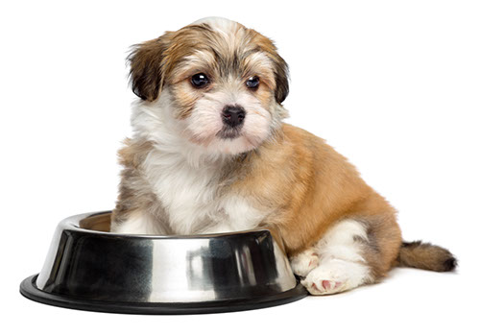
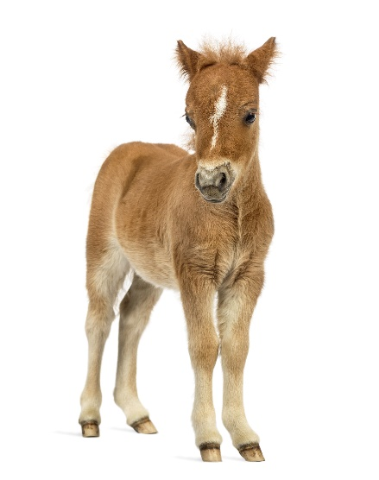
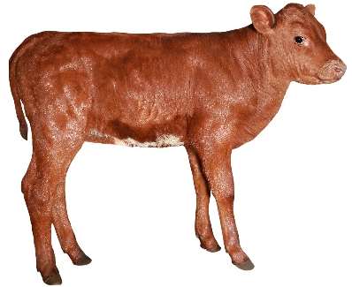
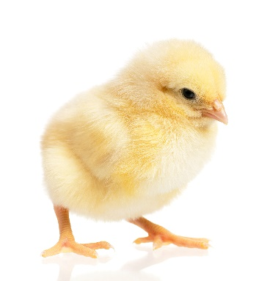
5)
7)
1. Cub
1)
2. Calf
3. Kitten
3)
4. Foal
6)
4)
5. Lamb
6. Puppy
2)
8)
7. Piglet
8. Chick
Baby Animals
Notes:
Ask the pupils to match the animals to the name we use to refer to them.
After you’ve gone through the answers, explain that animals have different names when they’re young. For example a lamb will turn into a sheep, a piglet will become a pig and a kitten will become a cat.

Slide 4


Learning Objectives
I will consider the changes humans go through as they grow older.
I will learn about the life stages of cats and dogs.
Learning Outcomes
P
I can compare being a baby to being a child.
I can describe the life stages of humans, cats and dogs.
I can write a diary entry as if from a different stage in life.

Slide 5


In what ways are you different from a baby?
Notes:
If you have time to prepare before teaching this session, ask your class to bring in a baby photo of themselves so they can compare their looks.
Pupils list all the things that make them different – things you can see like looks and things you can’t see like knowledge and emotions.

Slide 6

Getting older
Notes:
As humans, we go through a timeline.
We start as a baby – reliant on an adult to do everything for us.
Then we become a toddler – a time when we learn to walk and talk.
Next is a child – this is when we expand our knowledge at school.
Between 13 and 19 we are referred to as teenagers- this is when we go through puberty and become a…
Young adult – we can choose to expand our knowledge even further or enter the world of work.
Adulthood – this is a settled time when most people become settled in their careers and start a family. Not everyone has too get married or start a family though – we can choose what path we want to take.
Mature adults – We’ve been working for many years our children are now almost adults themselves and we’re looking forward to not having to work anymore.
Elderly – Some elderly people are grandparents, some chose not to be. Some say this is when your life truly begins as, if you’ve managed to save enough money (called a pension), you no longer have to work.
There is no set time for how long a life lasts – everyone is unique.

Slide 7
In what ways is a kitten like its mother?
Notes:
A kitten is another name for a young cat (a baby). After they’re born, kittens rely on their mother for survival - they don’t even open their eyes until after seven to ten days.
At about two weeks old, kittens quickly develop and become so curious about their surroundings that they start exploring.
After another three to four weeks, they begin to eat solid food and grow their adult teeth.
Kittens will return to their mother’s side when called and if she feels they’re in danger, she will move their ‘nest’ to somewhere safer.
Kittens, like cats, are very playful and will imitate hunting with their cat toys.
They both have the same welfare needs.

Slide 8





A HOME
EXERCISE & FUN
HEALTH
FOOD & WATER
FRIENDS
What do pets need?…
Notes:
All pets, whether they’re large or small, need the same five things to keep them healthy and happy:
The right kind of safe, warm home with lots of space
The right kind of food and 24 hour access to fresh water
Exercise and fun (the chance to show normal behaviour)
Friends (This can be other animals, people, or both)
Health ( We all need to make sure our pets are kept healthy and take them to the vet when they’re not well)
Ask whose responsibility it is to keep pets healthy and happy and confirm that owners are responsible for looking after their pet properly.

Slide 9

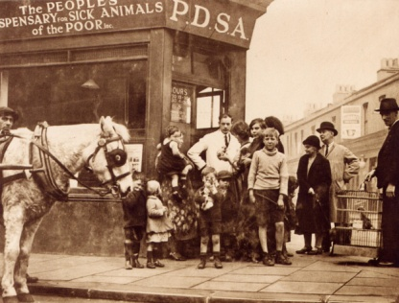
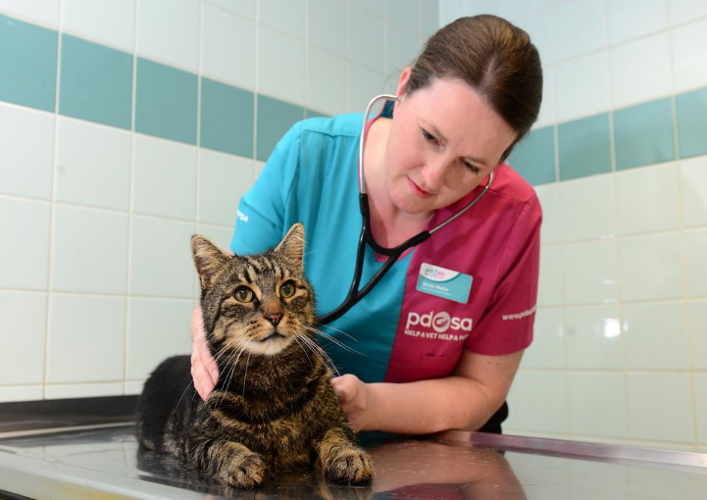
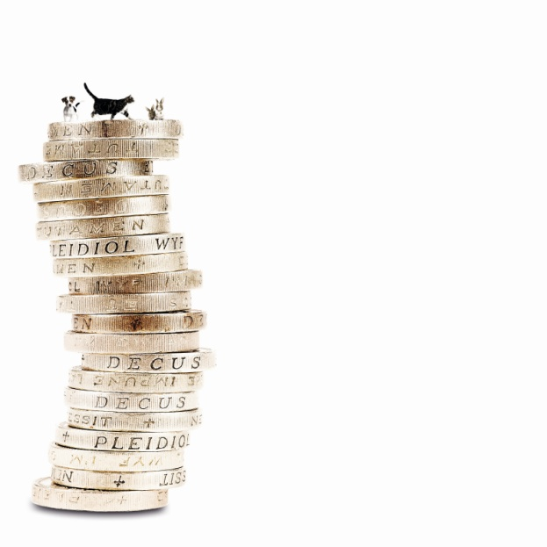
The UK’s leading vet charity …
PDSA is a 100 year old charity who have been treating sick and injured pets since 1917
They have Pet Hospitals all over the UK
They help one sick or injured pet every 5 seconds!
It costs the charity more than
£1 million every week to do their work
Notes:
Share the details on the slide and:
Tell children that PDSA treat the sick and injured pets of people in need..
Ask them if they think it’s important to help sick and injured animals to get better.
Explain that PDSA is a special kind of vets, because they’re a charity. Ask them what a charity does and explain that PDSA looks after pets when owners can’t afford vet treatment.
Ask them what would happen to all the sick and injured pets PDSA treat if they weren’t around.

Slide 10
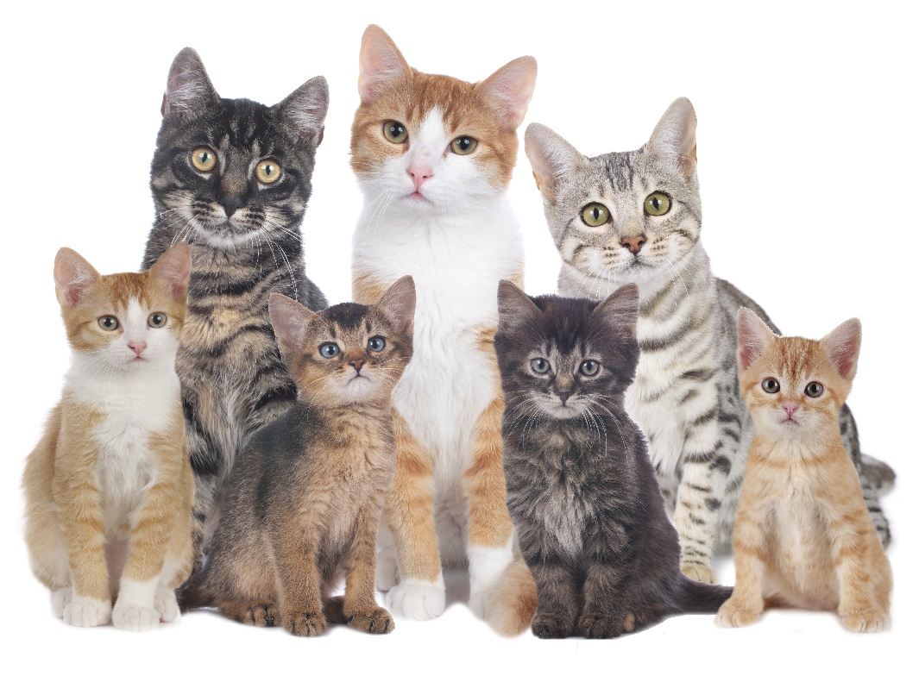
Just like humans, cats have life stages:
Kitten
Prime
Senior
Junior
Mature
Geriatric
Life Stages of a Cat
Notes:
Kitten – 0-6 months
A time when the young cat is growing quickly and is still a baby.
Junior – 6 months-2 years
During this time the cat reaches full size and learns about life including survival skills.
Prime – 3-6 years
The cat is mature physically and in terms of behaviour. They’re usually still healthy and active, with sleek-looking, shiny coats and are enjoying life.
Mature – 7-10 years
This cat is what we call 'Mature’ and this is equivalent to humans in their mid-40s to mid-50s.
Senior - 11-14 years
This is the cat equivalent of about 70 human years. They’re elderly but still living life to the full.
Geriatric - 15 years and over
A lot of cats do reach this age and some still show no signs of being old.

Slide 11
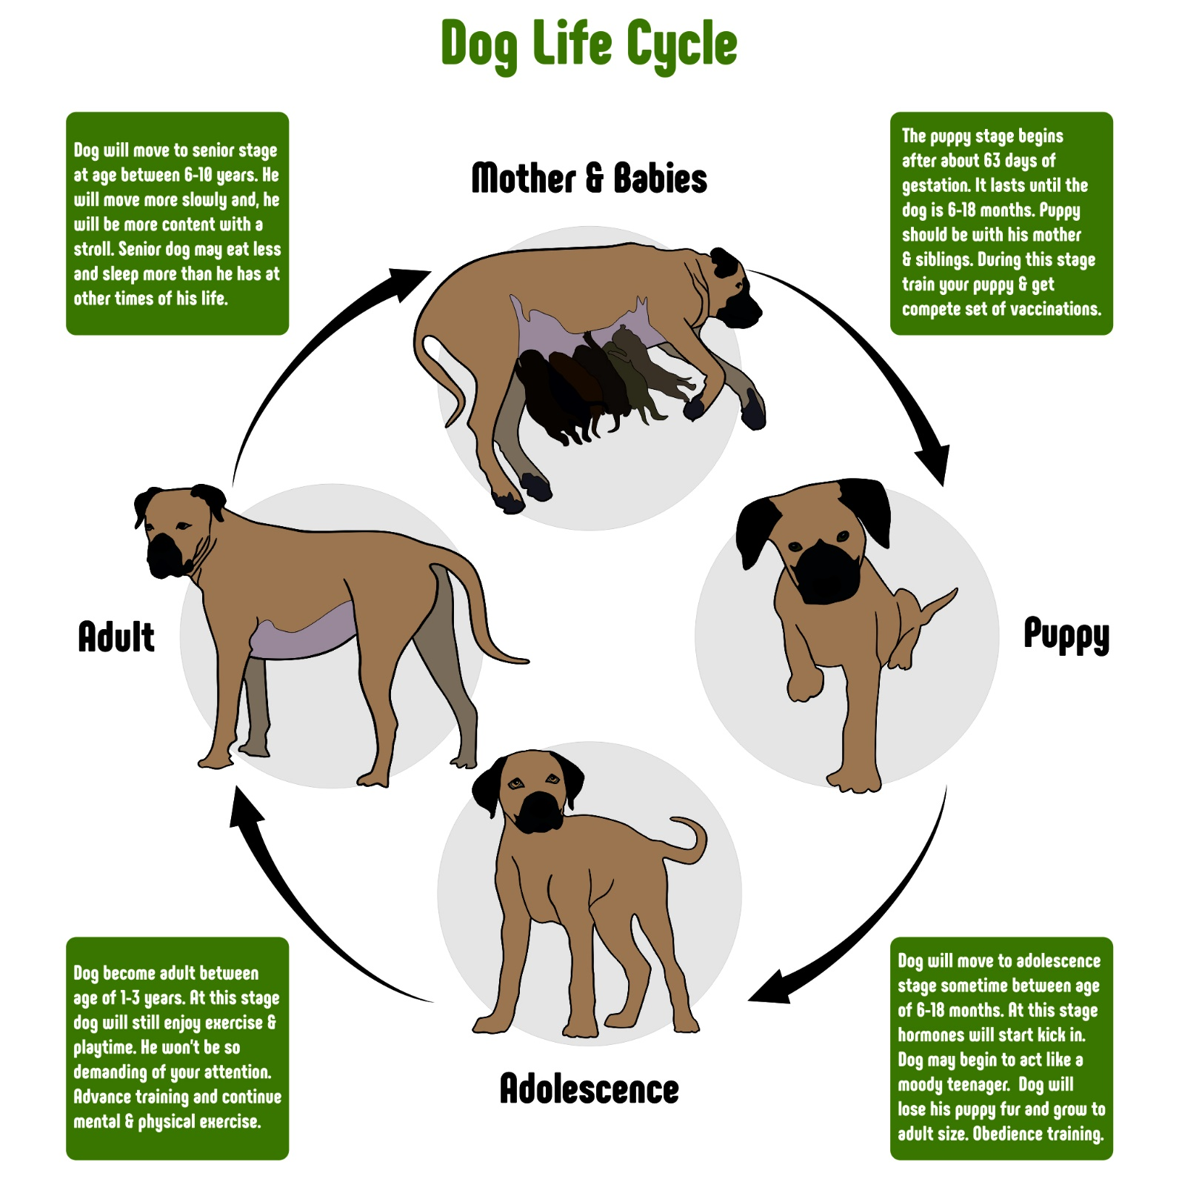
Life Stages of a Dog
Notes:
The puppy stage begins at about 63 days of gestation and lasts until the dog is between 6 and 18 months. The puppy should remain with their mum and siblings until they are 8 weeks old. Puppies need to be trained, socialised, microchipped and given a complete set of vaccinations during this time.
The dog will enter adolescence at age 6-18 months, At this stage, their hormones are starting to kick in and they act like a moody teenager. They lose their puppy fat and grow to adult size.
Dogs become adults somewhere between age 1 and 3 years. At this stage, the dog will still enjoy fun and exercise but he will no longer demand your attention all the time.
A dog moves in to the senior stage between 6-18 years (depending on their breed). They start to move more slowly and will be happier with shorter walks. Senior dogs might eat less and sleep more.

Slide 12
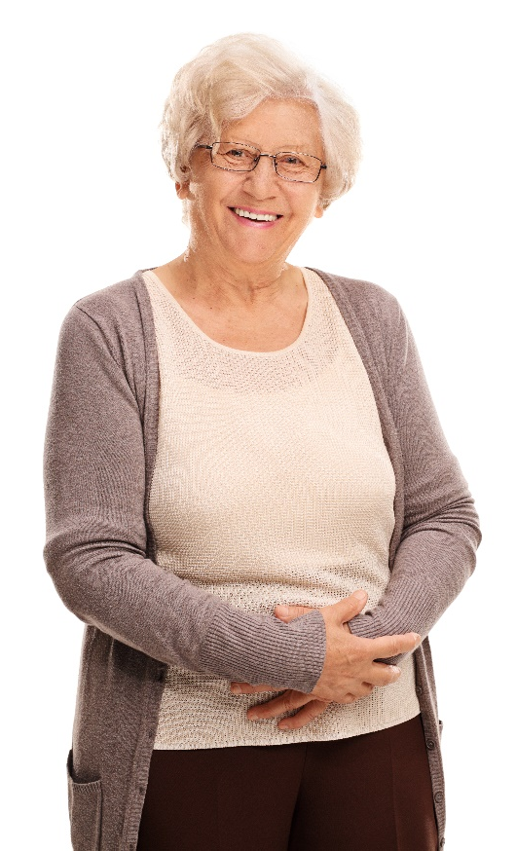



Write four short diary entries about a trip to the dentist as…
…a baby …the age you are now
…an adult …an elderly person
Activity

Slide 13
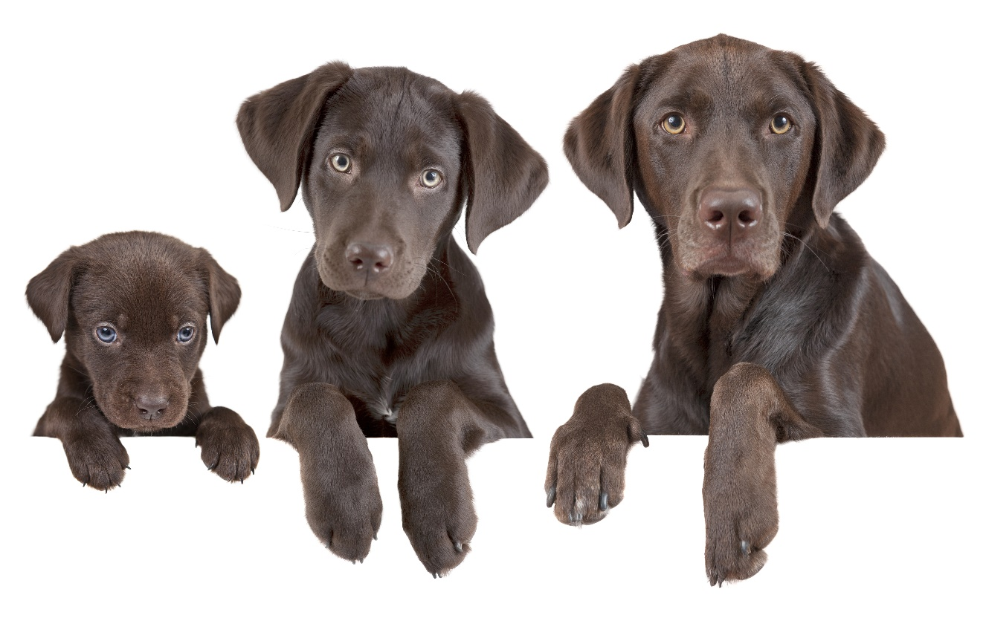
Write four short diary entries about a trip to the vet as…
…a puppy …a teenage dog
…an adult dog …a senior dog
Alternative Activity
Notes:
E.g. A puppy would be excited or scared.
As mentioned previously, a teenage dog would be moody and therefore might not want to go.
An adult dog might be fed up of visiting the vet or would know it’s nothing to worry about.
A senior dog might find the journey exhausting and might wish he was back in his bed.

Slide 14
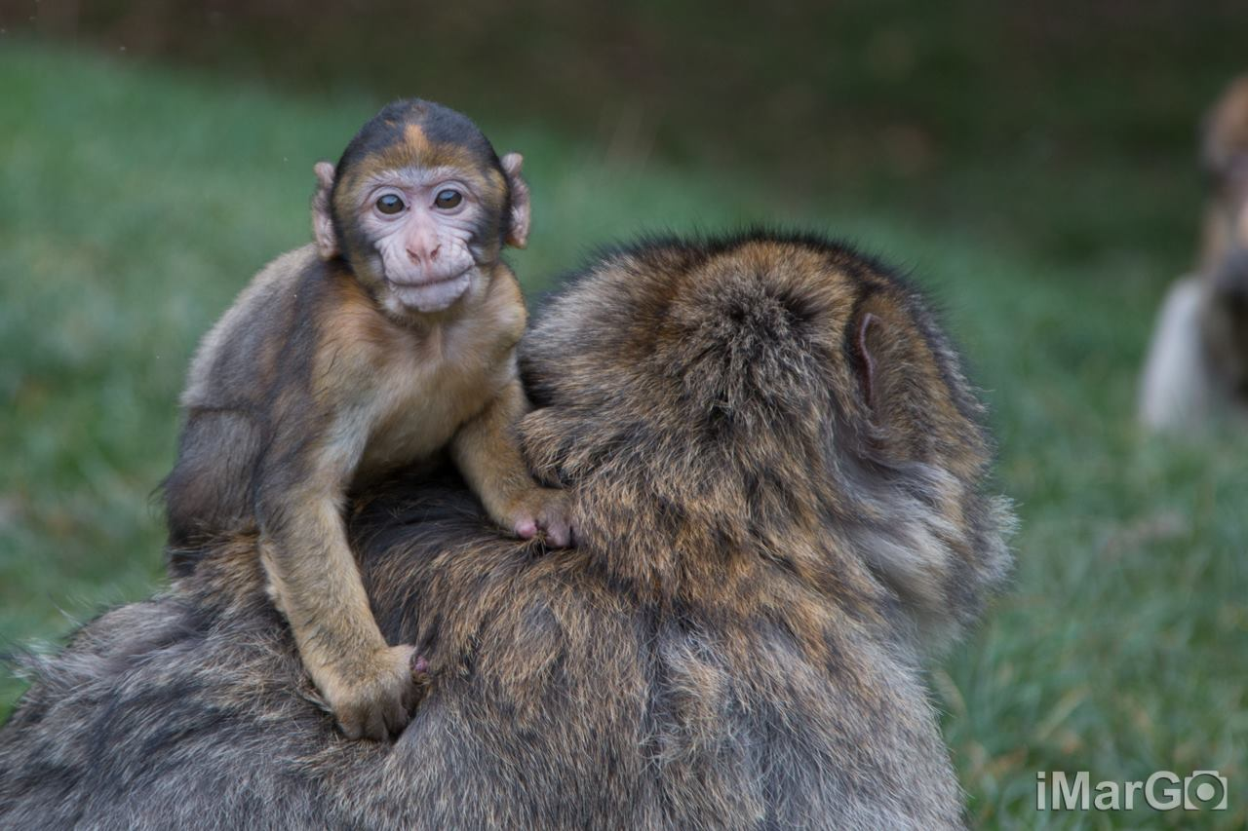
Thanks!

