Slide 1
Media at Work
Notes:
Share:
Introduce the session and PDSA.
Tell children that PDSA treat the sick and injured pets of people in need...
Explain that PDSA is a special kind of vets, because they’re a charity. Discuss what a charity is and explain that PDSA looks after pets when owners can’t afford vet treatment.
Ask:
If they think it’s important to help sick and injured animals to get better?
What would happen to all the sick and injured pets PDSA treat if they weren’t around?
Share:
Tell them that today, you’re all going to learn about what pets need to be healthy and happy and also about some of the pets that PDSA has helped in their Pet Hospitals.

Slide 2
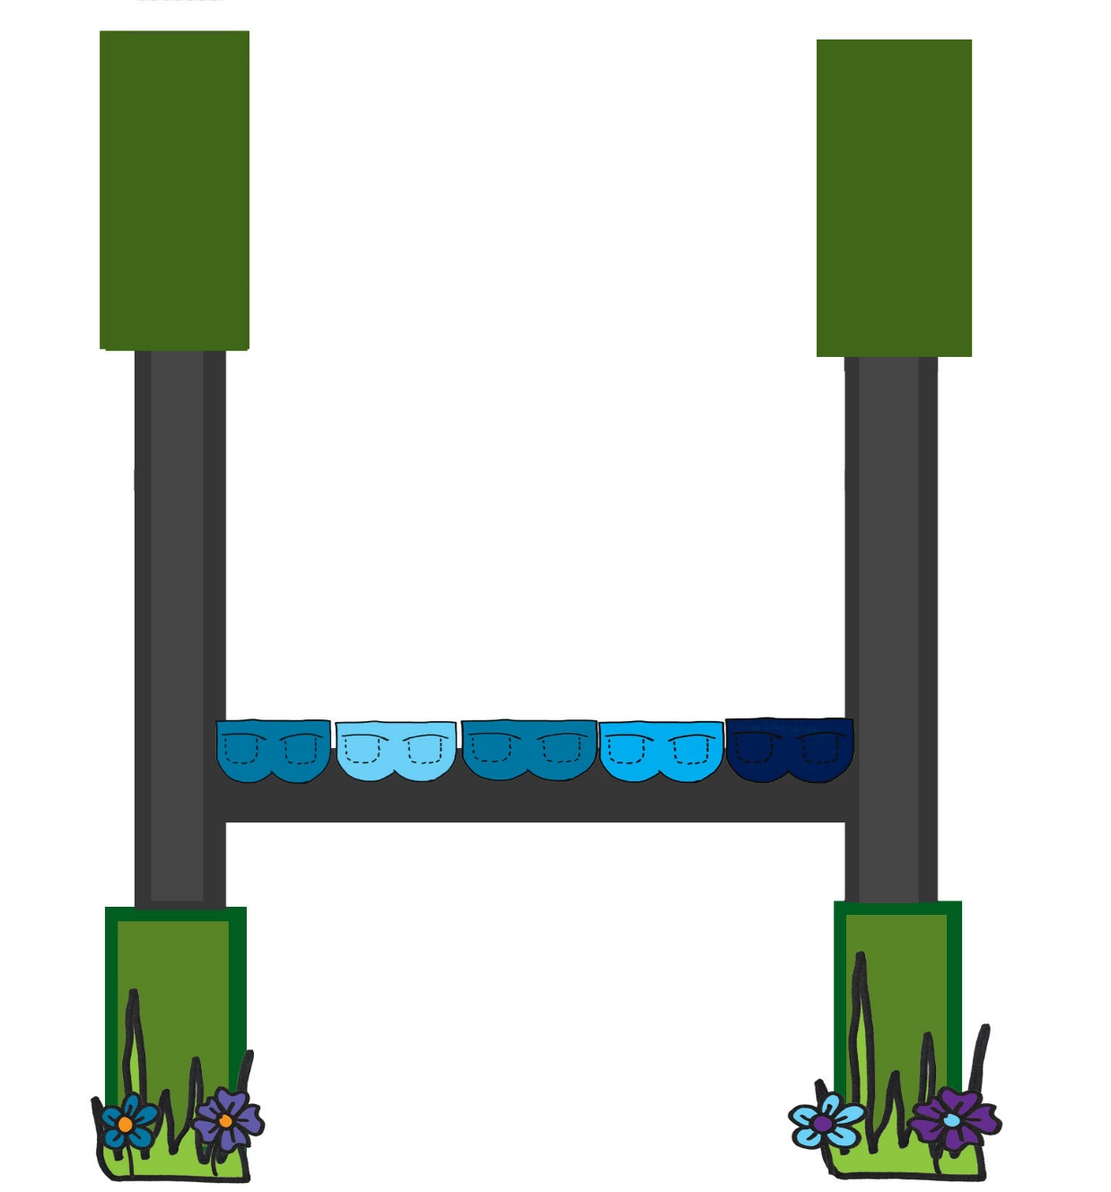
Think
about…
w
w
w
w
w
h
h
h
h
h
o
a
e
e
y
ow
t
r
n
e

Slide 3
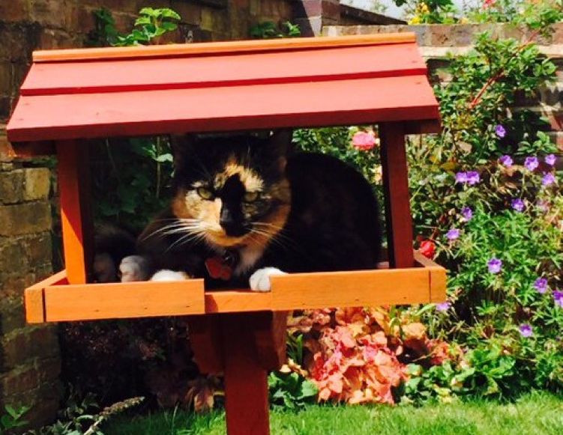
What happens next?

Slide 4
Learning Objectives
I will learn about different types of media and the use of advertising.
I will learn about the importance of PDSA and the work they do.
Learning Outcomes
P
I can plan
a simple
advert
I can use
persuasive
language
I can write
for a specific
audience

Slide 5
Different ways of advertising
Notes:
Radio
TV
Posters at bus stops/billboards
Flyers
Sides of buses and taxis
Online banners/social media
Word of mouth
Magazines/Newspapers

Slide 6
My favourite advert
Insert link to YouTube or images
Notes:
Share your favourite advert with the class.
Ask pupils to write about their favourite advert

Slide 7
What makes a good advert?

Slide 8
Informative
Think back to the bums on a rugby post
Who’s selling the product?
What’s the product?
Where can they buy it from?
When is it available?
Why should they buy it?
How much does it cost?
Notes:
Gives you information about the product, like where to buy it from and convinces you to buy it

Slide 9
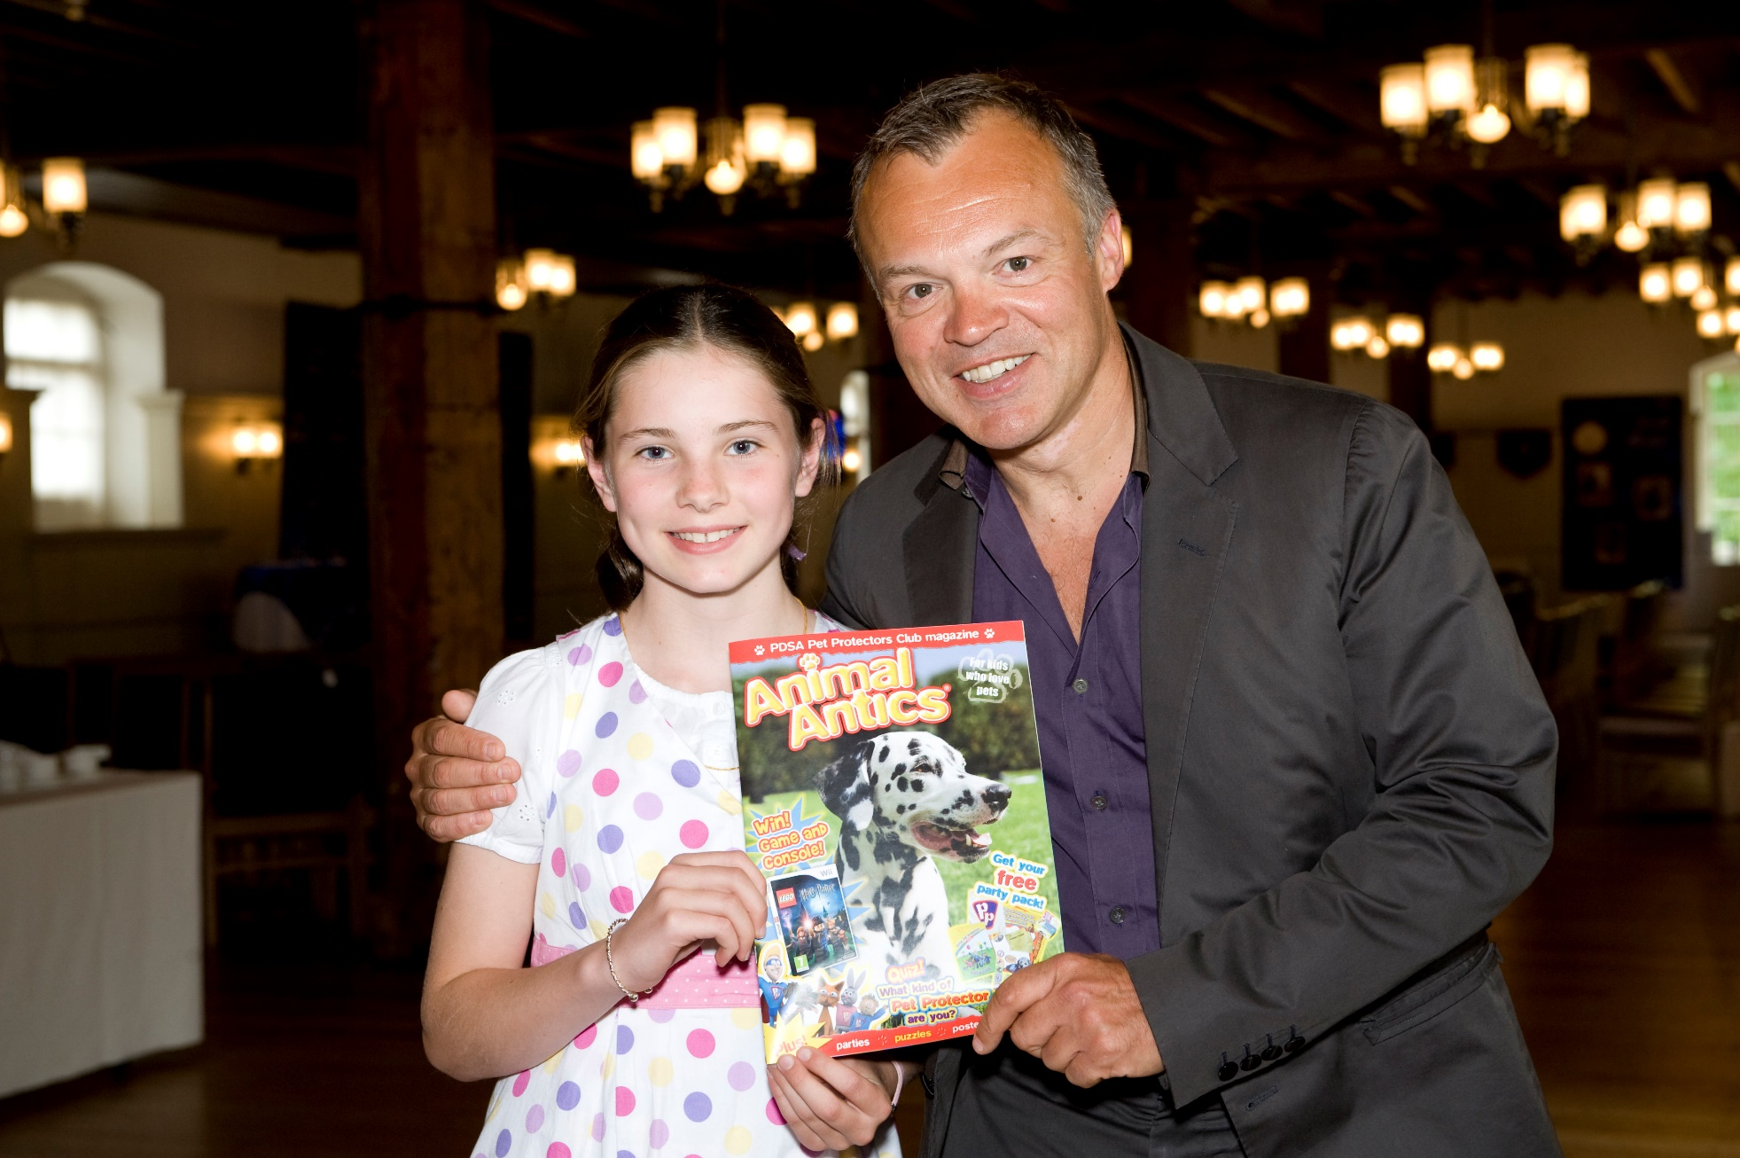
Celebrities

Slide 10
Catchy slogans
Every
little
helps
Girl
Power
Just
do it
I’m lovin’ it
Taste
the Rainbow
…because you’re
worth it

Slide 11
Positive Adjectives
These are positive descriptive words
memorable
fabulous
better
adorable
helpful
cute
fair
perfect
thankful
Can you think of any more?

Slide 12
Promises
Persuasive statements
‘It’s the best’
‘It’s free’
‘It’s really easy’
‘You’ll love it!’
‘It will save you money’
‘You’ll make a huge difference’
‘It’s safe’

Slide 13
Bossy Words
These are words that tell someone to do something (commands)
visit
enjoy
explore
learn
Can you think of any more?

Slide 14
Rhetorical questions
These are questions that you don’t expect an answer to.
For example…
Wouldn’t we all love to have less homework?
How many times do I have to tell you not to yell in the house?
How much longer can this cruelty continue?
Notes:
The only time you should really ask a question in your advertisement is when you can make a relatively accurate prediction of what the answer will be and in most cases, the answer you’re looking for should be “yes.”
The purpose of a question is to gain a response from the person you’ve asked it to but with writing, the conversation is completely one-sided. The audience has no chance to respond. Therefore, rhetorical questions have to serve a different purpose: getting your audience thinking about your brand’s message and persuading them to act.
Rhetorical questions are often used in persuasive writing to hook the attention of the audience.

Slide 15
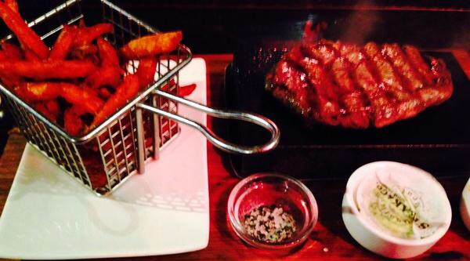
Eye-catching images

Slide 16
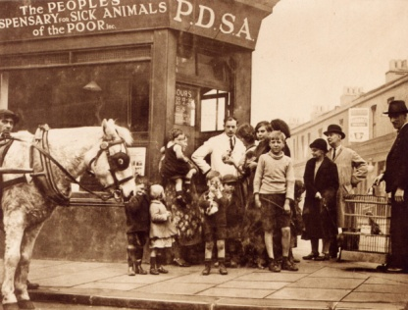
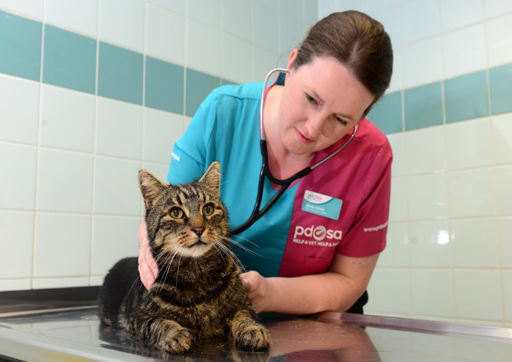
The UK’s leading vet charity …
PDSA is a 100 year old charity who have been treating sick and injured pets since 1917
They have Pet Hospitals all over the UK
They help one sick or injured pet every 5 seconds!
It costs the charity more than
£1 million every week to do their work

Slide 17
A HOME
FRIENDS
HEALTH
FOOD & WATER
EXERCISE & FUN
What do pets need?…
Notes:
All pets, whether they’re large or small, need the same five things to keep them healthy and happy:
The right kind of safe, warm home with lots of space
The right kind of food and 24 hour access to fresh water
Exercise and fun (the chance to show normal behaviour)
Friends (This can be other animals, people, or both)
Health ( We all need to make sure our pets are kept healthy and take them to the vet when they’re not well)
Ask whose responsibility it is to keep pets healthy and happy and confirm that owners are responsible for looking after their pet properly.

Slide 18
Activity

Slide 19
Persuasive sentence starters
We ALL know that…
In truth…
I believe that…
The time has come to…
In my opinion…
Everyone knows that…
I know…
I agree that…
I really feel that…
Of course…
Without doubt…
The fact is…
Clearly…
Surely…
Others must agree that…

Slide 20
Thanks!

