Slide 1
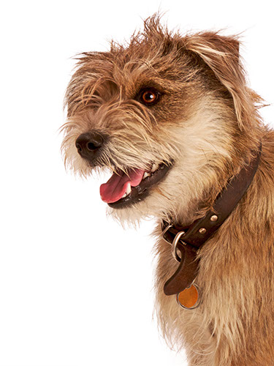
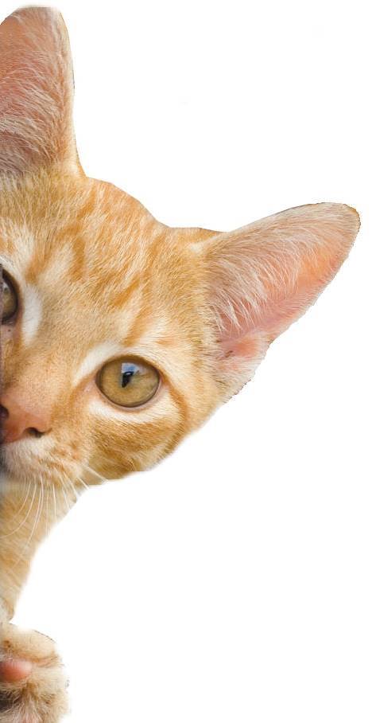
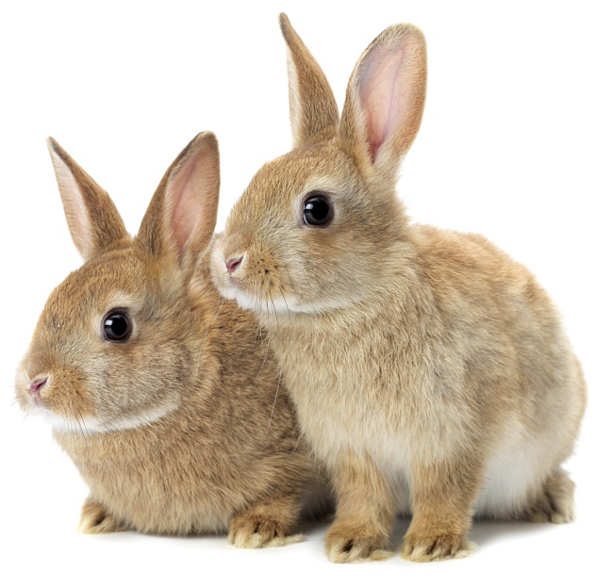
Animal Welfare Debates

Slide 2
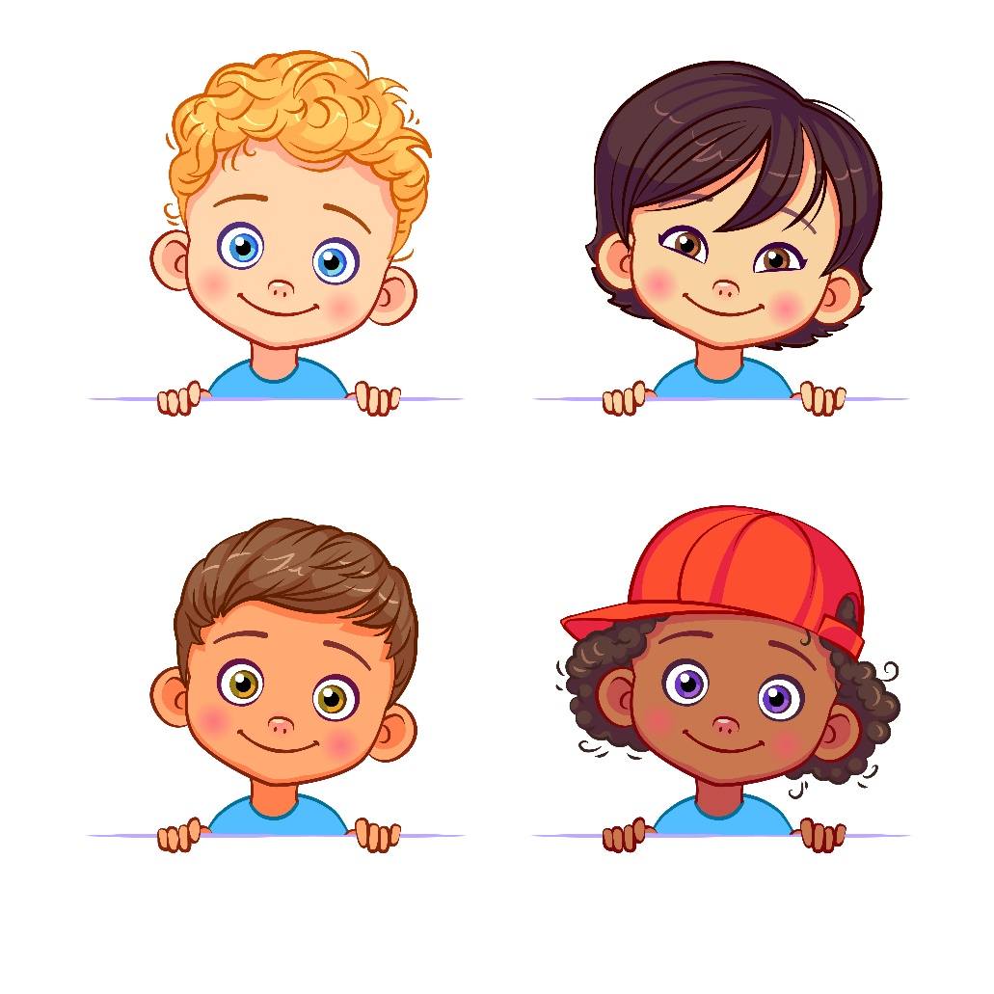
Which child do you think is correct?
I think that animals can’t be sad because they can’t tell me they are sad.
Ryan
Alice
Can animals be sad?
Animals can be sad, because they have feelings too.
Animals can’t be sad because only people can be sad.
Oscar
Grace

Slide 3
Learning Objectives
- To become aware of issues involving animal welfare and form an opinion on them.
- To speak clearly in front of an audience and listen attentively to others.
- To use fact to justify opinion.
Learning Outcomes
P
I can form an opinion on current animal welfare issues and be able to talk about these with a classmate.
I can speak clearly about my opinion in front of an audience.
I can justify my opinion with facts and take on board the opinion of others.

Slide 4
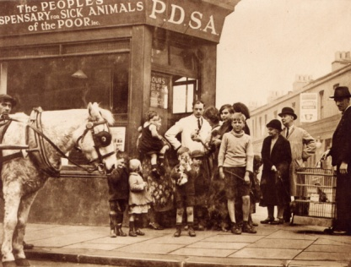
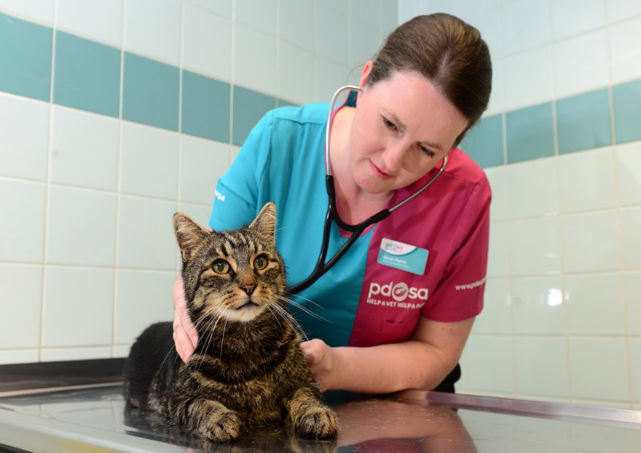
The UK’s leading vet charity …
PDSA is a 100 year old charity who have been treating sick and injured pets since 1917
They have Pet Hospitals all over the UK
They help one sick or injured pet every 5 seconds!
It costs the charity more than
£1 million every week to do their work
Notes:
Share the details on the slide and:
Tell children that PDSA treat the sick and injured pets of people in need..
Ask them if they think it’s important to help sick and injured animals to get better.
Explain that PDSA is a special kind of vets, because they’re a charity. Ask them what a charity does and explain that PDSA looks after pets when owners can’t afford vet treatment.
Ask them what would happen to all the sick and injured pets PDSA treat if they weren’t around.

Slide 5
A HOME
FRIENDS
HEALTH
FOOD & WATER
EXERCISE & FUN
What do animals need to be happy?
Notes:
All pets, whether they’re large or small, need the same five things to keep them healthy and happy:
The right kind of safe, warm home with lots of space
The right kind of food and 24 hour access to fresh water
Exercise and fun (the chance to show normal behaviour)
Friends (This can be other animals, people, or both)
Health ( We all need to make sure our pets are kept healthy and take them to the vet when they’re not well)
Ask whose responsibility it is to keep pets healthy and happy and confirm that owners are responsible for looking after their pet properly.

Slide 6
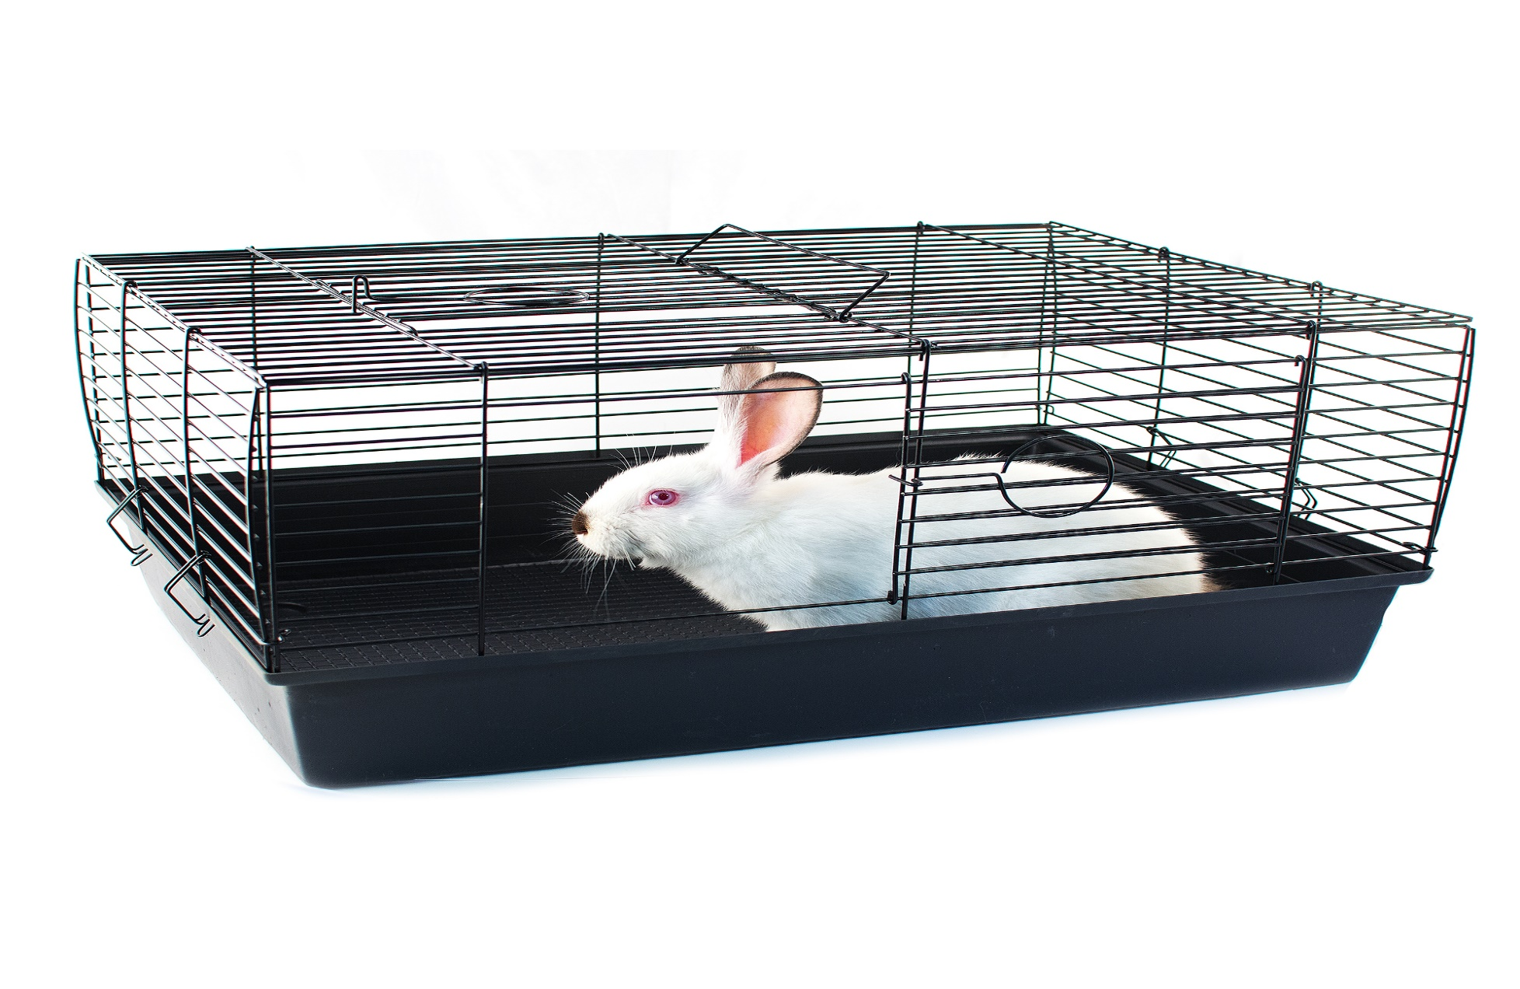
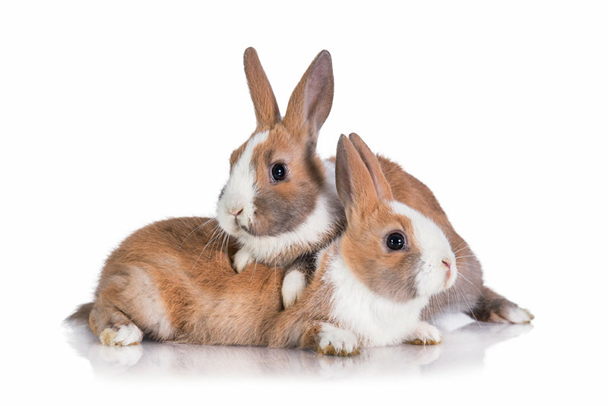
Should animals be kept in cages?
What do you think?

Slide 7
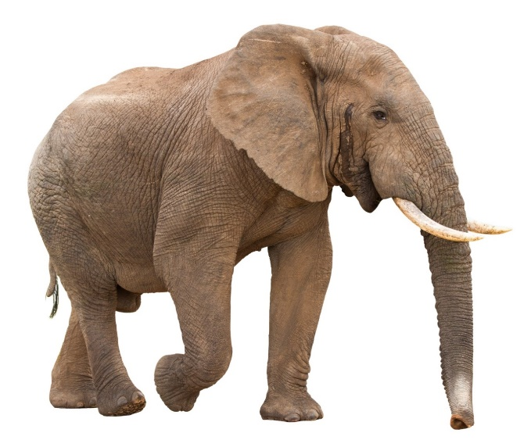
Elephants might not live as long in a zoo as they would in the wild.
TRUE or FALSE?
Facts about caged animals

Slide 8
The average life span of an elephant is greater in the wild.
TRUE
Facts about caged animals
Notes:
The average life span of an elephant in the wild is 56 years, but in a zoo it is only 16 years.

Slide 9
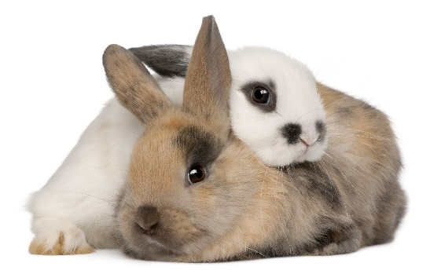
Rabbit hutches only need to be big enough for a rabbit to stretch out in.
TRUE or FALSE?
Facts about caged animals

Slide 10
Rabbits need to be able to do 3 bunny hops in any direction.
FALSE
Facts about caged animals
Notes:
Rabbits also need to be able to make at least three hops in their hutch.

Slide 11
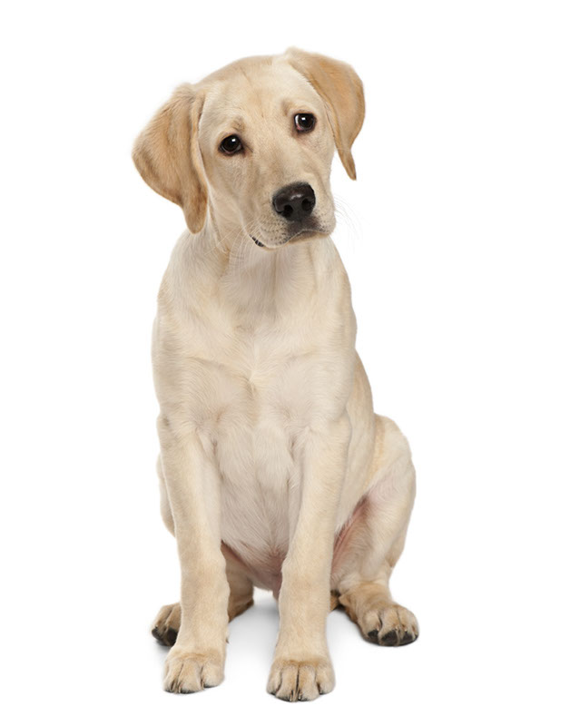
Dogs should not be in crates, even in the car.
TRUE or FALSE?
Facts about caged animals

Slide 12
If you are transporting a dog in a car, it is much safer to keep them in a crate for the duration of the car journey.
FALSE
Facts about caged animals
Notes:
If you are transporting a dog in a car it is much safer to have them in a crate, but only for the time it is in the car. Most dogs also feel safer when they are in a crate in the car.

Slide 13
Have the facts changed your mind at all?
Does keeping animals in cages meet their 5 Welfare Needs?
A HOME
HEALTH
FRIENDS
FOOD & WATER
EXERCISE & FUN
Facts about caged animals

Slide 14
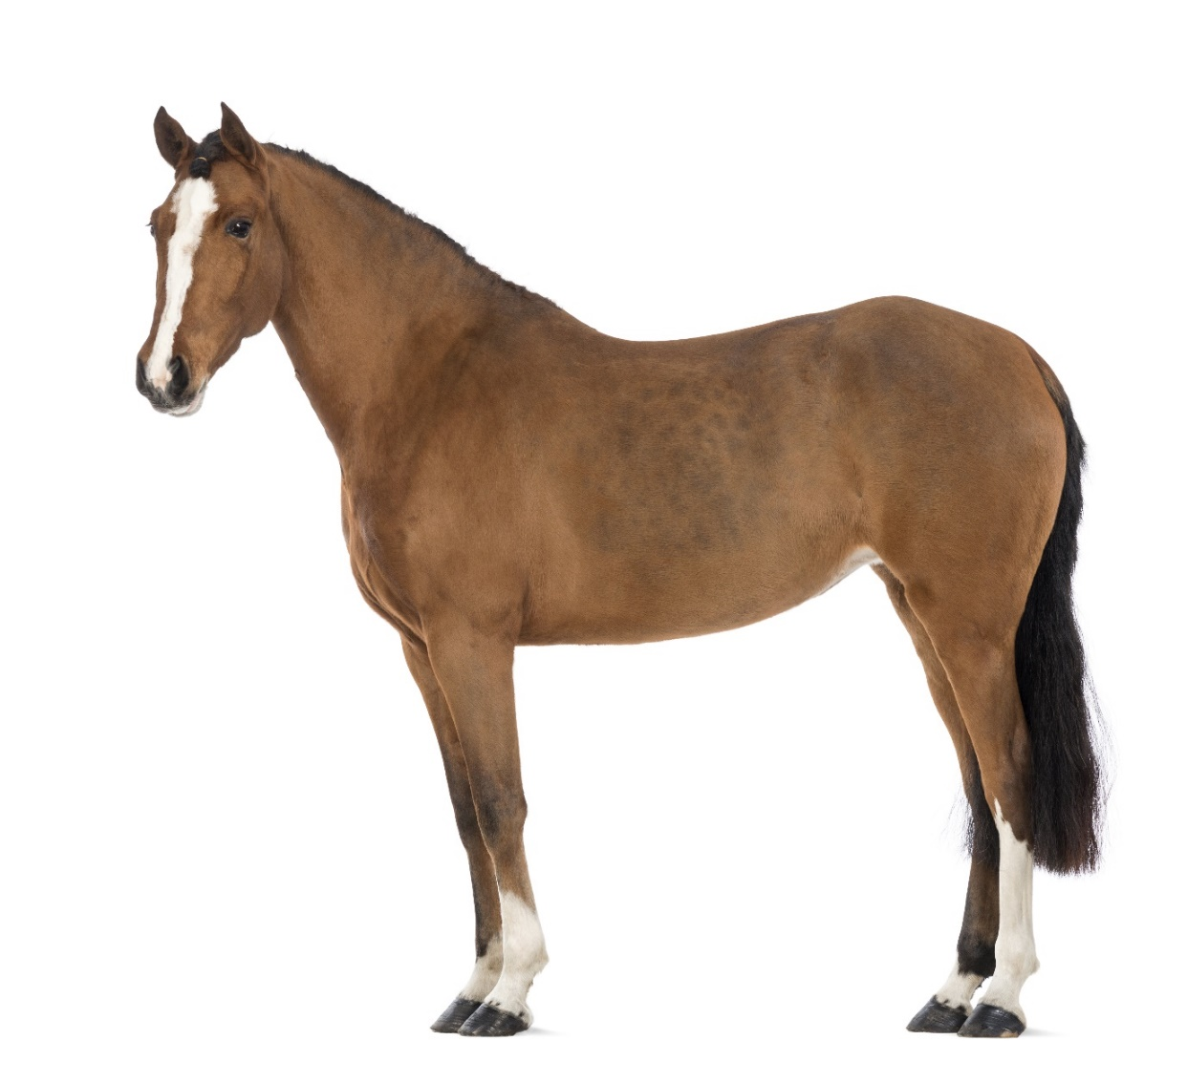
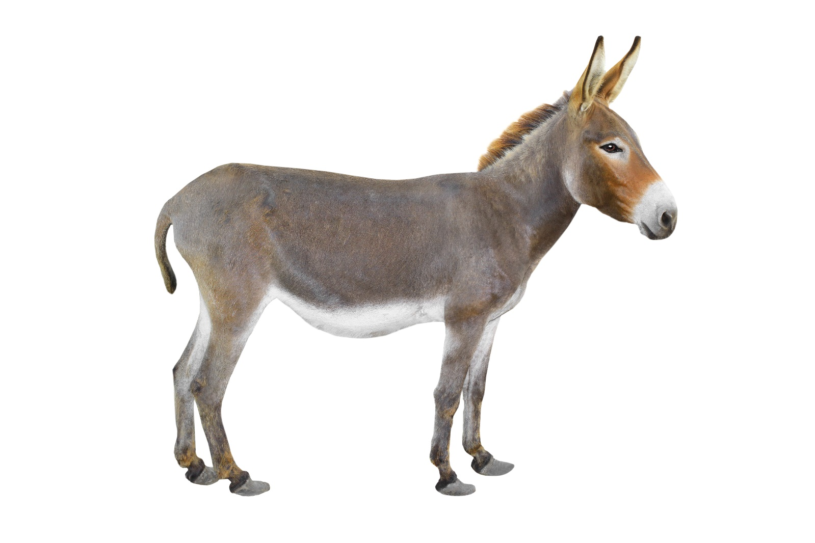
Is it kind to ride horses/donkeys?
What do you think?

Slide 15
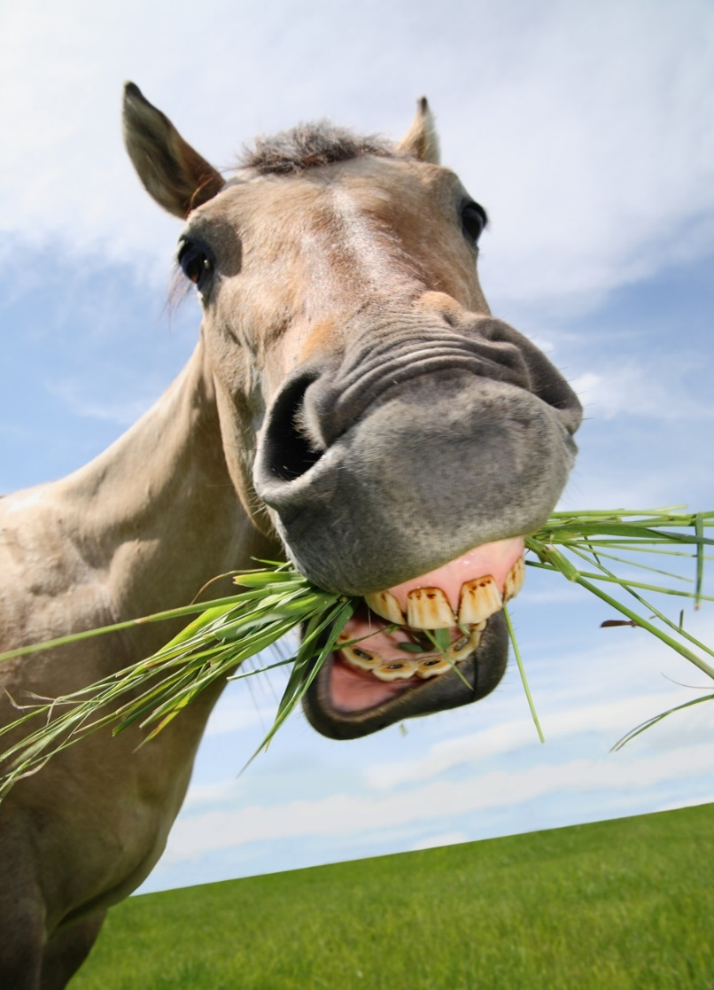
It is only recently that humans started riding horses.
TRUE or FALSE?
Facts about horse riding

Slide 16
The first documented horse ride occurred in 4200 B.C.
FALSE
Facts about horse riding
Notes:
Horses were first domesticated around 10,000 years ago with the first documented horse ride occurring in 4200 B.C.

Slide 17
It is illegal to offer donkey rides on the beach.
TRUE or FALSE?
Facts about horse riding

Slide 18
It is illegal to offer donkey rides on the beach.
FALSE
Facts about horse riding
Notes:
People are allowed to offer donkey rides on the beach as long as the donkeys are fit, over 4 years old, wearing properly maintained tack and the donkeys are willing to be ridden. The owner must also have a license. The donkeys must have appropriate rest periods with tack removed and be given ample food and water. They also must have at least one day off a week.

Slide 19
Horses can be really hurt by their saddle.
TRUE or FALSE?
Facts about horse riding

Slide 20
Horses can be really hurt by their saddle.
TRUE
Facts about horse riding
Notes:
It is important to make sure that a horse’s saddle is fitted properly by a professional and is checked regularly, as it can cause back problems and sores if it does not fit well. Liken to wearing shoes that don’t fit.

Slide 21
Have the facts changed your mind at all?
Does riding horses and donkeys meet their 5 Welfare Needs?
A HOME
HEALTH
FRIENDS
FOOD & WATER
EXERCISE & FUN
Facts about horse riding

Slide 22
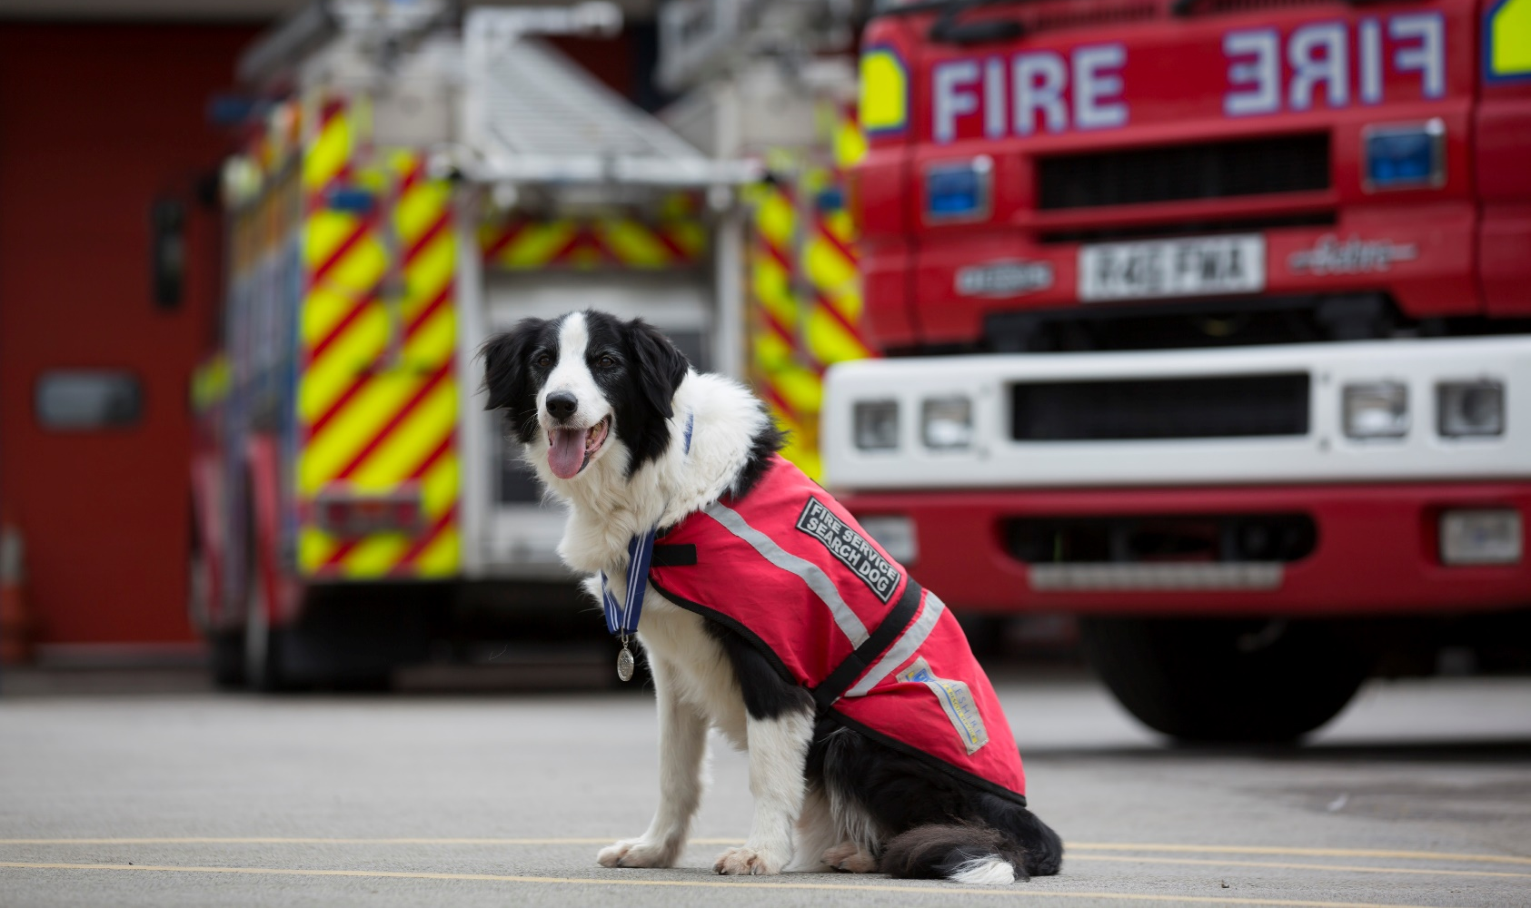
Should dogs be used for jobs such as farming and police work?
What do you think?

Slide 23
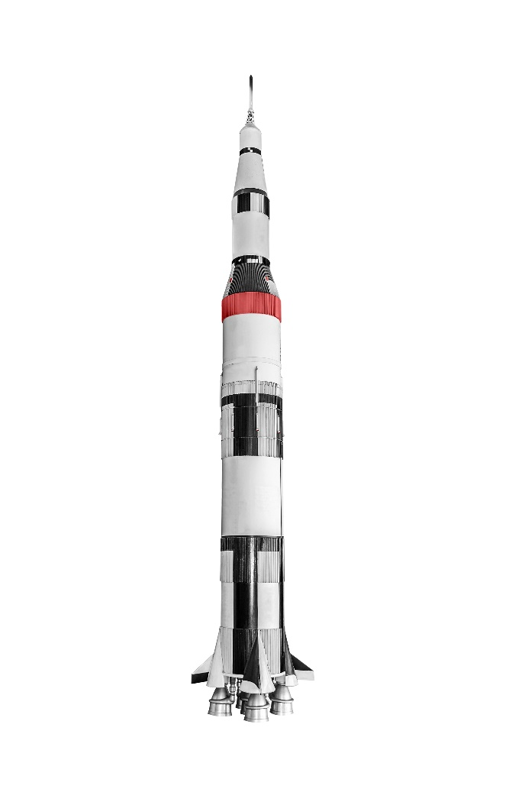
A dog was the first animal to be sent to space.
TRUE or FALSE?
Facts about dogs with jobs

Slide 24
A dog called Laika was launched in to space in 1957.
TRUE
Facts about dogs with jobs
Notes:
She was a husky type breed called Laika and was launched into space in 1957 in a Sputnik.

Slide 25
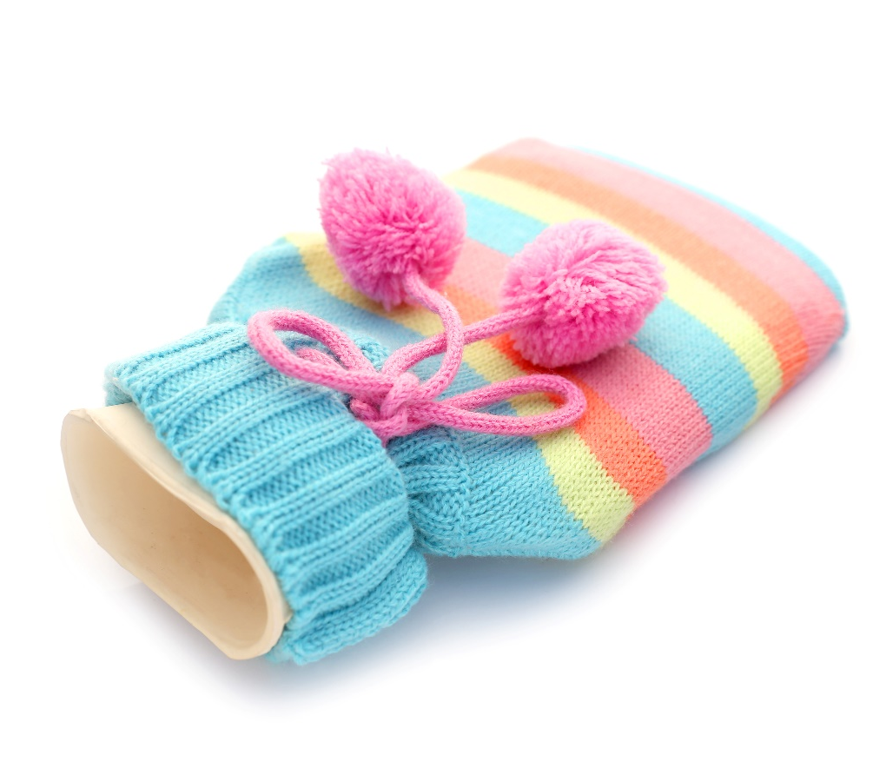
In ancient times, dogs were used as hot water bottles.
TRUE or FALSE?
Facts about dogs with jobs

Slide 26
In Ancient China people kept themselves warm by carrying around small dogs!
TRUE
Facts about dogs with jobs
Notes:
In Ancient China, when the weather was cold, people would keep themselves warm by carrying around small dogs! They kept them up their sleeves like hot water bottles.

Slide 27
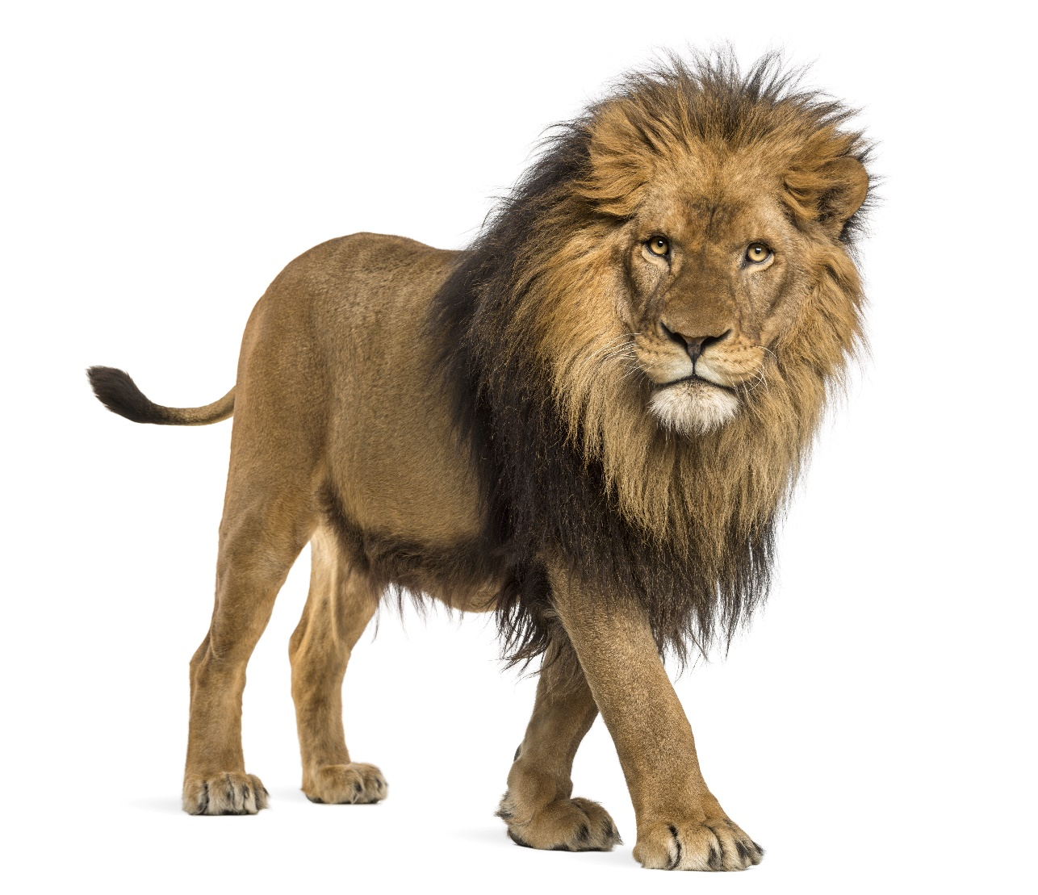
Some dogs were bred to hunt lions
TRUE or FALSE?
Facts about dogs with jobs

Slide 28
Some dogs were bred to hunt lions.
TRUE
Facts about dogs with jobs
Notes:
Rhodesian Ridgebacks were originally bred to hunt lions!
You could also bring up that dogs help to save people’s lives and show these links:
https://www.bbc.co.uk/news/magazine-33463191
https://metro.co.uk/2017/09/21/rescue-dog-who-has-saved-52-lives-is-hard-at-work-after-mexico-earthquake-6944553/

Slide 29
Have the facts changed your mind at all?
Does using dogs for jobs meet their 5 Welfare Needs?
A HOME
HEALTH
FRIENDS
FOOD & WATER
EXERCISE & FUN
Facts about dogs with jobs

Slide 30
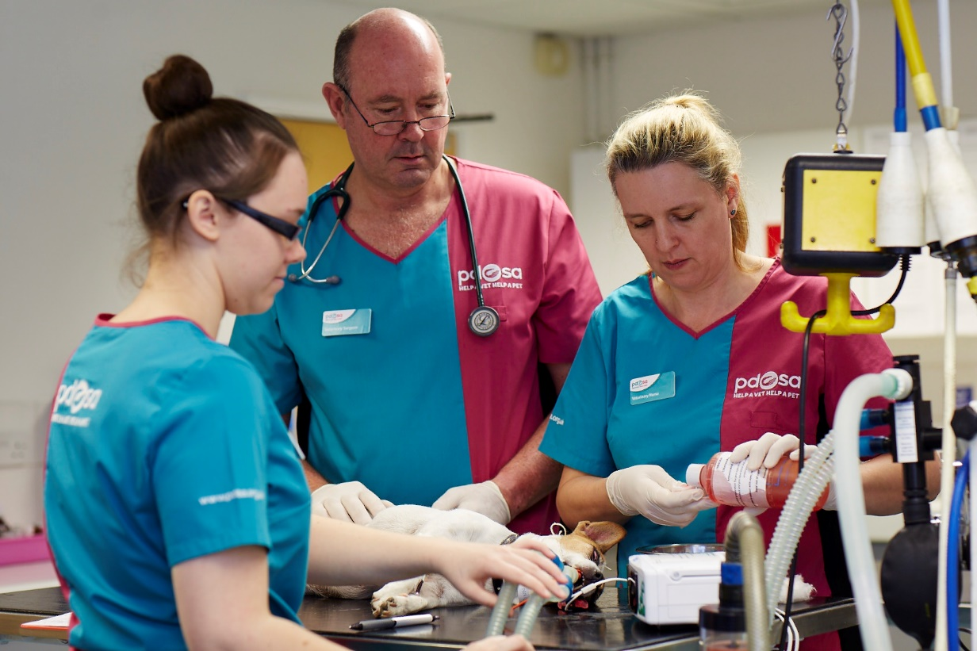
Should we neuter/spay animals?
What do you think?
Notes:
Neutering/spaying is where the animal has an operation so that they wont be able to have babies.

Slide 31
Spaying and neutering your pet can help prevent other illnesses.
TRUE or FALSE?
Facts about spaying/neutering

Slide 32
Spaying and neutering your pet can help prevent infections and even some kinds of cancer.
TRUE
Facts about spaying/neutering
Notes:
It can actually help prevent some kinds of cancer and infections.

Slide 33
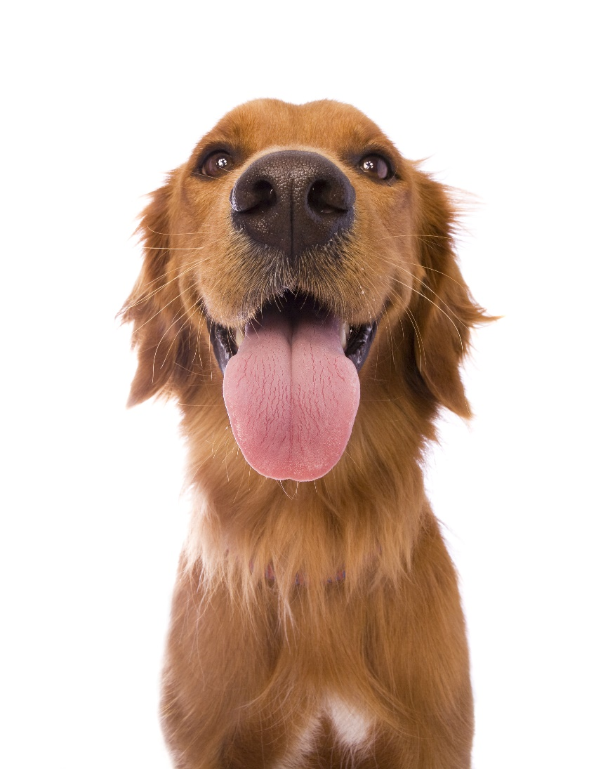
Spaying/neutering your pet will make them fat.
TRUE or FALSE?
Facts about spaying/neutering

Slide 34
Your pet will become overweight if they’re overfed and under-exercised.
FALSE
Facts about spaying/neutering
Notes:
Your pets will only become fat if you give them too much food and not enough exercise.

Slide 35
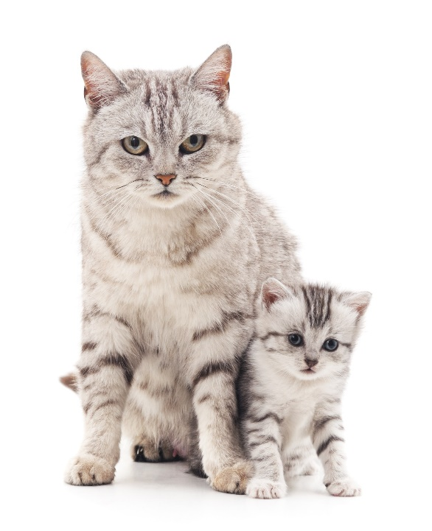
It’s not fair to take away their right to produce offspring.
TRUE or FALSE?
Facts about spaying/neutering

Slide 36
Thousands of unwanted pets are left without a home each year.
FALSE
Facts about spaying/neutering

Slide 37
Have the facts changed your mind at all?
Does spaying/neutering animals meet their 5 Welfare Needs?
A HOME
HEALTH
FRIENDS
FOOD & WATER
EXERCISE & FUN
Facts about spaying/neutering

Slide 38
It is ok to have different opinions as long as you can explain why!
?

Slide 39
As pet owners we need to make sure we meet the needs of our pets.
What are the 5 Welfare Needs?
HEALTH
A HOME
FRIENDS
FOOD & WATER
EXERCISE & FUN

Slide 40
Thanks!

