Slide 1
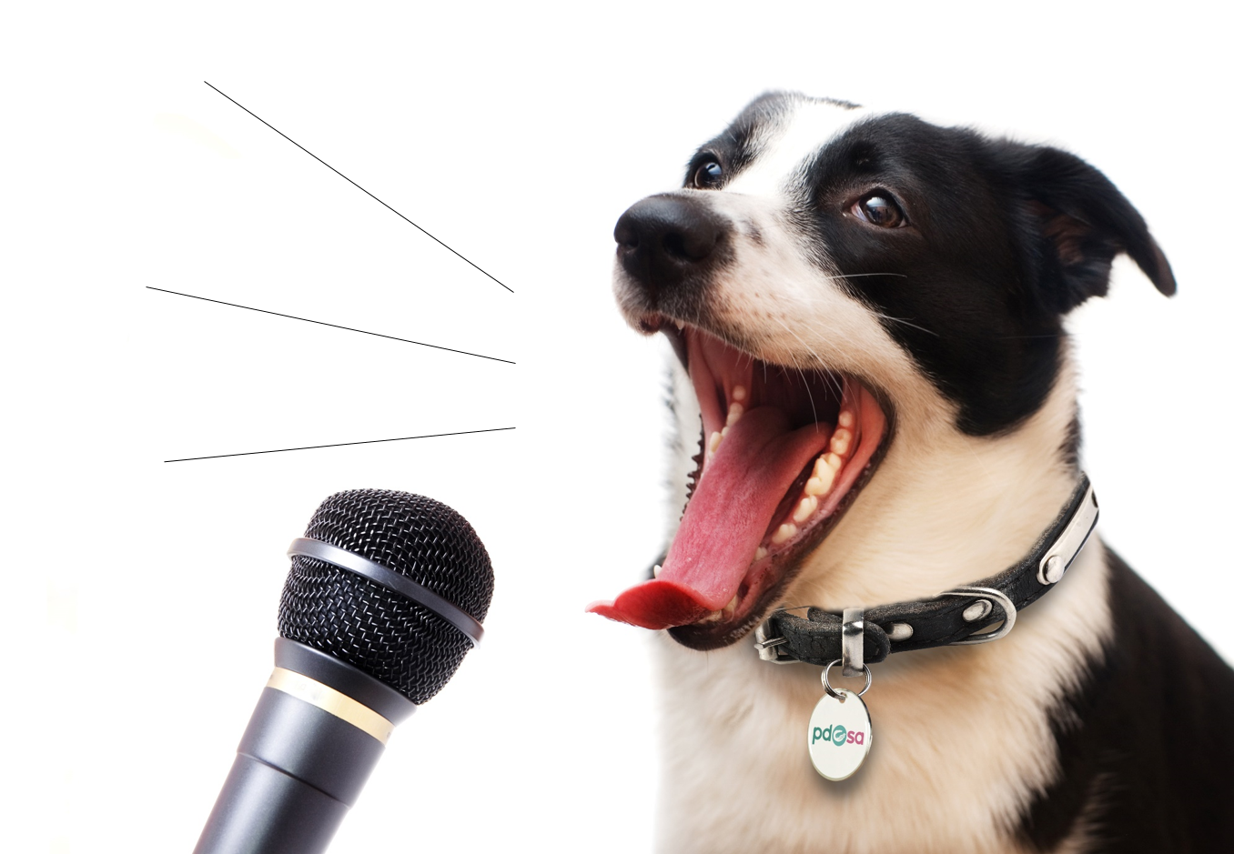
Animal Communication
Notes:
Introduce PDSA
Ask questions: who has a dog, who’s nervous of dogs?
Explain that today you’re going to share with them your knowledge and skills about how to speak dog.
Give an overview of session – explain that at the end of the session, they’ll:
Know what amazing skills animals have
Understand how our pets are feeling and how they ‘talk’ to you through their body language, if you’ll listen
Be able to keep themselves and their pets safe

Slide 2
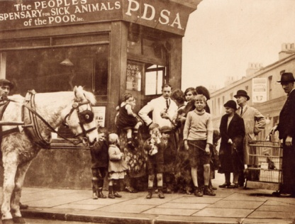
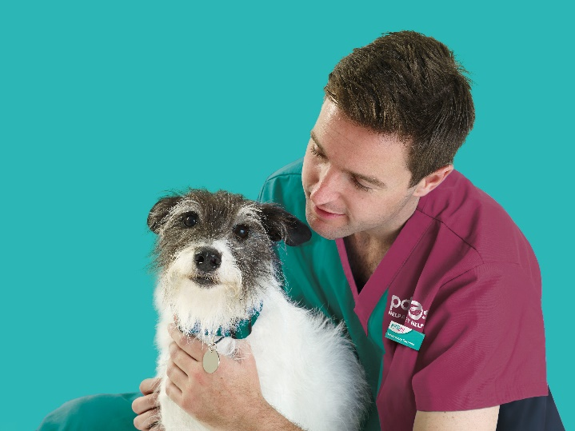
The UK’s leading vet charity..
Our charity is 100 years old, we’ve been treating sick and injured pets
since 1917
We have Pet Hospitals all over the UK
We help a sick or injured pet every 5 seconds!
It costs more than £1 million every week to do our work
Notes:
Share the details on the slide and:
Explain that PDSA is a special kind of vets, because we’re a charity. Ask them what a charity does and explain that PDSA looks after pets when owners can’t afford vet treatment.
Ask them if they think what PDSA does is important
Ask them what would happen to all the sick and injured pets PDSA treat, if we weren’t around.
Ask the group where they think the money comes from for PDSA to treat all these sick and injured pets - Explain that it comes from people doing fundraising and donating money

Slide 3
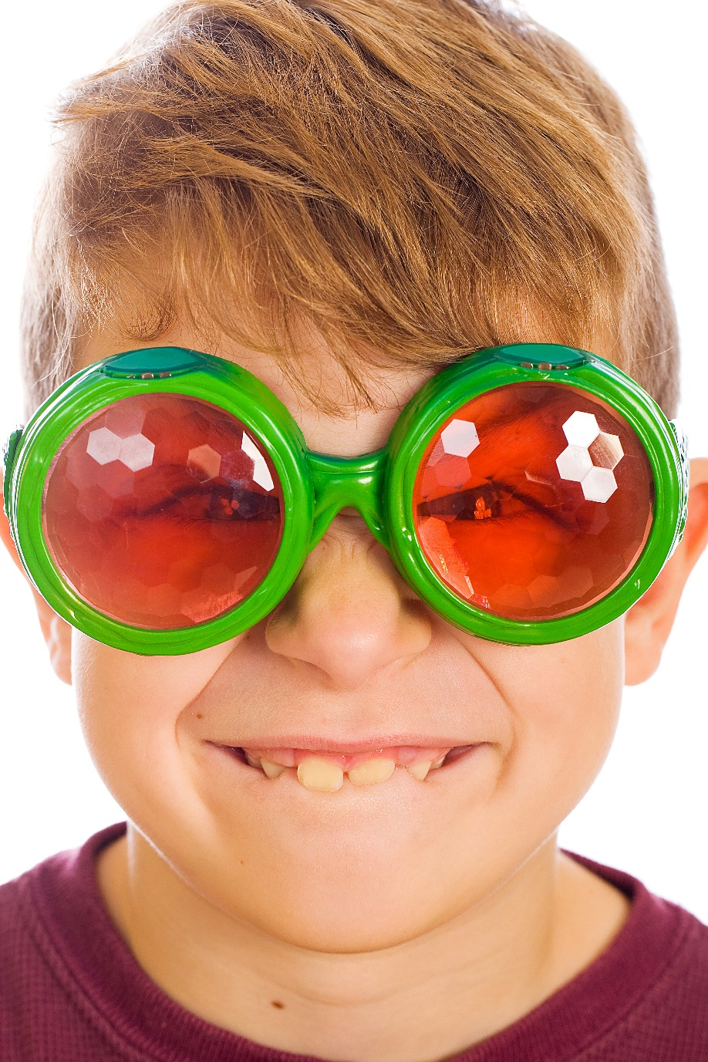
Emotions & body language
I’m angry
I’m confused
I’m excited
I’m lonely
I’m stressed
I’m happy
Notes:
As humans we use both words and body language to convey how we feel….
Body language is the non verbal communication that is used to tell others how we feel.
Animals – particularly dogs, are very good at understanding human body language – for those of you that have dogs – have you ever noticed how sometimes you just ‘think’ about getting up from your sofa to take them for a walk – you haven’t even moved yet – but they know – and they are at your feet with that expectant look in their eyes…..shall I get the lead now?
Throughout this session we’ll look at how we as humans use body language to communicate with each other and how different animals communicate with each other and with us humans.
Let’s start with the easy bit – humans…..

Slide 4
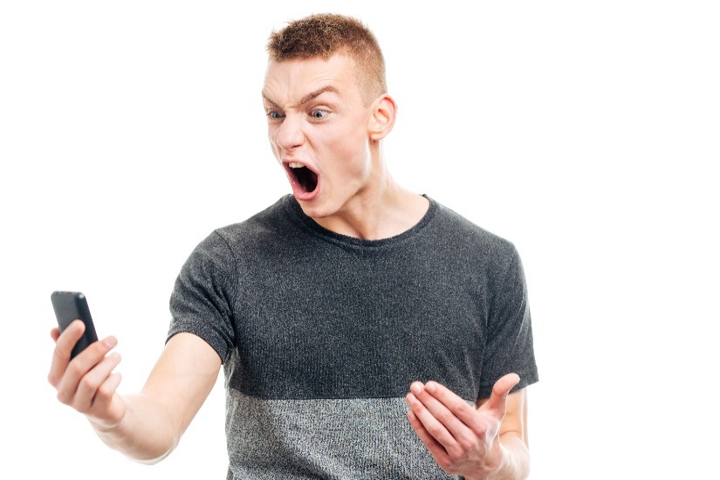
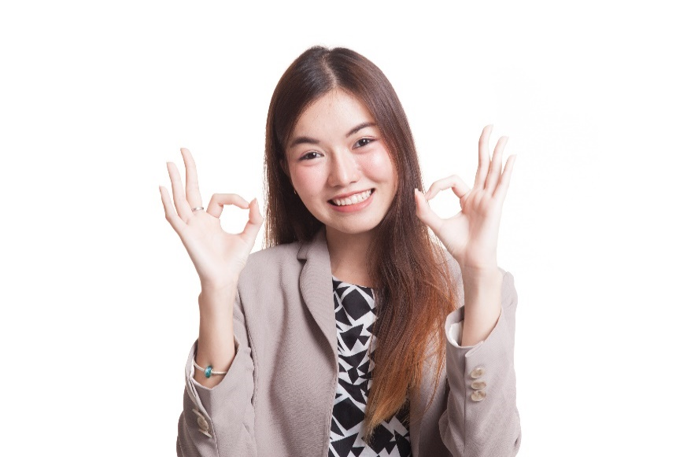
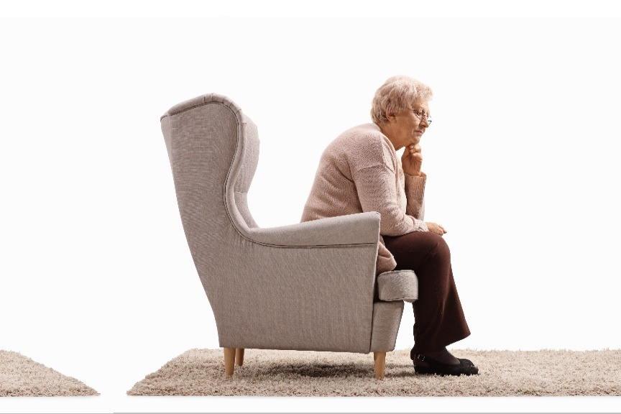
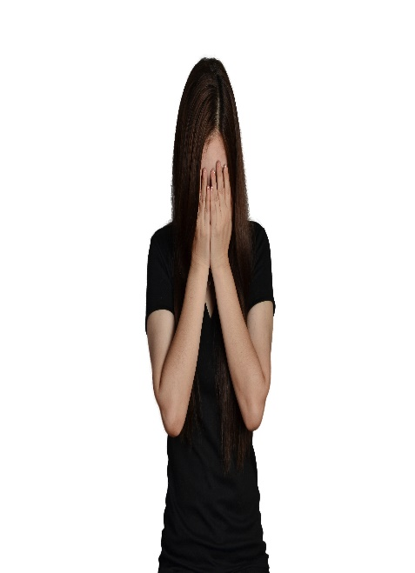
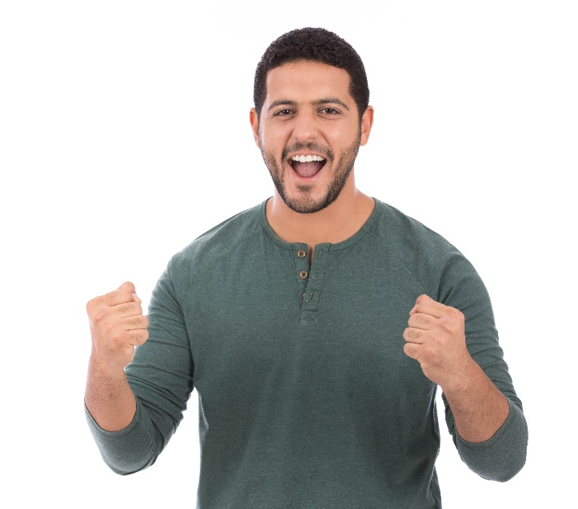
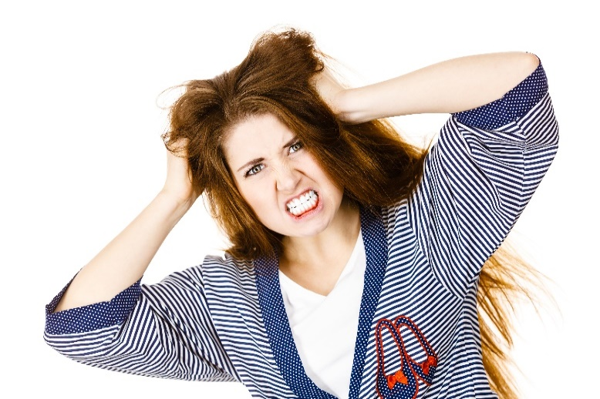
How do these people feel?
Notes:
What do you think these people are feeling? (go through each image and use questioning to discuss with group)
Without talking to each other, how can people understand what someone is trying to say? We normally do it through body language – this means you can tell what a person is feeling or trying to tell you just by looking at them.

Slide 5
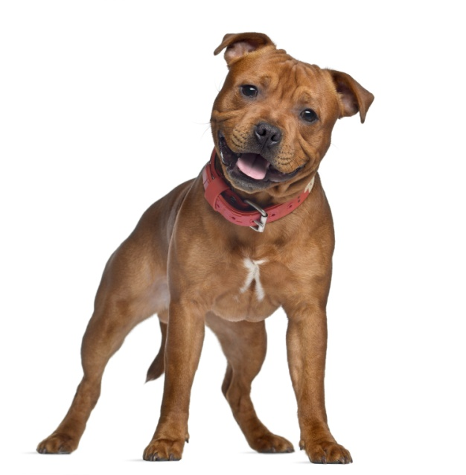
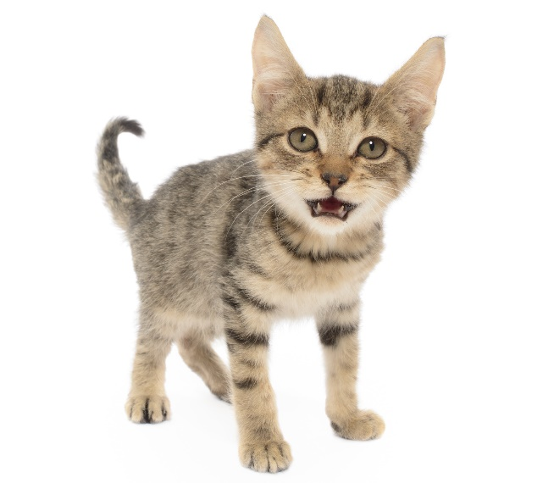
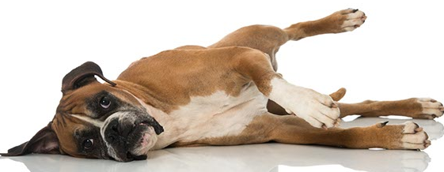
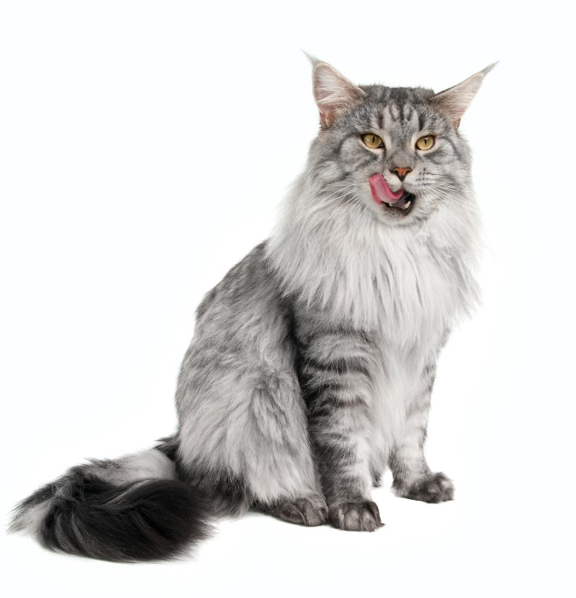
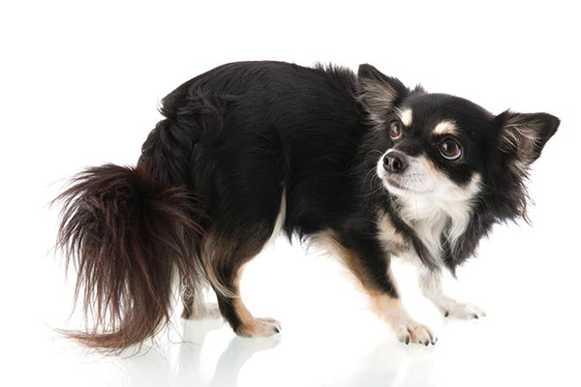
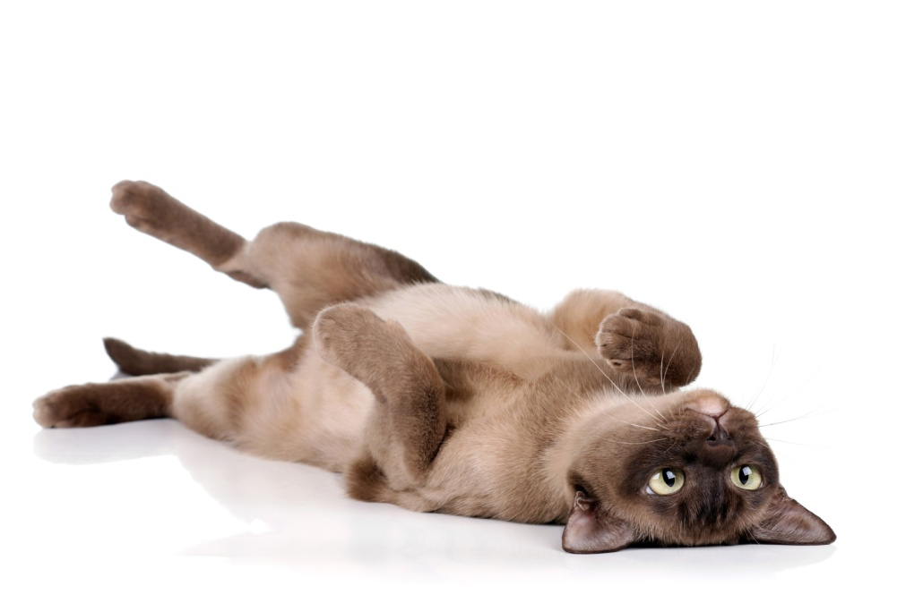
How do these animals feel?
Notes:
Now lets move on to animals – can you tell how these animals are feeling just by looking at these images?
Write down in your groups how you feel each of these animals is feeling and we’ll revisit this later to see if you were right.

Slide 6
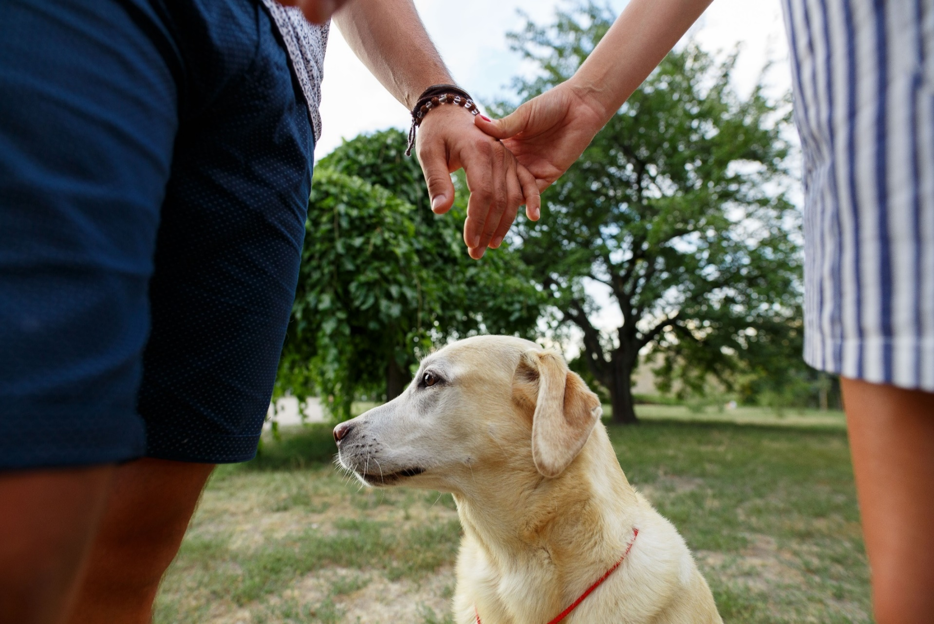
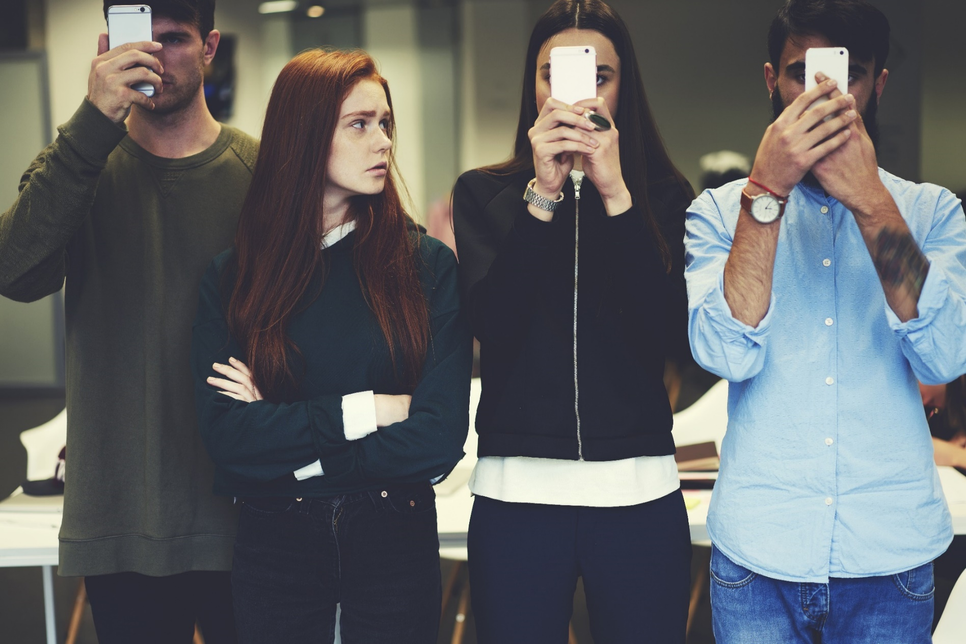
How would you feel if people didn’t listen?
Notes:
Now think about how you would feel if you were trying to say something important and no one was listening. Can anyone tell me how they’d feel? (Angry, frustrated etc.)
If you were shouting and shouting and shouting – and people weren’t listening, how would you feel?
IT’S THE SAME FOR PETS

Slide 7
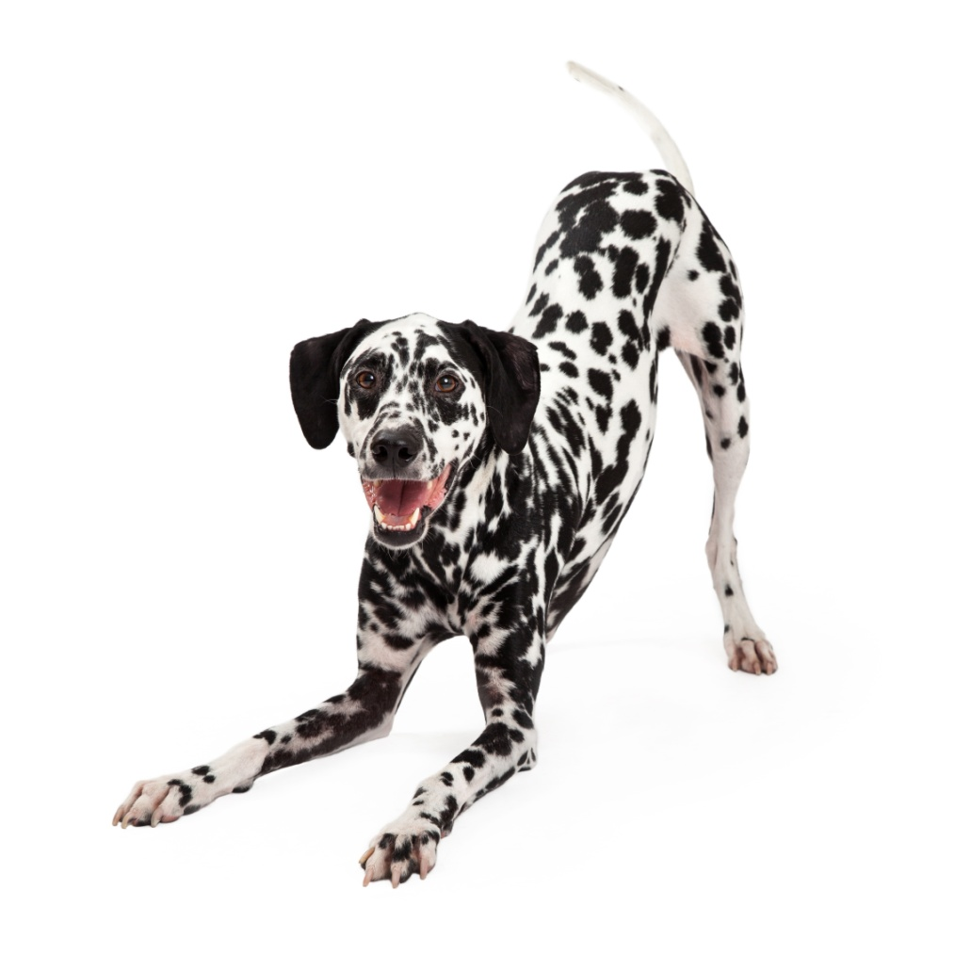
Relaxed & playful
Notes:
Both animals in this slide are showing playful/relaxed body language:
Cat – laid on back – is a very vulnerable position for a cat. The body is soft as is the gaze from her eyes.
Dog – this dog has adopted the ‘play bow’ position – legs lowered with bum in the air inviting play, the tail is wagging and loose, mouth open, relaxed/soft body, eyes alert but soft, ears pricked facing forwards – you can actually see the smile on his face!

Slide 8
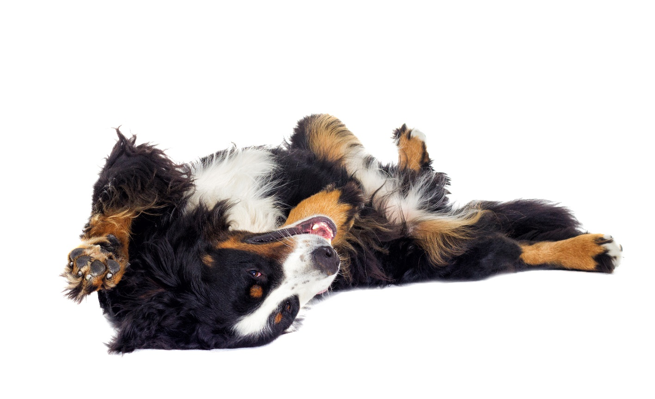
Not everything that looks the same means the same to all…
Notes:
Both these animals look as if they’re relaxed, happy and may even be inviting a ‘belly rub’.
Although you’d be right in thinking they’re both happy and relaxed, the way these two species may react to a belly rub may be completely different.
Dogs who look like this – loose and wiggly (as opposed to the stiffness in the legs of the Boxer dog we saw earlier) are very likely to be inviting a belly rub and make even wriggle around gleefully with the touch of your hand on their tummy.
For cats however, this is a big violation of trust, and if you go in for a belly rub you risk getting bitten or scratched. Try instead giving a little rub under the chin – this will be much better received and your cat will probably rub against you and purr at this.

Slide 9
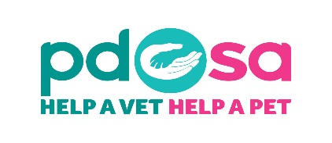
Alert & focused
Notes:
With both dogs and cats when they are alert or focused their ears and eyes with be set in the direction of what it is they are interested in.
They may become more rigid in their body posture as their brain works out the best survival response – fight or flight (or play).
Animals in this state – once they’ve made the decision will quickly alter their posture to reflect how they are feeling.
Example:
The cat has just seen a bird on the lawn – it adopts the posture below, focused on his target, watching the birds every move, waiting for the opportunity to pounce – but the bird quickly flies off into the sky – out of reach of the cat. The cat’s posture changes to reflect this – he watches the birds fly higher into the sky – out of reach and turns his attention back to relaxing in the garden.
Dog – she sees people approaching in the distance and looks to see if they are a danger to her – as soon as she feels they are no threat she relaxes and trots over gently to say hello which may demonstrate the loose, wiggly body language we’ve already spoken about. If however she feels threatened she may act in a couple of different ways – she may retreat, effectively removing herself from the danger – or she may decide that the best way to deal with the threat is to face it head on, she may stand her ground and take the gamble as to whether or not she’ll need to defend herself from the perceived danger.
Lets have a look at what could happen next if things didn’t go according to plan….

Slide 10
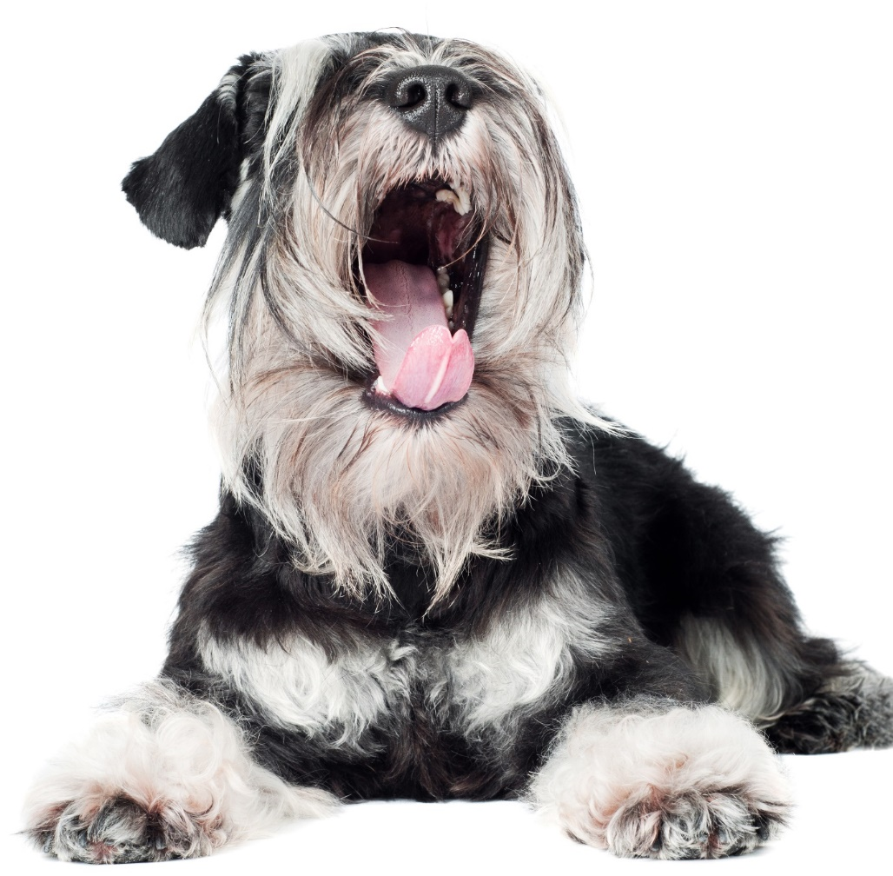
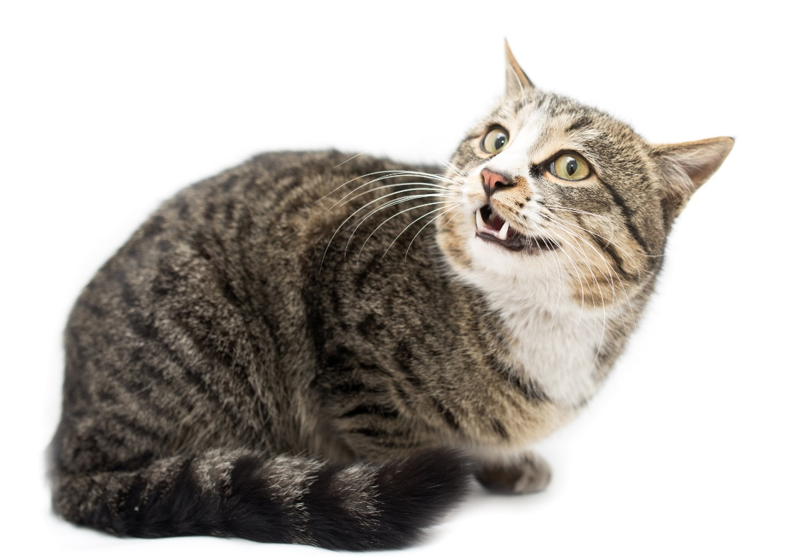
Anxious or worried
Notes:
When cats and dogs feel anxious or worried there are a few behaviours to look out for – it’s easier to tell with dogs as they have more developed facial muscles than cats – this is because dogs are pack animals and have developed these muscles as a way of communicating with each other – cats, being mainly solitary animals do not have the same social need to have developed these muscles.
Cat tend to use more vocalisations than dogs but here are some examples of things they share:
Avoidance – they’ll avoid direct eye contact by looking away or out of the corner of their eyes – in dogs you will often see the whites of their eyes – we call this ‘half moon eye’ or ‘whale eye’. Dogs displaying this should be left alone.
Ears turn flat or back – listening for possible escape roots
Tails – tucked under or wrapped around the body, cats may start to wiggle the end of their tail – showing dissatisfaction at the scenario.
Dogs: Yawning – when they aren’t tired
Cats & Dogs – lip licking when there is no food around
Dogs – furrowed brow
Cats & dogs – smaller body stance – try to make themselves less visible/threatening
Cats – Will sometimes clamp their eyes shut and tuck themselves into a corner. This is dependant on the situation – it’s often in times of stress.
If we /and other animals don’t heed these warning signs, they will make themselves clearer….

Slide 11
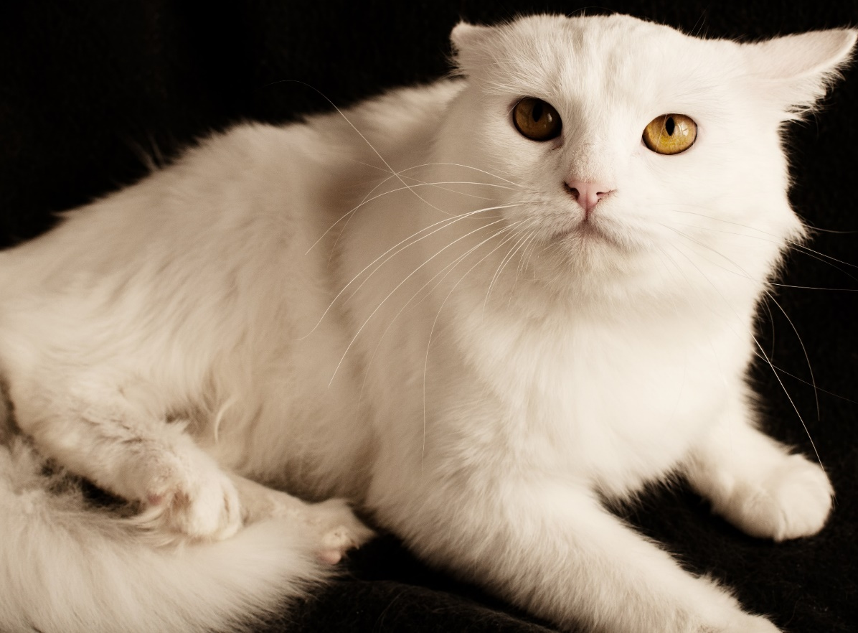
Scared
Notes:
Scared animals show signs a little more obviously – you can see from this cat picture that this cat is getting ready to react – either to run away (look at the back leg – it is not relaxed at all) equally he may decide it’s better to fight this one out – it depends how much he values the thing being threatened to be taken away – it could be that this is the best resting place in the house and another cat has decided they want to lay there instead – he may take his chance and fight for his place – or it could be that the owner has brought out the cat box ready to take the cat to the vet and there’s no way he wants to go in it – the owner could well end up with a scratched hand here!
The dog is very wary – see how the tail is low and starting to tuck under the body – you can also see the ears have flattened, the whites of the eyes and the low body posture – everything about this dog is saying ‘I’m worried/scared, please leave me alone’.
If we pushed this dog it could go either way – she might be so petrified that she may even urinate through fear or she might decide fight is the better option and give a growl or show her teeth in an attempt to stop the situation from escalating further.

Slide 12
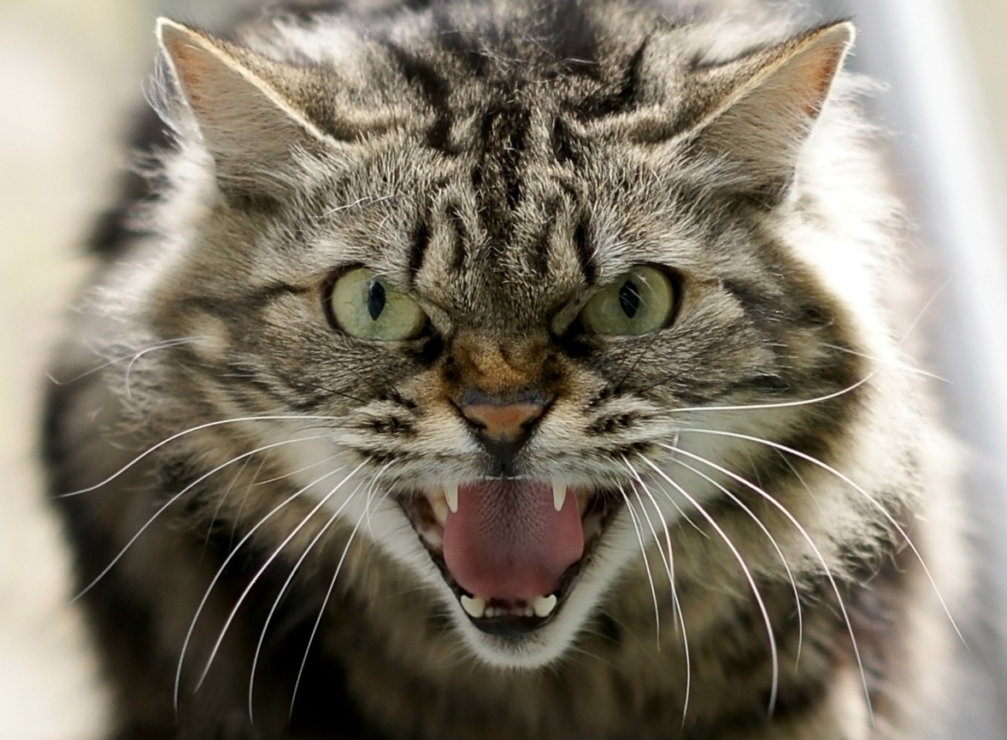
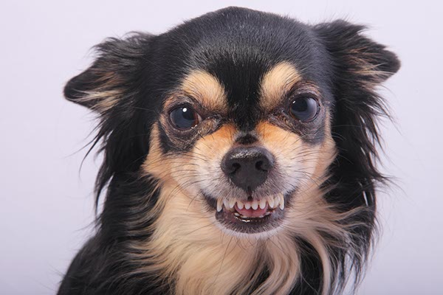
About to react & possibly bite
Notes:
These images are more obvious – you’d have to be very silly to put your hand near either of these animals and expect to not get bitten or scratched. The cat has even managed a furrowed brow in this picture – he’s really angry!
Unfortunately some people, often children, think that this dog is smiling - what could the possible outcomes be to this?
Possible answers:
Warning signs are mistaken for friendly welcome – human reaches out to stroke the dog
Human is warned further by the dog by either a growl, air bite (snap) or actual bite
Explain that the previous signs can sometimes be missed.
Which do you think is worse – cat bites or dog bites

Slide 13
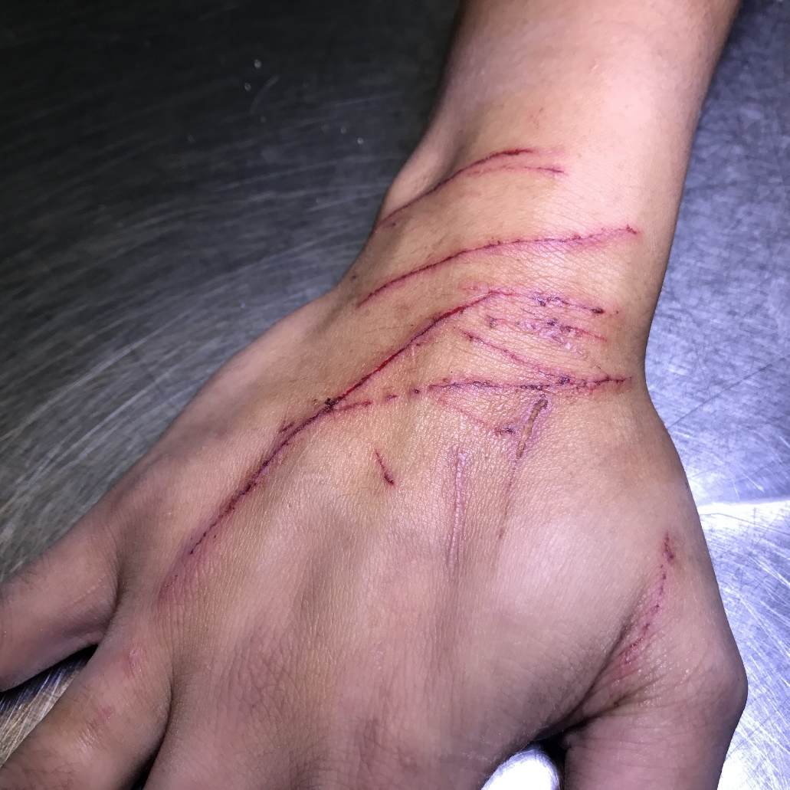
Which is worse?
Cat bites
Dog bites
Cat scratches
Dog scratches
Notes:
In your groups decide:
If a dog and a cat were of equal size which would be the worst / most damaging scratch or bite?
Give reasons for your answers
Answers:
Scratches
Cat scratches are undoubtedly the more painful of the two species – their claws are sharper and designed to hook onto their pray – as such they can hook into your skin and be extremely difficult to remove as they can hook both their front and back claws in the same way – cats win hands down in the claws department!
Bites
These are probably more evenly matched although dogs teeth are thicker so holes may cause more damage, dogs may also have a tendency to ‘shake’ their prey to death – thus causing further tissue damage. Either way you’d need antibiotics and painkillers if either were to bite you due to the bacteria in the animals mouth and both bites are very painful. Cat bites are likely to cause infection as their teeth hold bacteria and they sink their teeth into your skin. The infection moves up your arm and we’ve seen cases where people have nearly lost their thumbs!
Moral of the story here…….don’t get bitten or scratched – it hurts! (image is of a cat scratch to a vet)

Slide 14
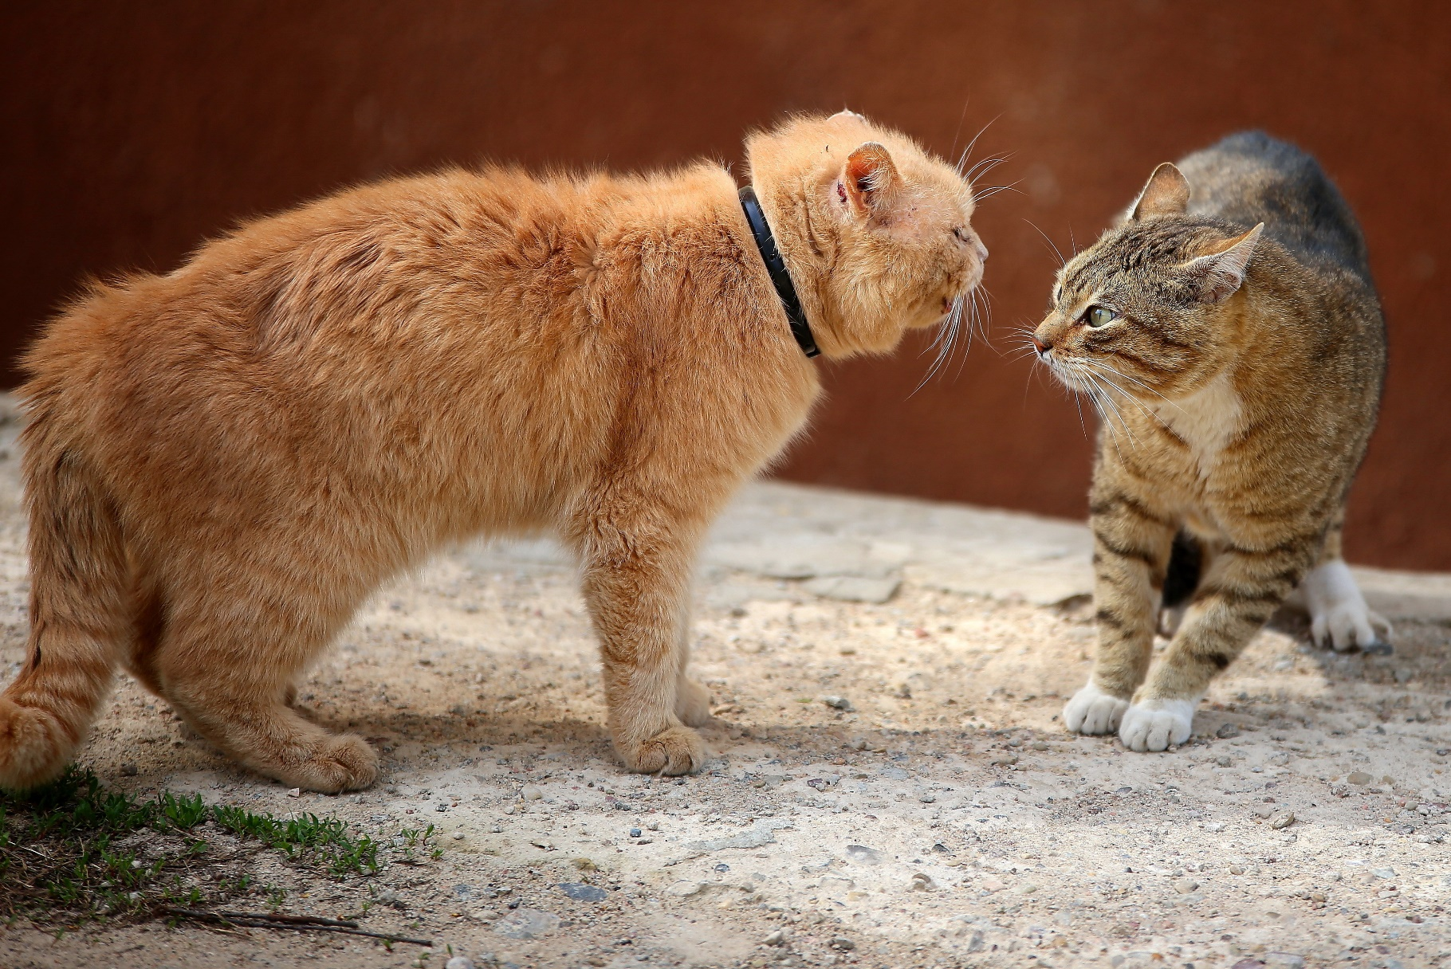
Cats
Notes:
We’ve looked at how animals communicate with us – let’s have a look at how they do this with each other…
What could be happening in this image:
Use what you’ve learned to show what body language each of these cats are showing
Which cat currently has the upper hand?
How do you know this?

Slide 15
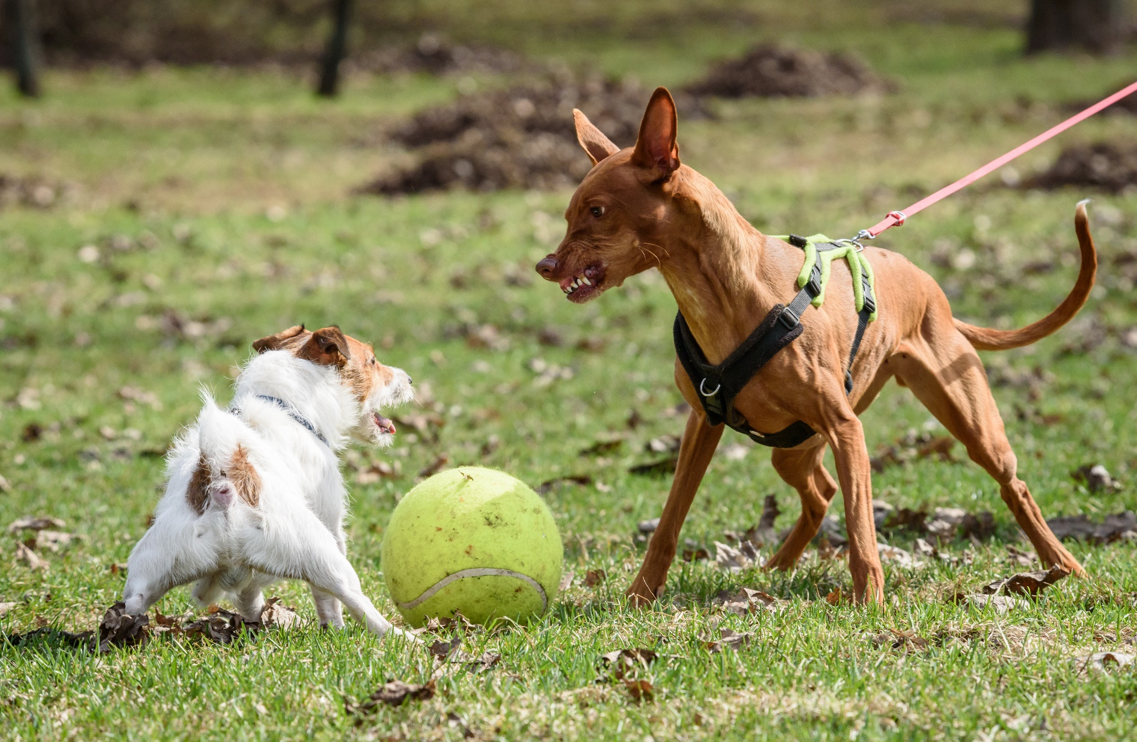
Dogs
Notes:
What could be happening in this image:
Use what you’ve learned to show what body language each of these dogs are showing
Which dog currently has the upper hand?
How do you know this?

Slide 16
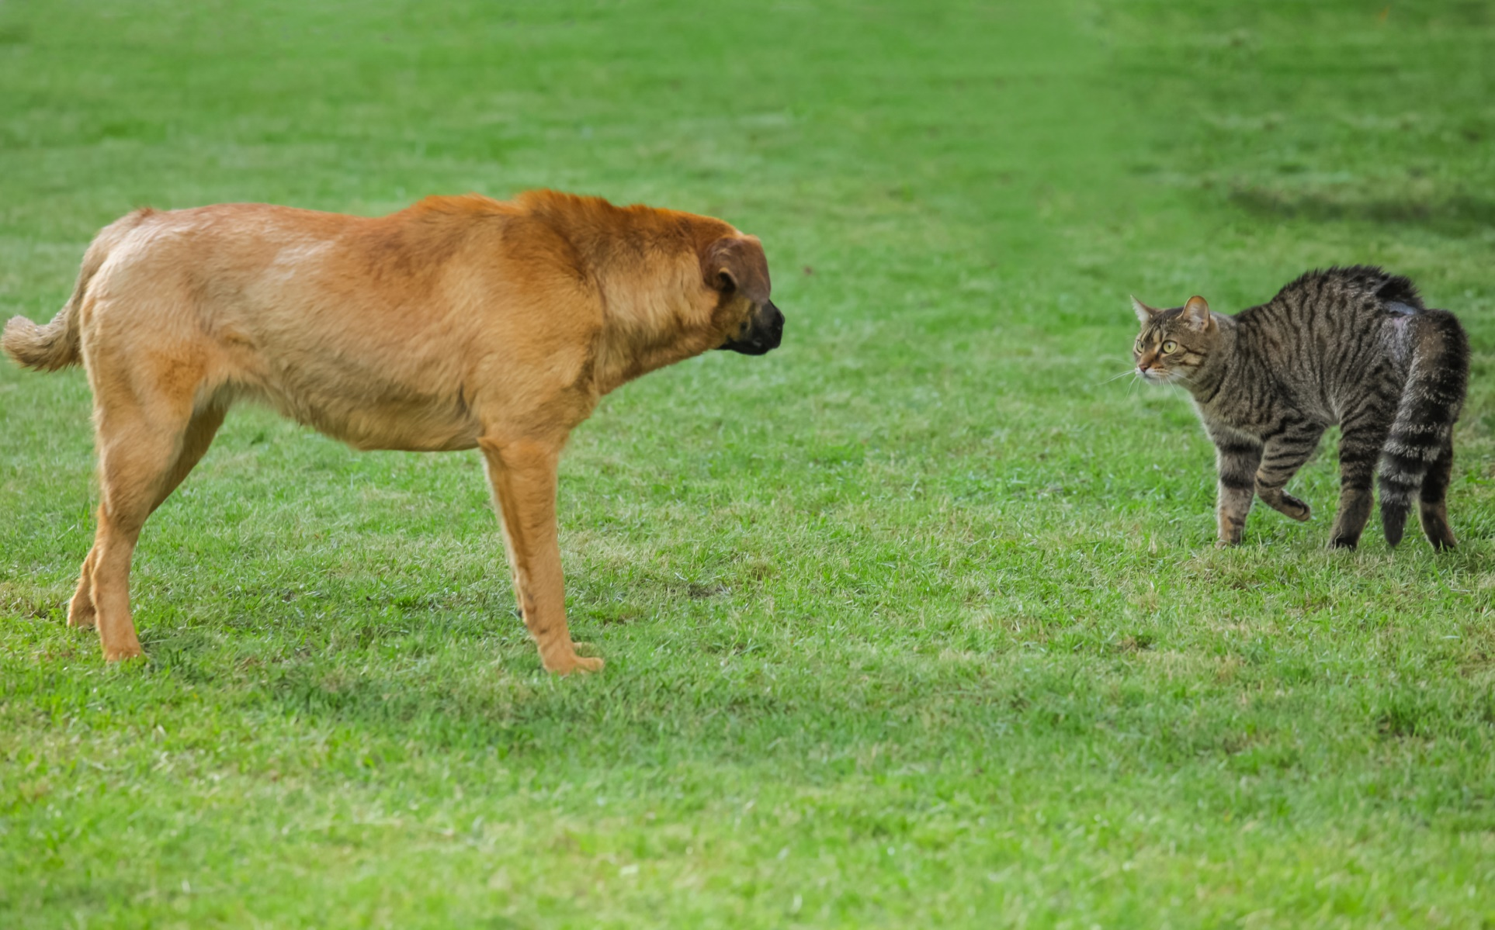
Interspecies interaction
Notes:
Here’s a dog and a cat communicating with each other…
What could be happening in this image:
Use what you’ve learned to show what body language each of these animals are showing
Which currently has the upper hand if any?
How do you know this?
Any idea on what might happen next?

Slide 17
How do these animals feel?
Notes:
Lets revisit the quiz from earlier and see how well you did at identifying how the animals are feeling..
Boxer (top left) – Worried/anxious – furrowed brow, stiffened posture, whites of the eyes showing, mouth closed. This breed in particular suffers from breed-related health issues, such as finding it harder to breath and regulate their body temperature. This means they are likely to get stressed much quicker than other breeds.
Kitten (top middle) – interested – eyes and ears looking forward on point of interest, tail up, mouth open – may be taking in additional scent.
Staffy (top right) – Happy – loose body posture, mouth open and relaxed, ears up, soft gaze
Grey cat (bottom left) – possibly worried/anxious – licking lips, ears turned outwards, no food around. This is normally detected by whisker and ear positions as described earlier.
Chihuahua (bottom middle) – scared – low body posture, tail tucked under body, ears flattening, whites of eyes visible.
Siamese cat (bottom right) – relaxed & happy – laid on back (vulnerable position), soft relaxed body posture, eyes soft
Next we’ll take look at a couple of other popular pet species…..

Slide 18
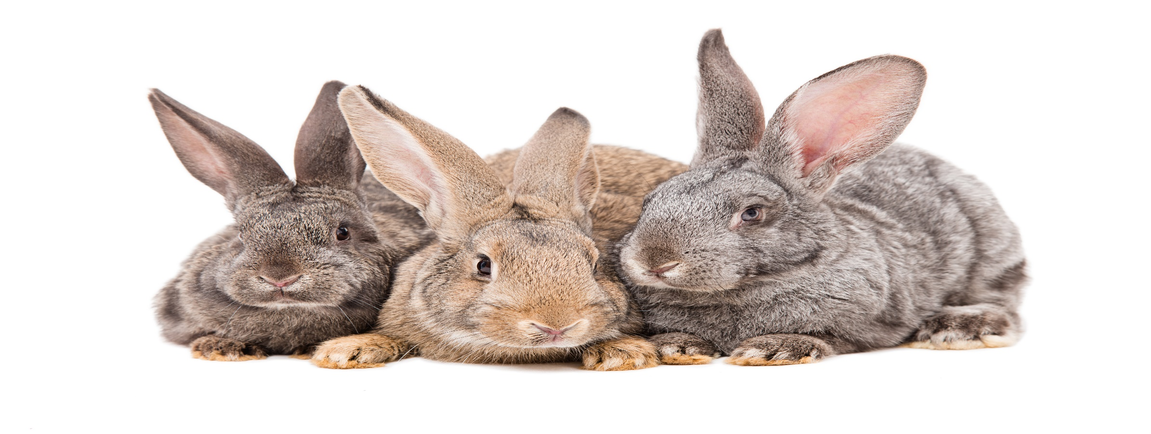
Rabbits
Notes:
Rabbits are highly social animals – in the wild they live in groups of several dozens. They have a pecking order which all rabbits in the group will abide by.
Rabbits are prey animals and spend most of their time making sure each other are ok – they will have various within the group which include:
Look out duty – they will then alert the rest of the group by thumping their hind legs on the ground as a warning or danger.
Playing/socialising – happy rabbits jump in the air – called binkying
Grooming – a very important part of the social and bonding experience for the whole group.
Sleeping
Eating
They live most of the day in tunnels underground and come out at dawn and dusk when it’s more difficult for predators eyes to spot them. Because they spend some much time in the dark they use limited facial expressions and body language but here are a few…

Slide 19
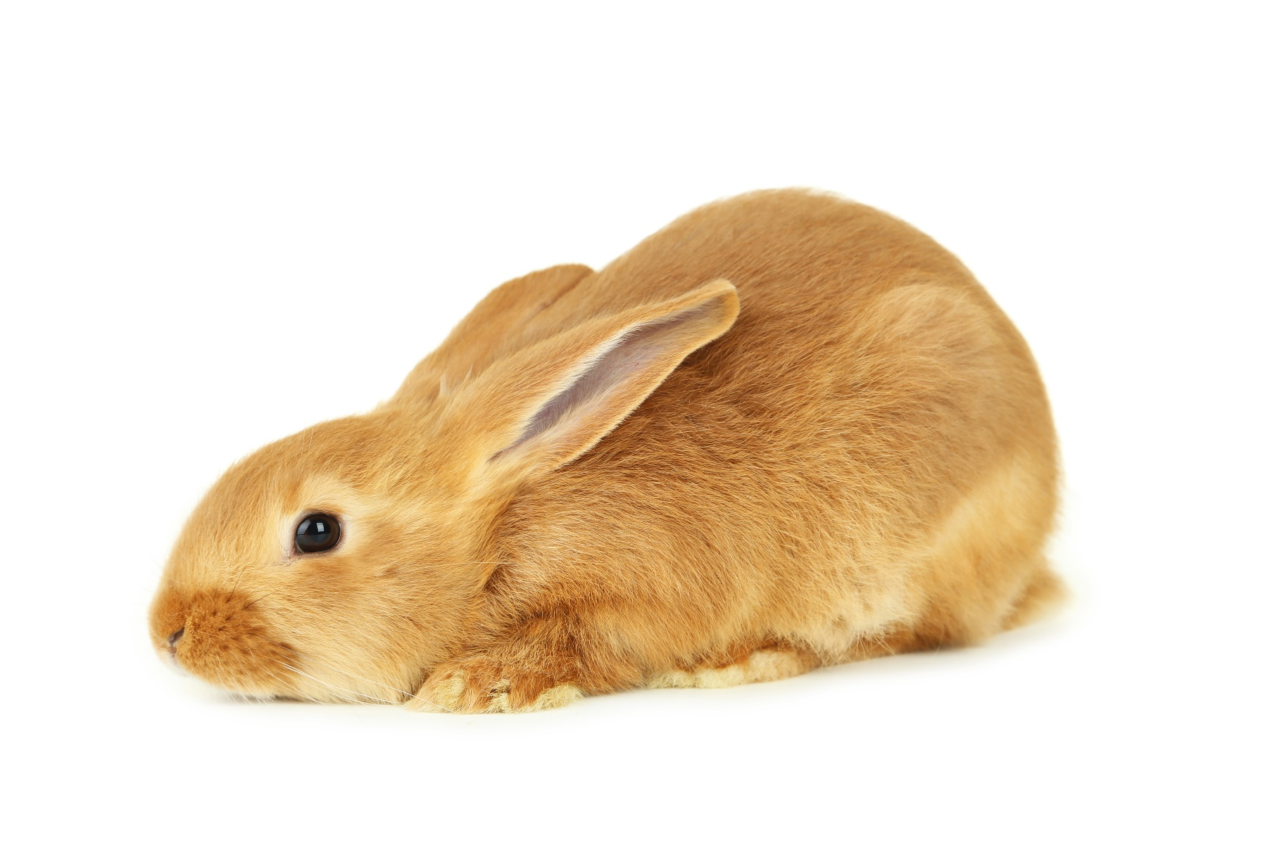
What else is going on?
Notes:
The rabbit on this slide is shown with it’s head and body low and stretched out in front of it with it’s ears back it could mean one of two things depending on what else is going on at the time:
It could be looking to be petted or groomed – this rabbit may even groom (lick) you in return.
It could also mean that this rabbit is scared as they will put their ears flat their back to try to make themselves undetectable to predators so they look like they’re sleeping. They’ll also try to avoid eye contact with you. Pupils dilated
Worried rabbits may hide
Rabbits in pain will stay really still and squint their eyes tight
So you can see its really important to take into consideration what else is going on.
It is really hard to tell how a rabbit is feeling as they’ll often pretend they’re fine. Google the rabbit grimace scale if you want to know more.

Slide 20
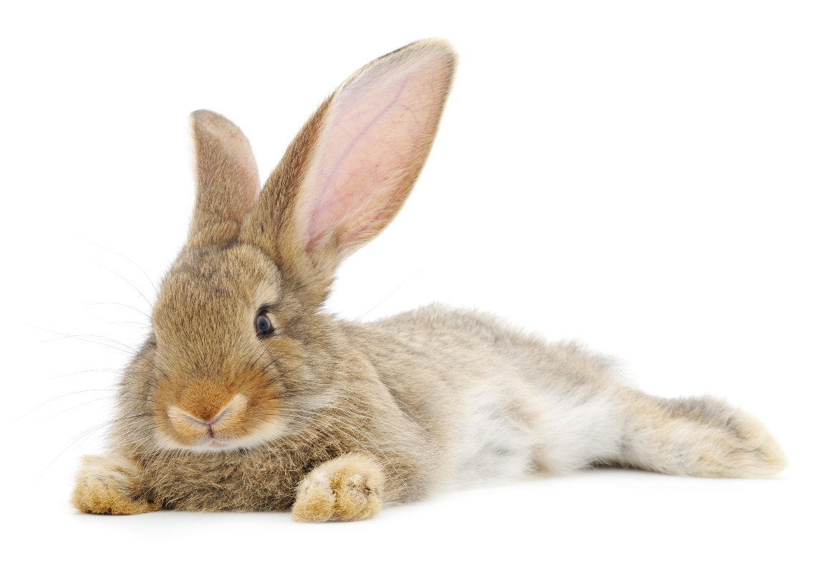
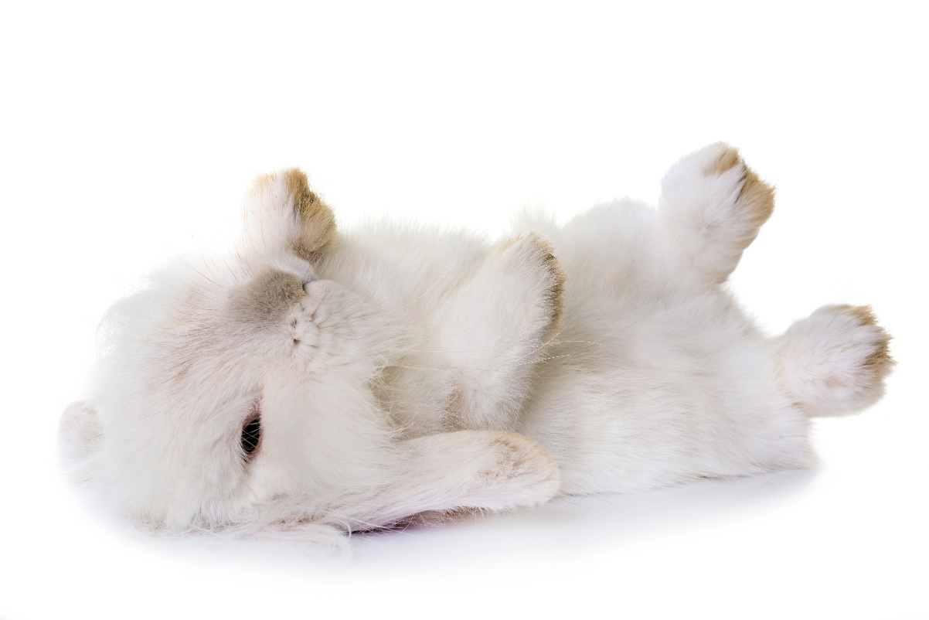
Relaxed & resting
Notes:
These rabbits are very happy and relaxed – commonly known as the bunnyflop – these postures are loose and floppy.
Ears closer together, facing slightly backwards and pointing outwards. Eyes may be partially closed.
Did you know – rabbits can sleep with their eyes open?

Slide 21
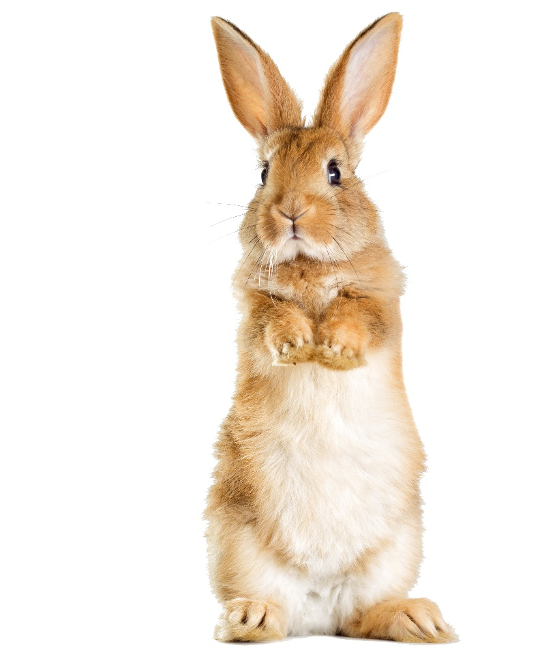
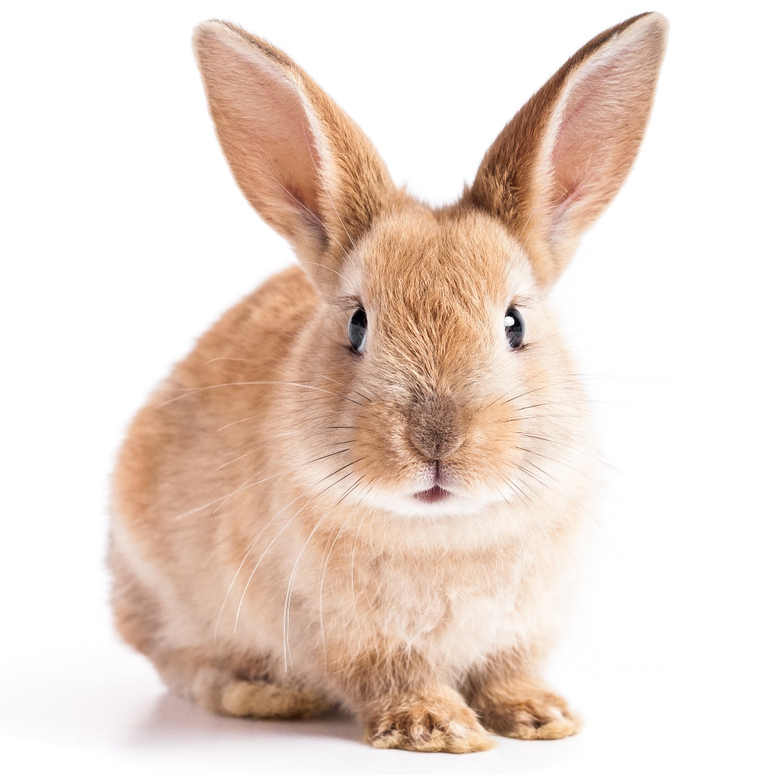
Alert & interested
Notes:
Rabbits that sit up on their hind legs with their nose pointed up are looking out for a better view or potential danger. Domestic rabbits also do this to ask for food or get your attention.
One thing to bear in mind is that rabbits will use their ears just like dogs and cats – pointy ears like this make it easier to decipher how they are feeling but it can be more difficult to tell with lop eared rabbits.

Slide 22
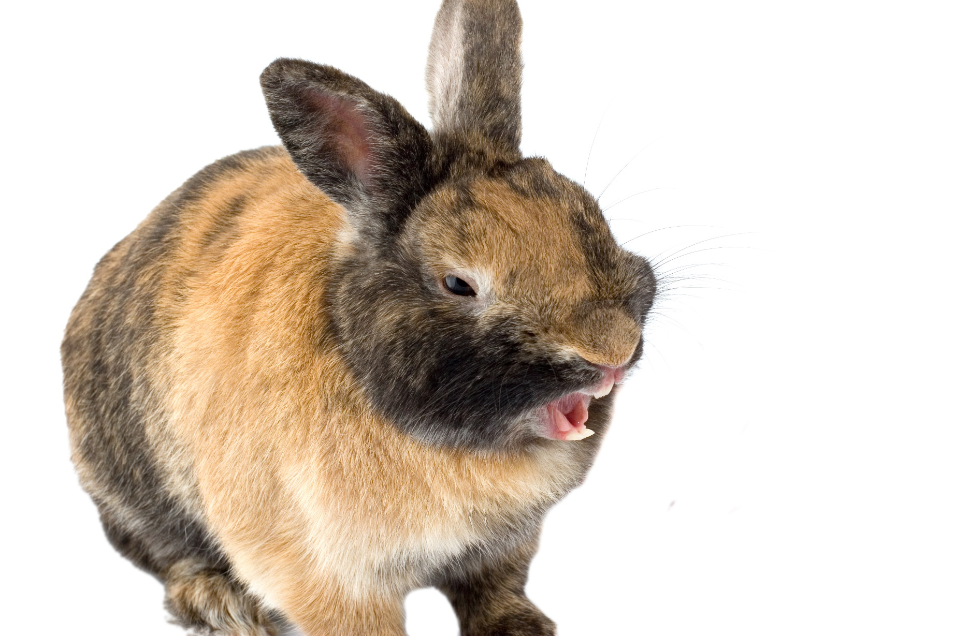
Angry or unhappy
Notes:
Angry or unhappy rabbit:
Standing tense with body down and weight towards the back, head tilted upwards, mouth open and teeth visible. Ears back and lowered, tail raised and pupils dilated
Other signs a rabbit is angry or unhappy are:
Turns and moves away flicking the back feet. Ears may be held against the back
Rabbit is sitting on back legs with paws in front raised displaying boxing behaviour. Ears pointed upwards and facing outwards – rabbit might be growling.
Rabbit is standing tense with back legs thumping on the ground. Tail raised, ears pointing upwards and slightly turned outwards, facial muscles are tense and pupils dilated.

Slide 23
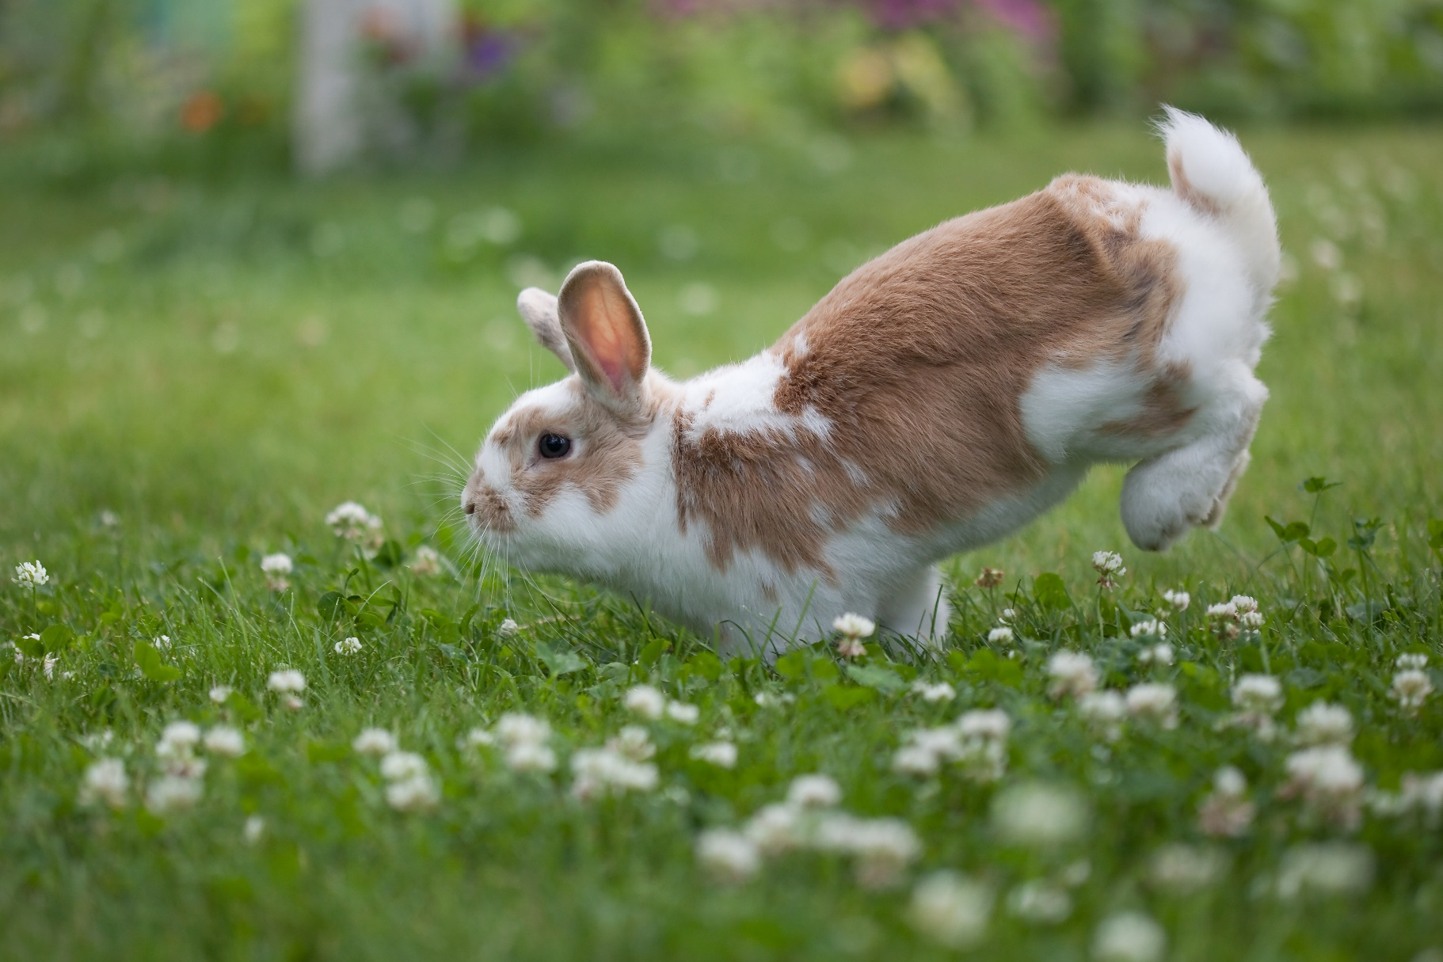
Happy - binky
Notes:
Happy rabbits will jump and flip in the air – this is called a Binky. Unfortunately many hutches are too small for rabbits to be able to do this properly.
Hutches need to be long enough and tall enough – use notes from Get PetWise.

Slide 24
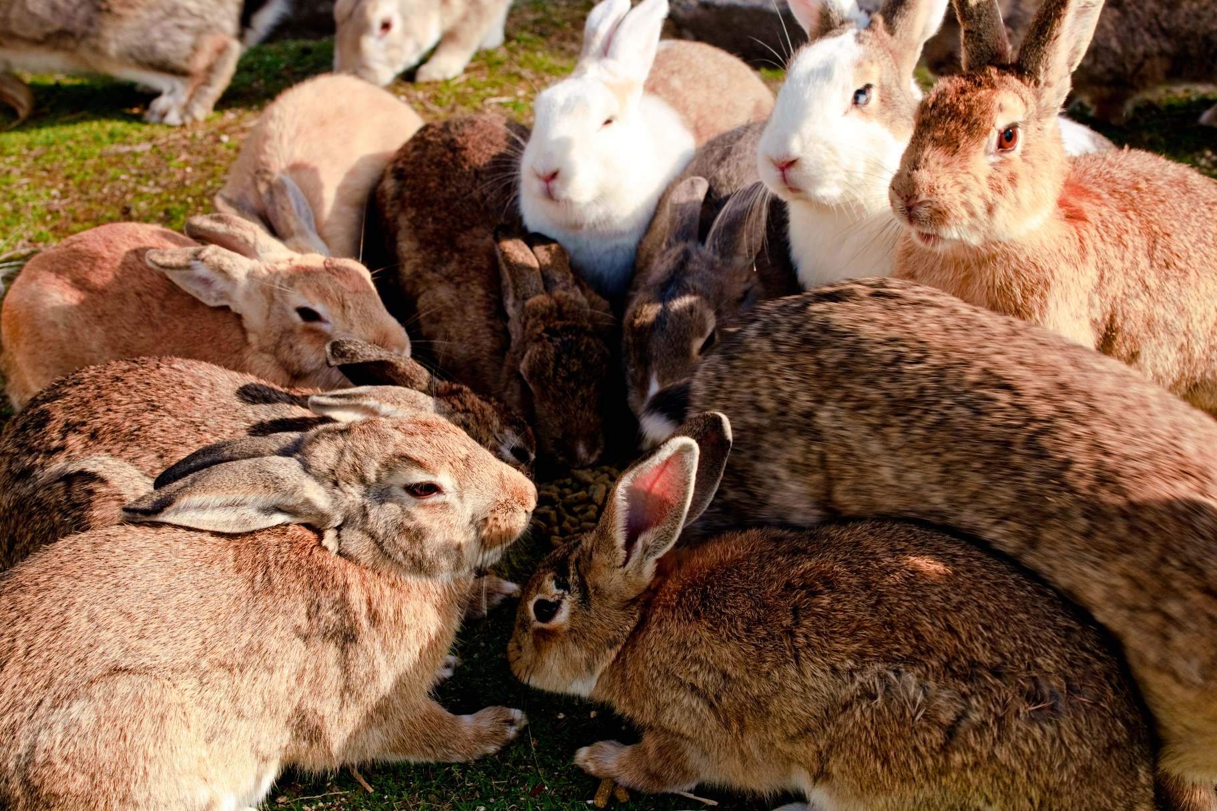
Social
Notes:
Although rabbits are very social animals they are generally very quiet – they have a small range of vocalisations:
Scream/squeal – if in danger/caught by a predator – they may give off a high pitched scream/squeal as this indicates pain or fear
Grunting/growling – a short grunt, with ears held back and leaping forward is a sign of irritation or fear.
Humming – a low, persistent hum means the rabbit is excited.

Slide 25
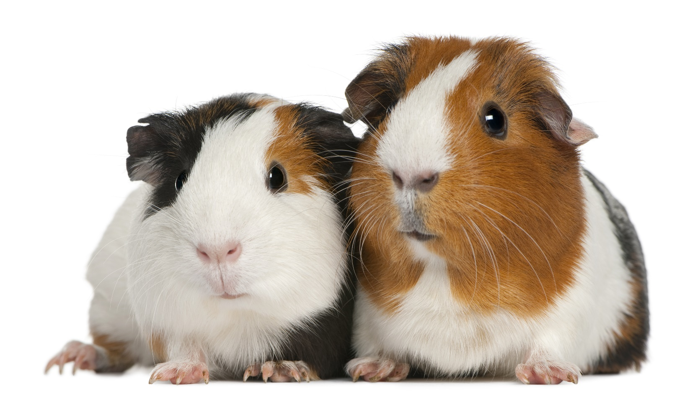
Guinea pigs
Notes:
There are many reasons why rabbits and guinea pigs are unsuitable housemates – despite having different dietary requirements the way the two species naturally communicate is completely different.
The main difference is in their vocalisations – whilst we’ve learnt that rabbits are generally very quiet animals – relying more on hearing, sight and smell due to their underground environments Guinea pigs are the opposite – they love to chatter and wheek with each other – so imagine how frustrating it would be for a guinea pig to live with a mute and for a rabbit to live with an animal that is constantly squeaking – a noise that in the rabbit world means – fear or pain!
Rabbits often bully guinea pigs when kept together.

Slide 26
Guinea pig vocalisations
Wheeking – most common – anticipation /excitement
Purring – differ depending on how they are feeling
Rumbling – Deeper than a purr noise – associated with mating
Teeth chattering – Aggressive - often show teeth as a warning
Hissing – Aggressive – like teeth chattering
Cooing – made by mother to young – reassurance noise
Shrieking – High pitched squeak – alarm, fear or pain
Whining – annoyance
Chirping – not very well understood why they do this – ‘song’?
Notes:
Here are the known vocalisations that guinea pigs use –
Wheeking: This is a distinctive (and common) vocalisation made by guinea pigs and it is most often used to communicate anticipation or excitement, particularly about being fed. It sounds like a long and loud squeal or whistle and sometimes wheeking may simply serve as a call for attention.
Purring: Purrs have different meanings, depending on the pitch of the sound and the accompanying body language from your guinea pig. Guinea pigs that feel contented and comfortable will make a deep purring sound, accompanied by a relaxed, calm posture. However, if the purr is higher pitched, especially towards the end of the purr, this is more likely a sound of annoyance. In fact, a guinea pig making this noise will be tense and may seem to even vibrate. A short purr, sometimes described as a "durr," may indicate fear or uncertainty, usually accompanied by the guinea pig remaining motionless.
Rumbling: A guinea pig rumble is deeper than a purr noise. It is made when a male romances a female and sometimes females in season also make it. Often accompanied by a sort of "mating dance,"
Teeth Chattering: This is an aggressive vocalisation that is a sign of an agitated or angry guinea pig. Teeth chattering is often accompanied by the guinea pig showing their teeth, which looks like a yawn, and it means "back off" or "stay away."
Hissing: Like teeth chattering, this is a sign of a guinea pig who's upset. It is just like the hissing noise that a cat or another kind of upset animal makes.
Cooing: Cooing communicates reassurance in guinea pigs. It is a sound most often, but not exclusively, made by mother guinea pigs to their young.
Shrieking: A piercing, high-pitched squeak called a shriek is a fairly unmistakable call of alarm, fear, or pain from a guinea pig. If you hear this sound, it would be good to check on your guinea pigs to make sure everything is okay and none of them is hurt.
Whining: A whining or moaning type of squeak can communicate annoyance or dislike for something you or another guinea pig is doing.
Chirping: This sounds just like a bird chirping and is perhaps the least understood (or heard) noise that guinea pigs make. A chirping guinea pig may also appear to be in a trancelike state. The meaning of this "song" is the subject of much discussion but is still not well understood.

Slide 27
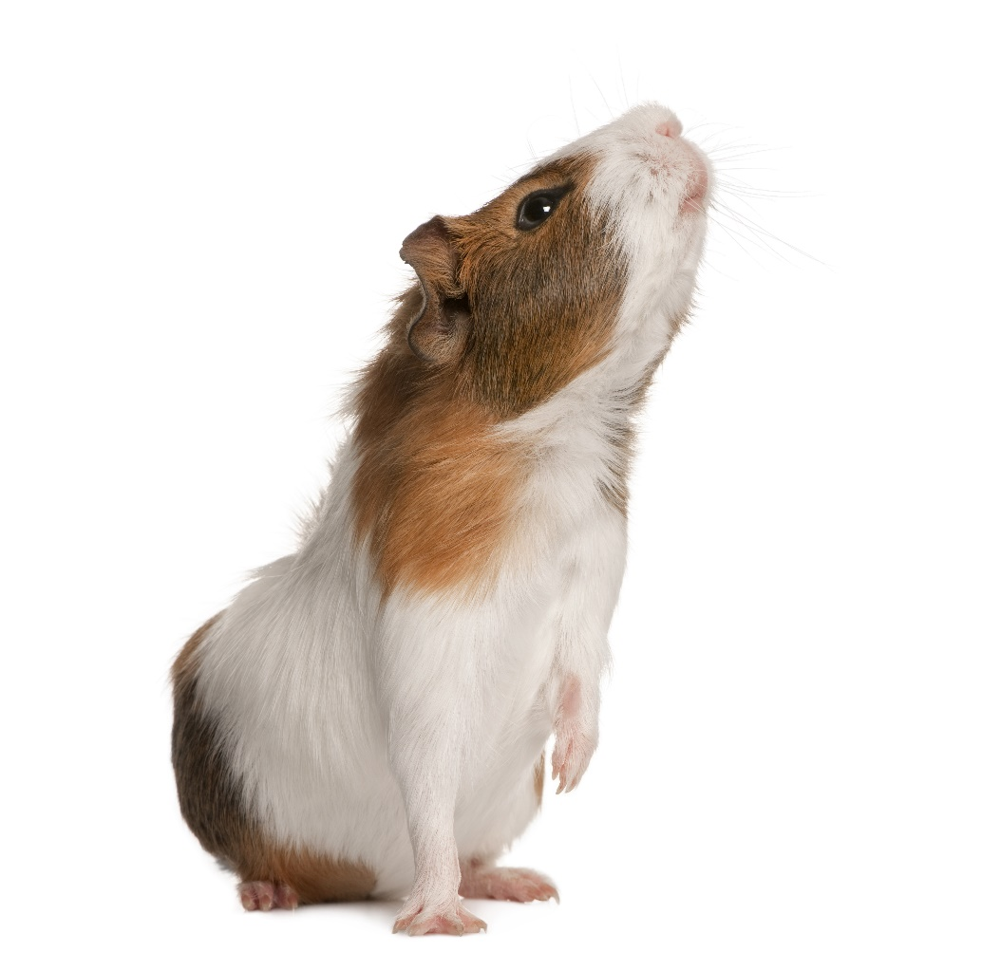
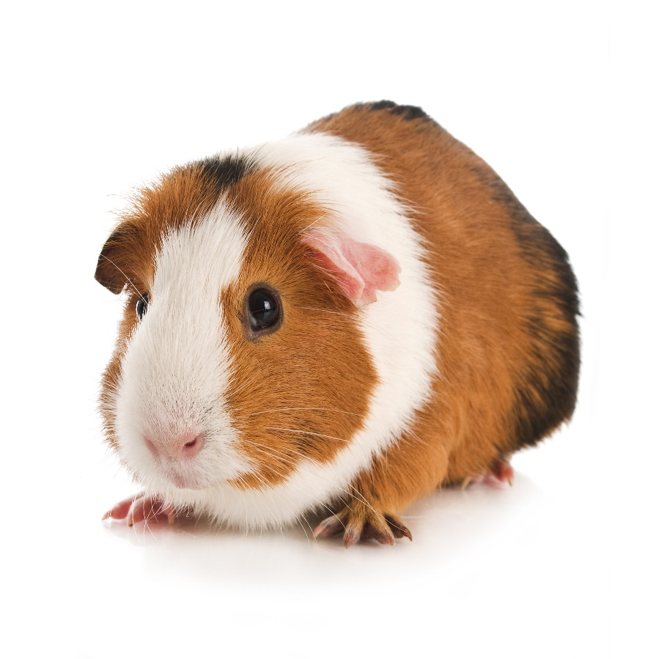
Guinea pigs
Aggressive actions
Freezing
Notes:
Guinea pig body language as with the other species we’ve seen takes different forms:
Popcorning: Easy to recognise, and similar to rabbits binkying - popcorning consists of hopping straight up in the air, sometimes repeatedly, just like popcorn does while it is popping. It is most often seen in young guinea pigs who are especially happy, excited or just feeling playful. Older pigs also popcorn, though they usually don't jump as high as younger pigs.
Freezing: A guinea pig that is startled or uncertain about something in its environment will stand motionless.
Sniffing: Sniffing is a way to check out what is going on around them and to get to know others. Guinea pigs particularly like to sniff each other around the nose, chin, ears, and back end.
Touching Noses: This is a friendly greeting between guinea pigs.
Aggressive Actions: These can include raising their head and/or rising up on their hind ends with stiff legs, shuffling side to side on stiff legs, fluffing out their fur, and showing their teeth (yawning). These actions are often accompanied by hissing and/or teeth chattering. If your guinea pigs do this with each other, be on high alert for fighting.
Strutting: Moving side to side on stiff legs can be a sign of aggression, often accompanied by teeth chattering. Strutting around another guinea pig while rumbling is a typical mating dance and the origin of the term "rumble strutting."
Scent Marking: Guinea pigs will rub their chins, cheeks, and hind ends on items they wish to mark as theirs. They may also urinate on things or other guinea pigs to show their dominance.
Tossing Head in the Air: A guinea pig getting annoyed with being petted will toss its head back as a way of asking you to stop.
Licking: Most owners consider this a sign of guinea pig affection, though it is possible that they just like the taste of the salt on your skin.

Slide 28
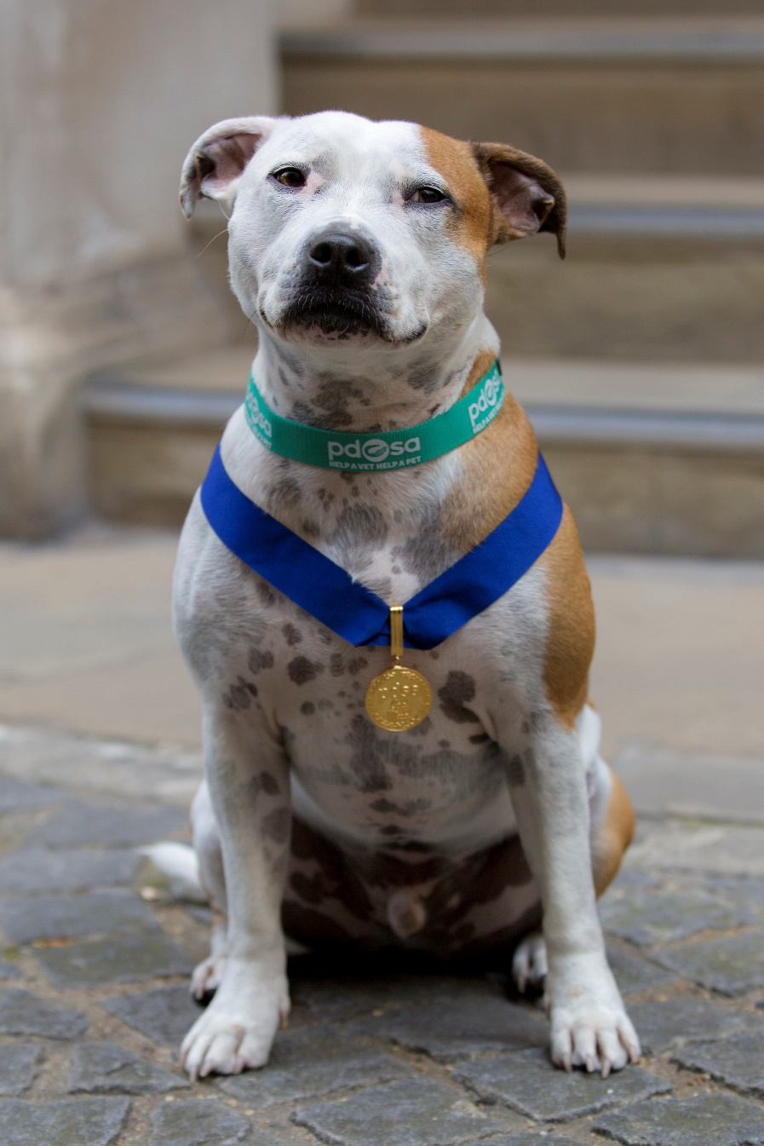
Diesel
Gold Medal
2017
Notes:
Explain that Diesel, an extraordinary family dog from Dartmouth, Devon, won our Gold Medal in 2017. He was awarded the medal after waking his family, and saving their lives, as a terrifying fire ripped through their home. Explain that you’re going to show a video of Diesel’s owner talking about his heroic act.

Slide 29
https://www.youtube.com/watch?v=_dgMU4OD_bI&t=1s
Notes:
Play the video of Diesel

Slide 30
https://www.youtube.com/watch?v=cUY4_nVpdj4&t=2s
Notes:
Show video

Slide 31
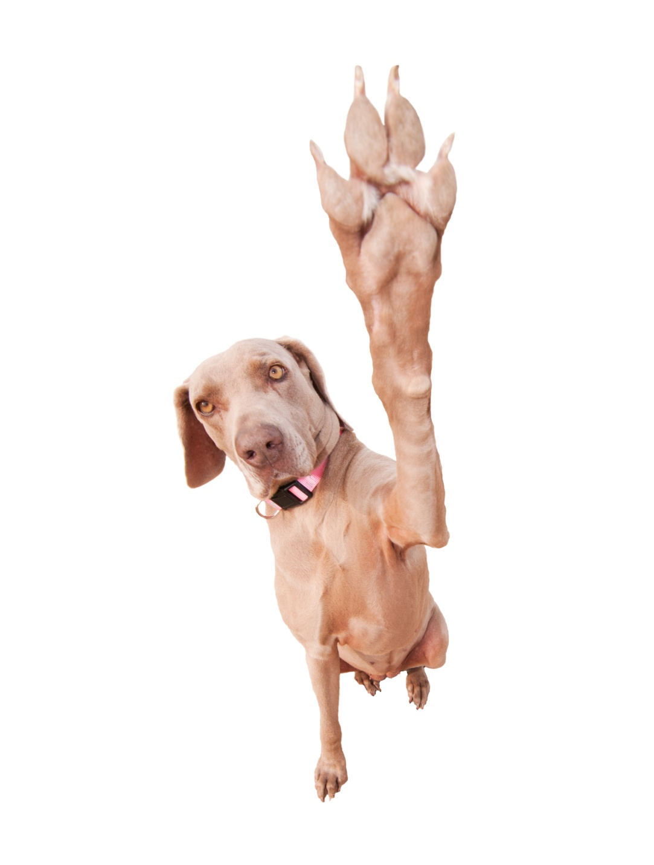
Thank you!
Thanks!
Notes:
Thank you from PDSA

