Slide 1
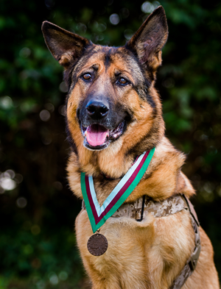
Animal Heroes in
War and Peace
Notes:
Give overview of session
Introduce PDSA
Explain that PDSA is different to private vets because we’re a charity – ask them what they think a charity is. Explain that PDSA help the sick and injured pets of people who can’t afford private vet treatment.
Ask if they think PDSA is important.
Explain that at the end of the session, they’ll
Have met some heroic people from history
Have met some amazing animal heroes of the past and present
Understand more about the different ways that animals help us and have met some animals who help
Know what kind of medals are awarded to animals by PDSA and why

Slide 2
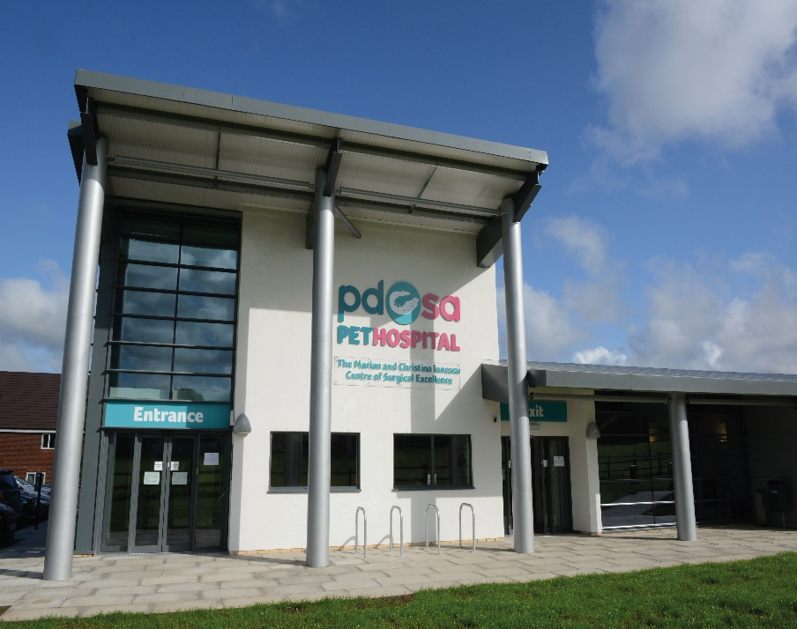
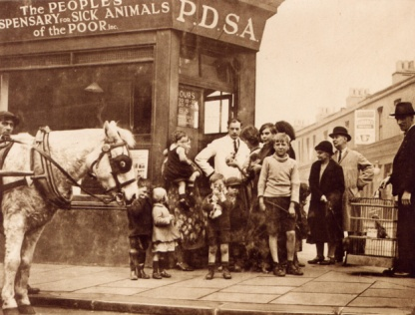
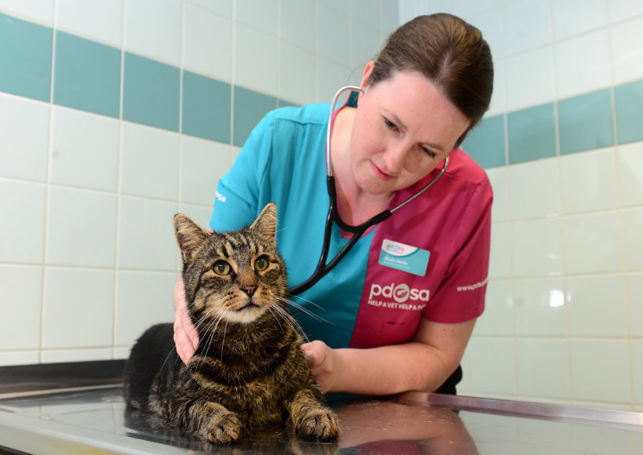
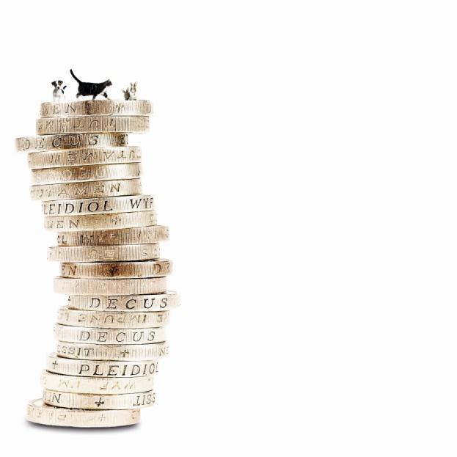
The UK’s leading vet charity …
Our charity is 100 years old and we’ve been treating sick and injured pets since 1917
We have Pet Hospitals all over the UK
We help a sick or injured pet every 5 seconds!
It costs more than £1 million every week to do our work
Notes:
Share the details on the slide and:
Explain the work that PDSA does
Ask the group where they think the money comes from for PDSA to treat all these sick and injured pets . Get answers from group and then share that it comes from people doing fundraising and donating money
Ask what would happen to all the pets we treat if PDSA weren’t around

Slide 3
Which words do you associate with bravery?
Notes:
Let this be led by the group and steer the discussion.
Perhaps use a whiteboard to complete a spider diagram

Slide 4
What kind of qualities do heroes have?
Notes:
Let this be led by the group and steer discussion.
Perhaps use a spider diagram

Slide 5
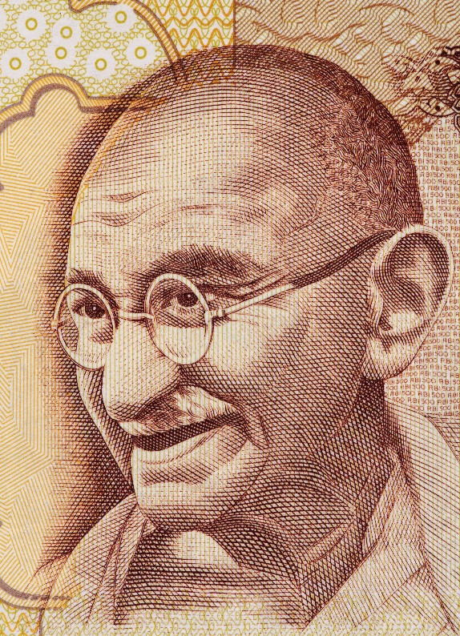
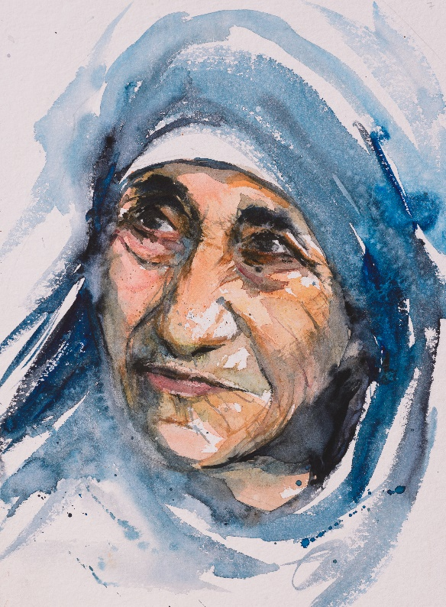
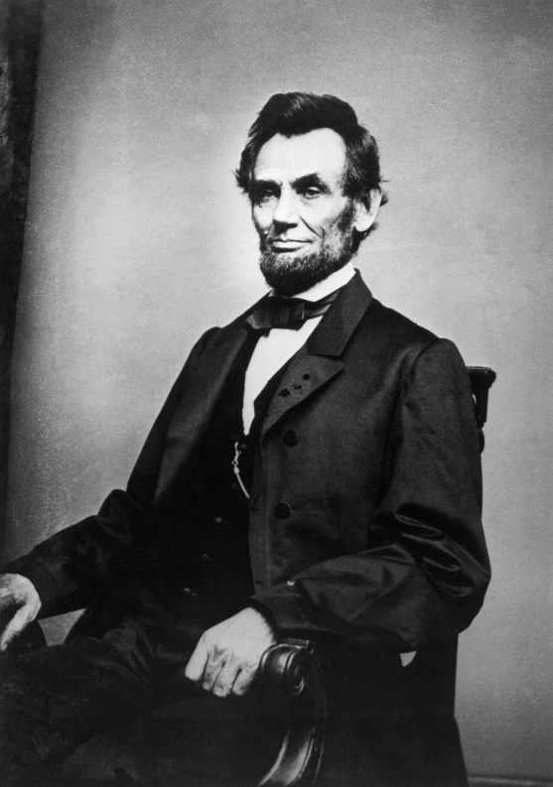
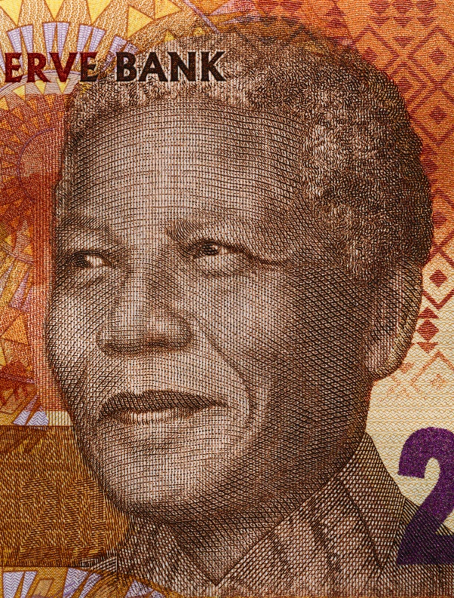
Can you name these real-life heroes?
Notes:
Ask the pupils to name the heroes and describe what they did to make them a hero.
Mahatma Gandhi believed in the unity of all mankind under one god. By the time he died, India had become an independent country, free of British rule and the largest democracy in the world. Today, Gandhi is remembered not only as a political leader, but also as a moralist who appealed to the universal conscience of mankind.
Nelson Mandela was the first black President of South Africa. He spent 27 years in prison for trying to overthrow the pro-apartheid government. After he left prison, he worked to achieve human rights and a better future for everyone in South Africa.
Abraham Lincoln was the 16th president of the United States. He preserved the Union during the U.S. Civil War and brought about the abolition of slavery
Mother Teresa formed a group within the Catholic Church called the Missionaries of Charity, to take care of the hungry, the homeless, the crippled, the blind and the lepers in India. She left behind her family and gave up all her possessions to do this work.

Slide 6
My Hero/Heroes
Notes:
Add your own hero here and tell the class about them.

Slide 7
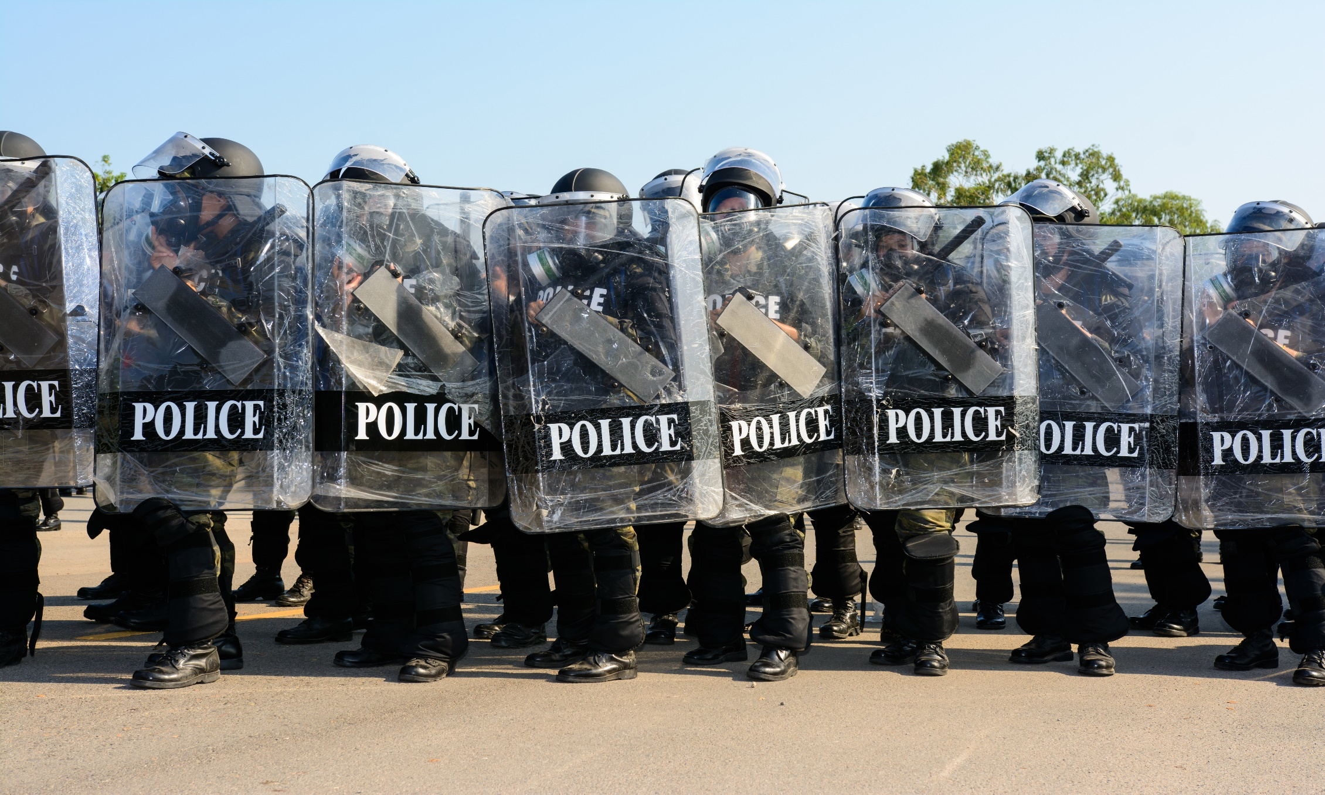
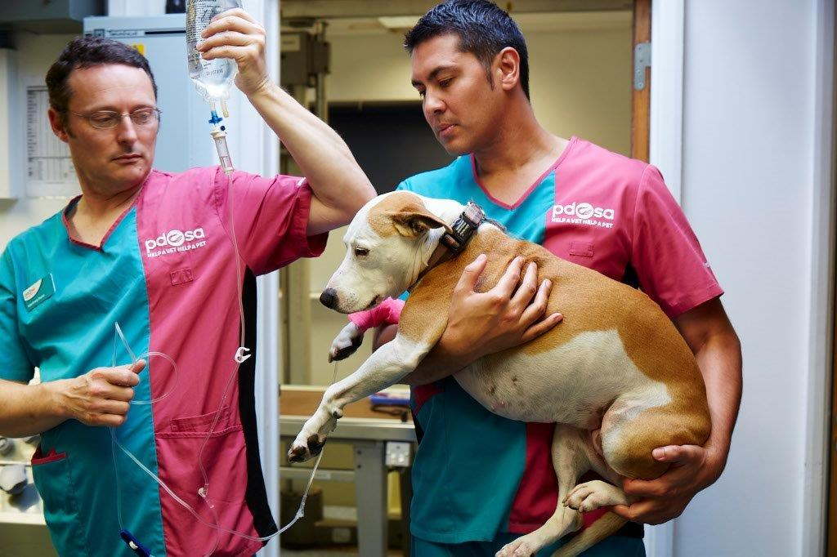
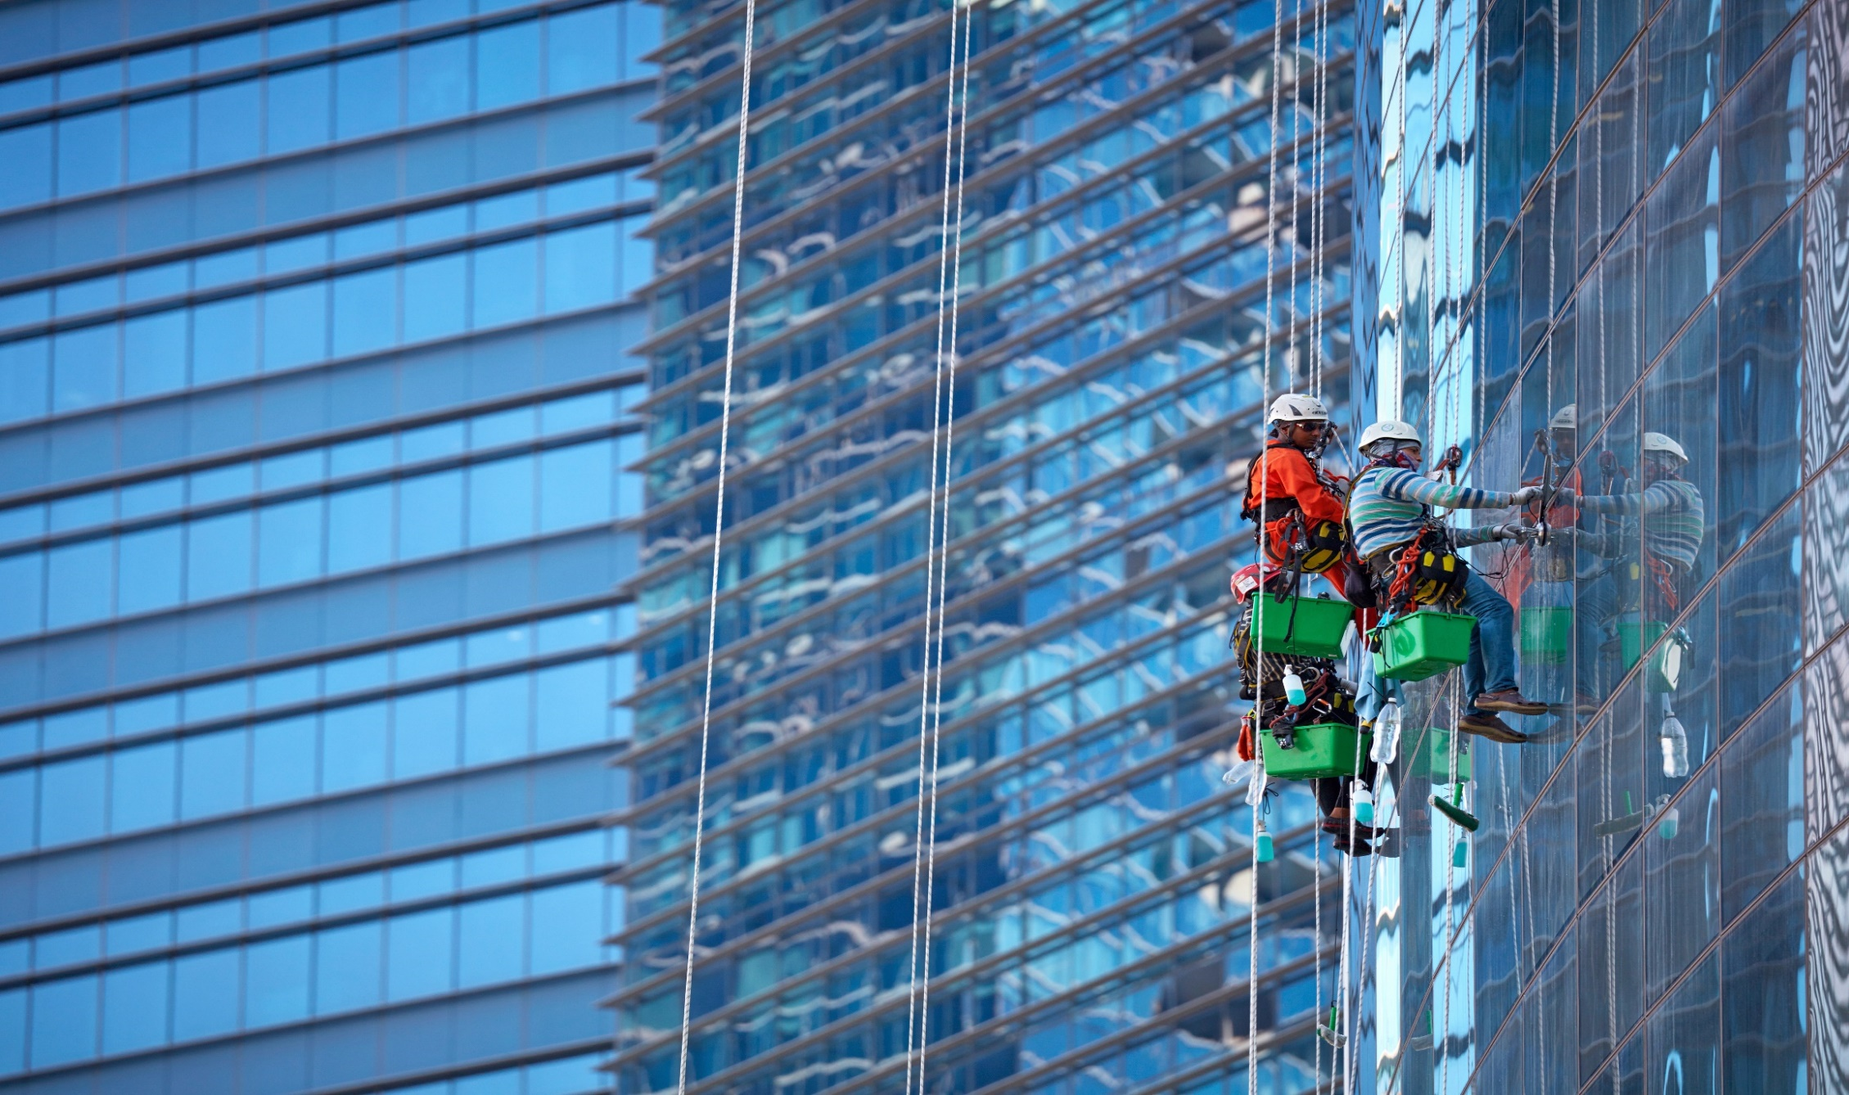
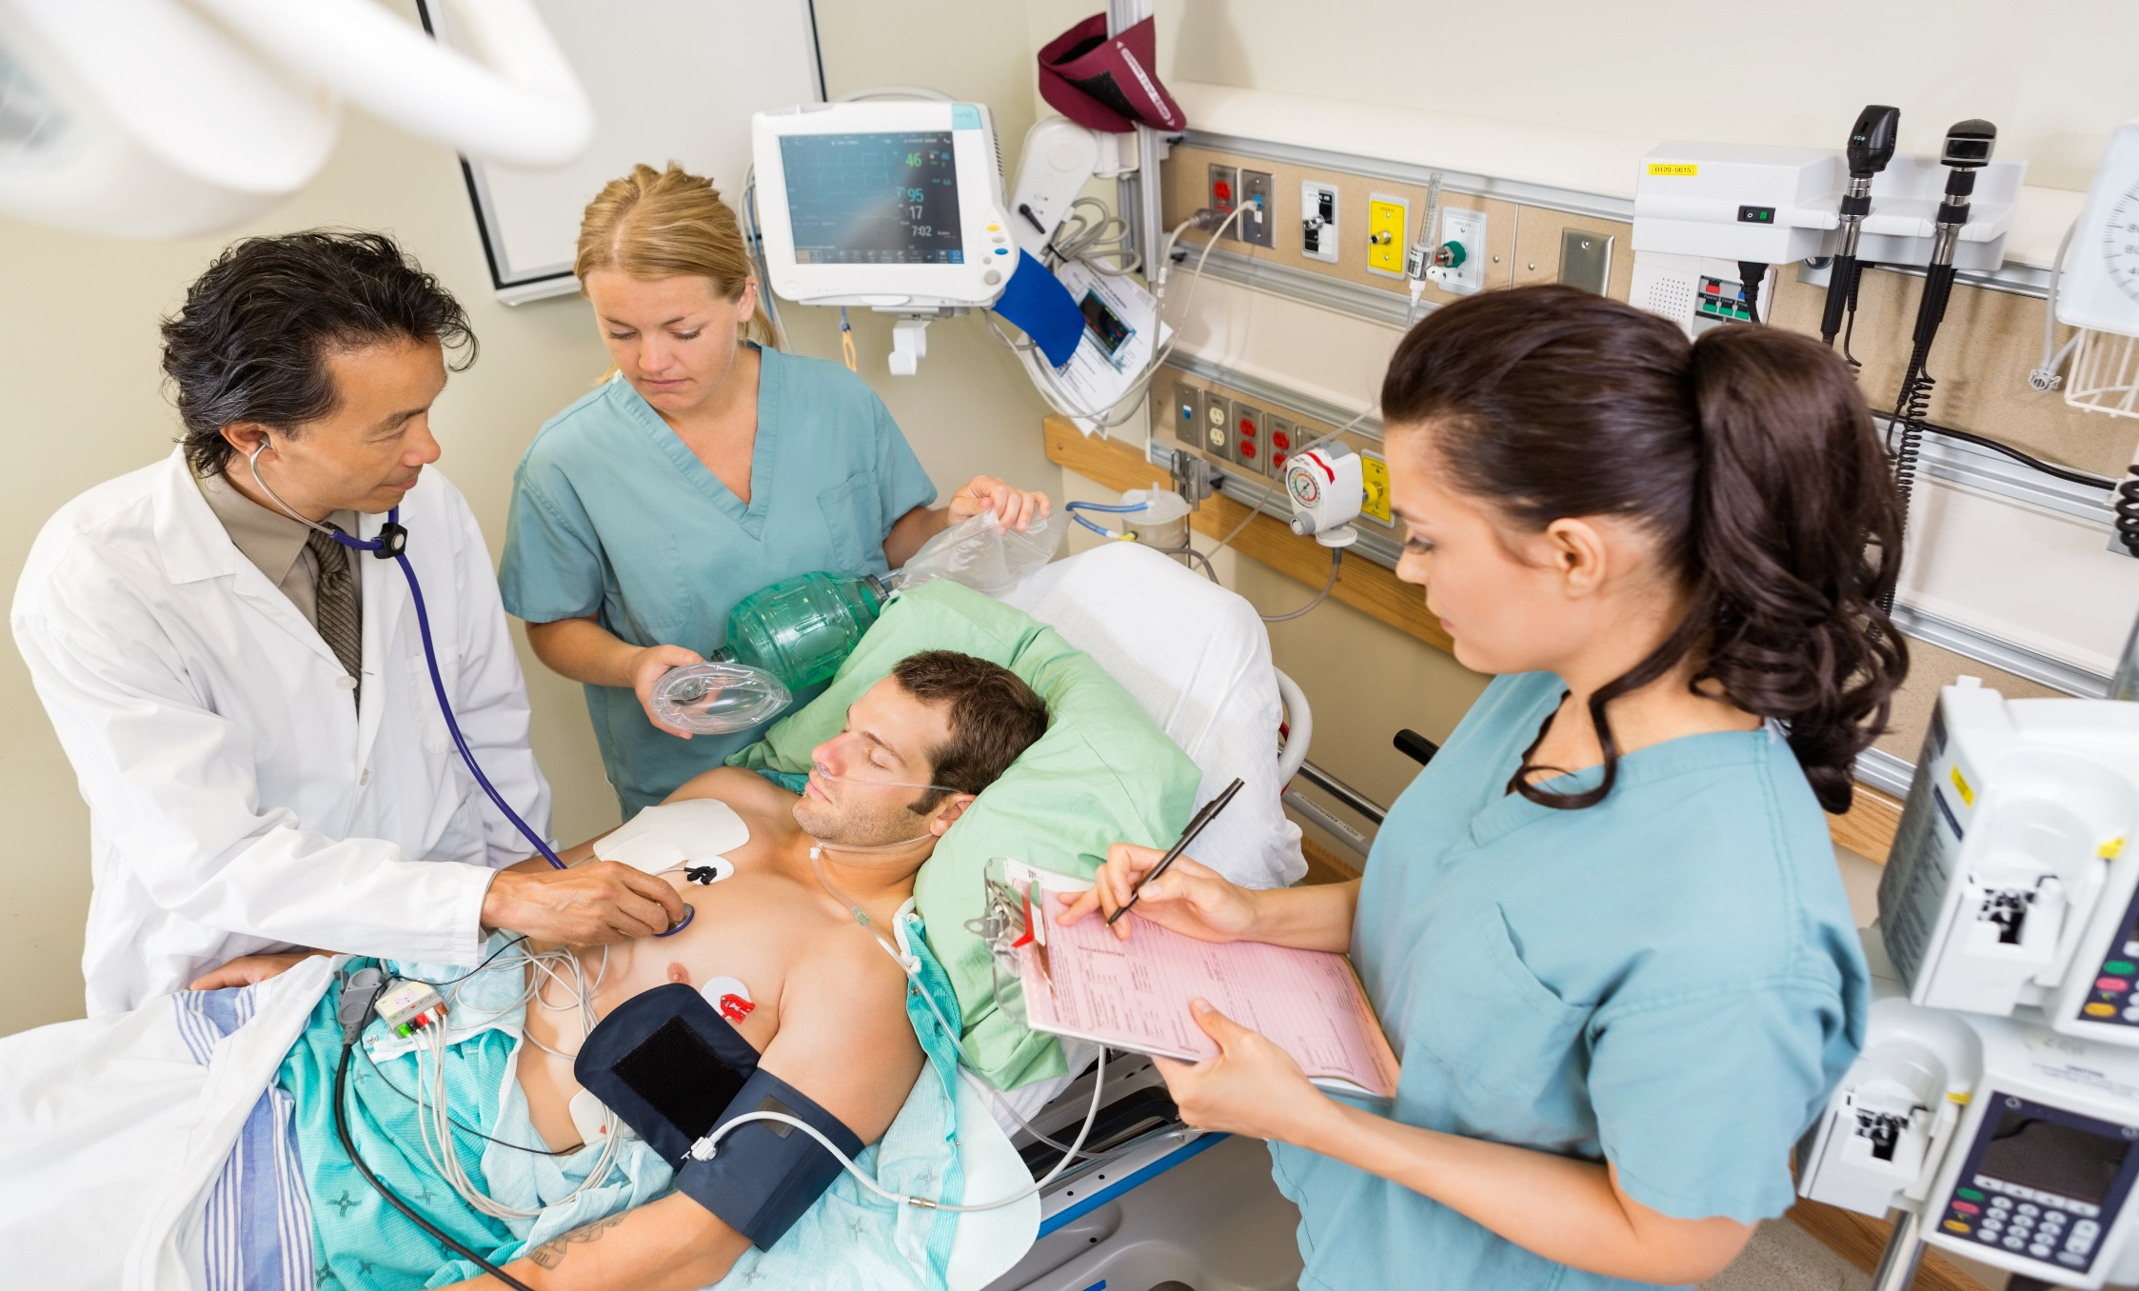
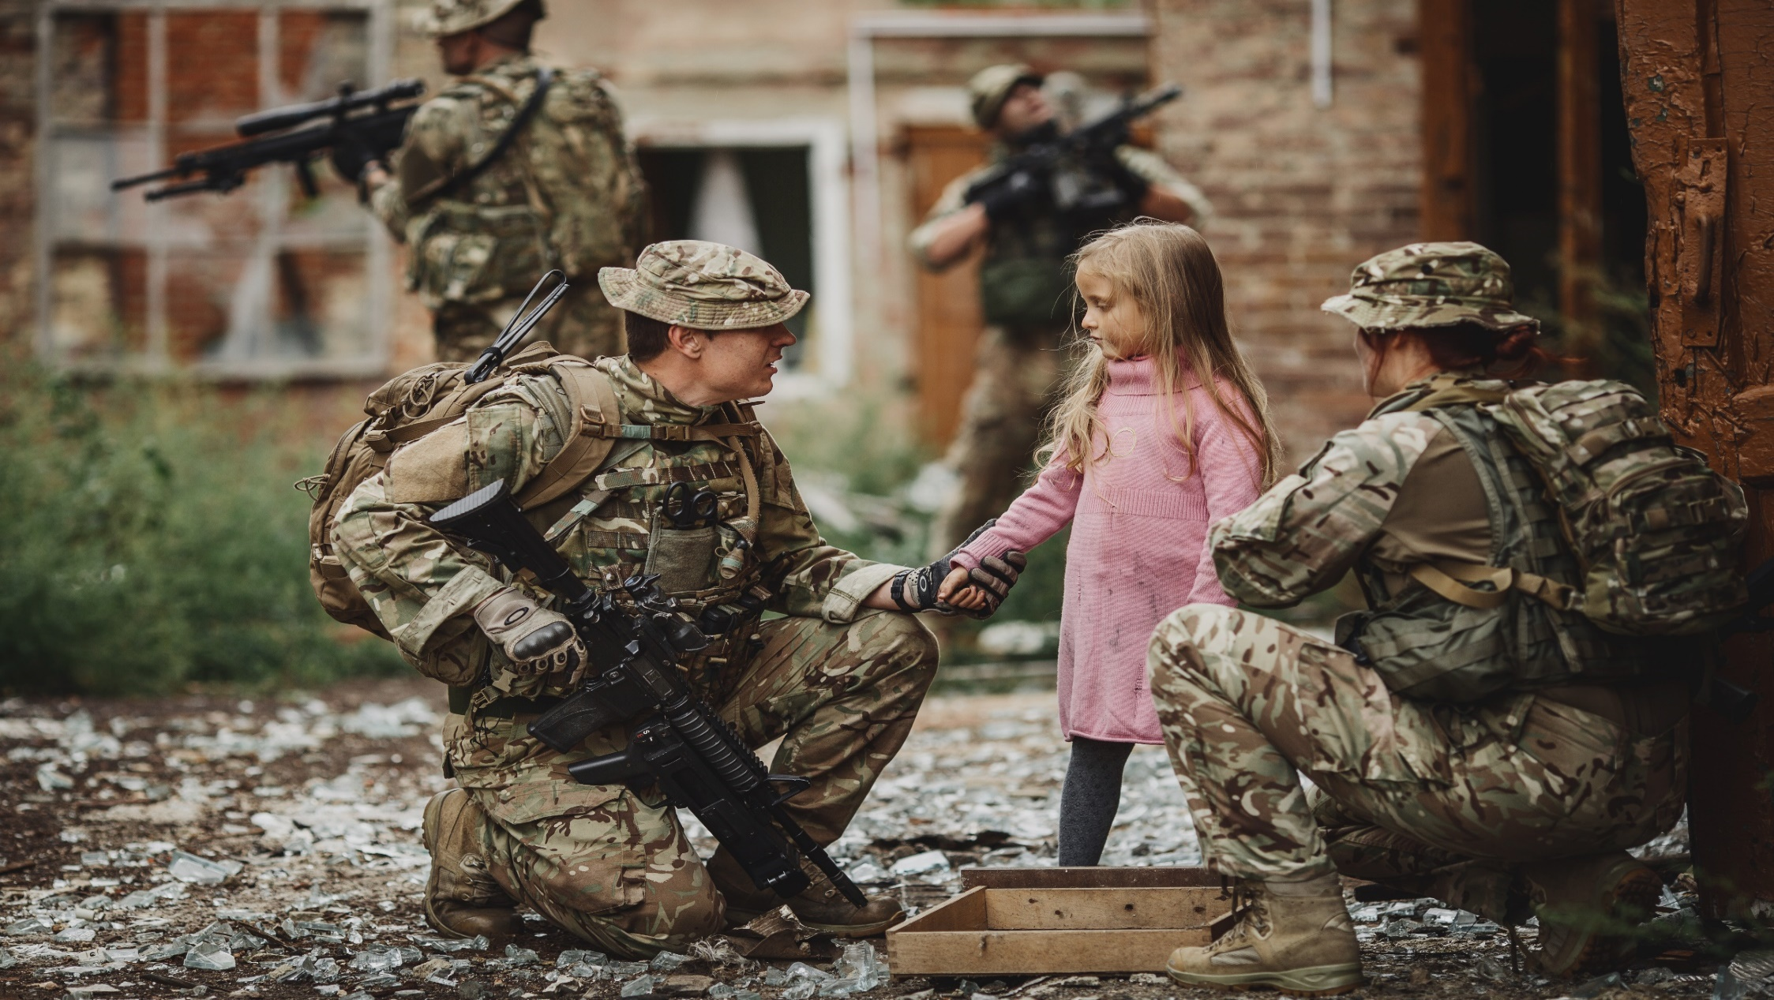
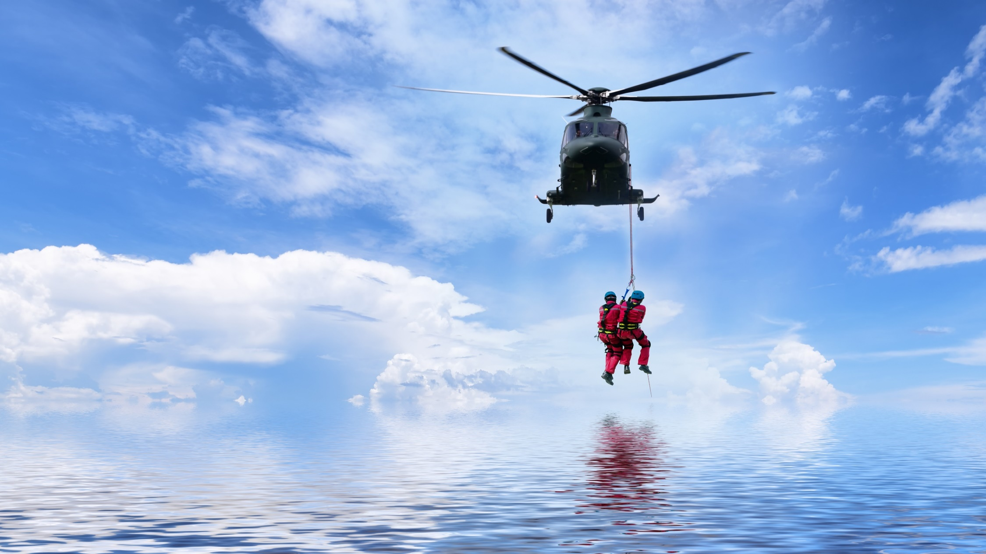
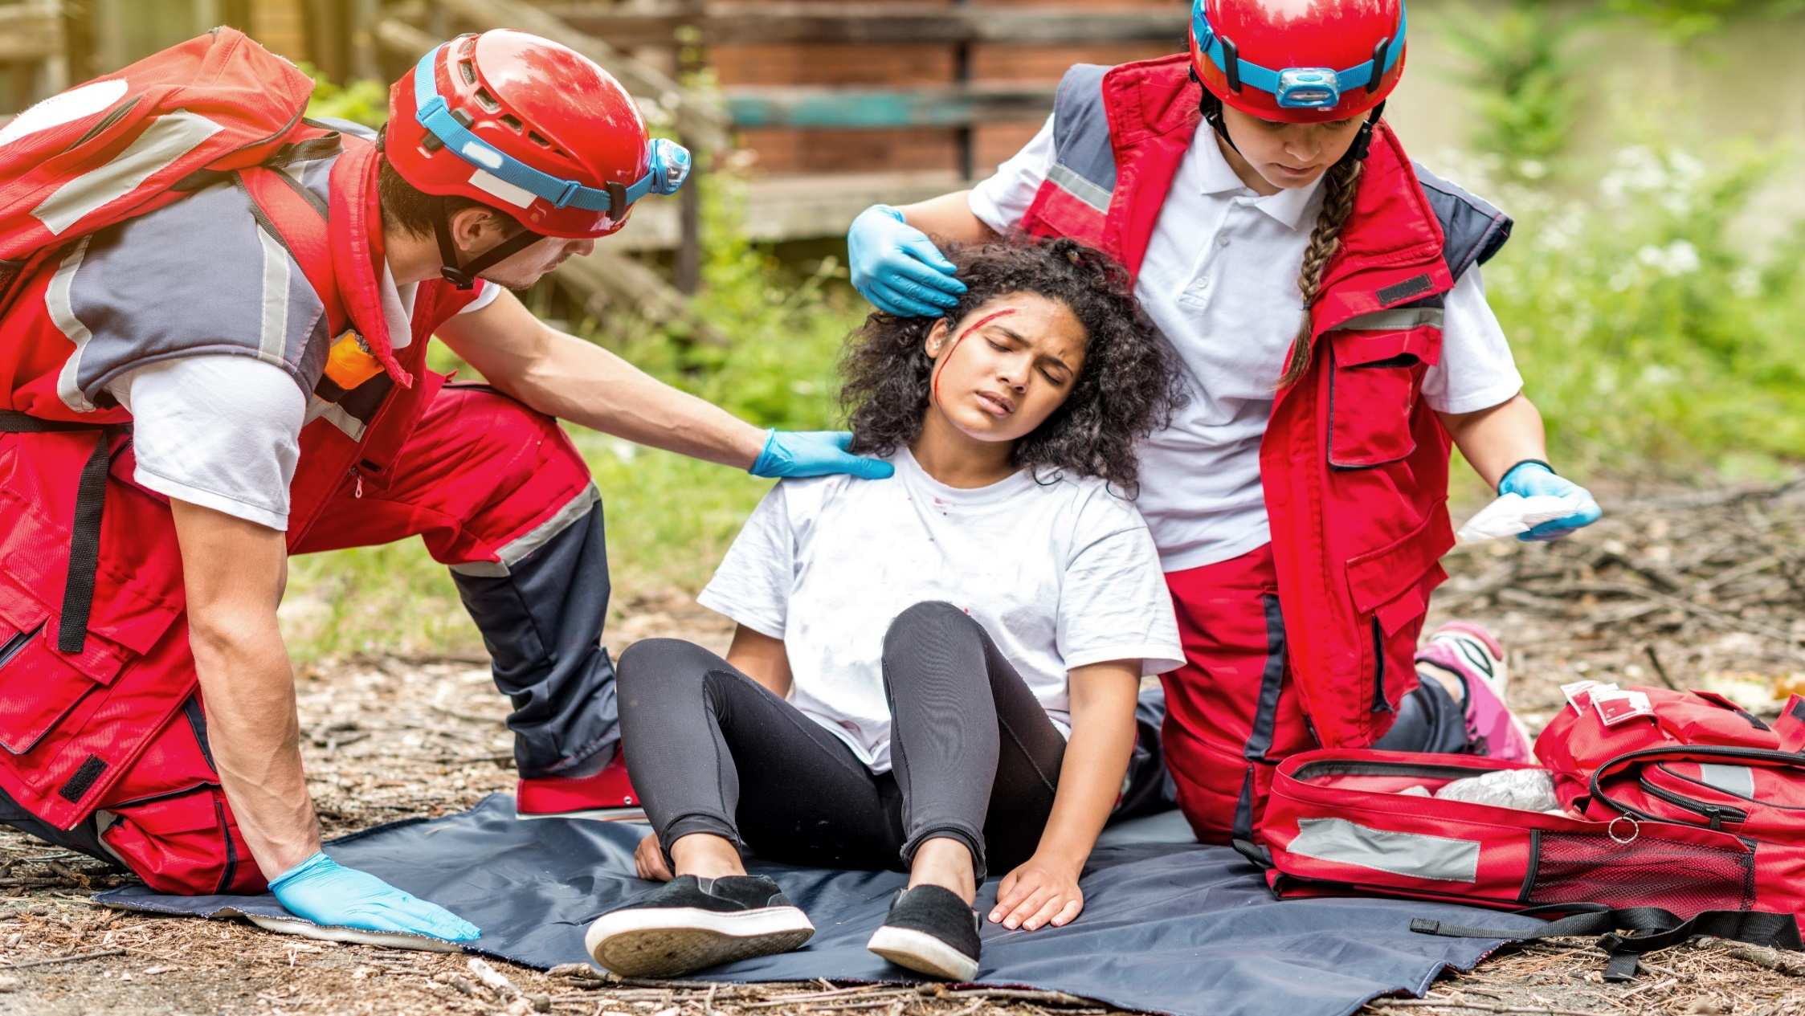
People who are brave in their jobs
Notes:
Some people need to be brave so they can do their job.
Some people risk their lives or have to deal with scary and upsetting situations everyday, just to keep other people and animals alive and safe.
Talk through each slide and discuss

Slide 8
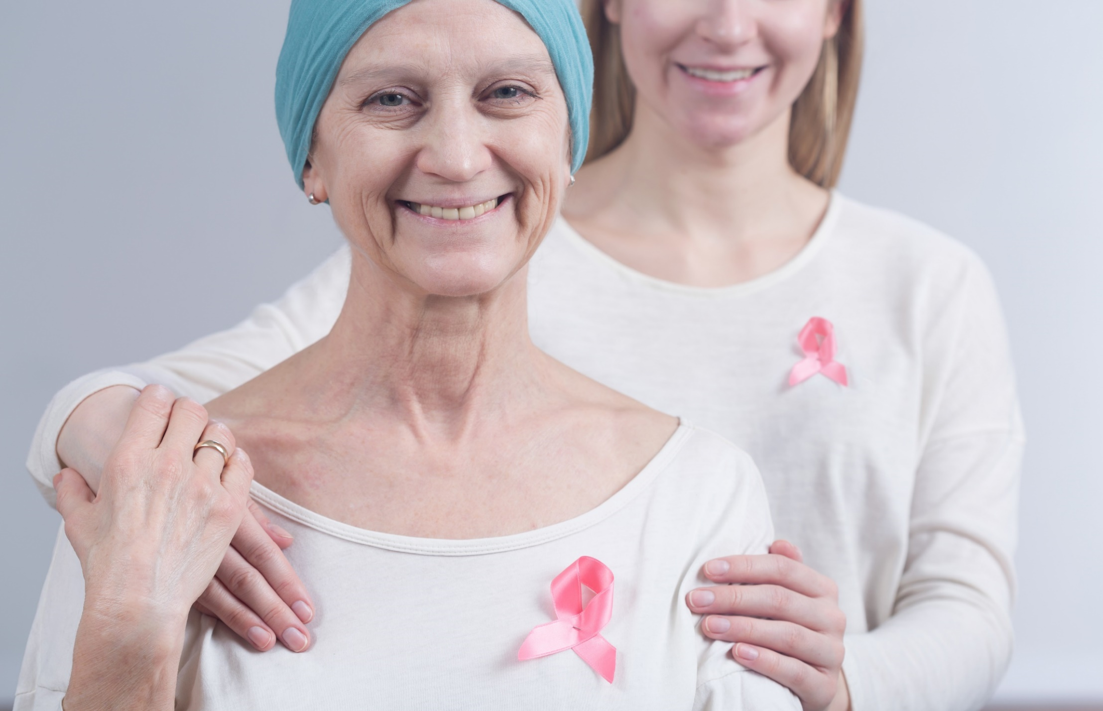
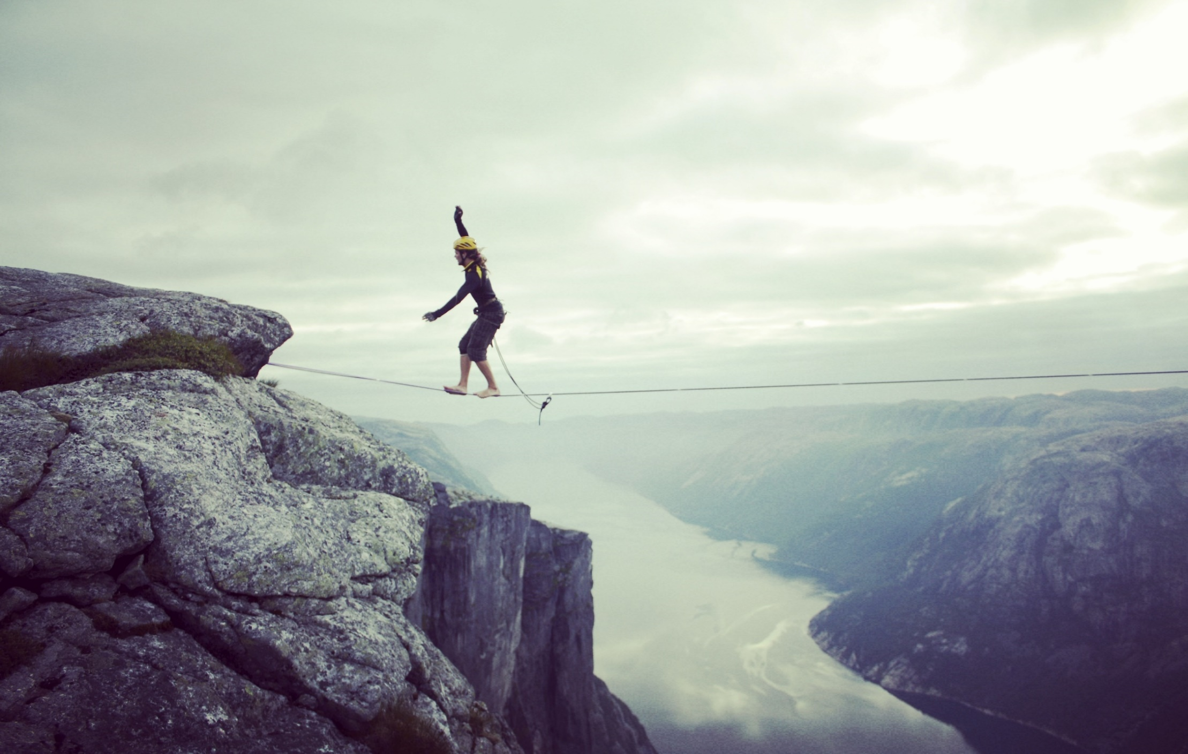
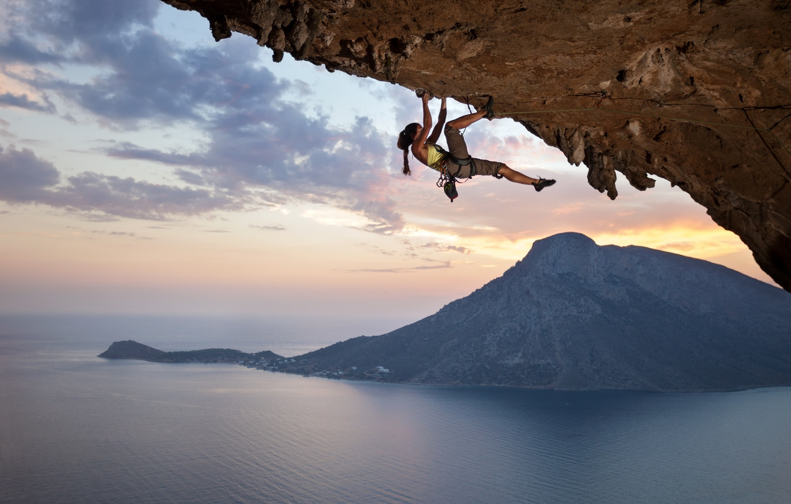
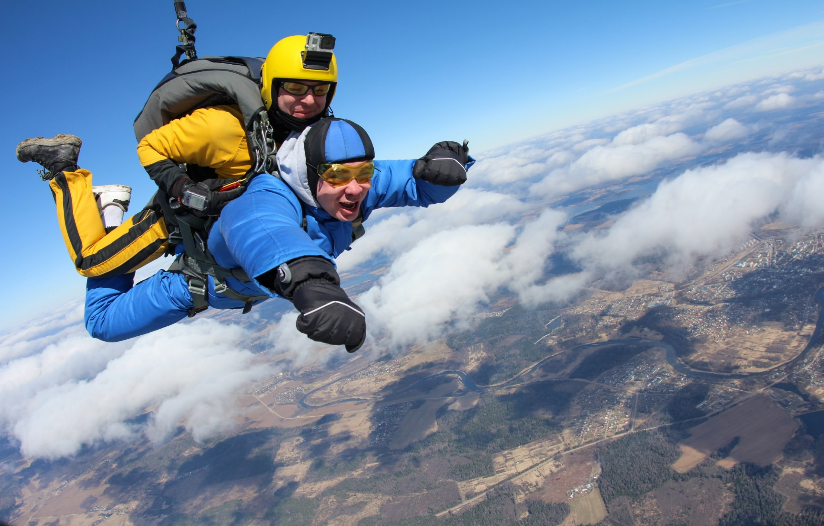
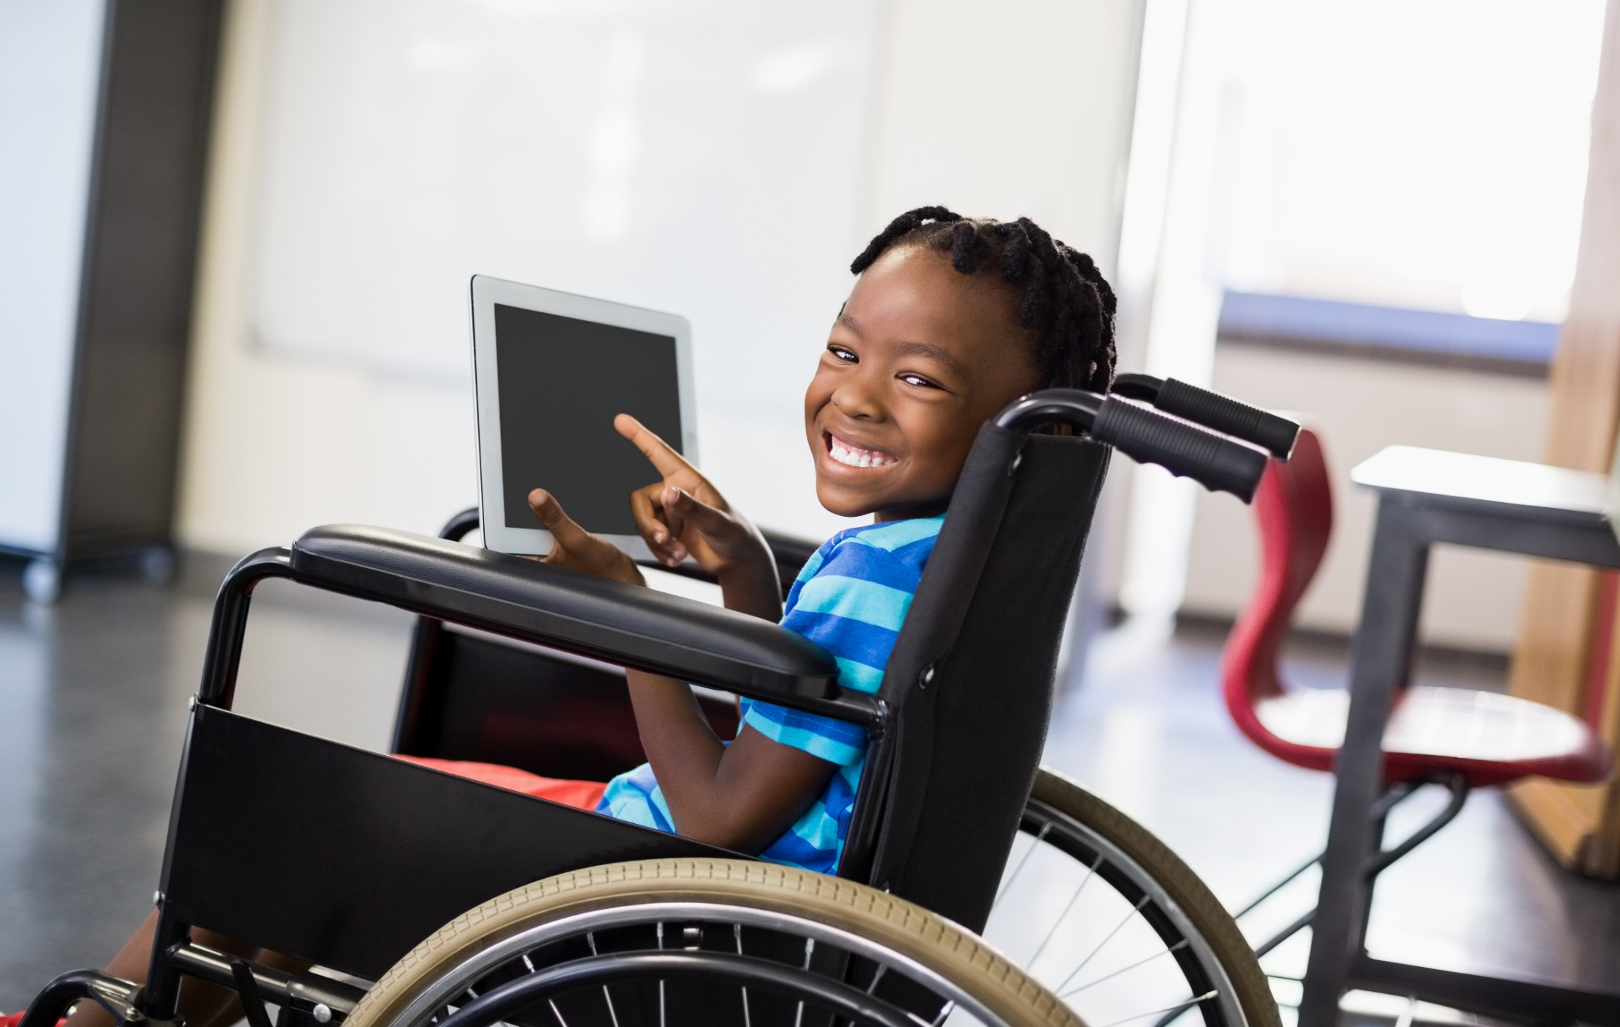
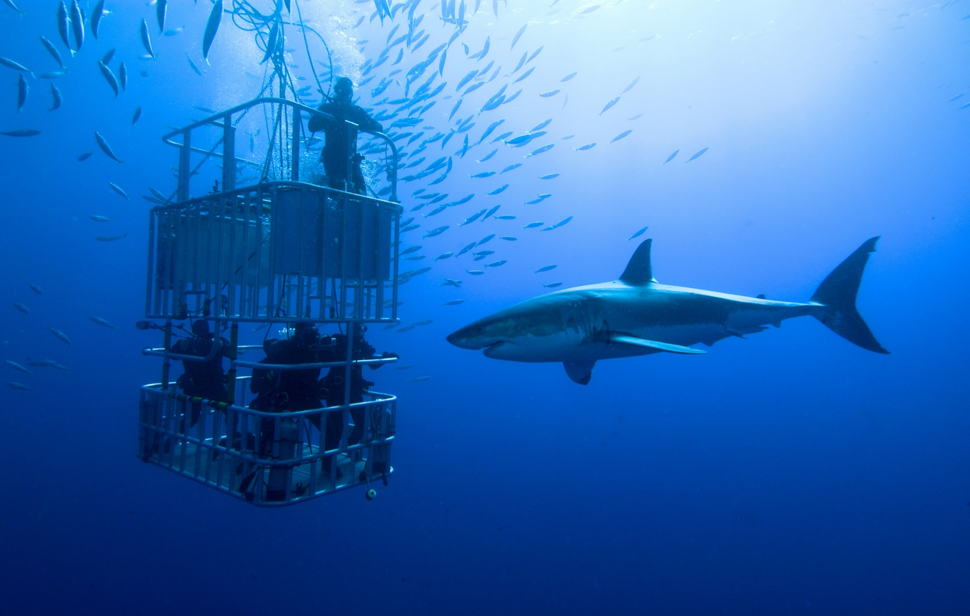
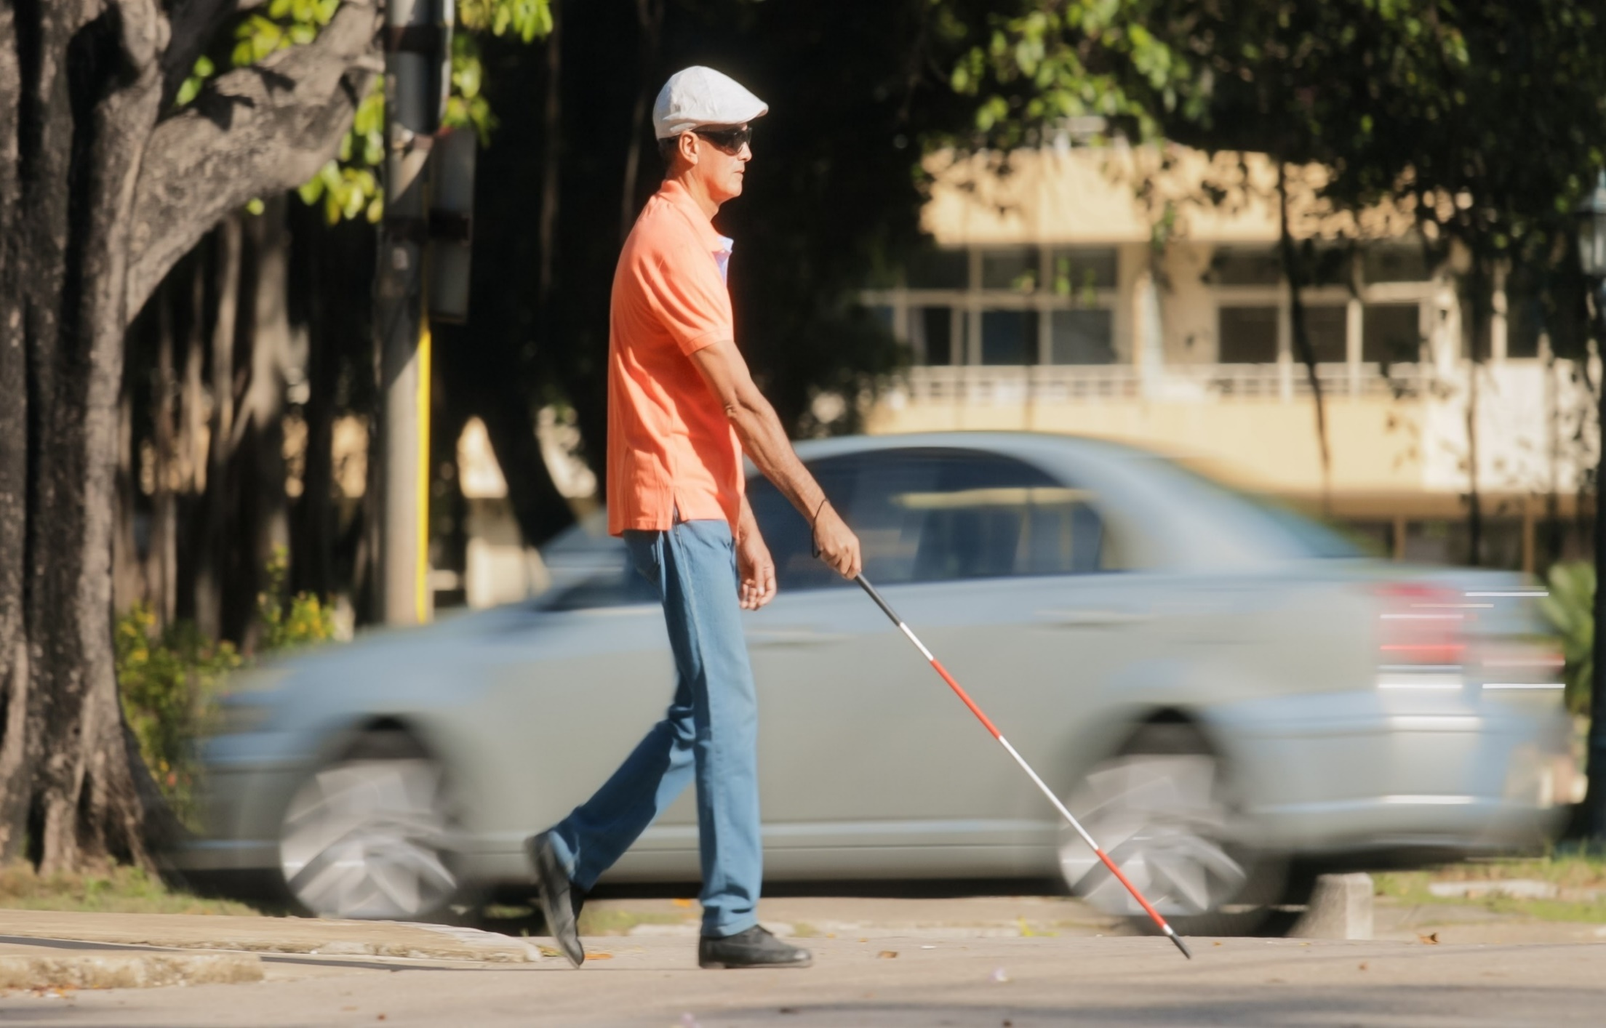
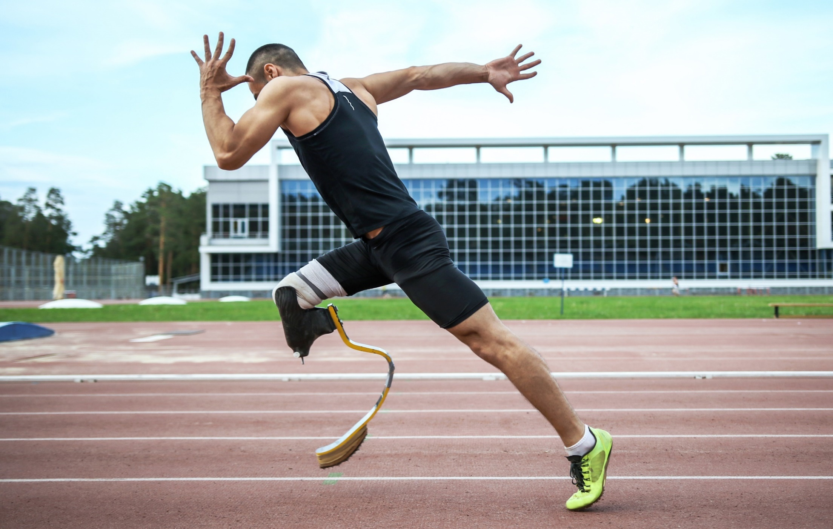
People who are brave everyday
Notes:
People can often show amazing bravery in everyday life too.
Some people like to take risks and do extreme sports, like skydiving or mountain climbing – do you think these people are brave or irresponsible? Explain that the images are taken out of context – the sky-diver may be jumping out of the plane as it’s on his bucket list or he’s raising money for charity. Does this change your view?
Some people though, have no choice but to be brave, when they’re sick, injured or disabled.
Talk through each slide and discuss

Slide 9
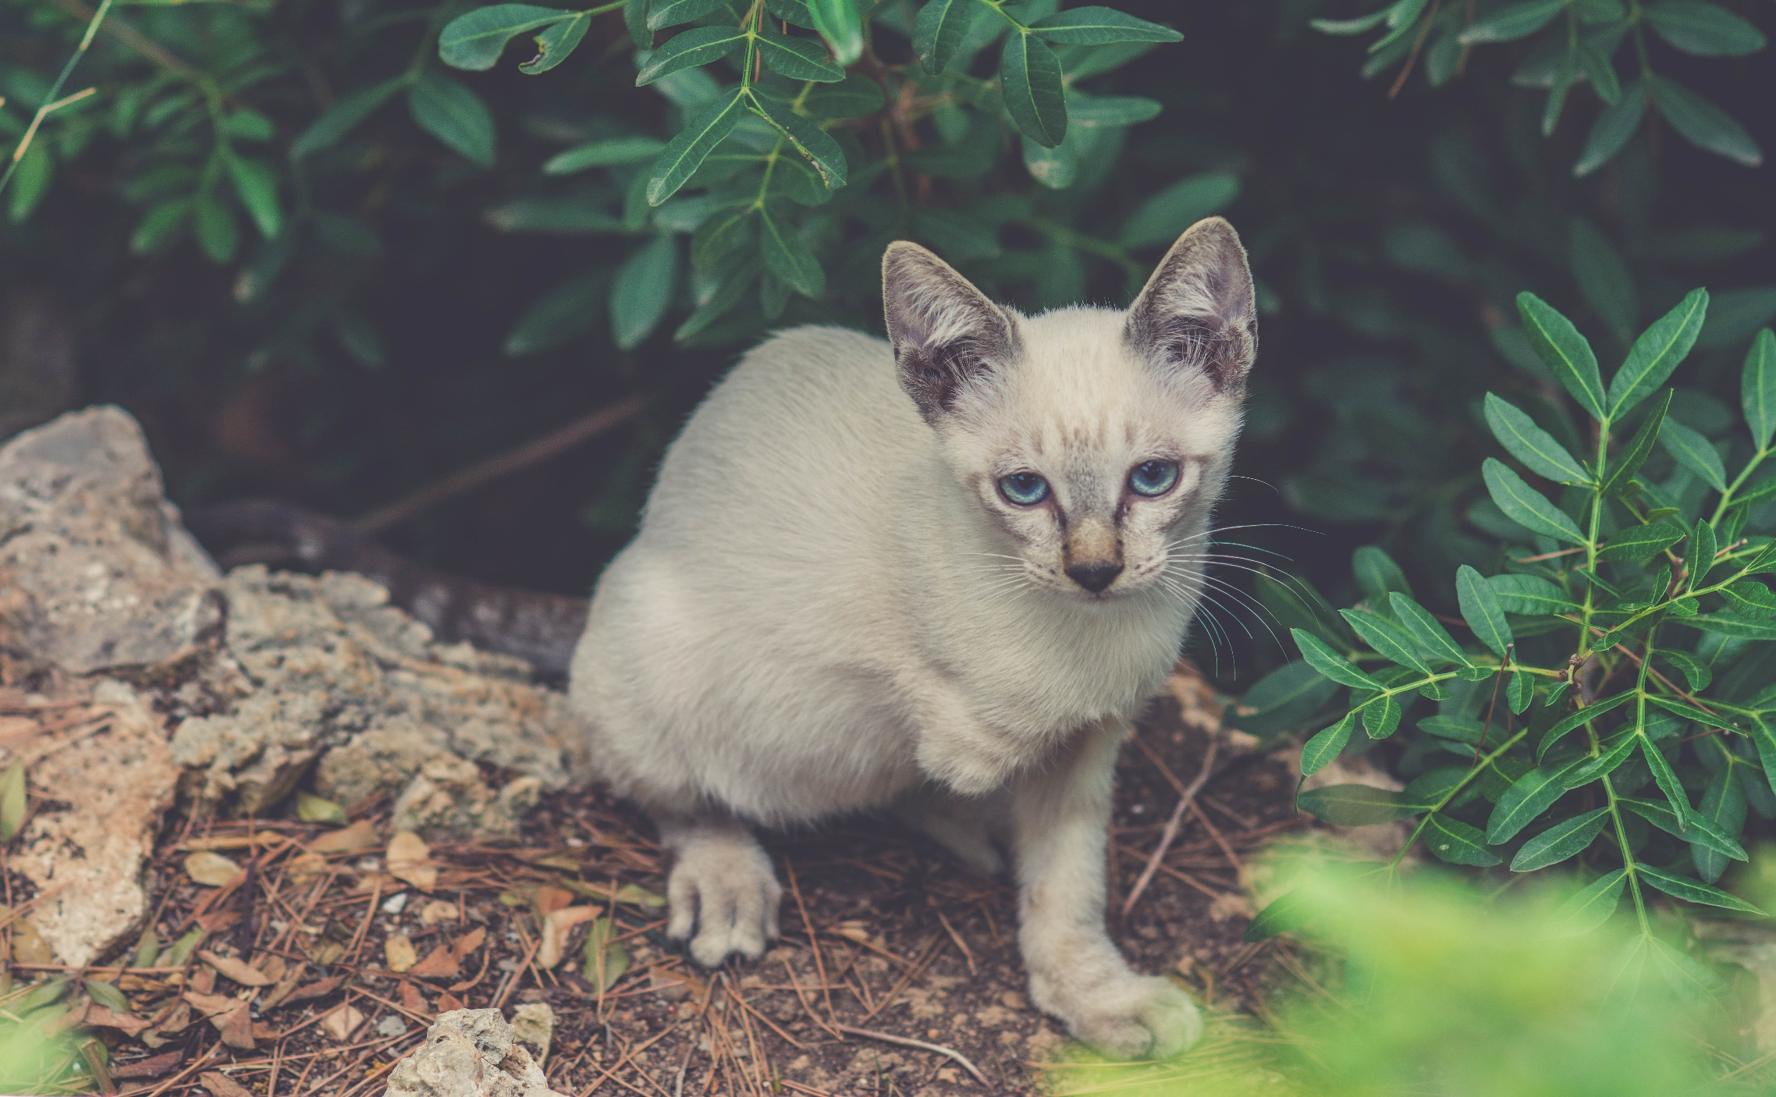
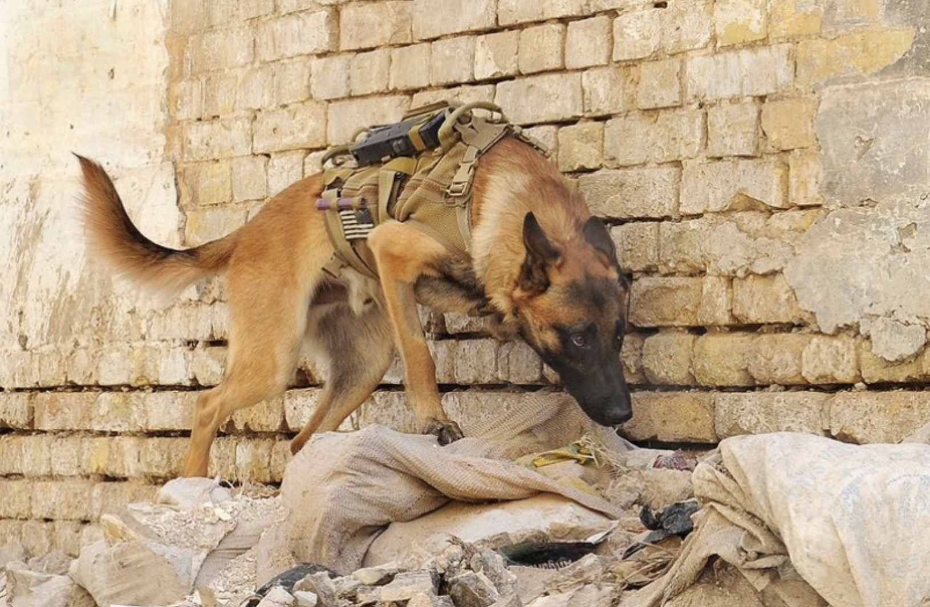
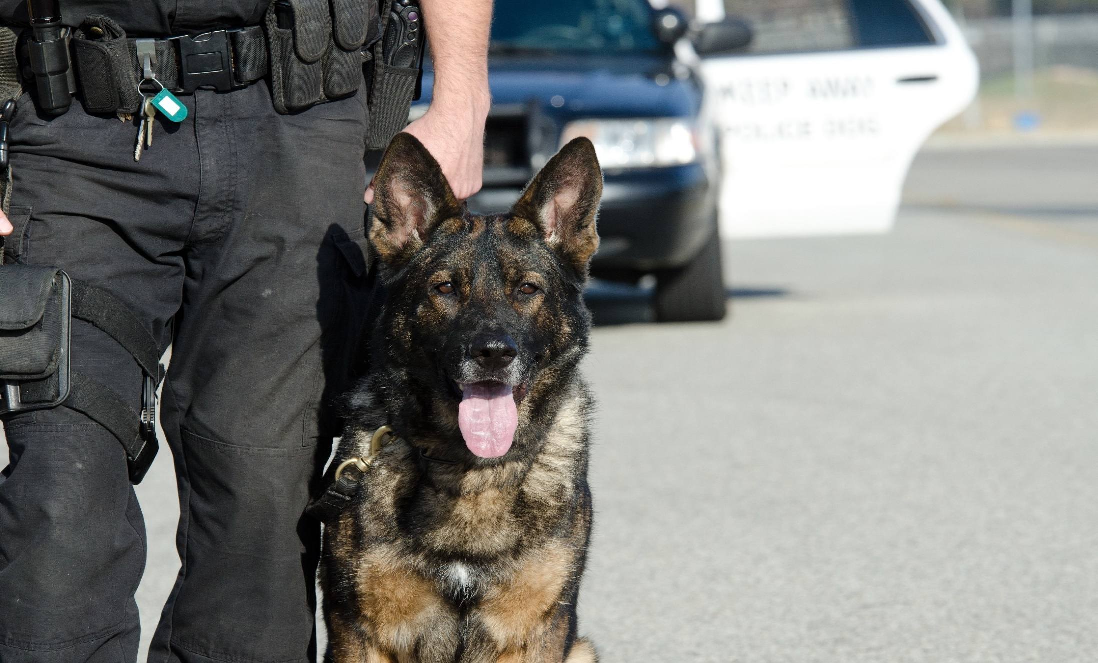
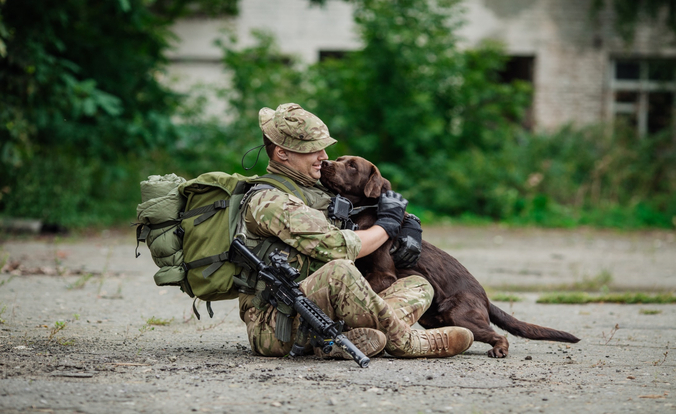
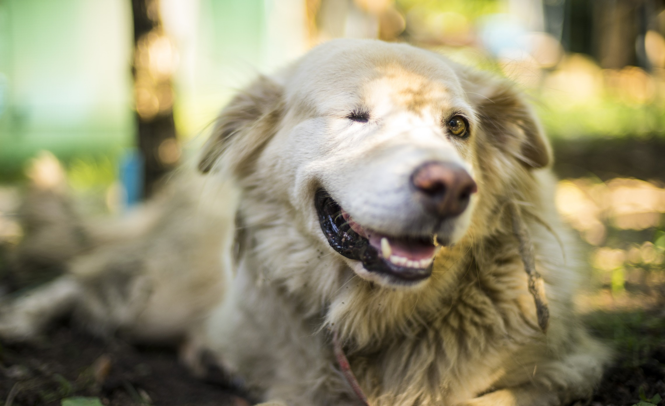
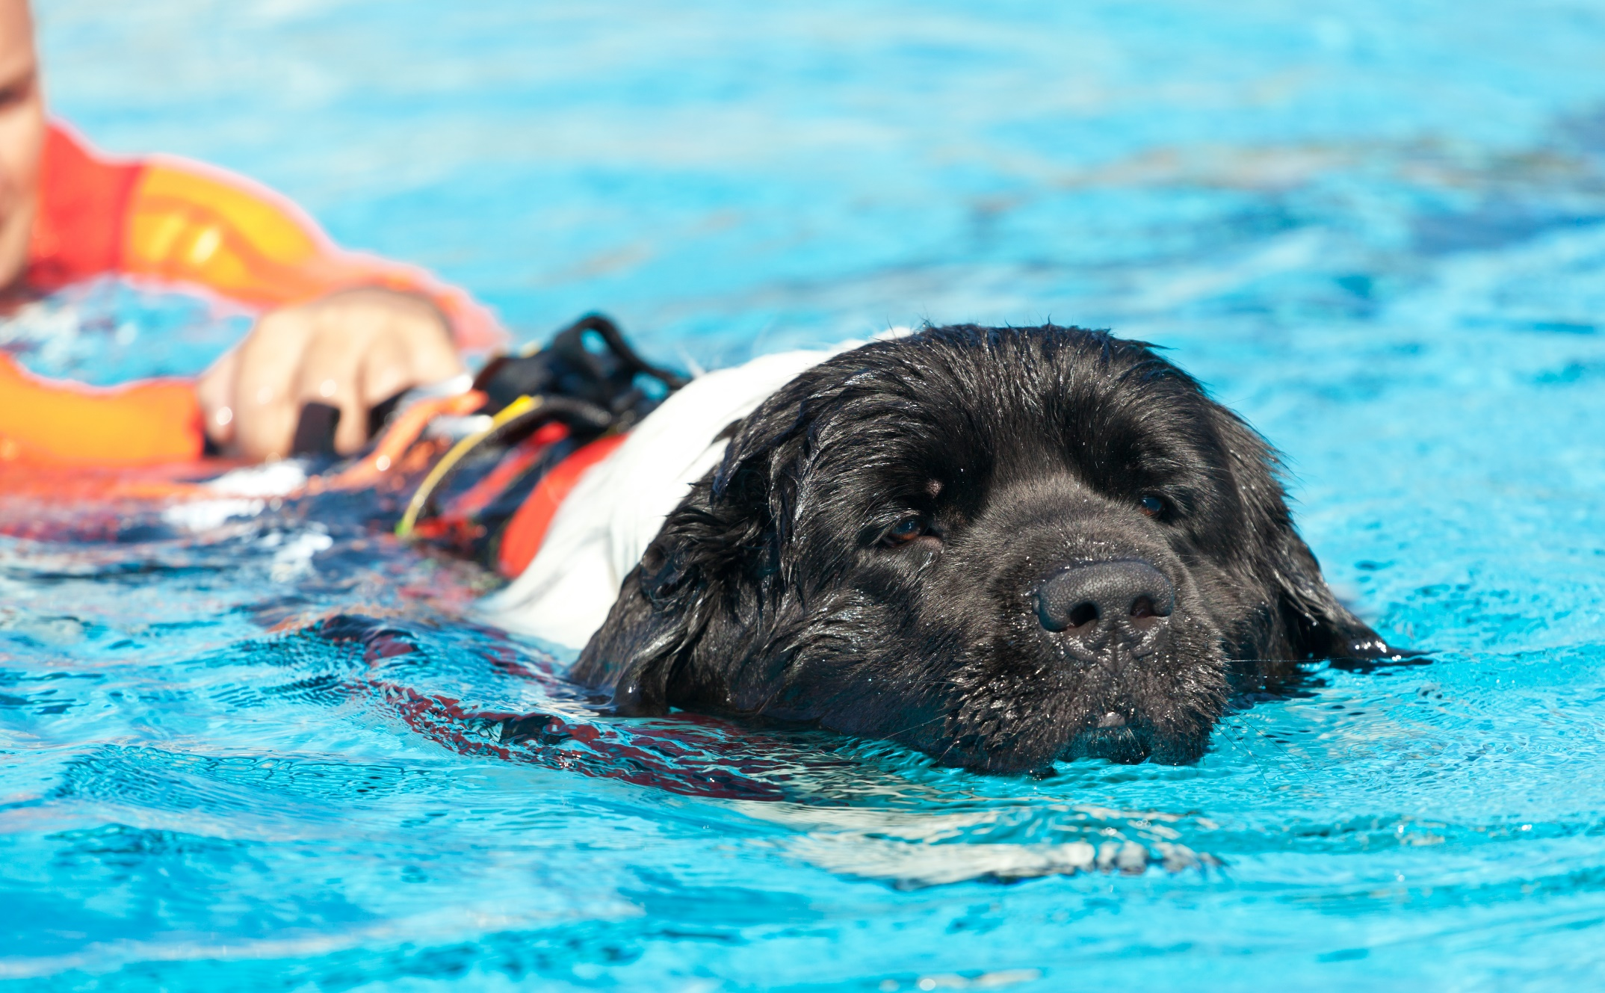
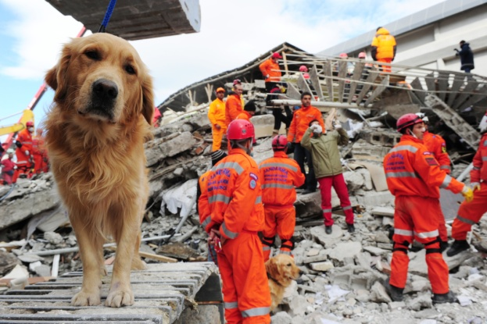
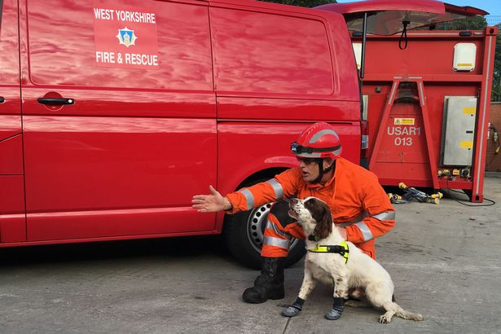
Can animals be brave too?
Notes:
Talk through each slide and discuss what each animal does/what disability it has and why it’s brave
Also discuss how animals too have to cope with health problems and disabilities

Slide 10
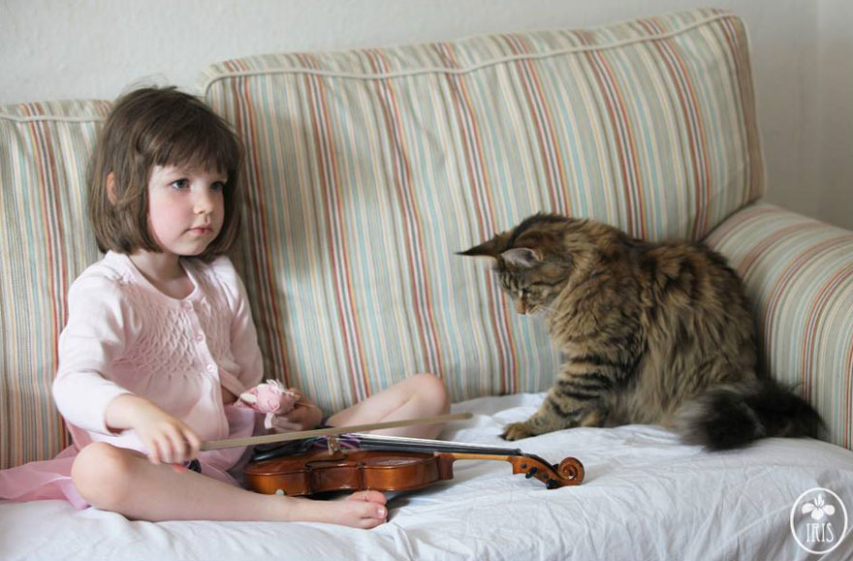
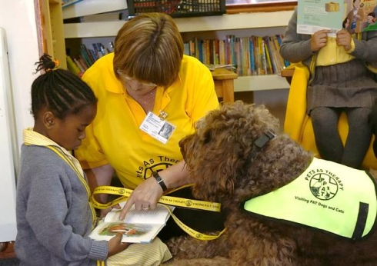
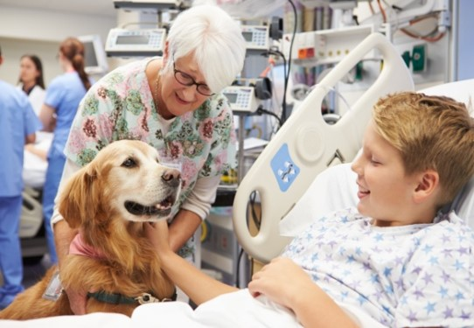
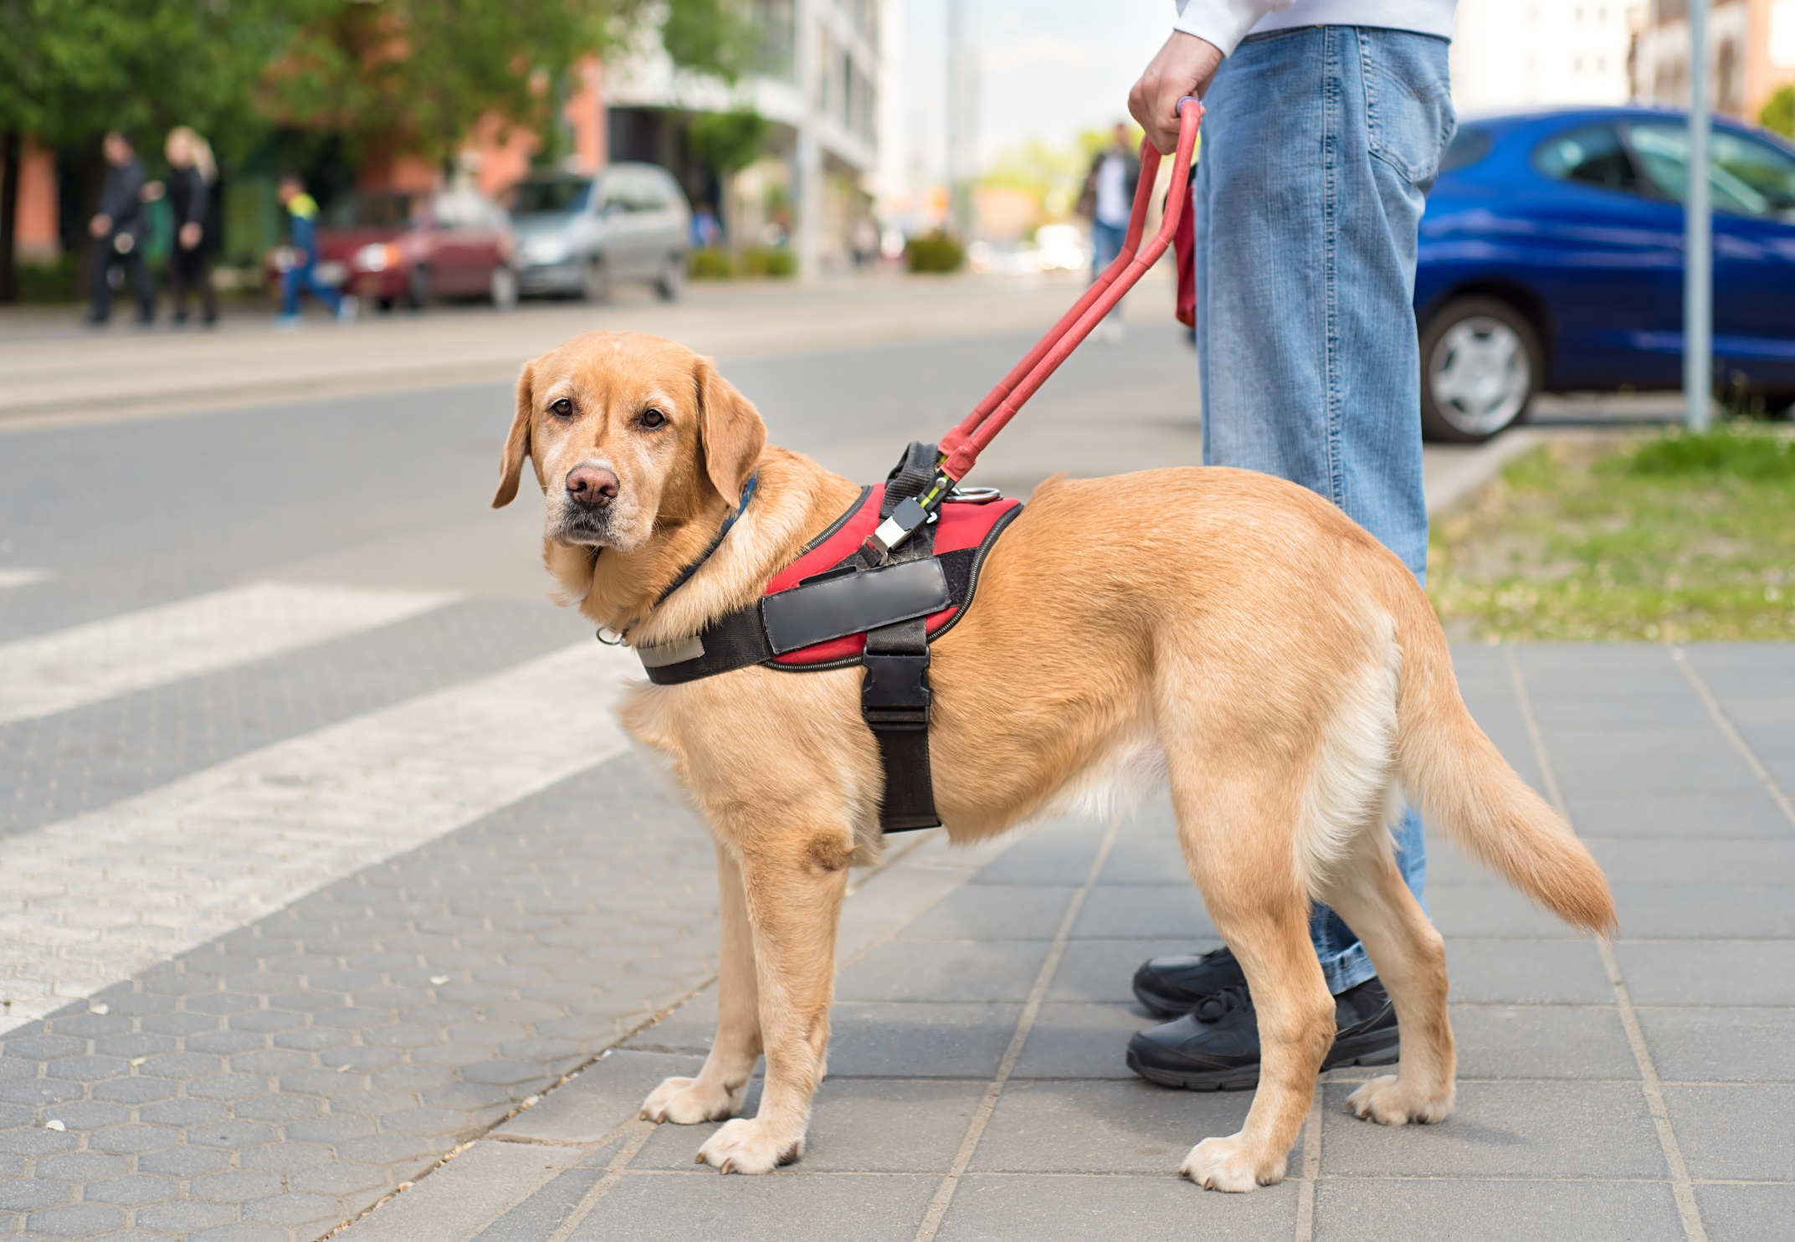
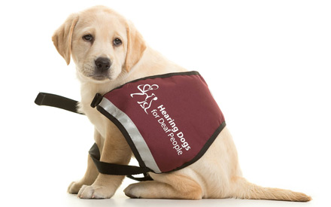
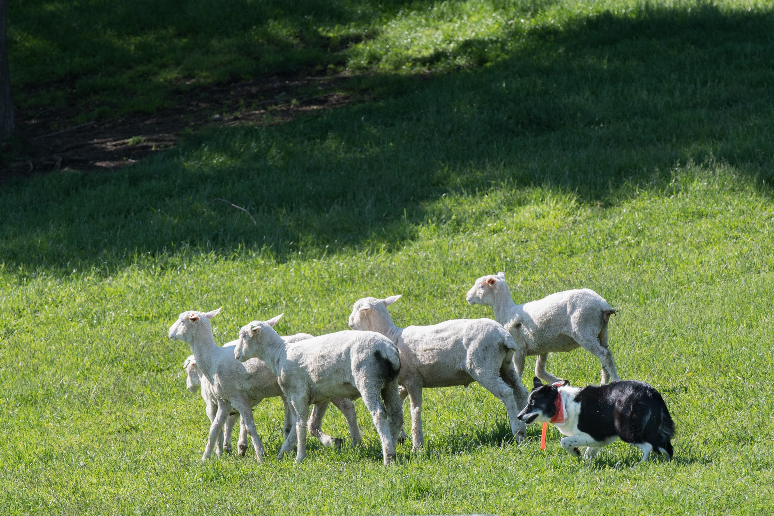
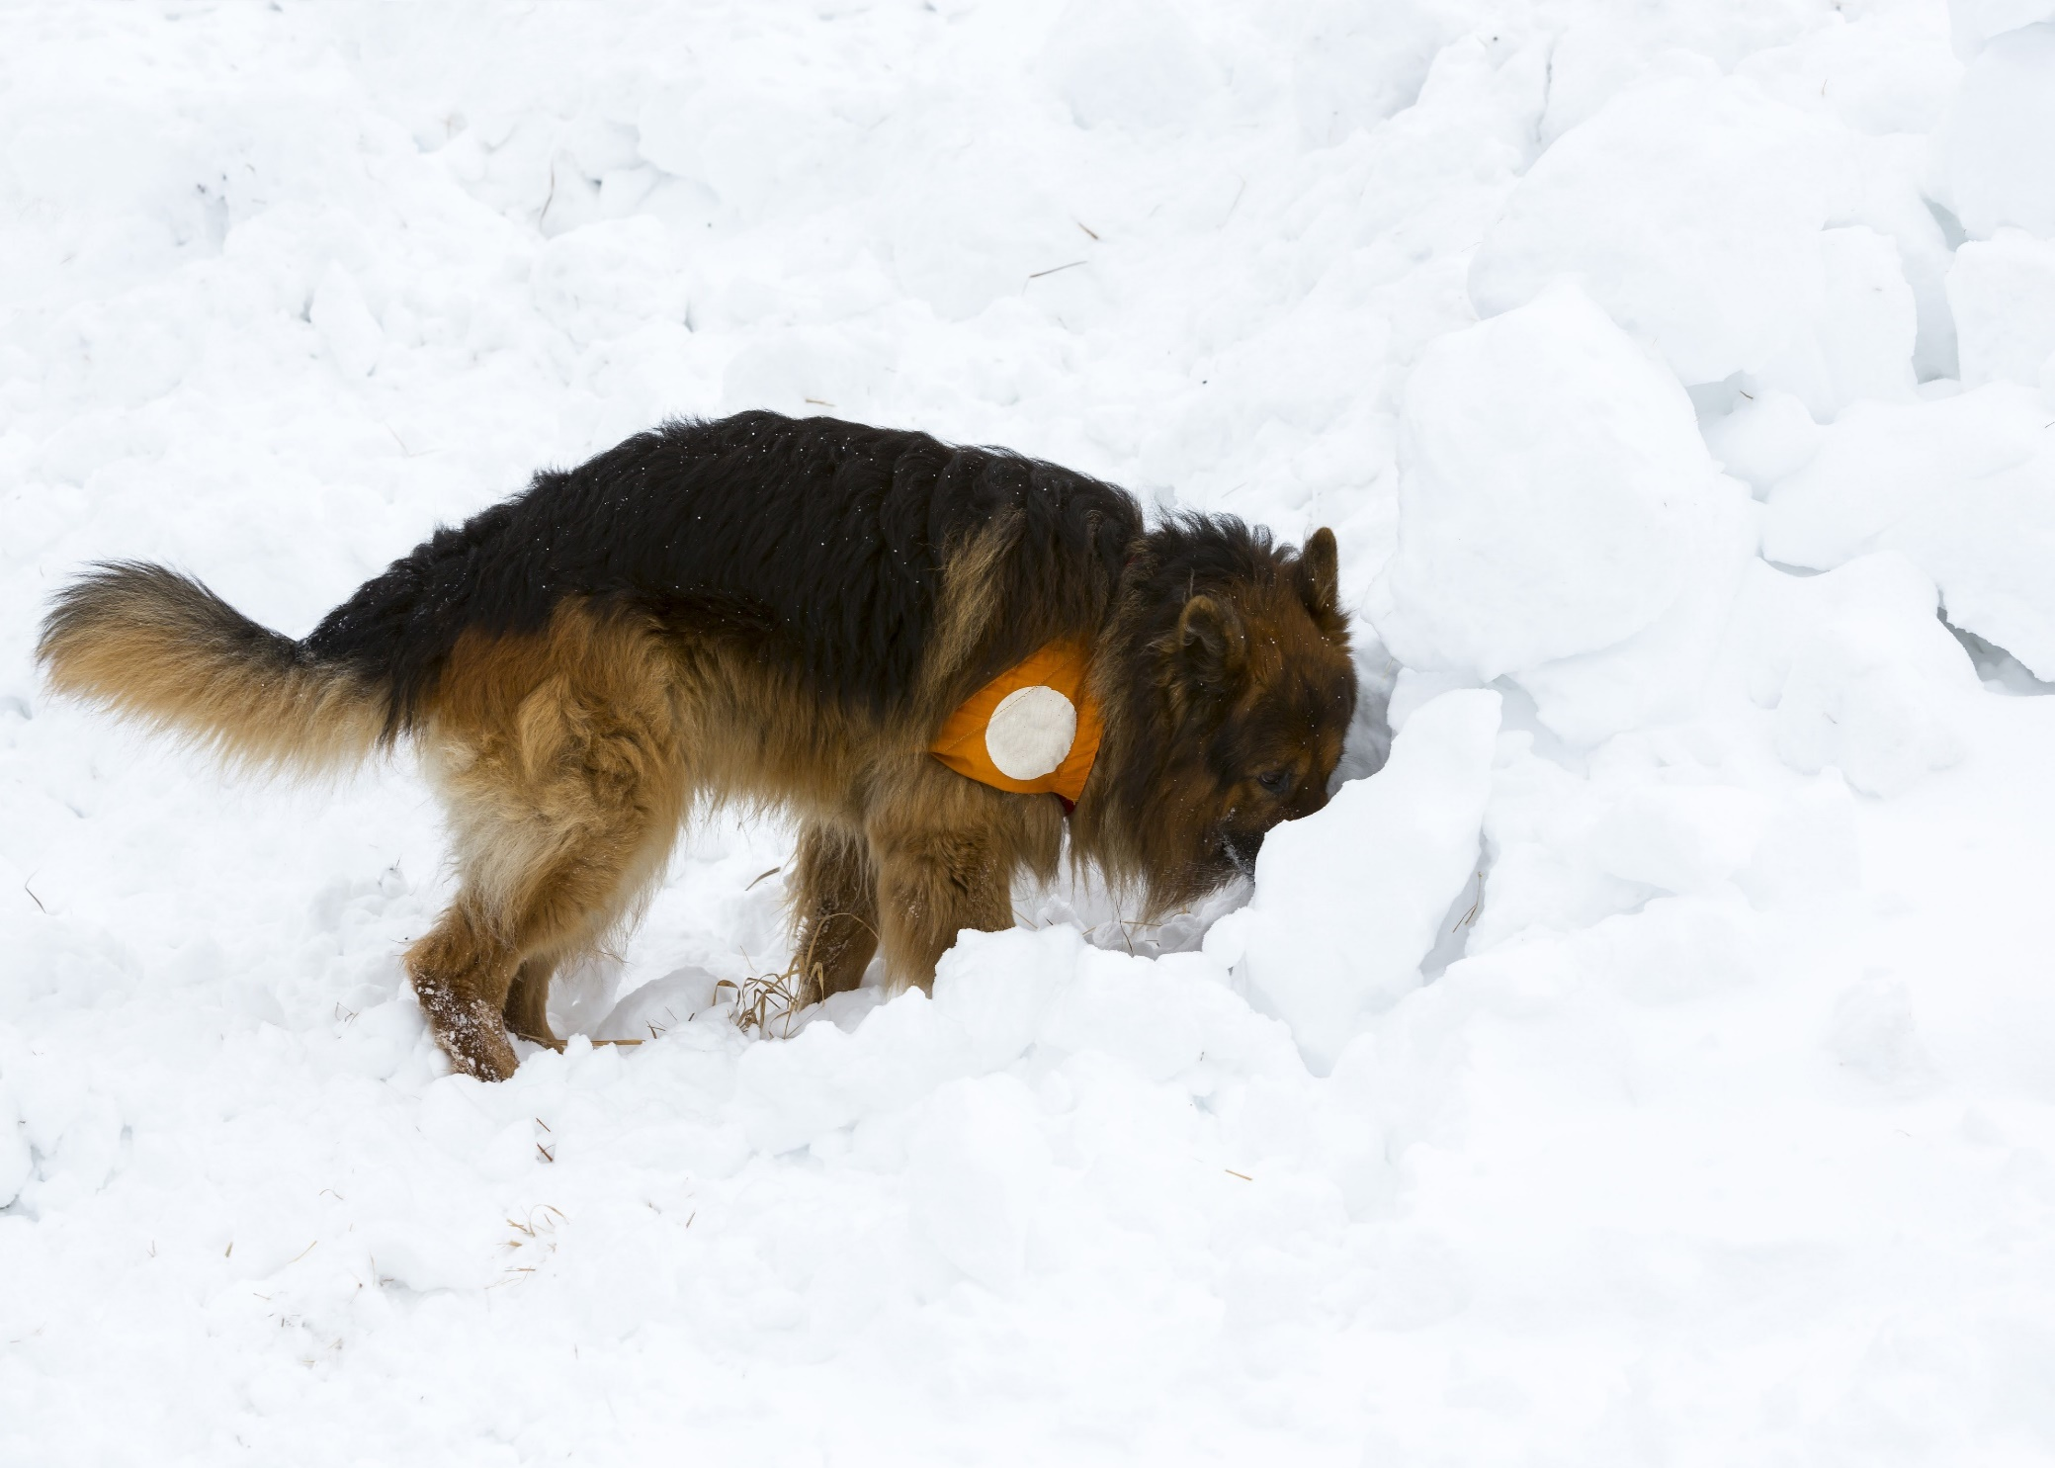
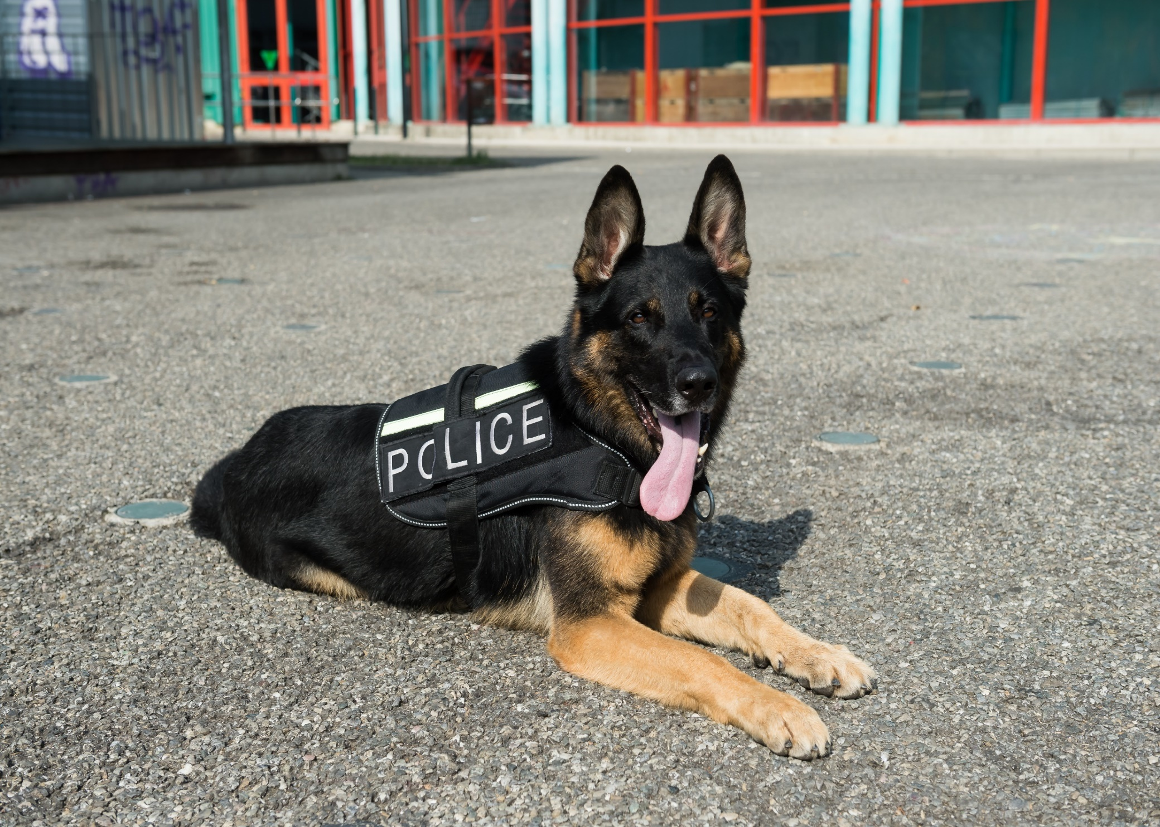
Animals who help
Notes:
Explain that some animals are trained to help people.
Show slides and discuss:
Herding dogs like this one help farmers to move their sheep
Guide dogs help people who are blind or partially sighted and act as their eyes to keep them safe
Police dogs work with other police to find and track criminals, as well as sniff out substances like guns
Search and Rescue dogs help to find people who are lost in dangerous conditions on mountains
Hearing dogs help people who are deaf or hearing impaired to alert them to sounds such as doorbells, kettles, oven etc
Therapy dogs help in a number of different ways. They might go into schools like yours to listen to reading, or visit people in hospital or in care homes.
Emotional support animals like this cat, can support people with a range of disabilities. This cat works with this little girl with autism, to help her to stay calm in stressful situations

Slide 11
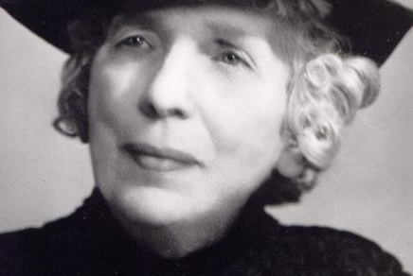
Maria Dickin CBE (1870–1951)
Notes:
Maria Dickin – The Animals’ Hero!
Maria Dickin was the founder of PDSA and was born in London in 1870.
She was horrified by the terrible poverty she witnessed at the end of WW1 – especially the sight of sick and injured pets who were in desperate need of veterinary care. Dogs, cats and lots of other animals had no choice but to scavenge from the gutters; many in pain and suffering - all because their owners simply couldn’t afford to pay for vet treatment.
In 1917, Maria rented a small basement room in Whitechapel in London and with the help of a vet friend, she opened it up to the public and PDSA was born.
She put a sign on the door which said:
“Bring your sick pets, do not let them suffer, all animals treated, all treatments are free”.
On that very first day, PDSA had 100’s of people turn up with their animals. They brought all kinds of creatures, including chickens, hens and goats and it was so busy, that the police had to come and control the crowd!
Maria thought it was important for us to recognise the bravery of animals as well as people.

Slide 12
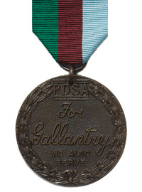
PDSA Animal Awards
PDSA Dickin Medal
Notes:
Share:
PDSA Dickin Medal
When people serving in the armed forces show great bravery, they may be awarded the Victoria Cross, which is presented by Her Majesty The Queen at Buckingham Palace.
PDSA’s Dickin Medal is the animals’ Victoria Cross.
It was the first PDSA medal – launched in 1943 to recognise the great part that animals play in times of war
- saving the lives of people and their fellow animals.
So far 70 animals have been given the Dickin Medal, they include dogs, pigeons, horses and 1 cat.

Slide 13
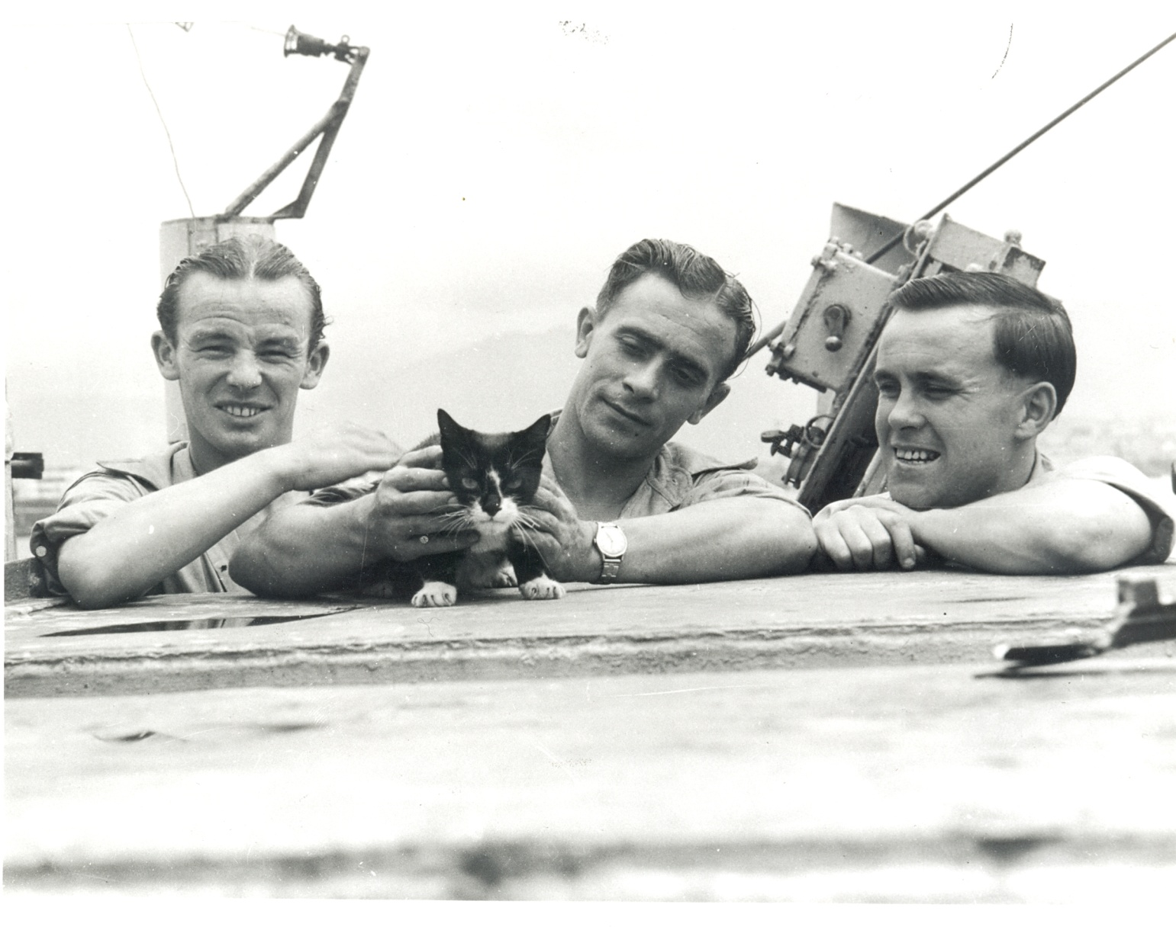
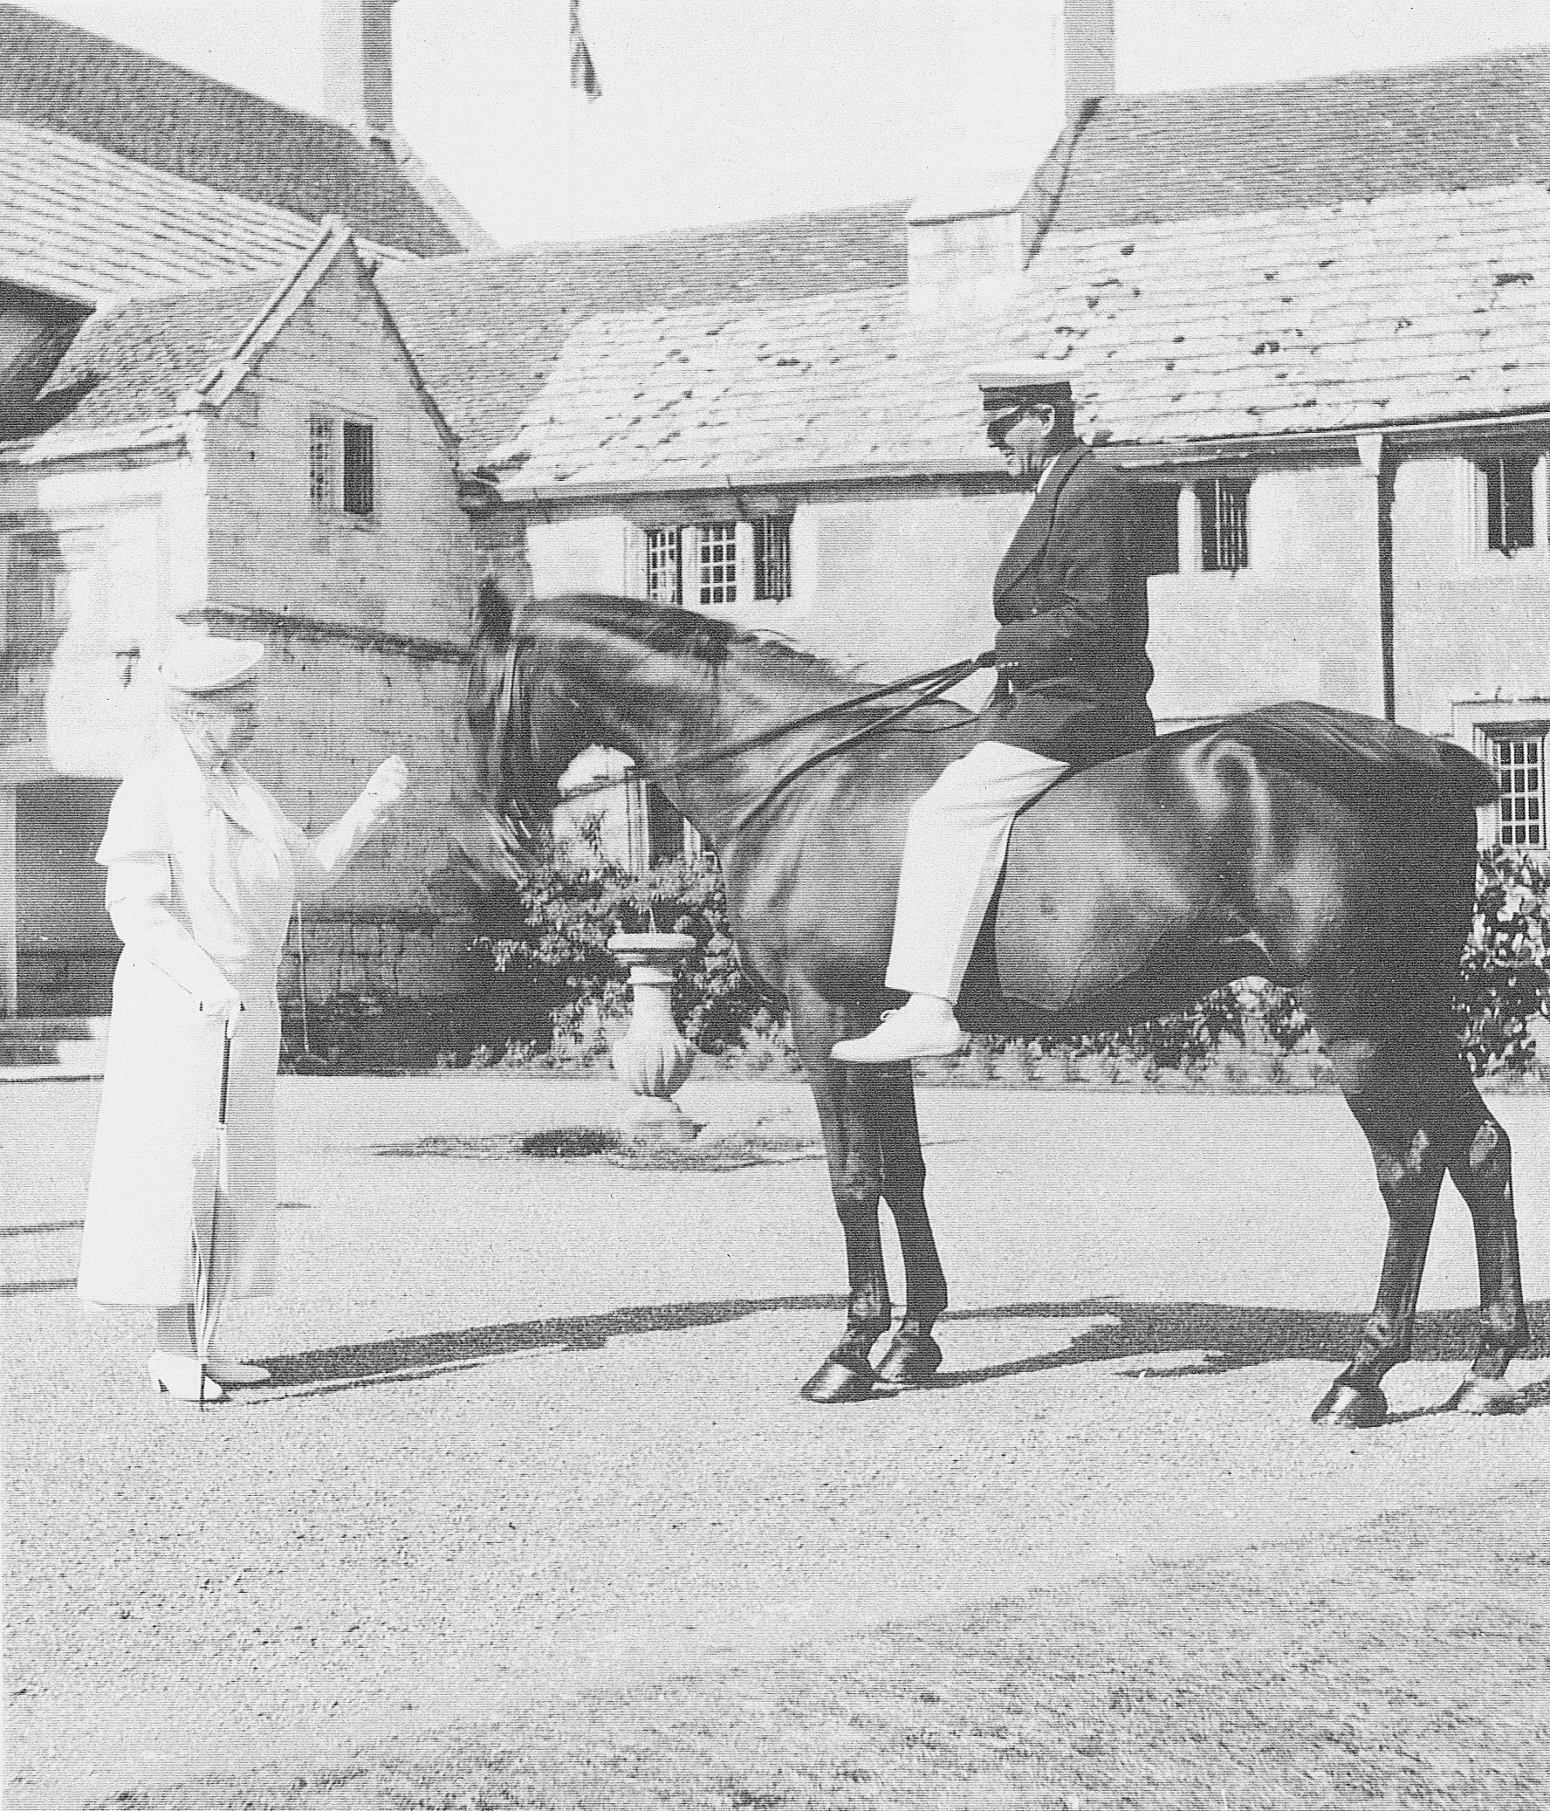
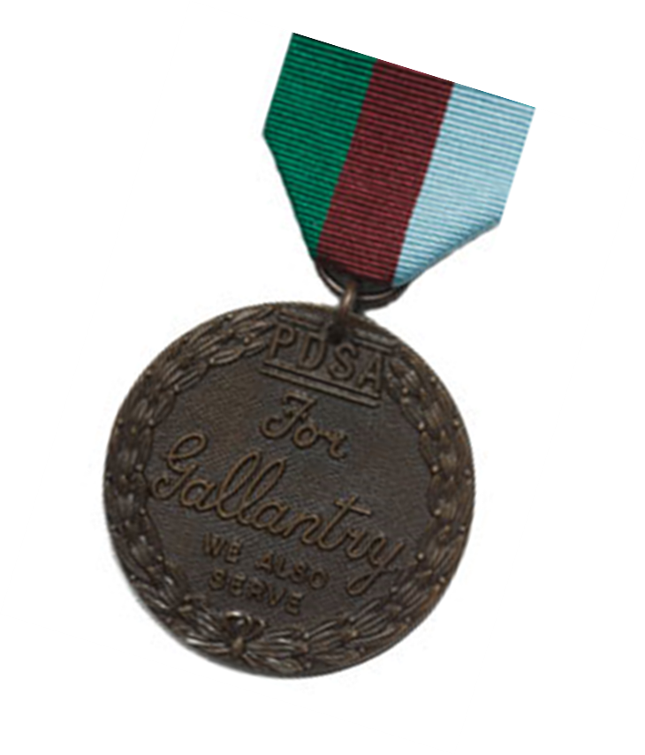
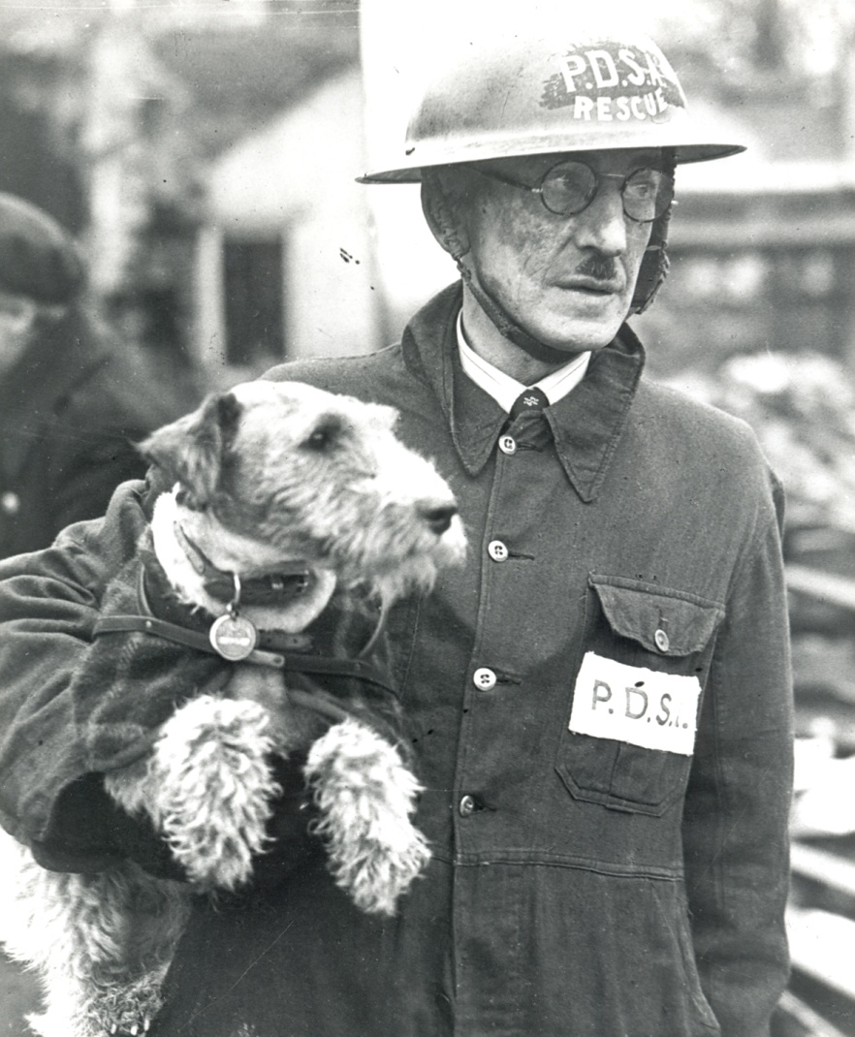
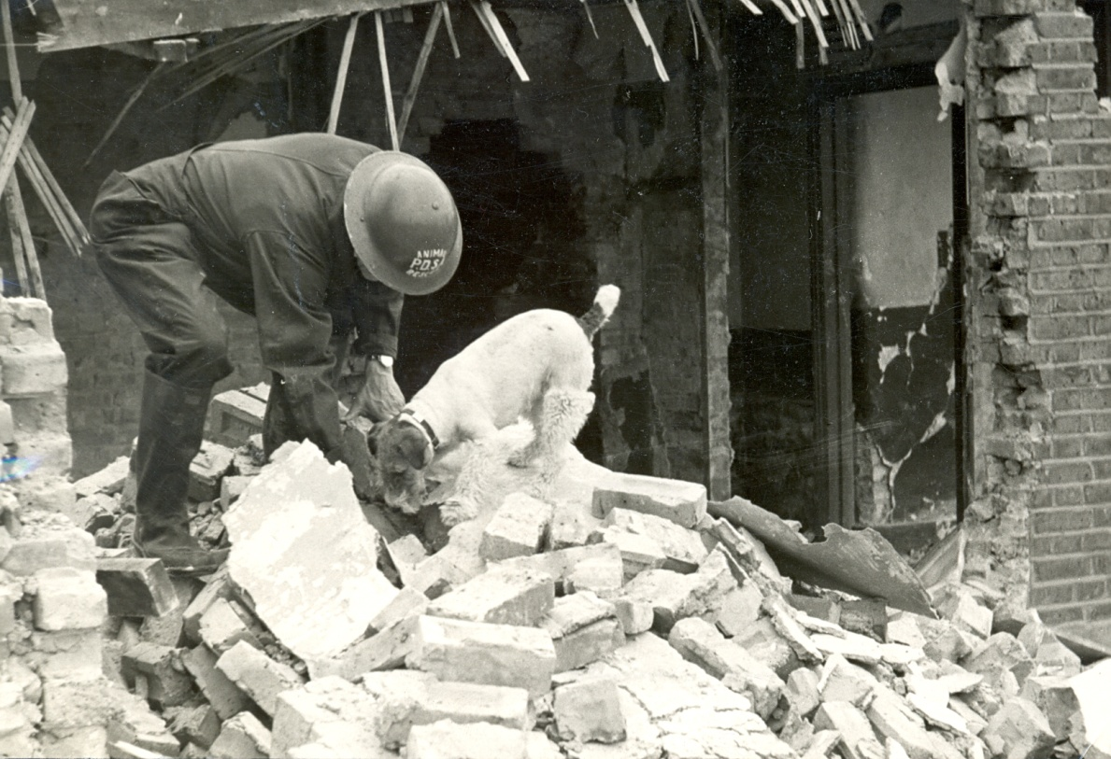
Simon the sailor’s friend!
Warrior the real War Horse
Beauty to the
rescue
Notes:
Share:
Simon the cat
Many cats used to live at sea on Royal Navy ships. Simon, the black and white cat lived on HMS Amethyst.
In 1949 the ship was travelling up the Yangtse River in China when it was attacked and lots of the crew were killed, including the Captain.
The ship was held captive for 100 days – Simon controlled the growing rat population and comforted the young crew who’d lost their friends and thought they’d never go home.
Simon was awarded the PDSA Dickin Medal at the end of 1949.
Beauty the dog
During wartime, specially trained dogs worked on patrol and guard duties and on search and rescue missions.
Beauty was the family pet of a PDSA worker, who led one of the animal rescue squads in London in World War II. One night in 1940 Beauty helped to dig through the rubble, and found a cat buried underneath. During her career she saved 63 animals from being buried alive, although she’d never been trained to do this.
She was awarded the PDSA Dickin Medal in 1945.
Warrior the horse
Some medals have been awarded years later – like in the case of Warrior the ‘war horse’ who survived the whole of World War I, but wasn’t given a PDSA Dickin Medal until 2014.
Warrior was a brave and dedicated horse who carried on with his duties even when soldiers and other horses were lost in the line of duty. Warrior received the medal on behalf of all animals that served during World War I. He had so many narrow escapes from death that he was known as ‘the horse the Germans can’t kill.’ A film was made about him, War Horse – have you seen it?

Slide 14
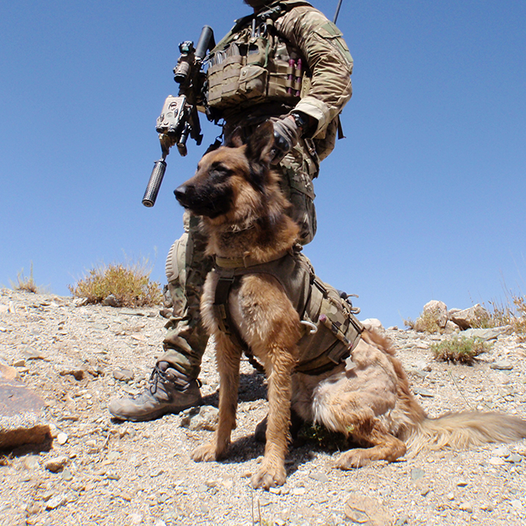
Kuga
PDSA Dickin Medal
2018
Click here for video
Notes:
Operations Dog Kuga receives PDSA Dickin Medal
A Military Working Dog who served with the Special Air service Regiment (SASR) in Australia has received the animal's VC for his remarkable actions while on duty in Afghanistan, in 2011.
Special Operations Military Working Dog (SOMWD) Kuga was posthumously awarded the PDSA Dickin Medal at a special ceremony at the Australian War Memorial in Canberra.
Kuga is the first Australian dog to receive the PDSA Dickin Medal in its 75-year history.
PDSA Director General Jan McLoughlin said "Kuga's actions undoubtedly saved the lives of his patrol. He took on the enemy without fear, saving his comrades despite suffering serious injury, and is thoroughly deserving recipient of the PDSA Dickin Medal."
Belgian Malinois Kuga has been posthumously recognised for his actions during Operation Slipper in the Khas Uruzgan district of Afghanistan. Kuga indicated the presence of an enemy ambush, concealed among trees alongside a river. Kuga swam into the river to apprehend the enemy and, in doing so, was show five times. He survived and was returned home to Australia, though he died less than a year later.
Whilst in Australia on other business, the formal presentation was made by PDSA Trustee Mary Reilly to Kuga's canine colleague, retired Military Working Dog Odin. Corporal Mark Donaldson – the recipient of the Victoria Cross for his actions in Afghanistan – received Kuga’s medal on behalf of the regiment.

Slide 15
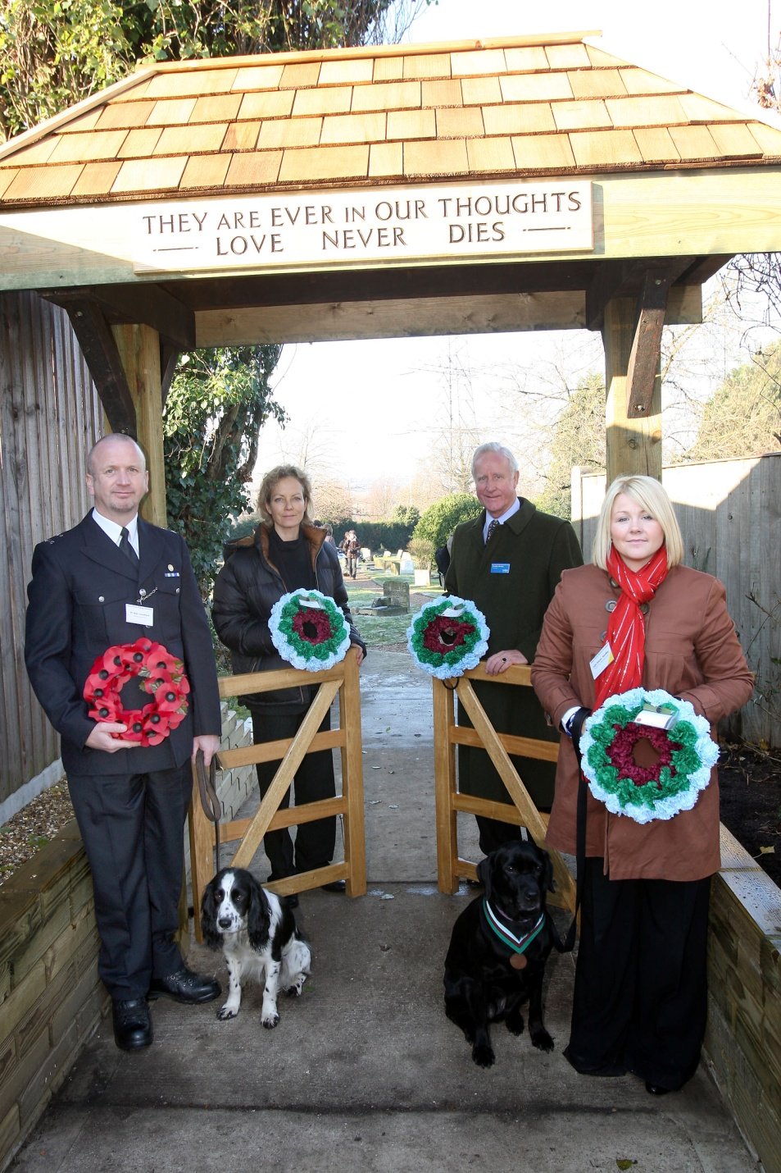
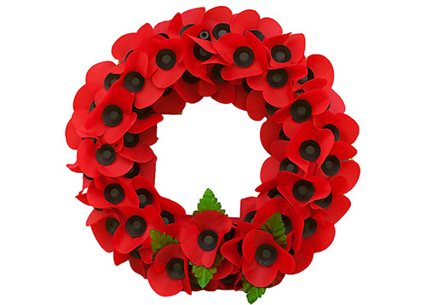
Remembering heroes
Notes:
How do we remember our heroes?
What’s the special day when we remember all the brave people that have been lost in battle - Remembrance Day, which is every year, is always on a Sunday in November.
The Queen, Prime Minister and other people, all lay wreaths to remember the people who’ve lost their lives in the line of duty.
Special wreaths are also laid to remember the hero animals too.

Slide 16
PDSA Animal Awards
PDSA Gold Medal
Notes:
Share:
PDSA’s Gold Medal is awarded for bravery and devotion, like the Dickin Medal, but can be given to pets as well as military animals. It’s known as the animals’ George Cross.
The George Cross is awarded to people in the armed forces and also, ordinary people, who’ve shown great courage and is presented by her Majesty the Queen at Buckingham Palace.
All the 24 PDSA Gold medals so far have been given to dogs.

Slide 17
Finn
Gold Medal
2018
Notes:
Finn has become the latest recipient of the PDSA Gold Medal – the animals’ George Cross. His medal ceremony will take place at a big PDSA event that is taking place in May.
Police Dog Finn, who is now retired from service, almost died from the stab wounds he sustained while protecting the life of his handler, PC Dave Wardell, who was also injured in the incident.

Slide 18
PDSA Animal Awards
PDSA Order of Merit
Notes:
Share:
When people do fantastic work in either business, public office or for charity work, they may be awarded the OBE (stands for Officer of the Most Excellent Order of the British Empire), which is presented by Her Majesty The Queen at Buckingham Palace.
PDSA’s Order of Merit award is the animals’ OBE.
So far, its been awarded to ten horses and four dogs.

Slide 19
Mojo 2018
Click here from video
Notes:
On 22 May 2017, Police Dog Mojo and his handler PC Phil Healy had returned home after an early shift. Later that evening, news came through of an explosion at the Arianna Grande concert inside Manchester Arena. Phil and Mojo immediately made their way back to work.
They were the first dog team on the scene and it was very chaotic. Their first task was to search Victoria train station's concourse, which was being used as the main casualty treatment area for the incident. Mojo searched around the injured victims to make sure that the area was safe and clear of further explosives, for the responding emergency services and the public.
PC Healy and Mojo were then moved into the Arena itself and to the site of the explosion. Mojo worked in horrendous conditions, searching for secondary devices among the sea of unattended, abandoned items, to secure the area and ensure the safety of the Firearms Units and other attending emergency services working in the area.
PC Healy and Mojo were later joined by other dog teams and together, they searched the whole stadium. Mojo worked alongside his handler until 7am the following morning. On their way home, Mojo and PC Healy were called out again to follow up on reports of a suspicious item elsewhere.

Slide 20
Bryn 2017
Click here for video
Notes:
Bryn
Search and rescue dog for Cheshire Fire and Rescue Service and UK’s International Search and Rescue Team Date of award: 16 March 2017 ‘For outstanding devotion to duty on behalf of UK International Search and Rescue, 2006 – 2016.’
Border Collie Bryn has worked as a search and rescue dog alongside his handler Steve Buckley since he was a puppy. In 2005 Bryn became fully qualified and UKISAR graded. In 2009, they became one of only four UK dog teams to attain the International Rescue Dog Organisation’s ‘mission readiness test’. The test consisted of seven searches over 36 hours, a 10km march, dog first aid and working at height. Alongside his work with Cheshire Fire and Rescue Service Bryn has been deployed to building collapses, missing persons’ searches and gas explosions throughout the UK. His international work involved working in Japan (2011) after the earthquake and tsunami, and in Nepal (2015) following the devastating earthquake which killed and injured thousands. Bryn’s ability to search large areas for casualties, with greater speed and efficiency than his human counterparts, was invaluable. It minimised the need for risky interventions when faced with precarious and volatile rescue situations. As well as helping find casualties within disaster areas, Bryn’s skills have also helped reunite families with lost loved ones, allowing them to be laid to rest. He retired in May 2016 after an outstanding 11-year career.

Slide 21
Activity
Notes:
Activity based on debating whether or not animals should be put in harms way to protect people. Scenarios worksheet

Slide 22
Everyday Animal Heroes
Notes:
Romeo works as a PAT (Pets as Therapy) dog, with people who are suffering from dementia. He visits care homes to bring a smile to the patients. He also regularly gives blood to sick and injured dogs who need blood transfusions.

Slide 23
https://www.youtube.com/watch?v=xpQNTCjtXts&t=2s
Notes:
Play medals video

Slide 24
Ruby’s story
Notes:
Brave kitten, Ruby, was found wandering the streets as a stray, with terrible burns on her head and back, which were thought to have been caused by chemicals. Luckily, a kind member of the public found her and took her to the nearest PDSA Pet Hospital.
Action taken:
When Ruby arrived at the Hospital, she was examined by our vets and was taken into Hospital for treatment. She was given antibiotics to treat any infection and analgesics to stop her being in any pain. Our vets and nurses flushed out her wounds and used special creams to help her skin to heal.
Everyone at the Hospital adored Ruby, especially our Vet Care Assistant, Natalie Lodge, who fell in love with her fighting spirit and lovely personality – so much so, that she gave the kitten a forever home.
Vet’s comment:
‘We estimated Ruby to be just four months old when she came in. Her injuries were so serious that we did consider whether it would be kindest to put her to sleep. But she was so bright and courageous, despite the pain she must have been in, we just had to give her a chance.”

Slide 25
SAVED
thanks to
PDSA!
Ruby’s story
Notes:
New owner, Natalie’s comment:
“Ruby is such as little fighter and so adorable; despite everything she went through her cheeky character always shone through. Her wounds are now completely healed and her fur has mostly grown back, although some fur on her face has grown back white!”

Slide 26
Thank you!
Thanks!
Notes:
Thanks from PDSA

