Slide 1
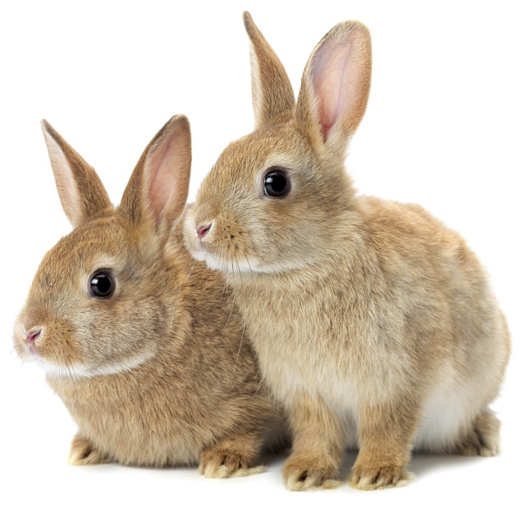
The Five Welfare Needs
Notes:
Introduce PDSA
Explain that PDSA is a not a private vet practice and is a charity.
Ask them what a charity does and explain that we look after pets when owners can’t afford to take their pets to the vet.
Ask them what would happen to all the sick and injured pets we treat if PDSA weren’t around.
.
Explain that today, you’re going to learn about what all pets need to be healthy and happy and also about one of the pets that PDSA has helped in our Pet Hospitals.

Slide 2
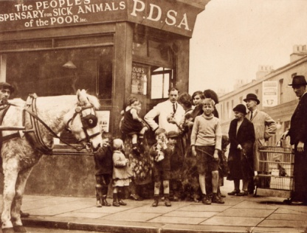
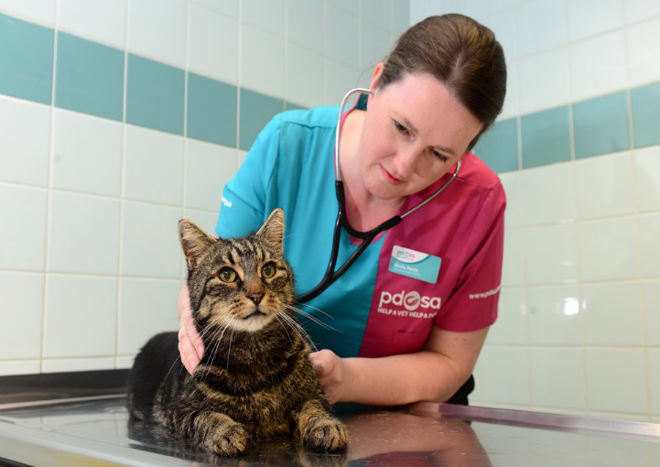
The UK’s leading vet charity …
Our charity is 100 years old and we’ve been treating sick and injured pets since 1917
We have Pet Hospitals all over the UK
We help a sick or injured pet every 5 seconds!
It costs more than £1 million every week to do our work
Notes:
Share the details on the slide and:
Explain that PDSA relies on people doing fundraising and donating money to do its work.

Slide 3
My Pets
Notes:
Add images of your pets and share funny stories about them

Slide 4
People - What do we need?
Home
Friends
Healthy diet
Exercise & Fun
Good Health
Notes:
This slide sets up for the welfare needs – encourage the group to think about what they need to stay happy and healthy and use the images as prompts or to give answer
When you get to the health slide, talk about the things they do to keep themselves healthy: Brush their teeth, bathe, wash and brush their hair, trim their nails, have vaccinations etc. Also talk about where they go when they’re poorly – compare vets with doctors.

Slide 5
All pets need …
The right
ENVIRONMENT
To show natural
BEHAVIOUR
Good
HEALTH
A healthy
DIET
COMPANIONSHIP
The Five Welfare Needs
Notes:
Explain that pets are just like us and need a variety of things to keep them happy and healthy even though they are very different from us and from each other (different species)
For instance; you wouldn’t keep a dog in a rabbit hutch or a cat in a fish tank!
Environment – animals need a clean, safe environment with enough space
Diet – animals need the right kind of food in the right amount and 24 hour access to fresh clean water
Behaviour – animals need to be able to express their normal behaviour; they need to exercise, to play and do specific things, depending on the species
Health – animals need to be kept in good health. This means taking them to the vet when they’re ill, but also making sure we keep them healthy.
Companionship – animals need the company of people and sometimes other animals, depending on the species. Some animals also need to have their own territory, like cats.
Responsibility: Stress to the group that if they have a pet, that it’s their responsibility to make sure that all these welfare needs are met. People who don’t provide these needs are now breaking the law.

Slide 6
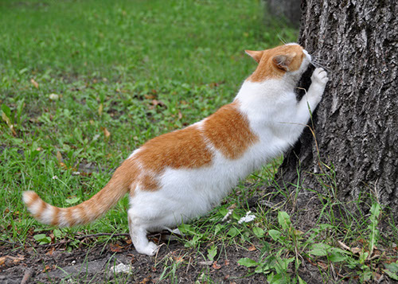
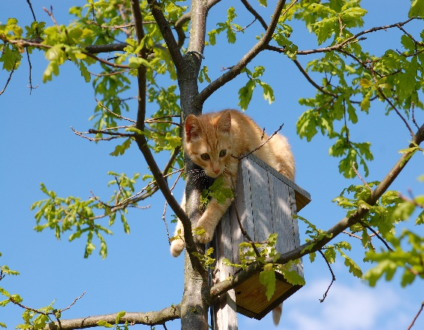
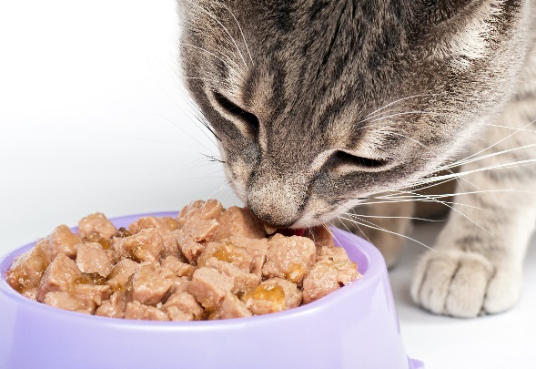
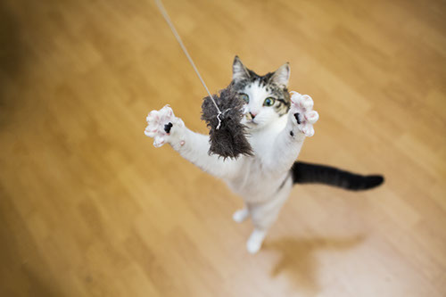
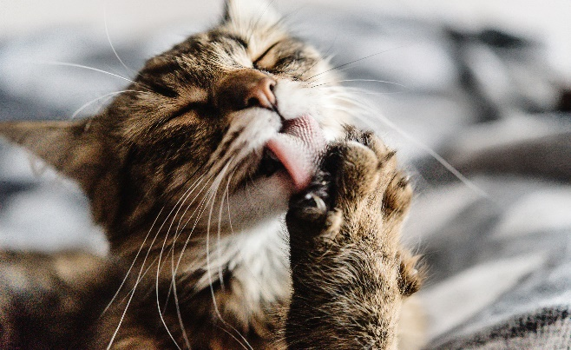
Cats – What do they do?
Scratch/Scent Mark
Climb/Hide
Eat/Drink
Sleep
Hunt/Play
Groom
Notes:
So let’s start with cats – you can see from the headings that cats naturally do lots of different things.
Explain each picture
Scent mark/scratch – Cats leave their individual scent behind from the pads of their feet and their faces, to let other cats know that this is their territory – cats naturally like to live alone, although some will put up with other cats if they have enough space around them or if they’ve grown up together. Explain that cats rub their faces on furniture and on people to leave their scent – explain that by rubbing their faces on you, they’re telling other cats that you belong to them!
Climb/Hide – cats are great at climbing. They’re very agile creatures with great balancing skills. Explain that cats climb so they can stay safe and see what’s going on from above and that if they’re scared they’ll hide.
Eat/Drink – All living things need water to survive and must have fresh water at all times. Explain that cats often prefer to drink from running water or from pools. This means they prefer to drink from wide and flat bowls or fountains. Explain that cats have to eat meat to survive and can’t be vegetarian. Also explain that some cats still have wild behaviour and hunt. Explain that this is natural behaviour for a cat.
Sleep – Explain that cats sleep a lot – for almost two thirds of their lives! They can spend up to 16 hours every day asleep. In the mammal world, only sloths and bats sleep for longer than cats. Cats actually do have ‘catnaps’ and sleep for short periods of time very frequently. They tend to be awake early morning and when it’s going dark – the best time for hunting.
Hunt/Play – Cats like to hunt and play at hunting. They’ll try to stay hidden for as long as possible and sneak up on their prey or their toys – they’ll move very slowly so that they won’t be seen and when they get close enough they’ll sprint as fast as they can to catch their prey.
Groom– Cats love to be clean and spend a lot of time grooming themselves – their tongues have lots of hairs on them that act like little combs. Ask if anyone has been licked by a cat and talk about how their tongues are rough like sandpaper.
Ask if they’d like to see some cats in action and introduce the video.
Here is a video of some cats showing some cat behaviours

Slide 7
https://www.youtube.com/watch?v=7qZLVA_06ko
https://www.youtube.com/watch?v=Imeq3GeRttw

Slide 8
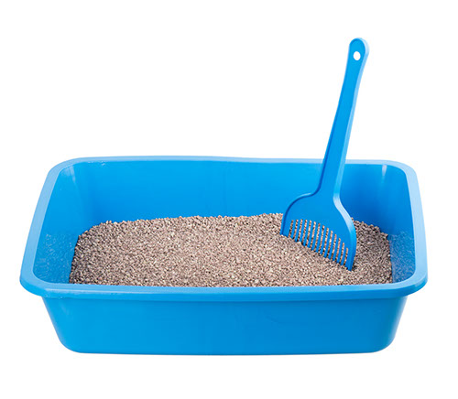
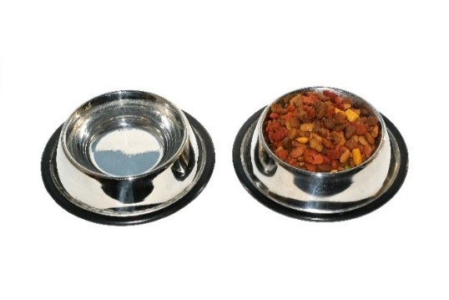
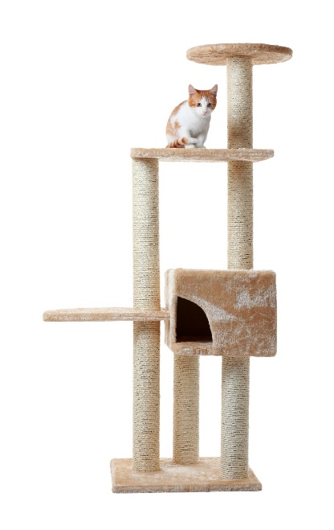
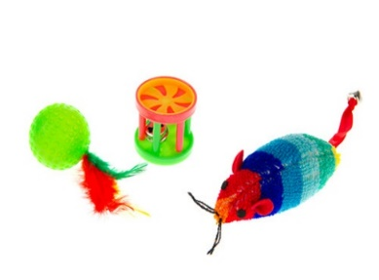
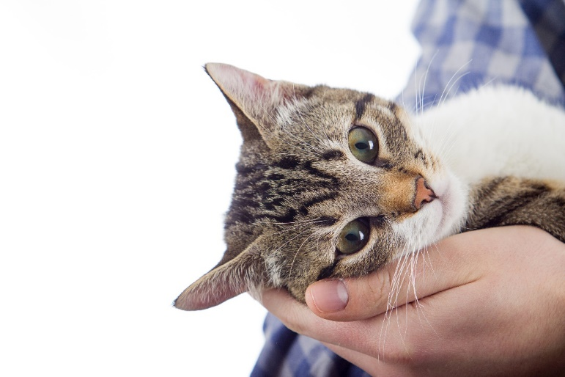
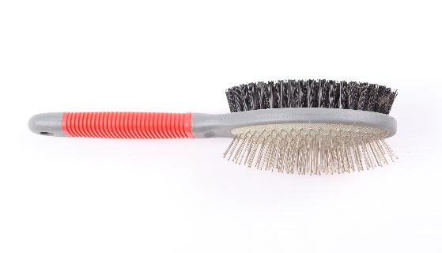
CATS
Notes:
Ask the group if they can guess what things they’d need to provide a cat with to keep it happy.
Show each picture and ask group to discuss why they need it:
Scratch post – display natural scratching/scent marking/climbing behaviours – up high away from dangers
Water fountain for fresh water or wide brimmed bowl – away from food and litter tray
Food – complete balanced diet, either wet/dry or both. Many cats are overweight, which can lead to health problems such as joint problems, diabetes, heart disease and some cancers. It’s really important to make sure that cats get the correct amount of food and not too many treats, as well as lots of exercise.
Litter tray – at least one per cat in household in different areas of house and away from food and water bowls.
Toys – practice stalking/hunting behaviours
Companionship – people rather than lots of cats
Milk – Discuss that milk can cause digestive problems in cats as it contains lactose, something they can’t digest.

Slide 9
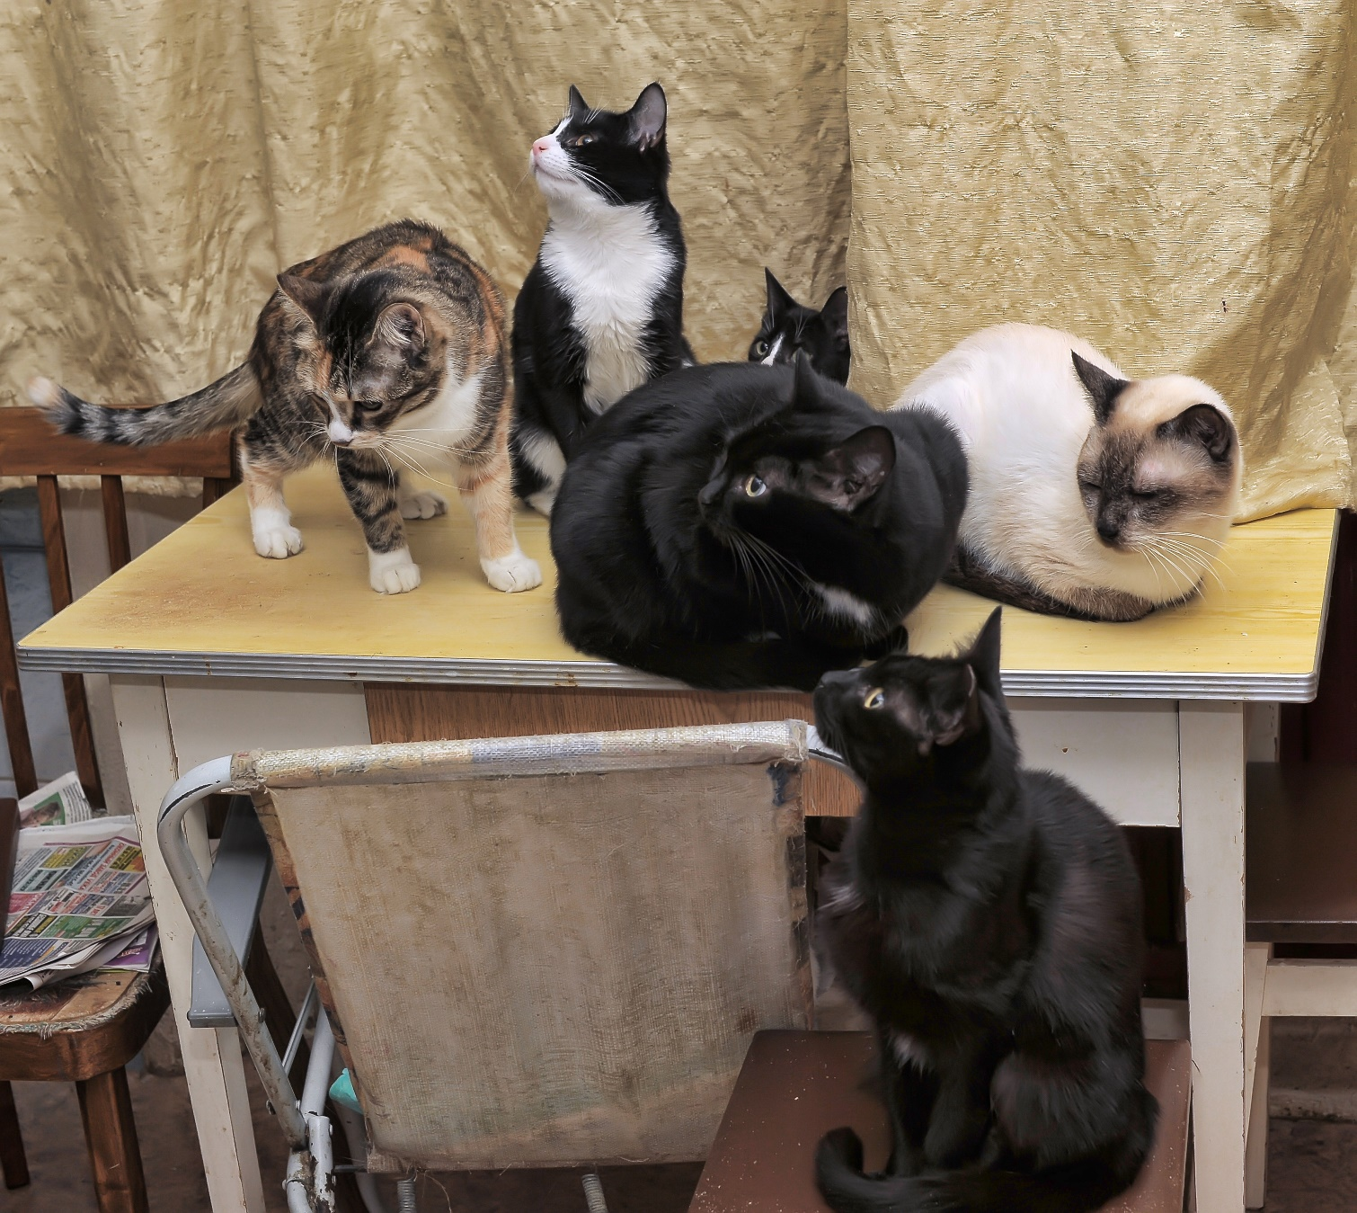
Notes:
Discuss:
Based on what we’ve just learnt about cats, what are these cats are missing in terms of their five welfare needs being met?
How to meet the cats needs - discuss

Slide 10
How do we meet a cat’s welfare needs?
ENVIRONMENT
BEHAVIOUR
HEALTH
DIET
COMPANIONSHIP
Notes:
Ask the pupils to work in groups to decide how we’d meet each need for a cat. You could divide the class in to 5 groups and give them a Welfare need each. Hear feedback from the class before moving on.
Example answers:
Environment – A home with people rather than other pets
Diet – Meat or a mixture of dry food and meat. It’s important that cats are given cat food rather than human food as it contains all the right nutrients for them to stay fit and healthy.
Health – It’s important to take cats to the vets for check ups and keep them up to date with their vaccinations/flea and worm treatments.
Behaviour – Cats need toys that encourage them to use their natural hunting skills.
Companionship – Cats like human company but may struggle with the company of another cat.

Slide 11
https://www.youtube.com/watch?v=WPpBE_-ZxFA
https://www.youtube.com/watch?v=vzzCj_xK2x8
https://www.youtube.com/watch?v=0ZewLSyvAxg
https://www.youtube.com/watch?v=2jzFteKLNbE
Notes:
Following the video complete a spider diagram based on what they think rabbits need to be healthy and happy.

Slide 12
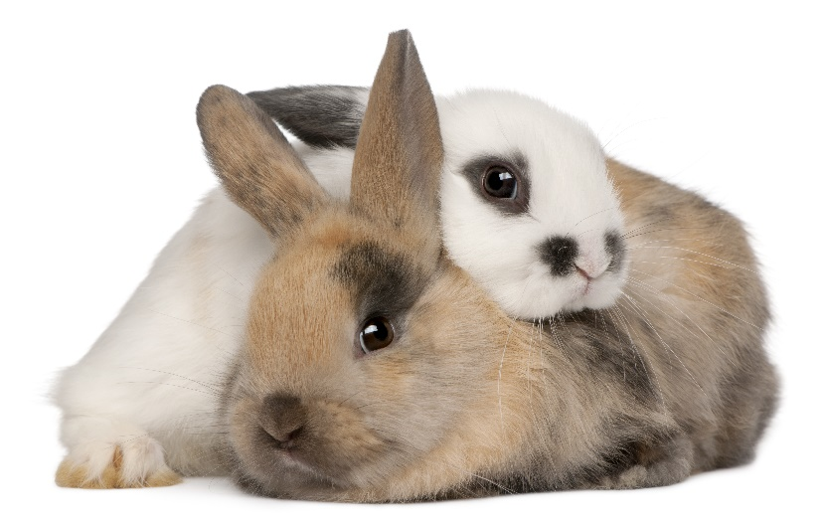
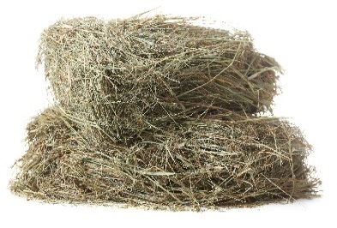
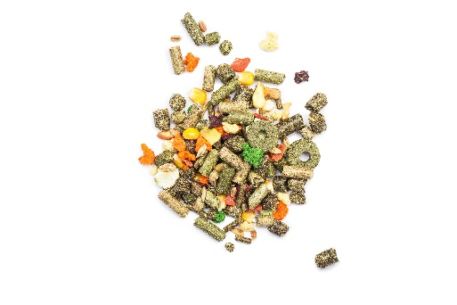
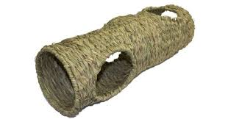
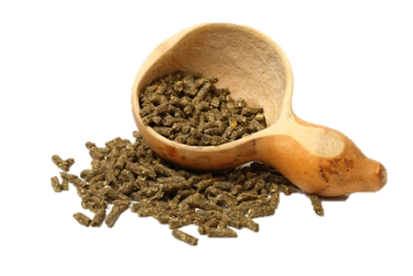
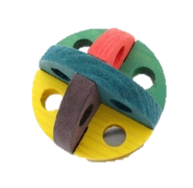
RABBITS
Notes:
Ask the group what they think pet rabbits need?
Big hutch with plenty of room to run around – reflect on the video at just how much space a rabbit needs – a hutch alone is not enough – they are not ‘easy’ pets to care for as people think. You could get one of them to do 3 big hops and stand as tall as possible to show how much space they need.
Food – pellets are better than muesli as they contain all nutrients, lots of hay & grass, small amount of greens, & unlimited water.
Hay – explain importance of right amount of hay in their diet for their tummies and their teeth.
Toys to play with and tunnel etc to run through and hide in.
Friends – rabbits hate being alone – remember how they live in the wild – in groups – they look out for each other – a lone bunny will be a very worried and lonely bunny!

Slide 13
Notes:
Discuss:
Based on what we’ve just learnt about rabbits, what is this rabbit missing in terms of his five welfare needs being met?

Slide 14
How do we meet a rabbit’s welfare needs?
ENVIRONMENT
BEHAVIOUR
HEALTH
DIET
COMPANIONSHIP
Notes:
Ask the pupils to work in groups to decide how we’d meet each need for a rabbit. You could divide the class in to 5 groups and give them a Welfare need each. Hear feedback from the class before moving on.
Example answers:
Environment – A large hutch with an even bigger rabbit run attached. Rabbits need to be able to jump without their ears touching the roof. They can also live in the house. Demonstrate how big the hutch would need to be by asking a volunteer to do three large jumps across the room with their arms up.
Diet – Mixed greens and hay. Rabbits need to eat their body weight in hay each day. Rabbits can eat carrots but only in small amounts as carrots contain a large amount of sugar (as previously addressed).
Health – It’s important to take rabbits to the vets for check ups and keep them up to date with their vaccinations/flea and worm treatments.
Behaviour – Rabbits like to dig and burrow so it’s important that they’re given the opportunity to do this.
Companionship – Ideally, rabbits need to live with another rabbit. If a rabbit is kept on it’s own it will be lonely and may display negative behaviour or even get sick. You can take a single rabbit to a rehoming centre to find a friend. This is often called Bunny Bonding. Rabbits don’t like to be paired with Guinea Pigs – compare to two people speaking different languages and not understanding each other.

Slide 15
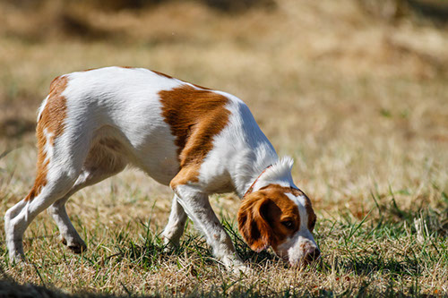
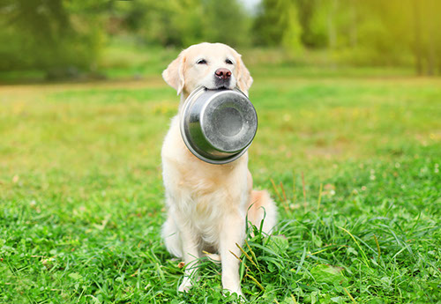
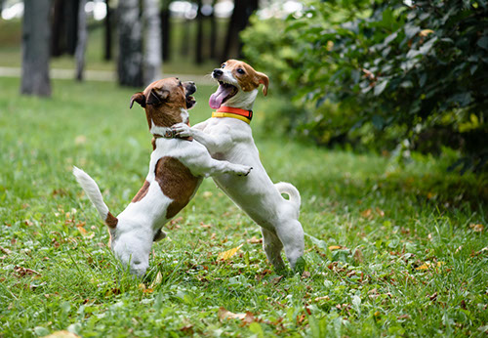
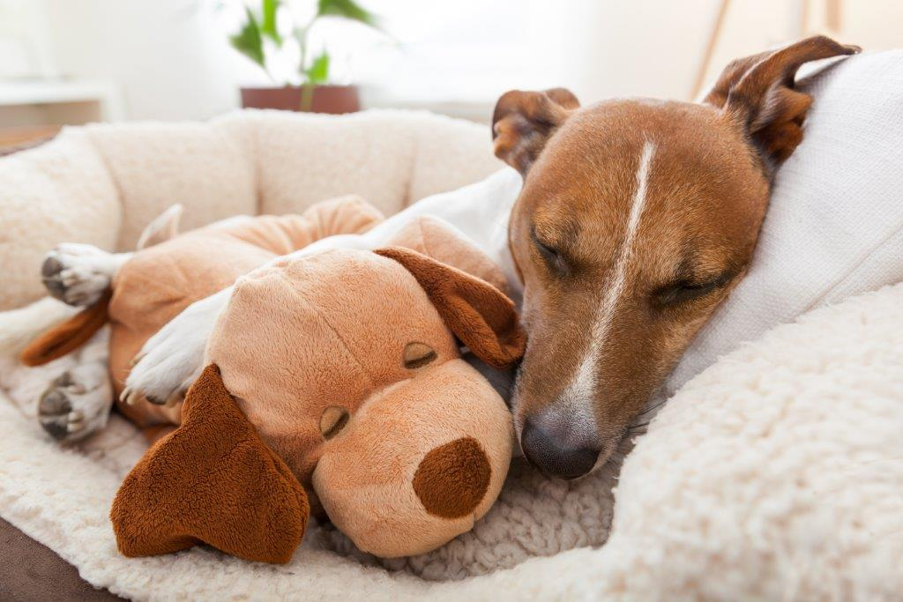
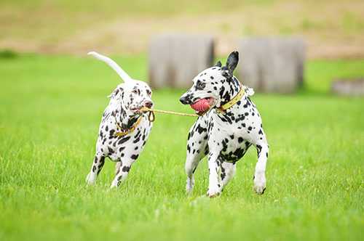
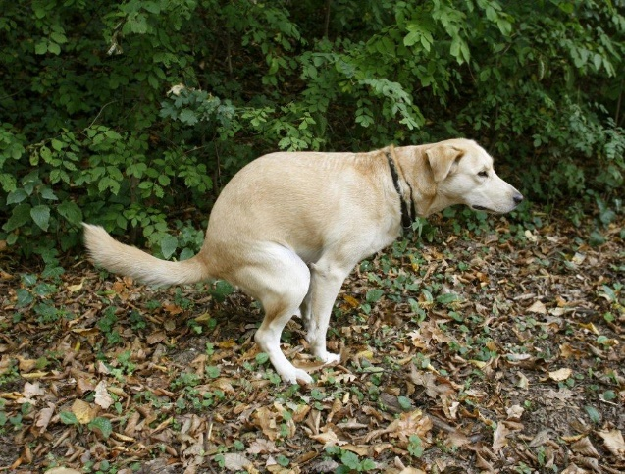
Dogs – What do they do?
Sniff/Smell
Eat/Drink
Exercise/Socialise
Sleep
Hunt/Play
Toilet
Notes:
Sniffing/smelling –Explain that dogs use their great sense of smell to sniff people, other dogs and the environment. Explain that some dogs use their great sense of smell to help people, by sniffing out drugs, weapons, people buried by earthquakes etc. Tell them amazing facts of dogs sniffing out cancer and being able to tell a person’s mood by how they smell.
Eat/Drink – Explain that dogs are omnivores. Check if anyone knows what this means. Confirm that omnivores can survive on eating either meat or plant material (or a mixture of both) We provide them with their food which must be a complete balanced diet that gives them everything they need – not our food! Explain that some human foods can be dangerous to dogs. Explain that they need unlimited fresh water.
Exercise/Socialise - Explain that dogs are very social and don’t like to be left alone. People have developed such a strong bond with dogs that we’ve replaced their ‘wolf pack’ – which is why we should make sure that our dogs are only left alone for up to four hours at a time. Wolves will exercise naturally by hunting and covering large distances. Our pet dogs need lots of exercise too – at least two walks a day, with time off the lead to run.
Sleep – Explain that it’s important to make sure that dogs have their own bed and that they’re not approached when they’re on it – give explanation and safety advice.
Hunt/Play – Explain that play is a huge part of a dog’s life. Dogs love to play but it’s no fun playing on their own, so make sure your dog gets plenty of chance to play with other dogs and also has lots of toys that you can help him play with at home. Remember, dogs use their mouths to play – they don’t mean to hurt, but sometimes their teeth can hurt our delicate skin – other dogs with fur coats make a much better play mate. Unlike cats, our domestic dogs don’t hunt but they still have some natural desires – they love to chase and catch with toys – just like in the picture
Toileting/Scent marking Explain that this is something that dogs do. They’ll often seek out spots that another dog, or many dogs, have used to pee on, to make their mark on the world and mask the scent markers left by other dogs. Female dogs in heat will pee at every chance they get, to try to attract a mate. Explain that scent marking and sniffing are like doggy Facebook. Explain the importance of poop scooping from a public health angle.
Here are some dogs doing some great doggy things and a few tricks too

Slide 16
hhttps://www.youtube.com/watch?v=ZHwlmvuW4NY
https://www.youtube.com/watch?v=plFCDMQLGpw
https://www.youtube.com/watch?v=cSd5gYfRgoY
https://www.youtube.com/watch?v=2cJNGf3os-0
https://www.youtube.com/watch?v=q8FfNQ_E0l0
https://www.youtube.com/watch?v=GF60Iuh643I
Notes:
hhttps://www.youtube.com/watch?v=ZHwlmvuW4NY (3.24-3.30)
https://www.youtube.com/watch?v=plFCDMQLGpw (36-39) (107-113)
https://www.youtube.com/watch?v=cSd5gYfRgoY (300-311)
https://www.youtube.com/watch?v=2cJNGf3os-0 (10-24)
https://www.youtube.com/watch?v=q8FfNQ_E0l0 (4-6) put at beg of video) 37-38, 42-43, 112-114, 125
https://www.youtube.com/watch?v=GF60Iuh643I (2.03-2.10) (4.29-4.34)

Slide 17
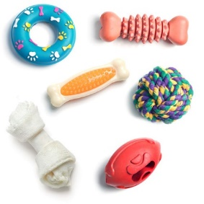
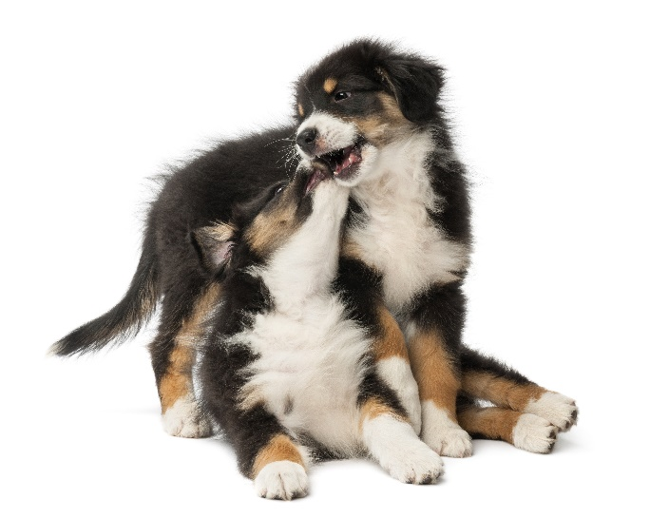
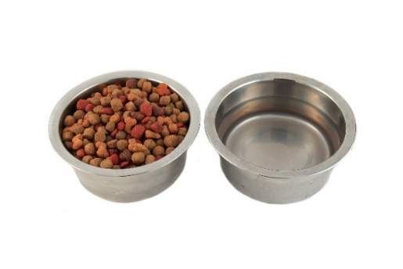
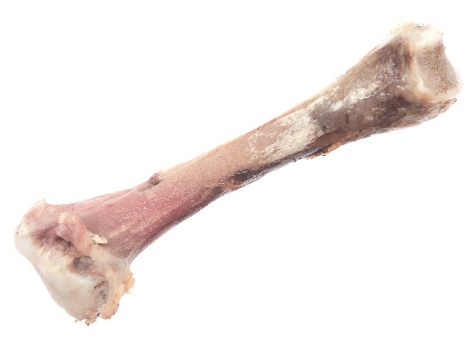
DOGS
Notes:
What do they need -Based on what we’ve just spoken about?
Explain the needs of dogs and discuss the danger of feeding chocolate or bones.
Also, check if they know the following items are also poisonous for dogs:
Onions
Garlic
Chives
Grapes and raisins
Alcohol
Mouldy foods
Macadamia nuts
Sugar free items containing xylitol, such as chewing gum

Slide 18
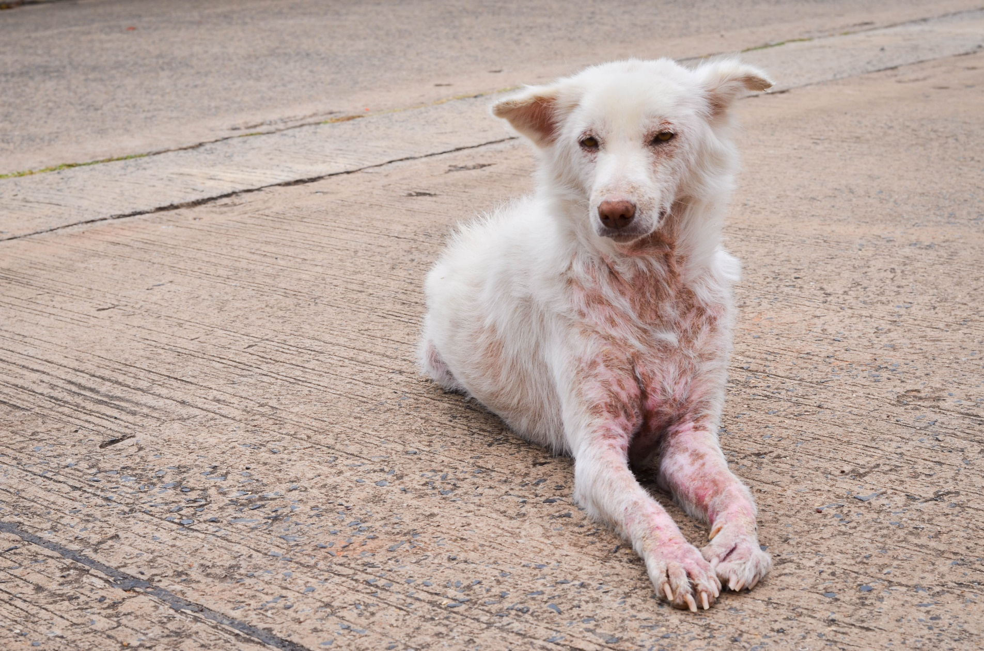
Notes:
Discuss:
Based on what we’ve just learnt about dogs, what is this dog missing in terms
of his five welfare needs being met?

Slide 19
How do we meet a dog’s welfare needs?
ENVIRONMENT
BEHAVIOUR
HEALTH
DIET
COMPANIONSHIP
Notes:
Ask the pupils to work in groups to decide how we’d meet each need for a dog. You could divide the class in to 5 groups and give them a Welfare need each. Hear feedback from the class before moving on.
Example answers:
Environment – A warm dog bed, within a home with humans and possibly another dog.
Diet – It is important to feed dogs specialist dog food so they get the nutrients they need and maintain a healthy weight. Feeding a dog off your plate may result in obesity and there are many human foods that are poisonous to our pets. It’s also important to avoid bones (as previously discussed)
Health – It’s important to take dogs to the vets for check ups and keep them up to date with their vaccinations/flea and worm treatments. They also need to be microchipped as you’ll find out about shortly.
Behaviour – Dogs like to be able to play either with humans, toys or other dogs and should be socialised from an early age. Dogs can be trained to do certain behaviours and need to be walked each day. A dog shouldn’t be left alone for more than four hours.
Companionship – Dogs love company. They’d be happy with human friends or canine friends.

Slide 20
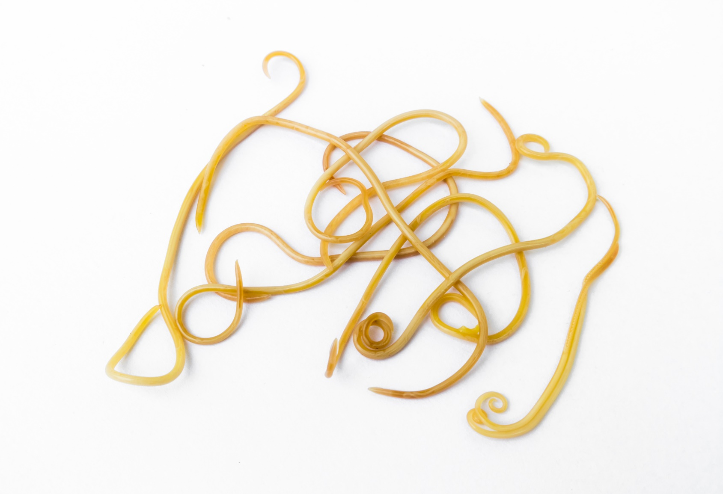
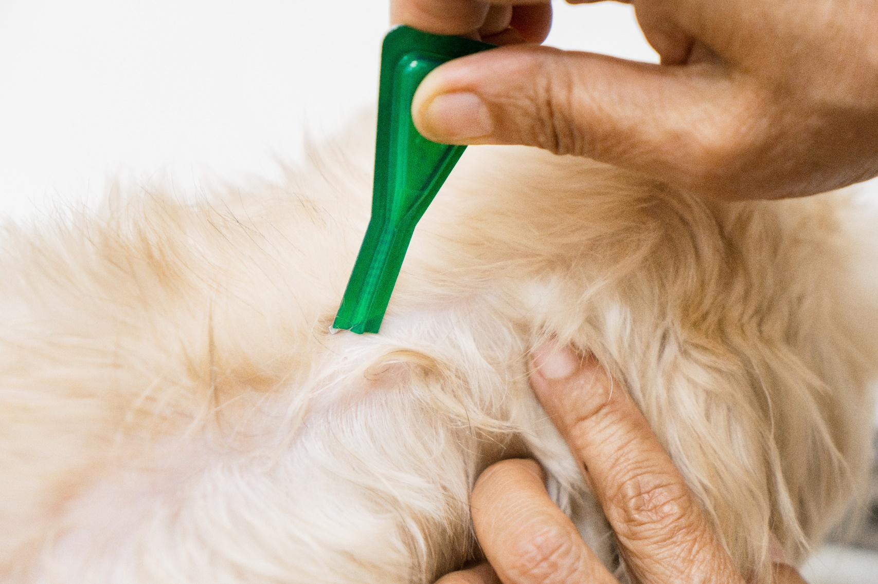
KEEPING PETS HEALTHY
Notes:
Explain each aspect of preventive healthcare
Vaccinations – explain need to given every year to dogs, cats and rabbits to prevent disease
Scan for chip – explain dog microchip law but also good to have other pets chipped too
Grooming – explain that pets need to be groomed to keep their skin and coat healthy. Explain that it’s also a chance to check all is ok – look for parasites
Parasites – explain internal and external and treatment – Use toy flea and worm.
Neutering – explain the importance of neutering
Ask if they’d like to see one of the pets we’ve helped to get better at PDSA.

Slide 21
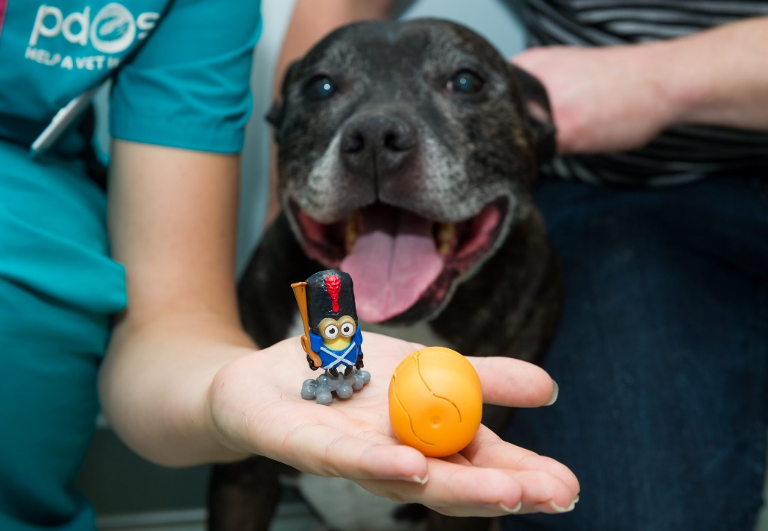
Chase swallowed a toy!
Notes:
Chase the SBT gobbled down a chocolate egg with a plastic toy in it.
Although chocolate is poisonous to dogs, Chase didn’t show any signs of illness, as his owners saw him eat the chocolate egg and rushed him straight into our Pet Hospital.
Action taken:
The team at the PDSA Pet Hospital x-rayed Chase to find out where the egg was in his body before operating to remove it. Luckily, the toy was still in his stomach. If it had moved further down into his intestines it could have caused a blockage, which would have been much more dangerous for Chase, or could’ve even killed him.

Slide 22
Notes:
Take a look at Chase’s X-Ray and explain.

Slide 23
Saved thanks to PDSA
Notes:
Chase made a full recovery thanks to PDSA.

Slide 24
https://www.youtube.com/watch?v=cUY4_nVpdj4&t=8s

Slide 25
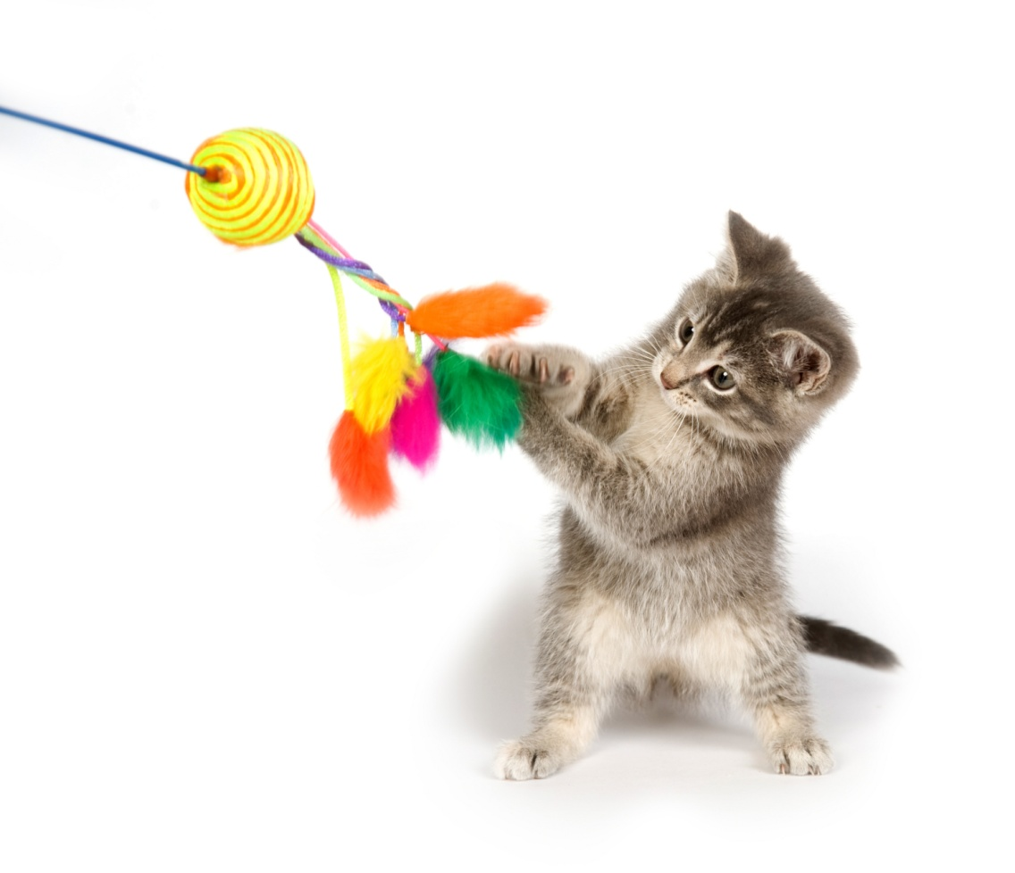
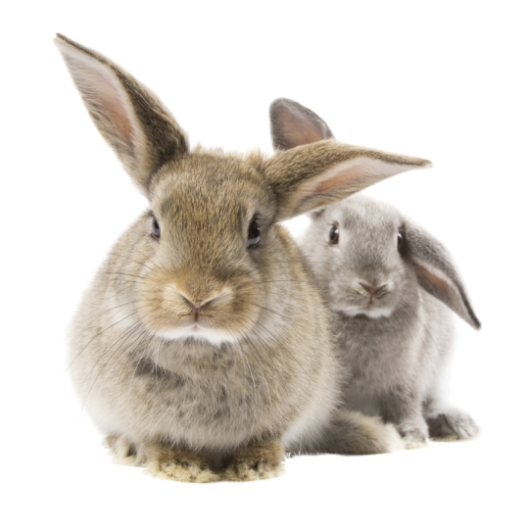
Thanks!
Notes:
Thank them all for being fab, joining in and answering questions.
Remember:
To ask the teachers for their completed feedback forms back before they leave the room.
To leave each teacher with a Pet day flyer
To give out the NCOP flyer

