Slide 1
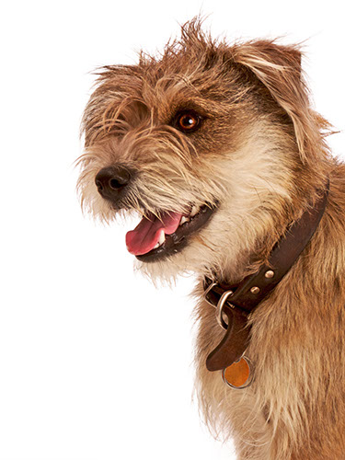
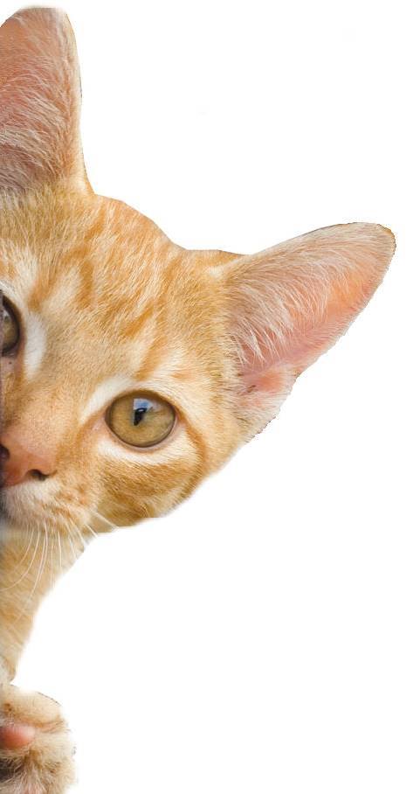
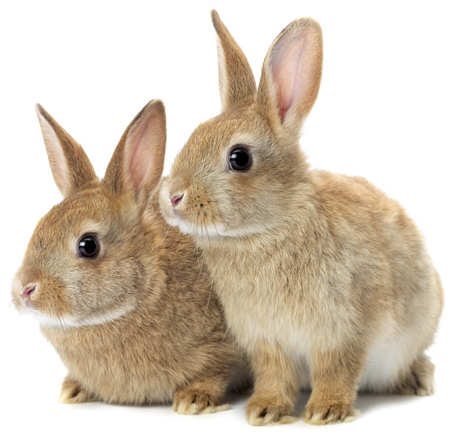
Les animaux
Notes:
Share:
Introduce the session and PDSA.
Tell children that PDSA treat the sick and injured pets of people in need...
Explain that PDSA is a special kind of vets, because they’re a charity. Discuss what a charity is and explain that PDSA looks after pets when owners can’t afford vet treatment.
Ask:
If they think it’s important to help sick and injured animals to get better?
What would happen to all the sick and injured pets PDSA treat if they weren’t around?
Share:
Tell them that today, you’re all going to learn about what pets need to be healthy and happy and also about some of the pets that PDSA has helped in their Pet Hospitals.

Slide 2
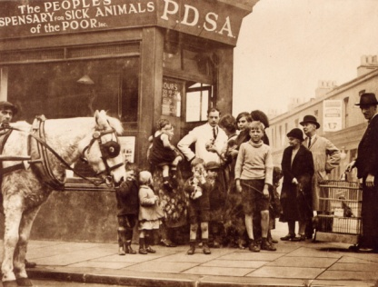
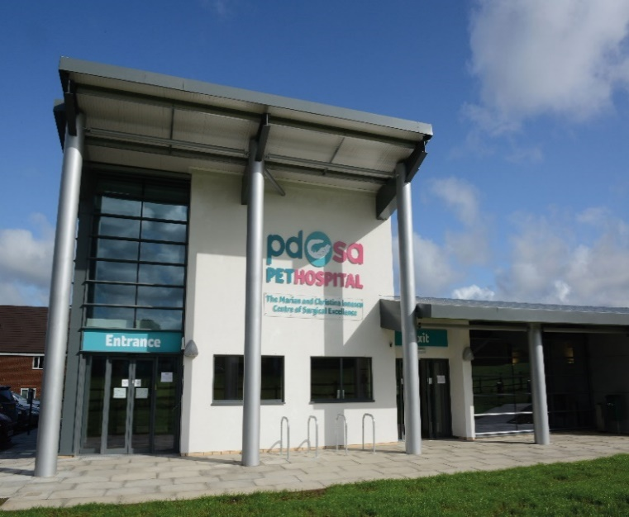
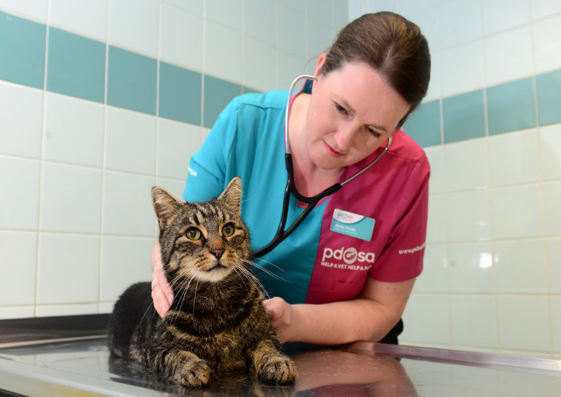
The UK’s leading vet charity …
PDSA is a 100 year old charity who have been treating sick and injured pets since 1917
They have Pet Hospitals all over the UK
They help one sick or injured pet every 5 seconds!
It costs the charity more than
£1 million every week to do their work
Notes:
Share the details on the slide and:
Tell children that PDSA treat the sick and injured pets of people in need..
Ask them if they think it’s important to help sick and injured animals to get better.
Explain that PDSA is a special kind of vets, because they’re a charity. Ask them what a charity does and explain that PDSA looks after pets when owners can’t afford vet treatment.
Ask them what would happen to all the sick and injured pets PDSA treat if they weren’t around.

Slide 3
une maison
amis
santé
nourriture et eau
exercice et amusement
What do pets need?…
Notes:
All pets, whether they’re large or small, need the same five things to keep them healthy and happy:
The right kind of safe, warm home with lots of space
The right kind of food and 24 hour access to fresh water
Exercise and fun (the chance to show normal behaviour)
Friends (This can be other animals, people, or both)
Health ( We all need to make sure our pets are kept healthy and take them to the vet when they’re not well)
Ask whose responsibility it is to keep pets healthy and happy and confirm that owners are responsible for looking after their pet properly.

Slide 4
Learning Objectives
I will learn the names of pets in French.
I will learn how to ask if someone has a pet and how to answer.
Learning Outcomes
P
I can understand the words for different common pets.
I can match descriptions of animals to images using a dictionary to help me.
I can recognise if someone has a pet or not

Slide 5
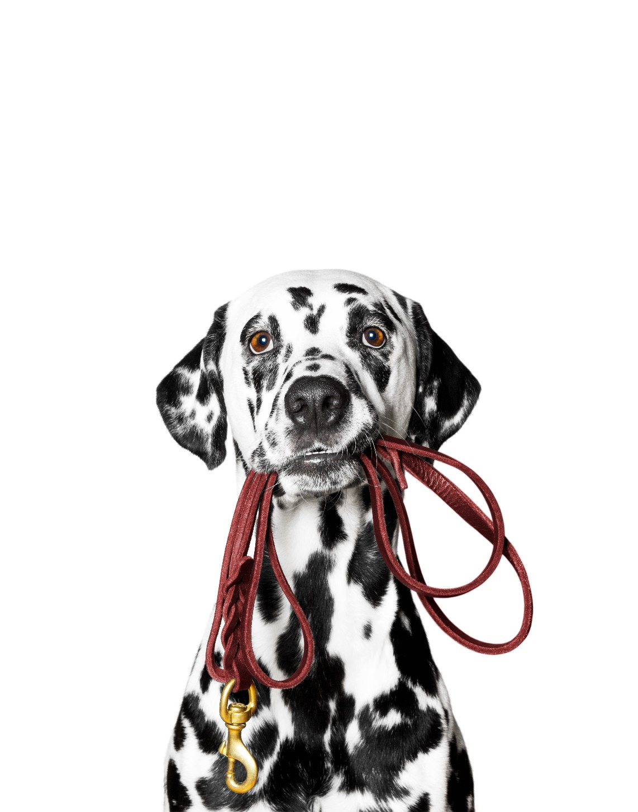
un chien

Slide 6
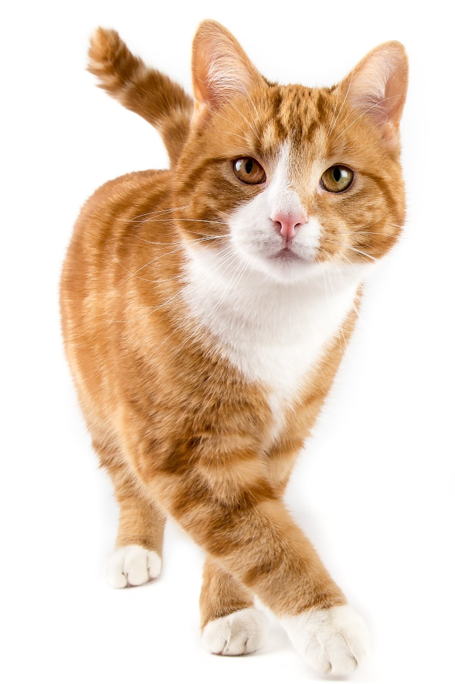
un chat

Slide 7
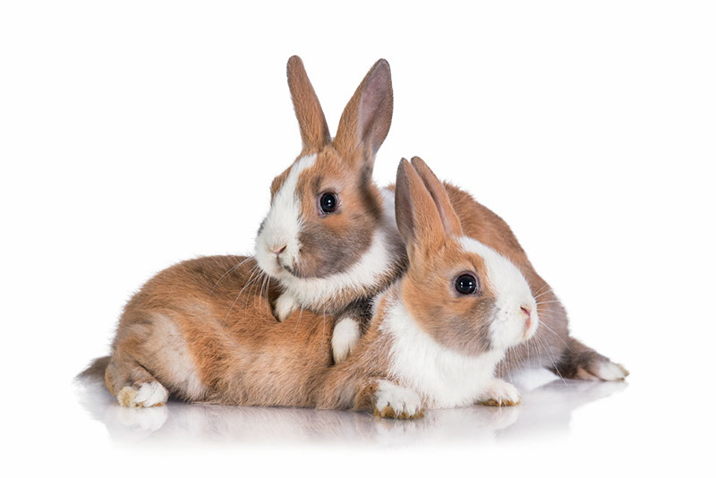
deux lapins

Slide 8
un serpent

Slide 9
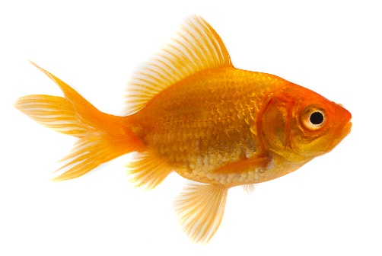
un poisson

Slide 10
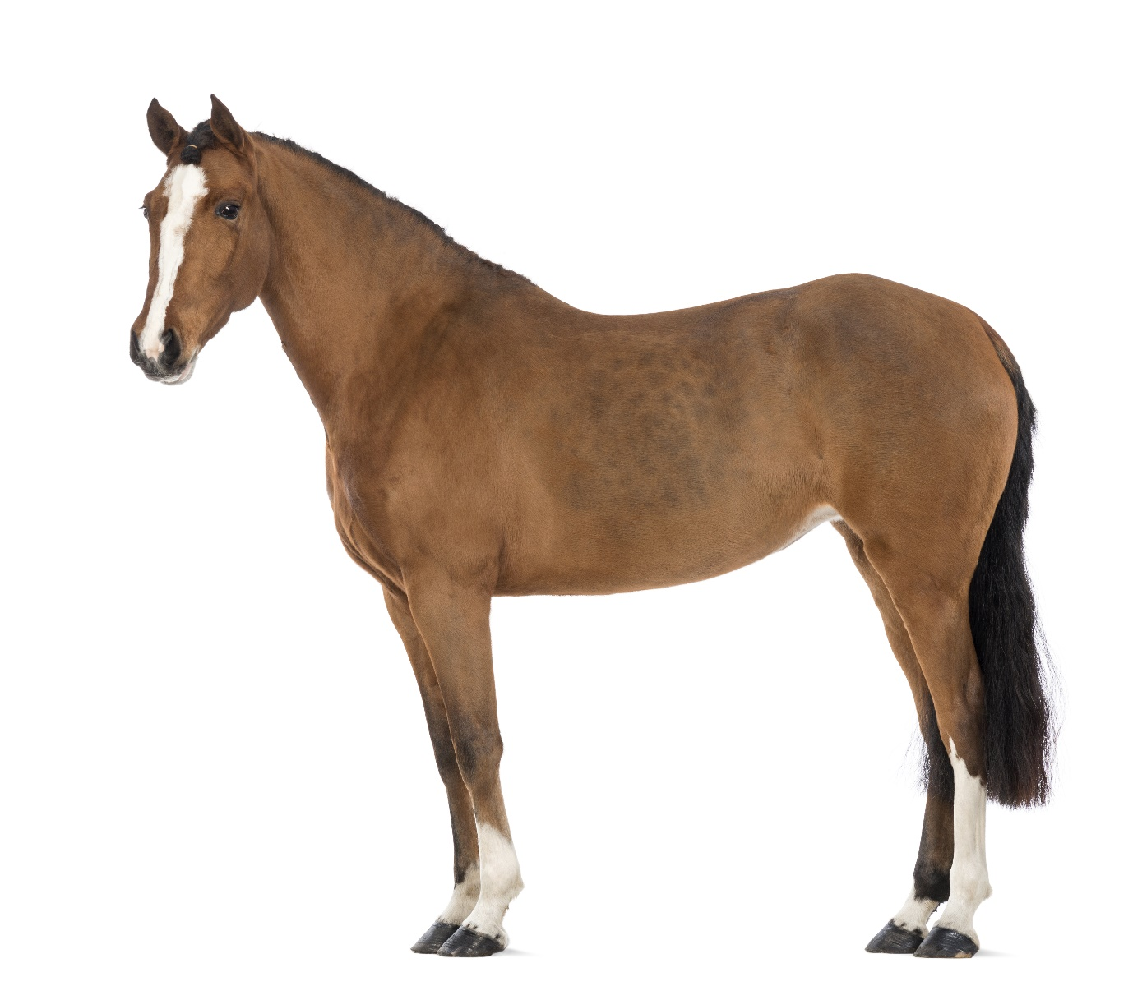
un cheval

Slide 11
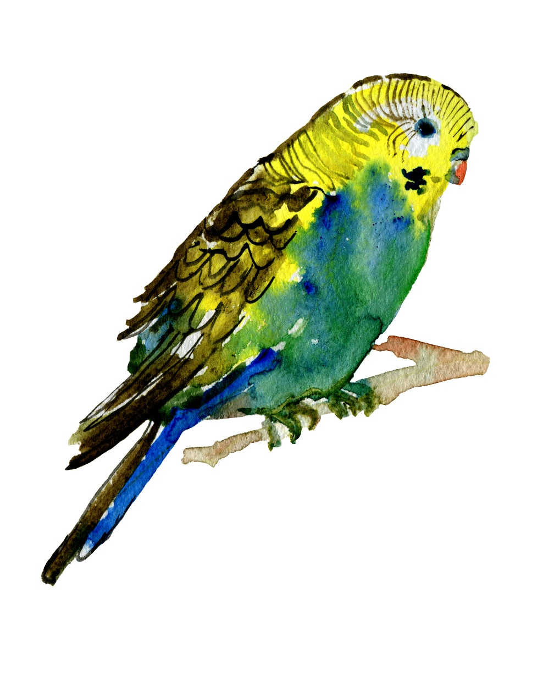
un oiseau

Slide 12
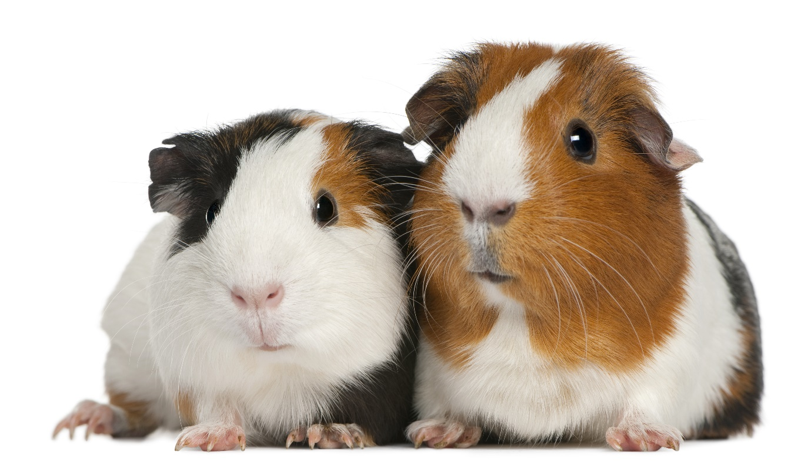
deux cochons d’Inde

Slide 13
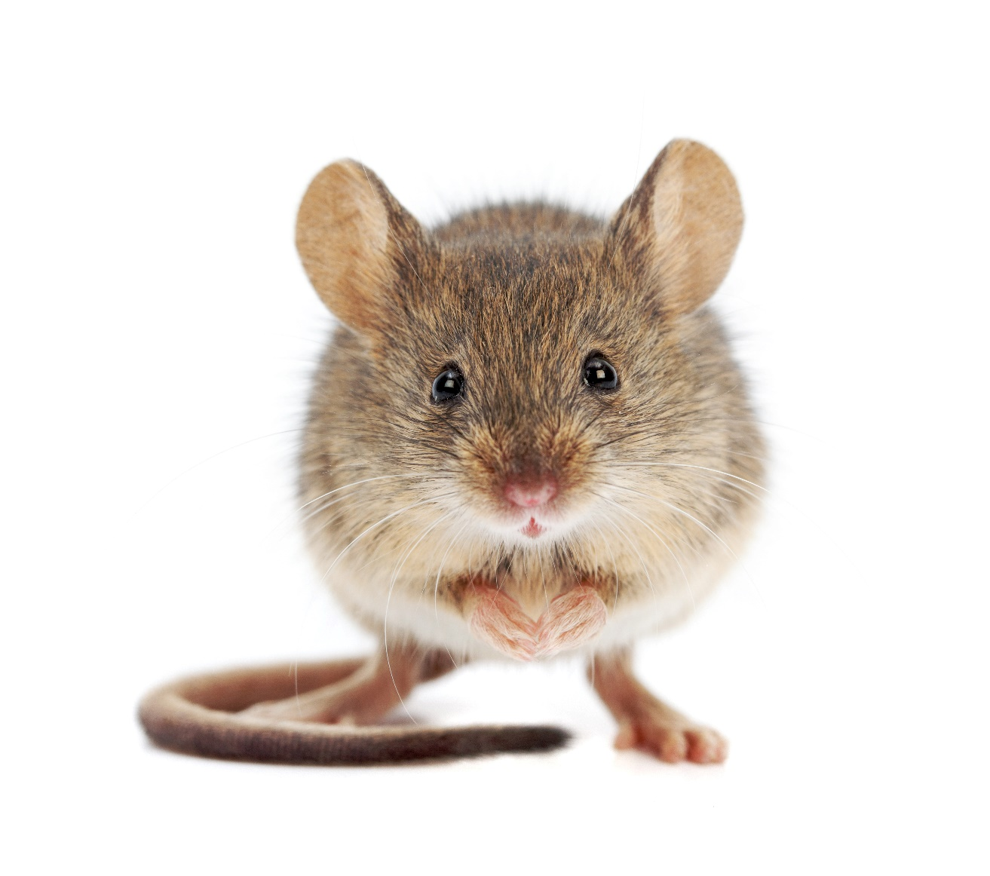
une souris

Slide 14
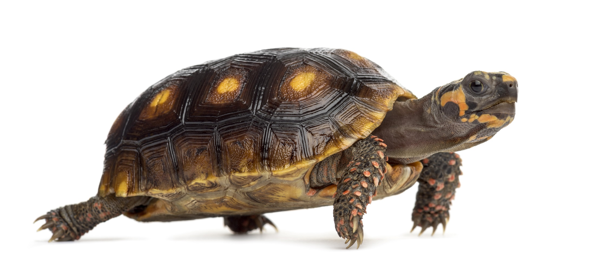
une tortue

Slide 15
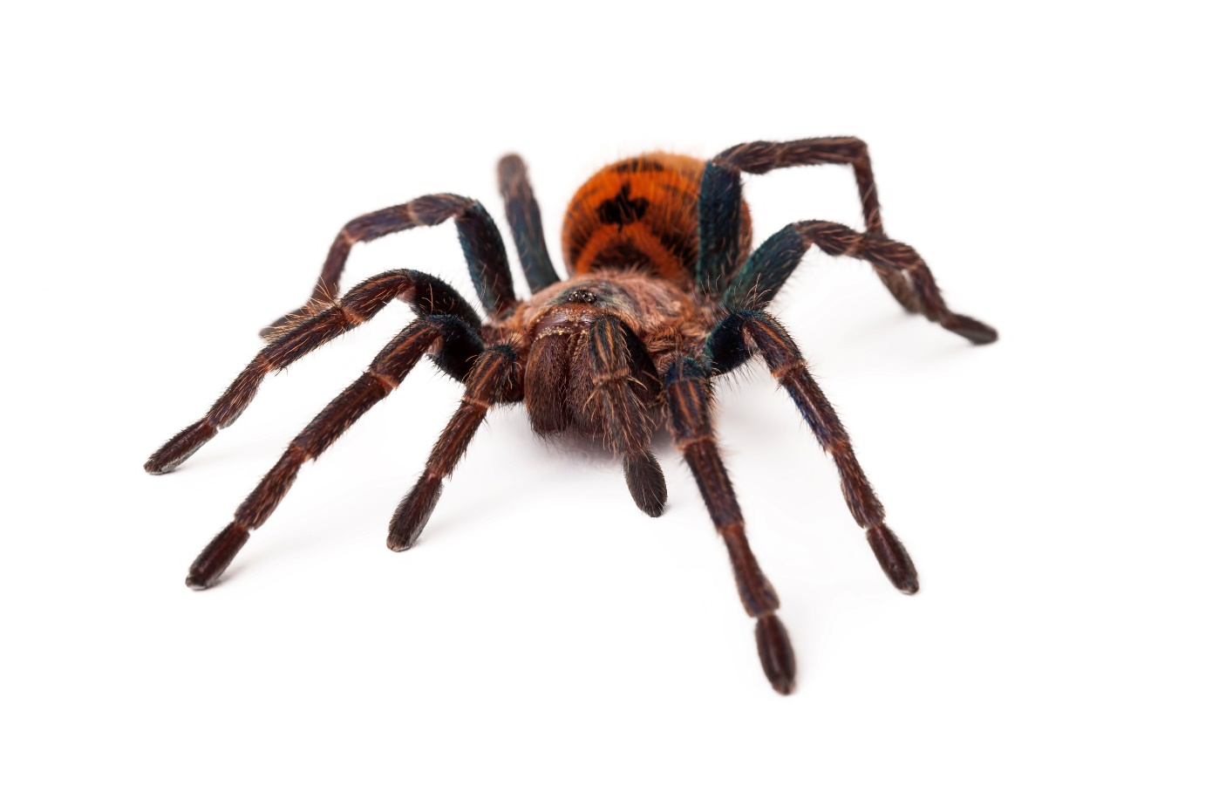
une araignée

Slide 16
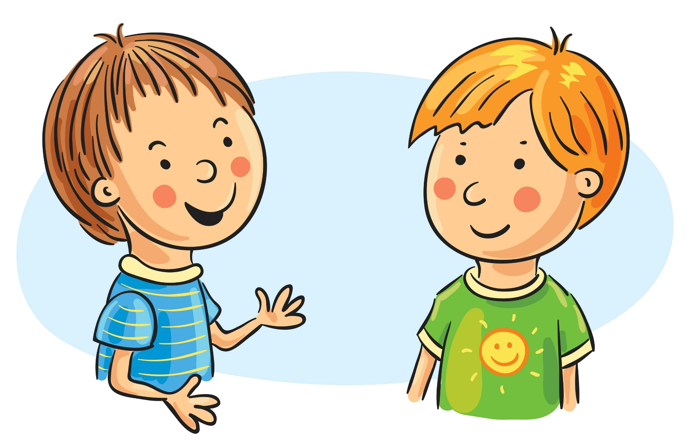
Do you have a pet?
As-tu un animal?
Yes, I have a…
Qui, j’ai un(e)….

Slide 17
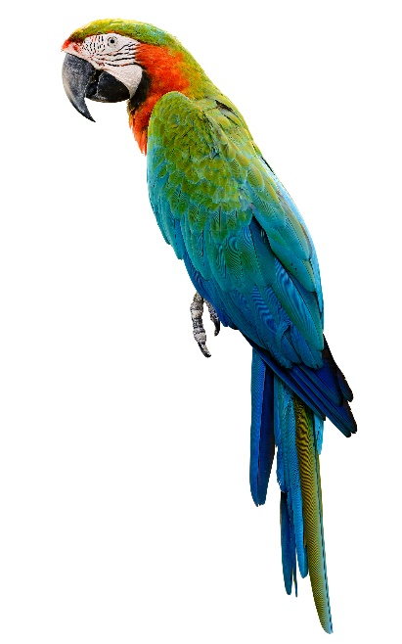
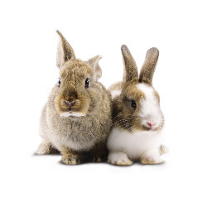
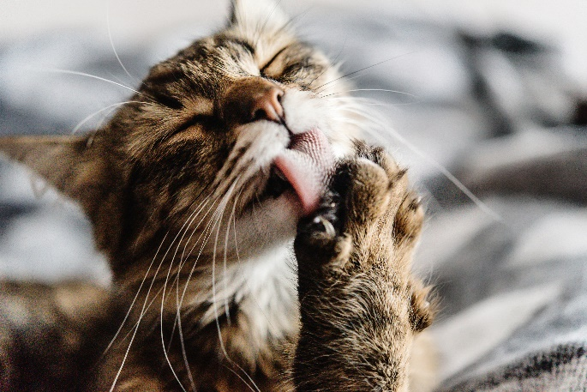
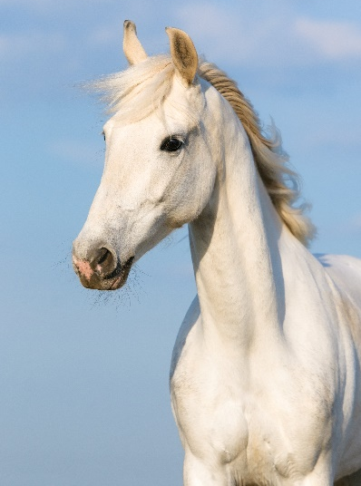
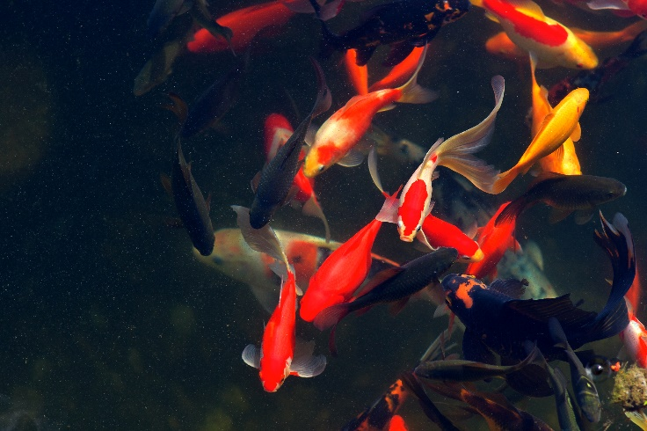
As-tu un animal?
J’ai un gros cheval blanc qui s’appelle Blanche-Neige.
Notes:
Answer: I have a white horse called ‘Snow White’.

Slide 18
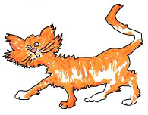
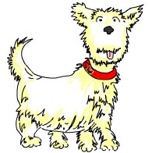
C’est de quelle couleur/C’est quell animal?
A
B
C
Mon chien s’appelle Manu.
Il est blanc et très mignon!
F
Mon frère a une perruche
qui s’appelle Charles.
C
A
J’ai un chat qui s’appelle Toto.
Il est orange et blanc.
B
Mon lapin est blanc. Il aime la salade et il s’appelle Roger.
D
E
J’ai une petite souris blanche qui s’appelle Hercule. Mon père déteste Hercule. Il n’aime pas les souris!
F
E
D
Mon poisson rouge s’appelle
Zidane. Il aime le foot!
Notes:
Pupils may use a French dictionary to help them.

Slide 19
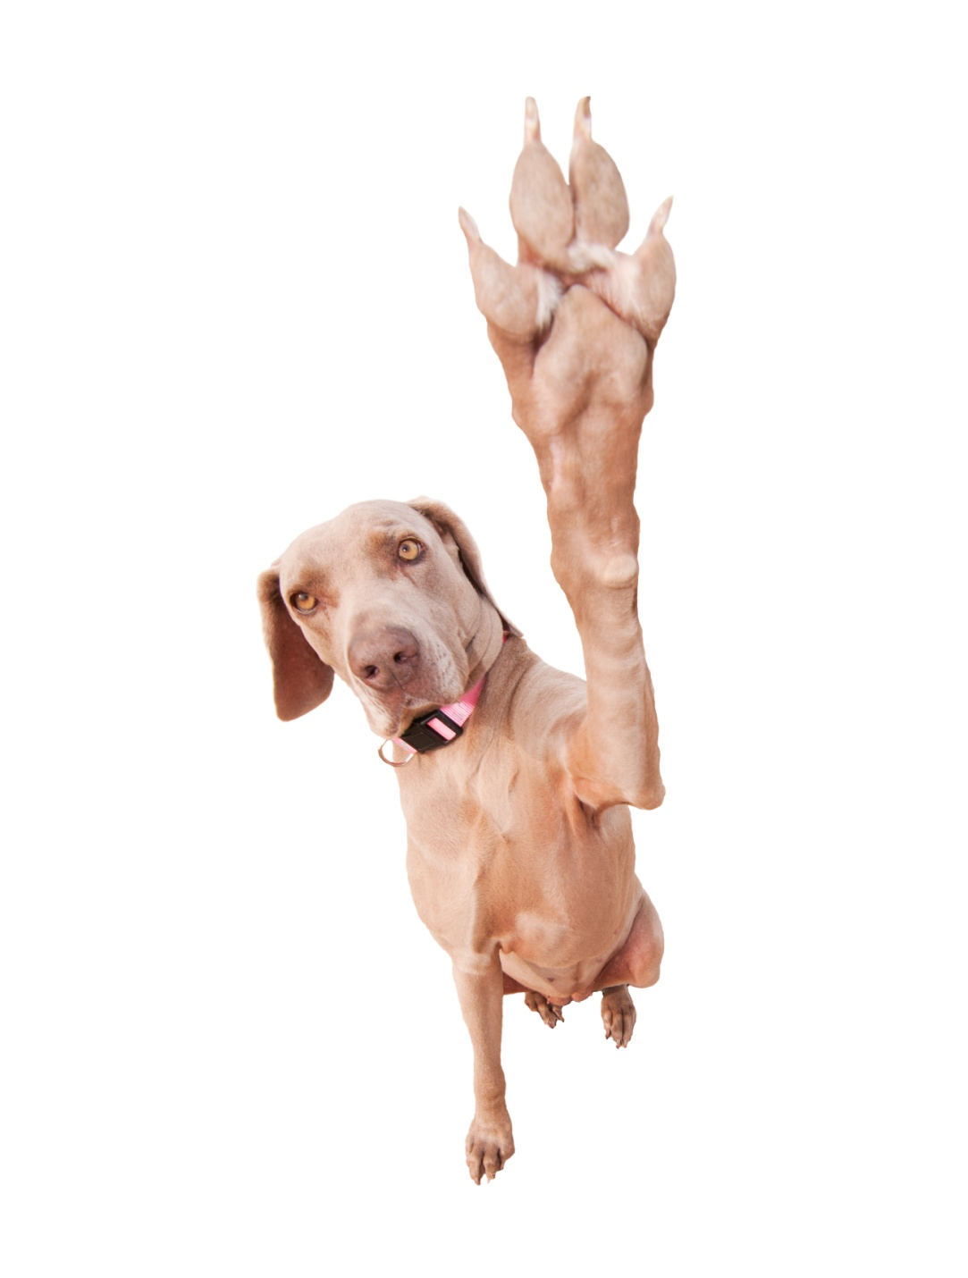
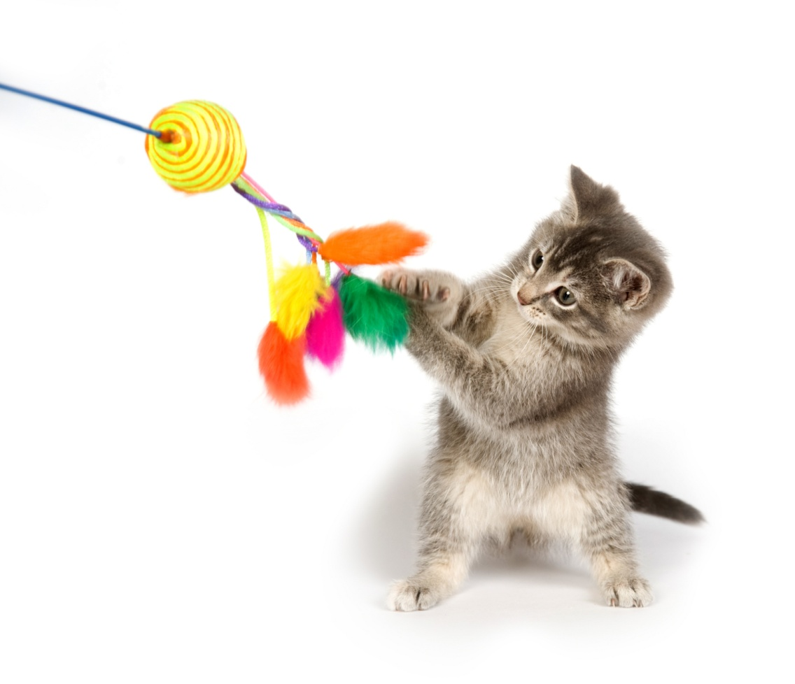
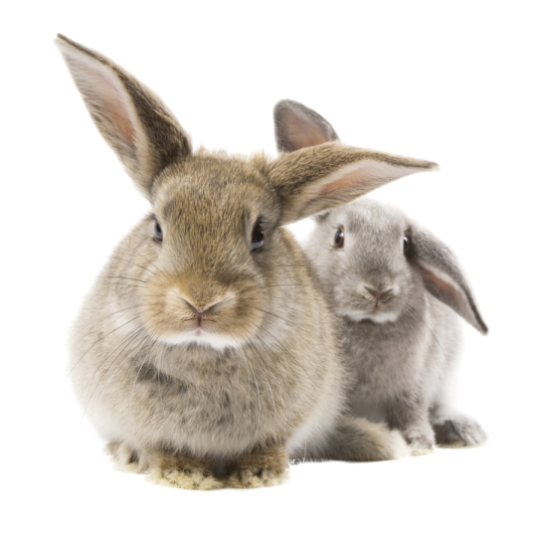
Merci!

