Slide 1
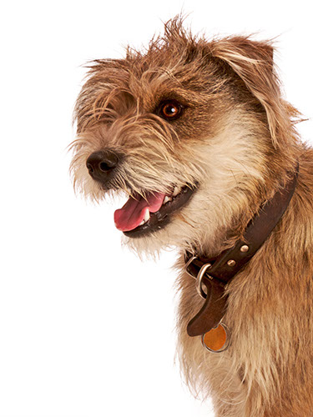
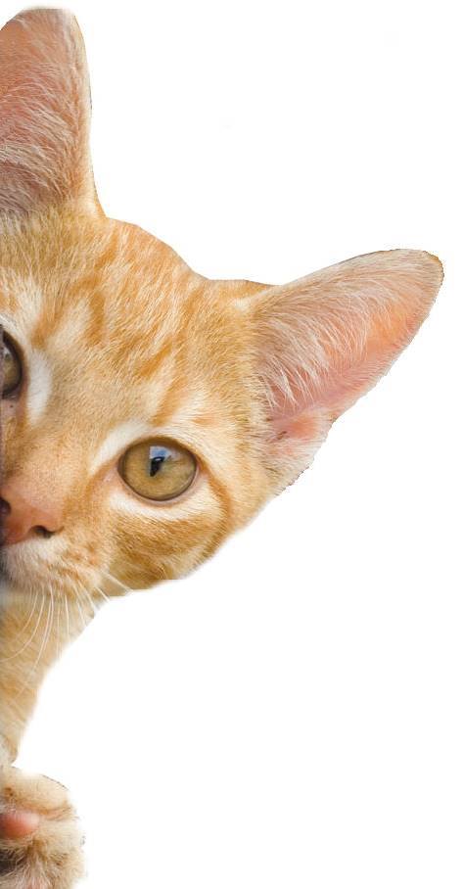
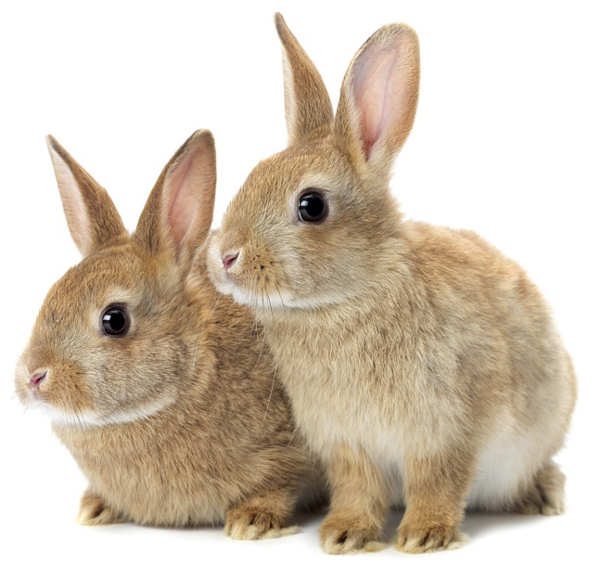
Animales
Notes:
Share:
Introduce the session and PDSA.
Tell children that PDSA treat the sick and injured pets of people in need...
Explain that PDSA is a special kind of vets, because they’re a charity. Discuss what a charity is and explain that PDSA looks after pets when owners can’t afford vet treatment.
Ask:
If they think it’s important to help sick and injured animals to get better?
What would happen to all the sick and injured pets PDSA treat if they weren’t around?
Share:
Tell them that today, you’re all going to learn about what pets need to be healthy and happy and also about some of the pets that PDSA has helped in their Pet Hospitals.

Slide 2
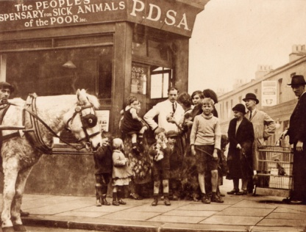
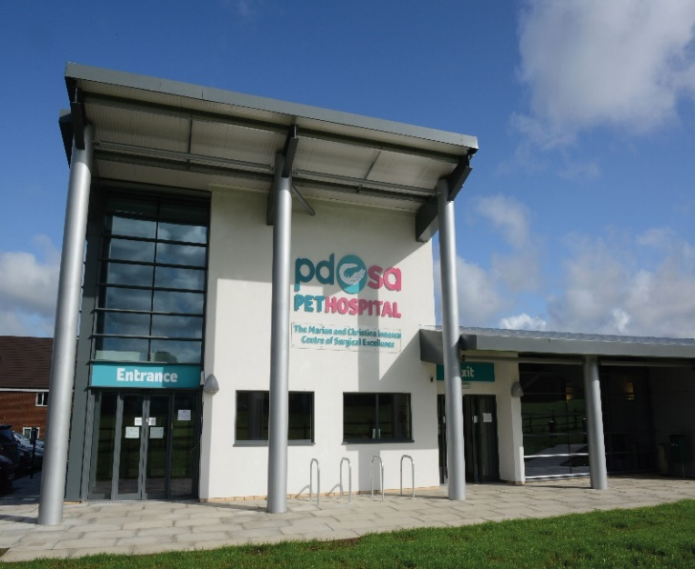
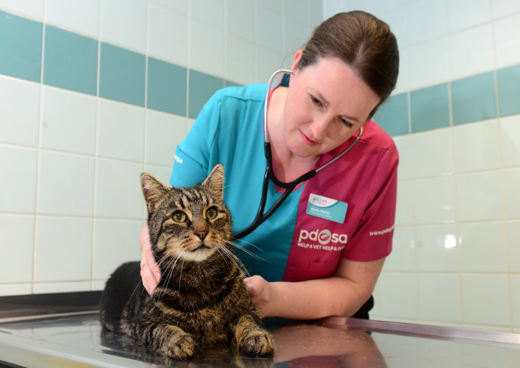
The UK’s leading vet charity …
PDSA is a 100 year old charity who have been treating sick and injured pets since 1917
They have Pet Hospitals all over the UK
They help one sick or injured pet every 5 seconds!
It costs the charity more than
£1 million every week to do their work

Slide 3
Casa
Amigos
Salud
Comida y agua
Ejercicio y diversión
What do pets need?…
Notes:
All pets, whether they’re large or small, need the same five things to keep them healthy and happy:
The right kind of safe, warm home with lots of space
The right kind of food and 24 hour access to fresh water
Exercise and fun (the chance to show normal behaviour)
Friends (This can be other animals, people, or both)
Health ( We all need to make sure our pets are kept healthy and take them to the vet when they’re not well)
Ask whose responsibility it is to keep pets healthy and happy and confirm that owners are responsible for looking after their pet properly.

Slide 4
Learning Objectives
I will learn the names of pets in Spanish.
I will learn how to ask if someone has a pet and how to answer.
Learning Outcomes
P
I can understand the words for different common pets.
I can match descriptions of animals to images using a dictionary to help me.
I can recognise if someone has a pet or not

Slide 5
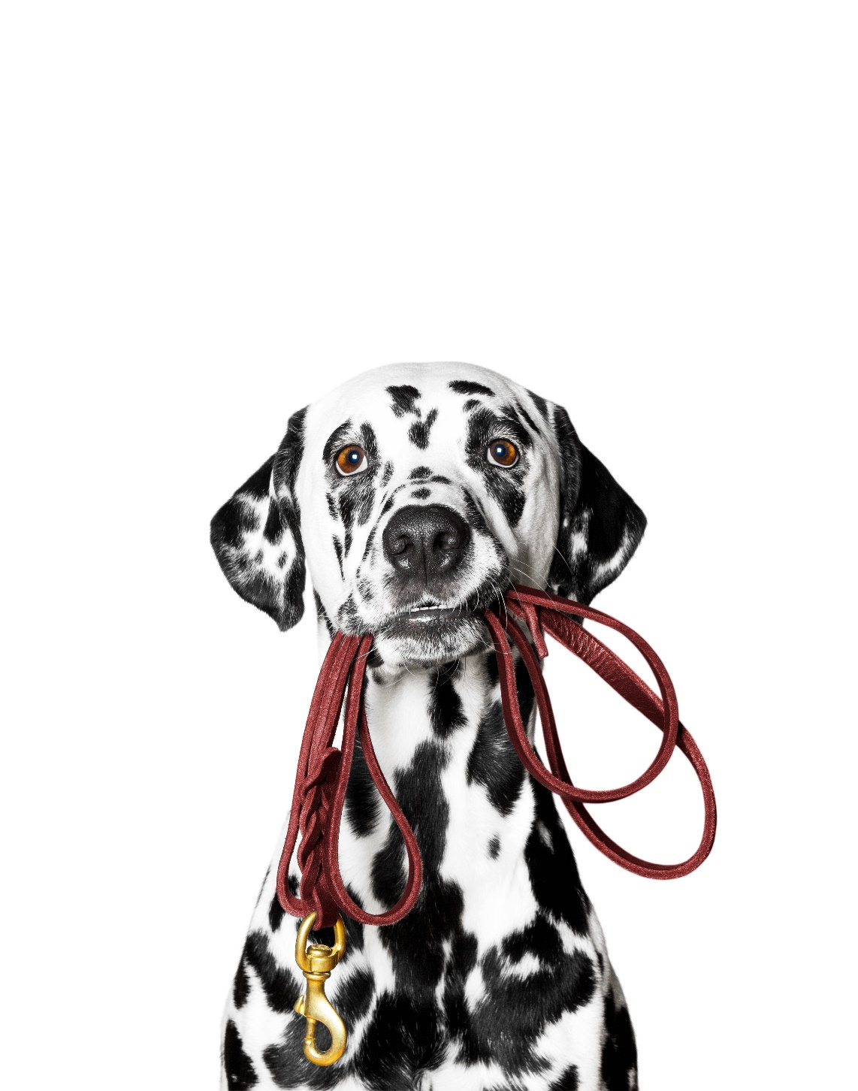
perro

Slide 6
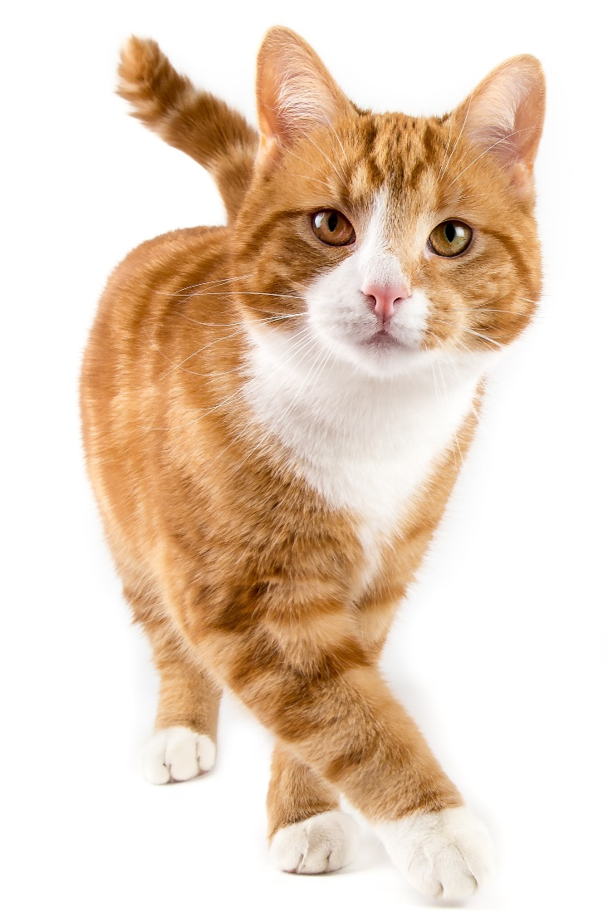
un gato

Slide 7
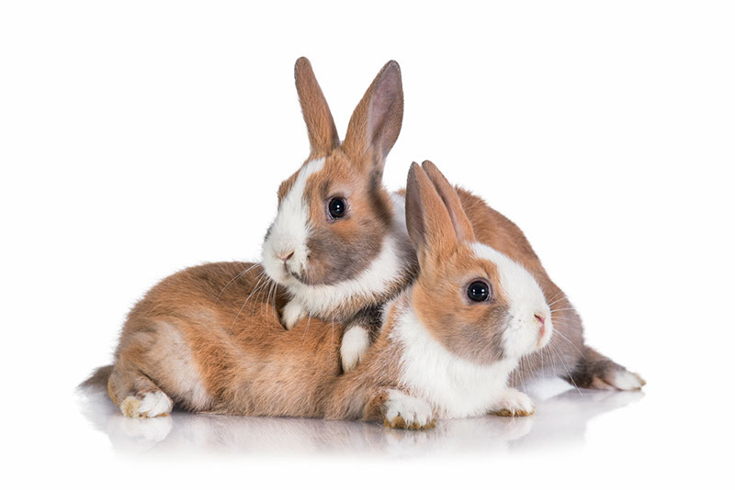
Dos conejos

Slide 8
una serpiente

Slide 9
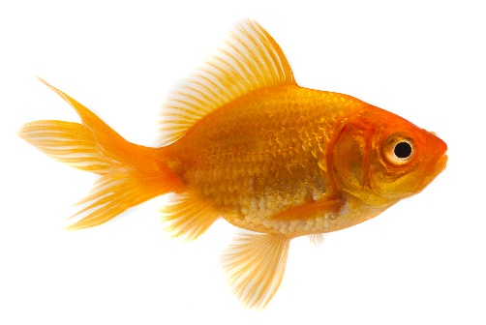
un pescado

Slide 10
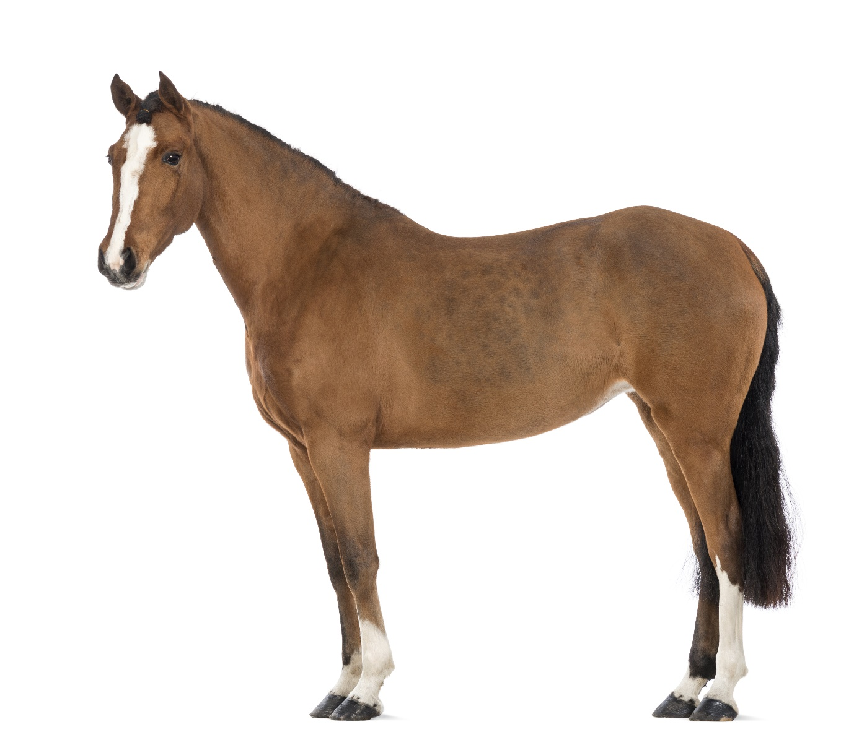
un caballo

Slide 11
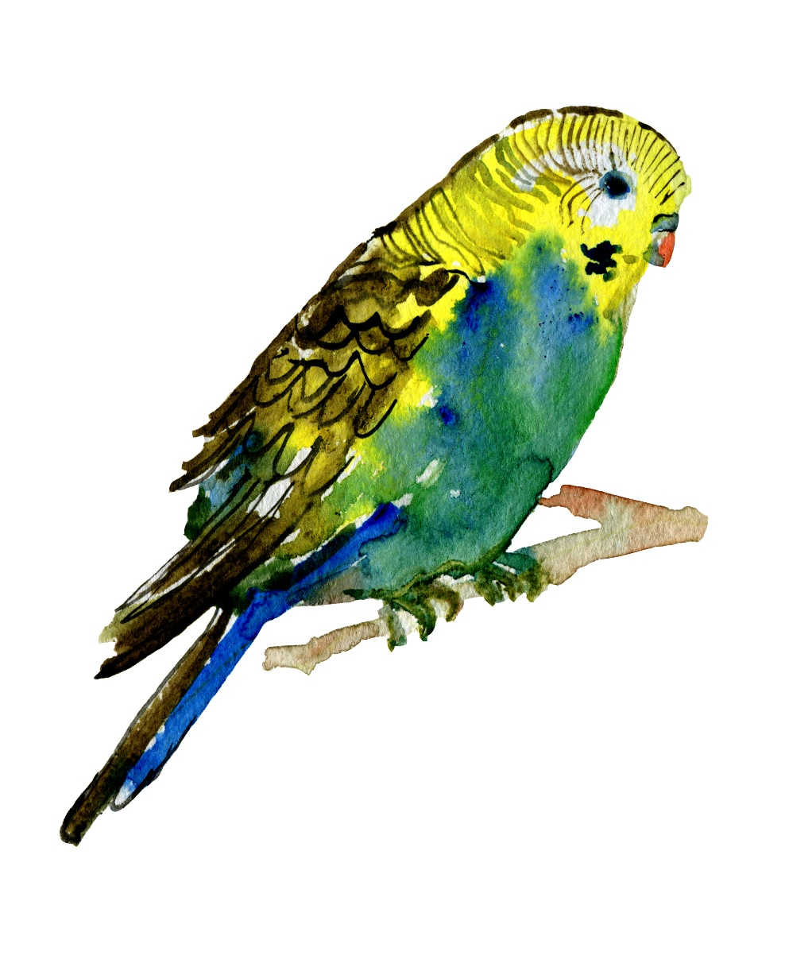
un pájaro

Slide 12
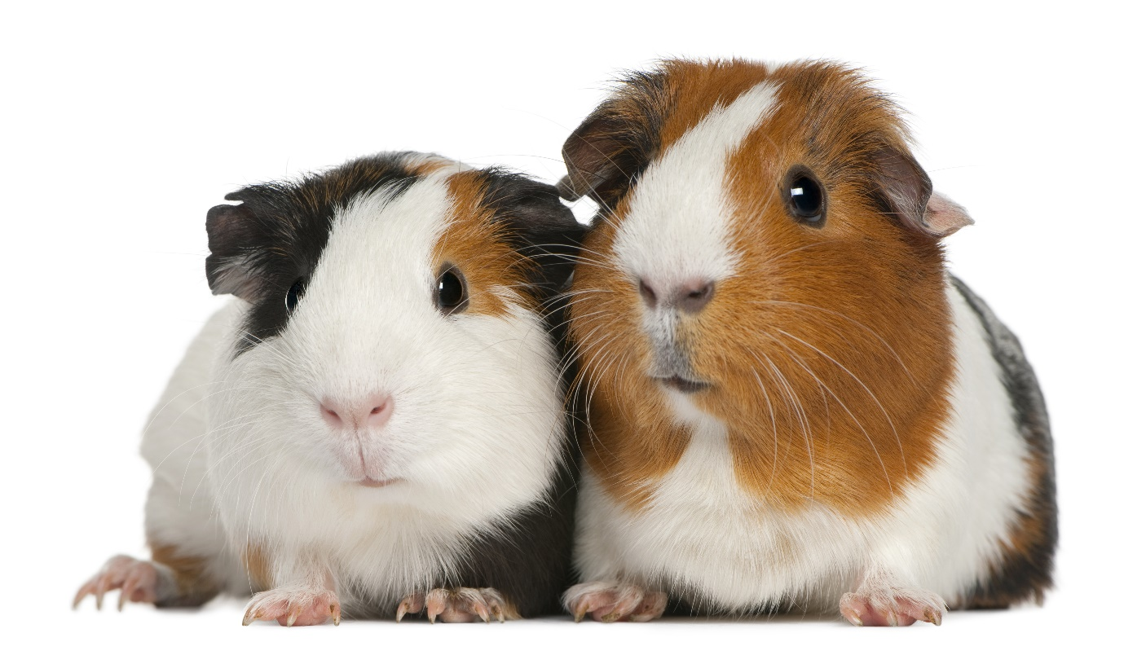
Dos conejillos de Indias

Slide 13
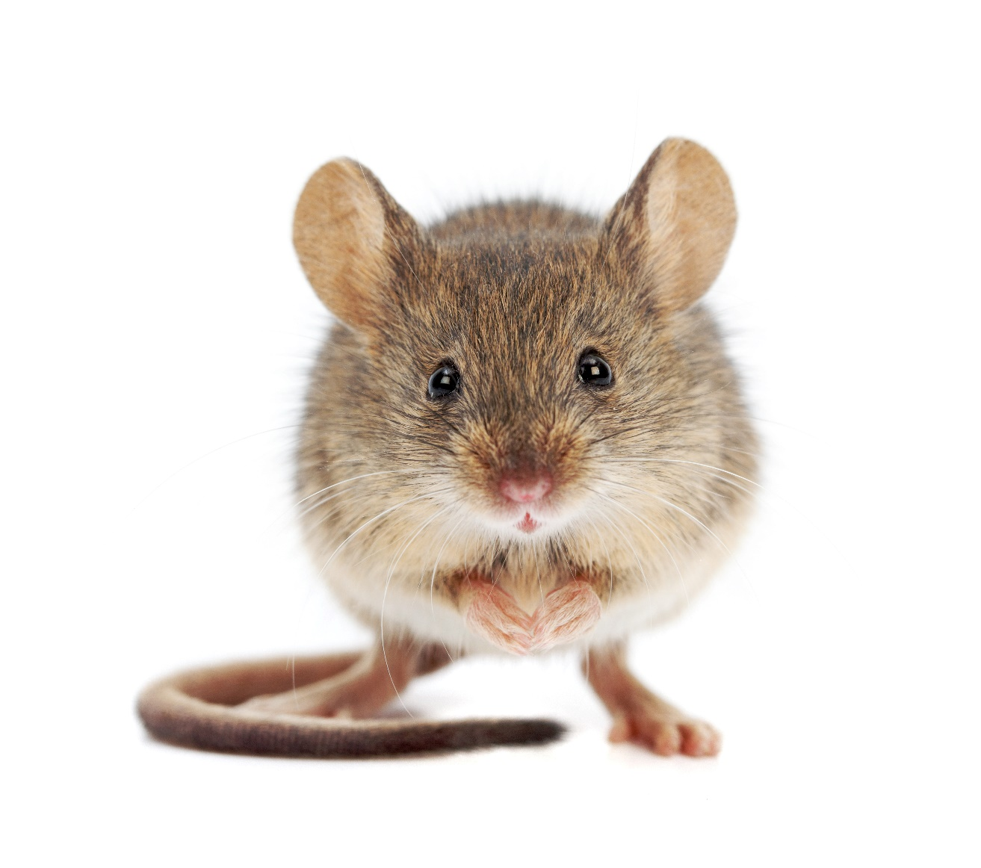
un raton

Slide 14
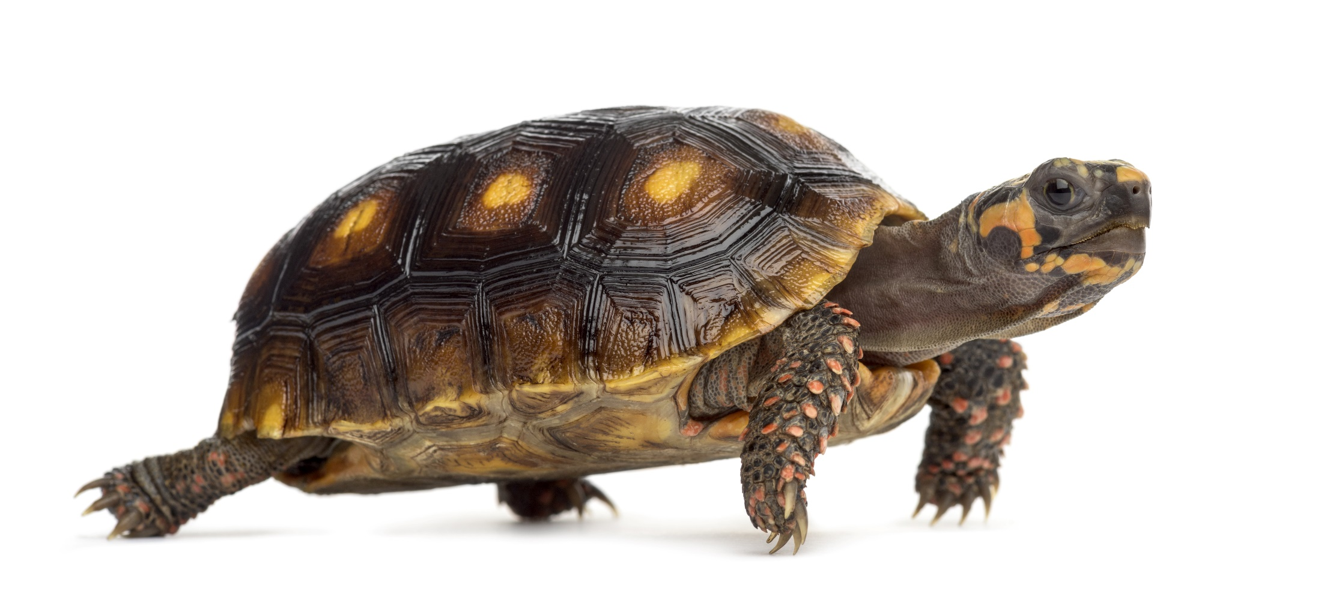
una tortuga

Slide 15
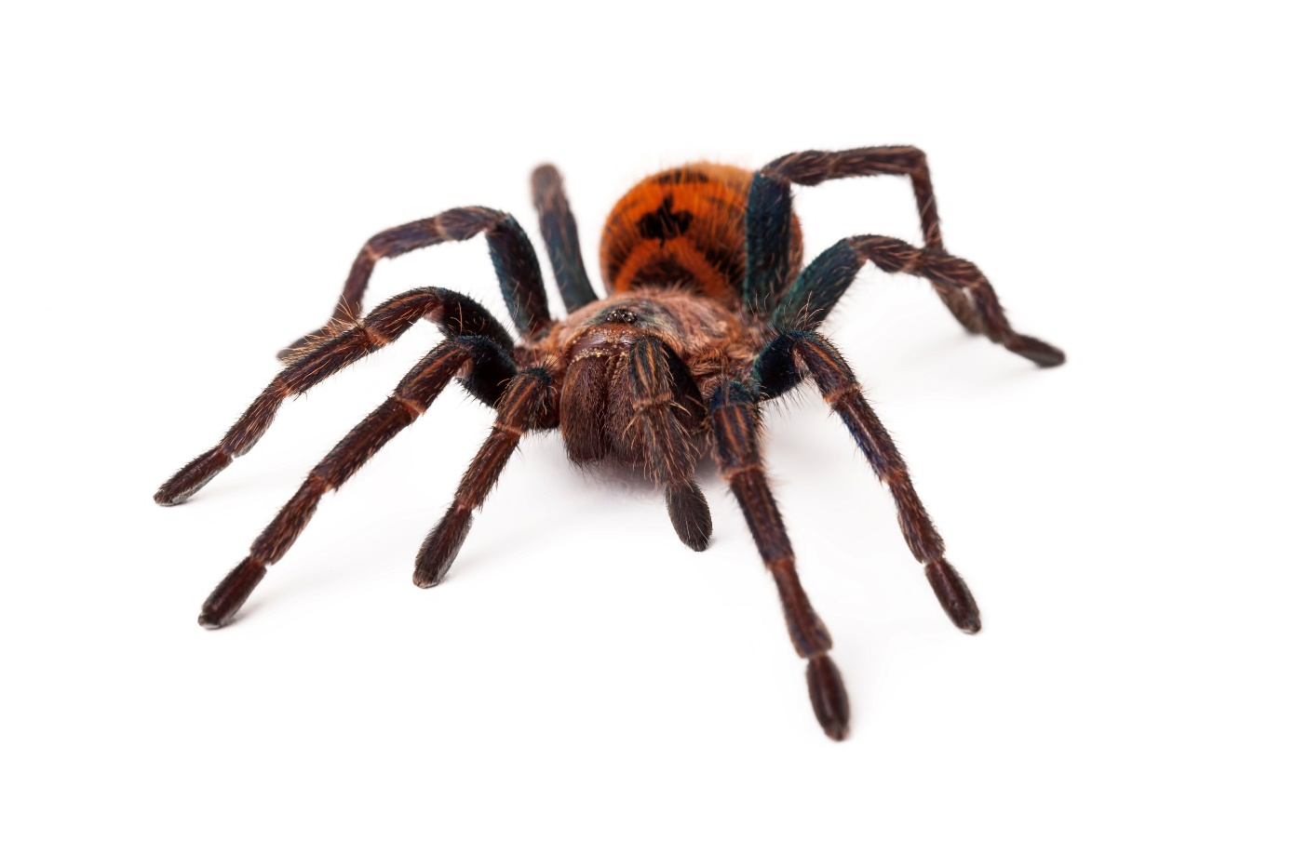
una araña

Slide 16
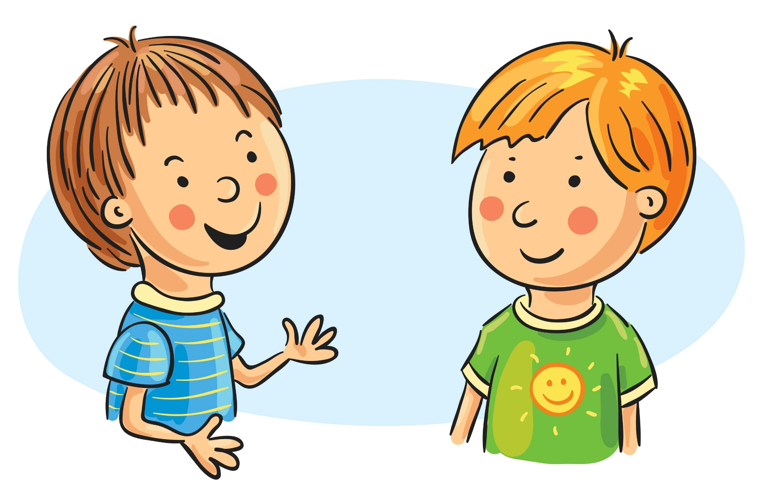
Do you have a pet?
¿Tienes un animal?
I have a…
Tengo un…

Slide 17
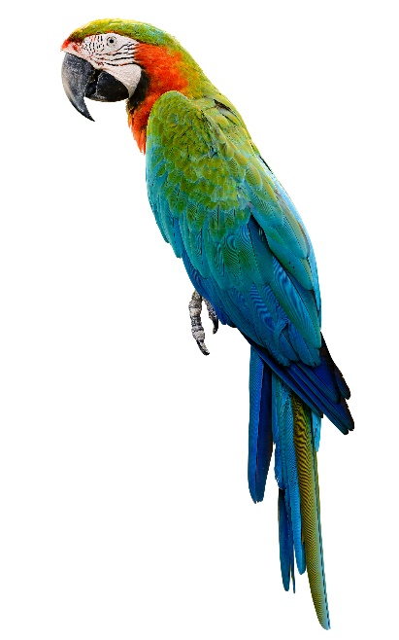
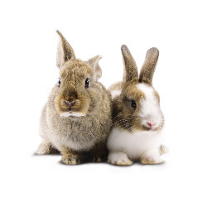
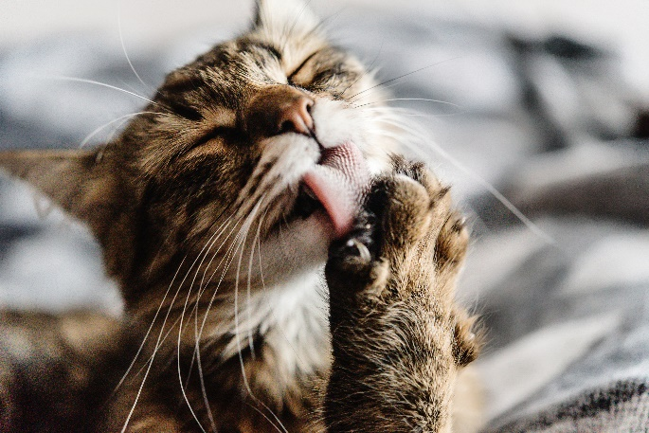
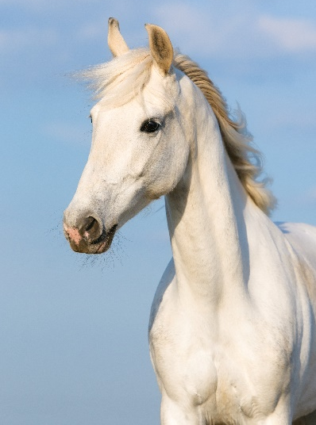
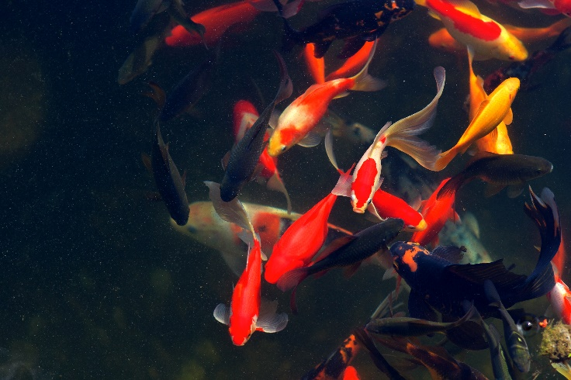
¿Tienes un animal?
Tengo un gran caballo blanco llamado Blancanieves.
Notes:
Answer: I have a white horse called ‘Snow White’.

Slide 18
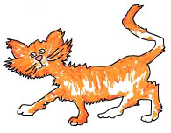
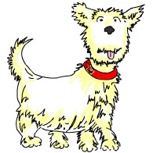
¿Cual es el color/qué animal es?
A
B
C
Mi perro se llama Manu. ¡Él es blanco y muy lindo!
F
Mi hermano tiene un perico llamado Charles.
C
A
Tengo un gato llamado Toto. Es naranja y blanco.
B
Mi conejo es blanco Le gusta la ensalada y su nombre es Roger.
D
E
Tengo un pequeño ratón blanco llamado Hércules. Mi padre odia a Hércules. ¡No le gustan los ratones!
F
E
D
Mi pez dorado se llama Zidane. ¡Él ama el fútbol!
Notes:
Pupils may use a French dictionary to help them.

Slide 19
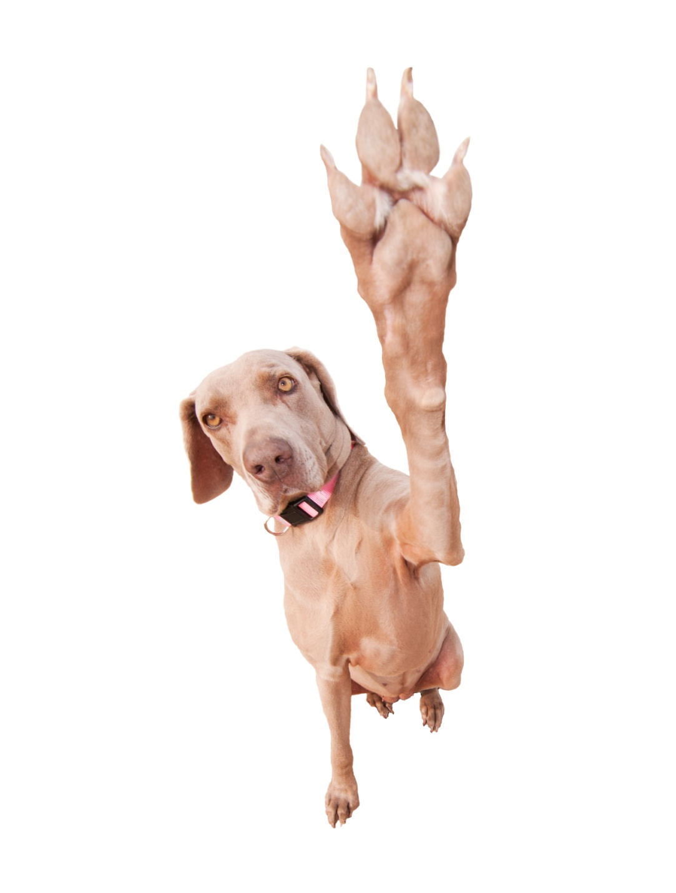
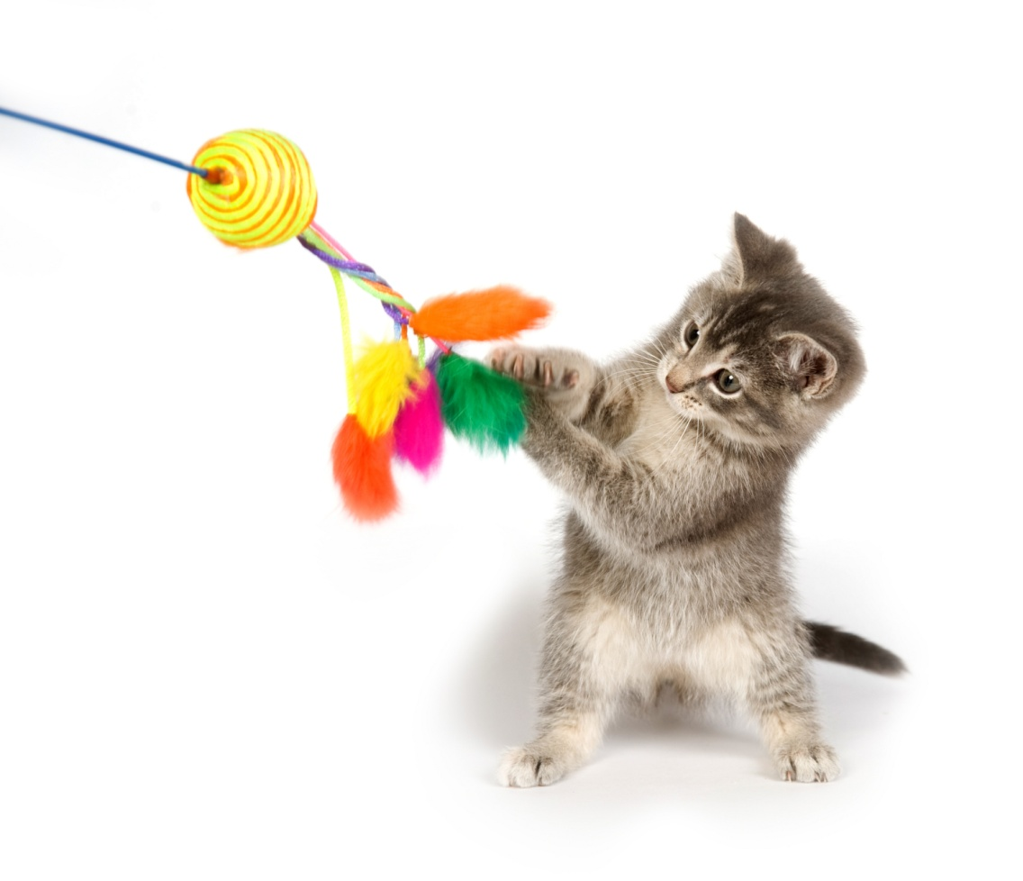
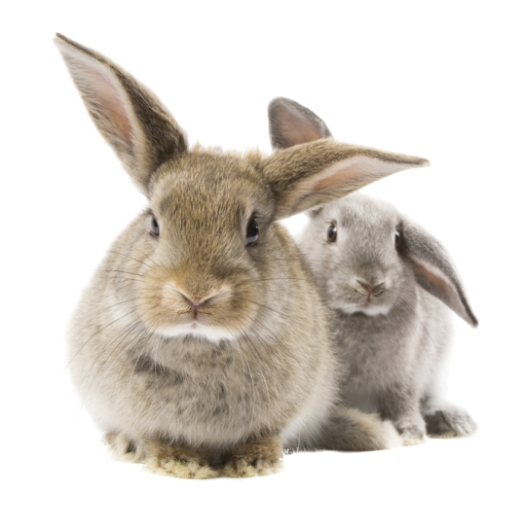
¡Gracias!

